Slide 1

What is DevOps
DevOps is the combination of cultural philosophies, practices, and tools.
Increases an organization’s ability to deliver applications and services at high velocity evolving and improving products at a faster pace.
Enables organizations to better serve their customers and compete more effectively in the market.

Slide 2
Developer Challenges

Slide 3
Operations Challenges

Slide 4
Business Benefits of DevOps

Slide 5
DevOps Adoption

Slide 6
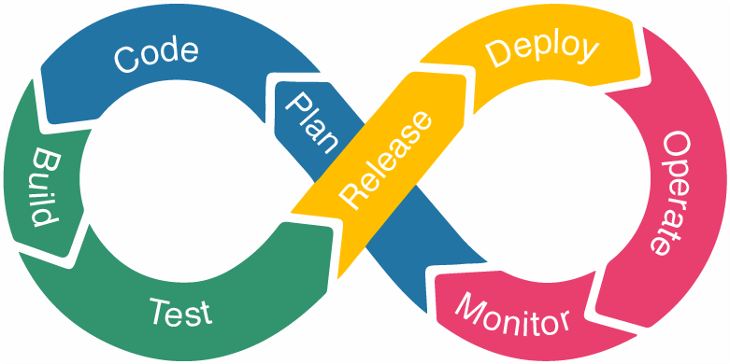
DevOps Lifecycle

Slide 7
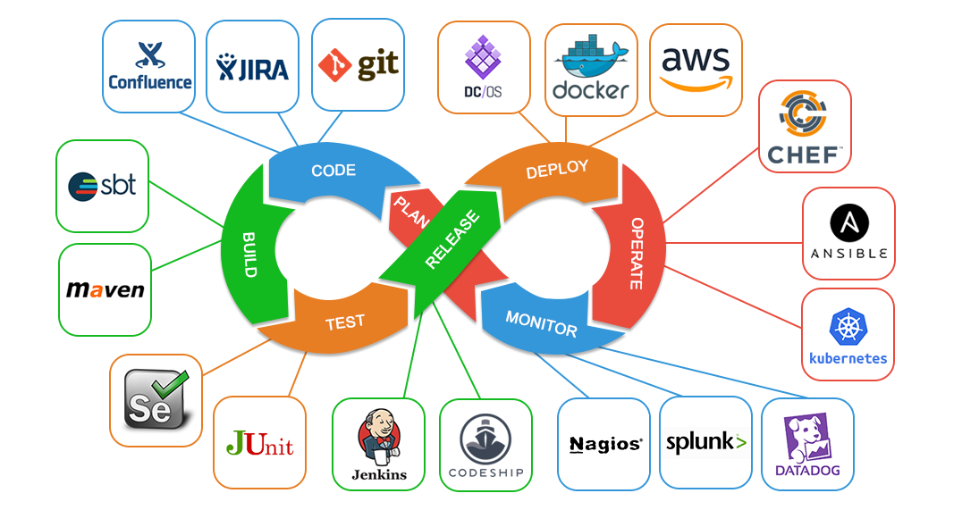
DevOps Tools

Slide 8
DevOps Engineer Skills

Slide 9
Career Progression

Slide 10
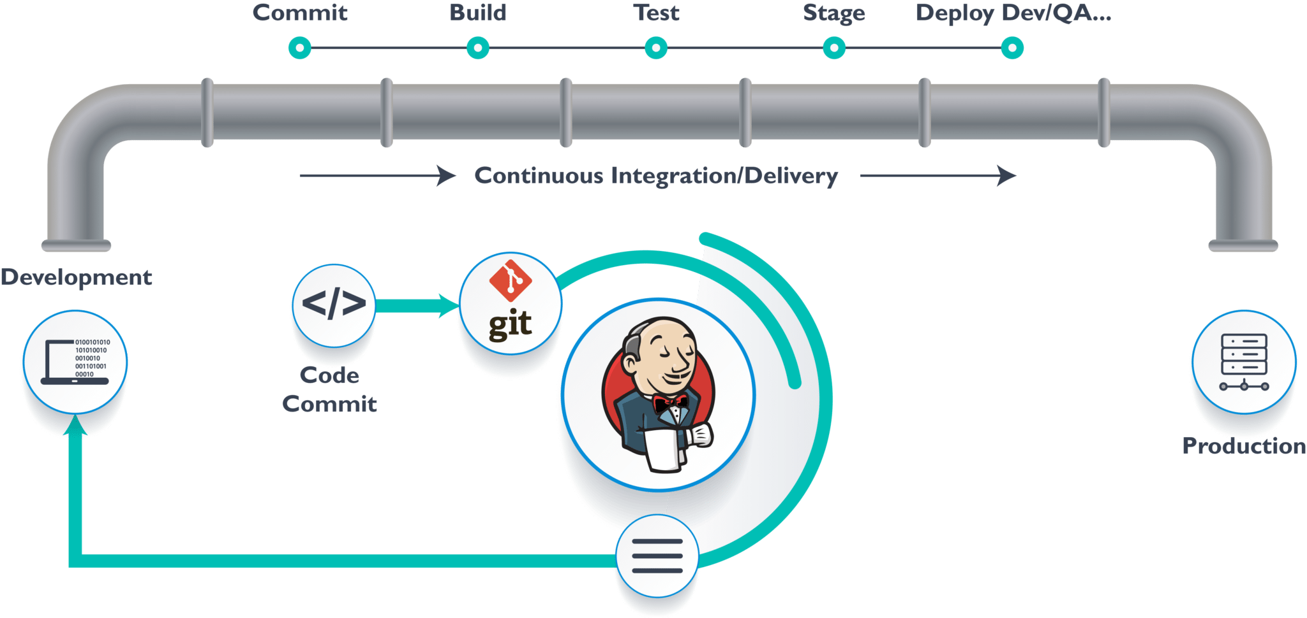
Projects
Real life data Projects
Mentor team will guide execution of projects
Regular project review meetings and deadlines for each phase of the project
Participants will be creating and configuring Pipelines using CI/CD best practices

Slide 11
Thank You

