Slide 1

What is DevOps:
DevOps is the combination of cultural philosophies, practices, and tools.
Increases an organization’s ability to deliver applications and services at high velocity evolving and improving products at a faster pace.
Enables organizations to better serve their customers and compete more effectively in the market.

Slide 2
Developer Challenges

Slide 3
Operations Challenges

Slide 4
Business Benefits of DevOps

Slide 5
DevOps Adoption:

Slide 6
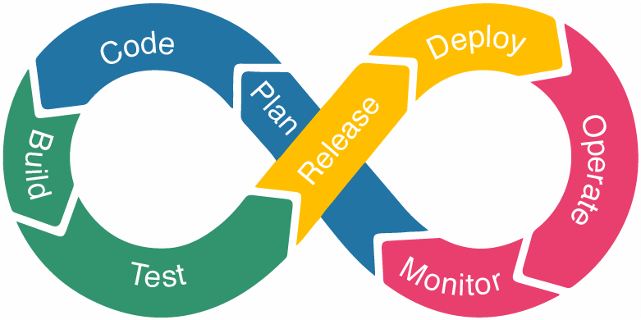
DevOps Lifecycle:

Slide 7
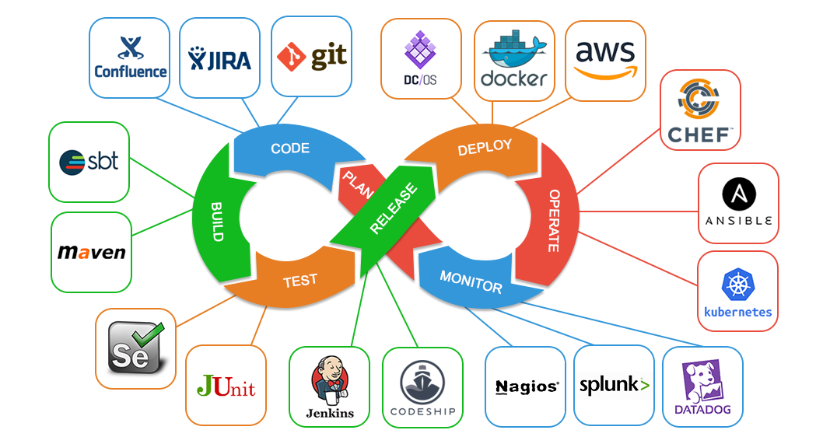
DevOps Tools:

Slide 8
DevOps Engineer Skills:

Slide 9


