Slide 1
DevSecOps: Integrating Security into DevOps
DevSecOps = Development + Security + Operations
It is the philosophy of integrating security practices within the DevOps process.
Focuses on building a culture of 'Security as Code'
Encourages collaboration among development, security, and operations teams.

Slide 2
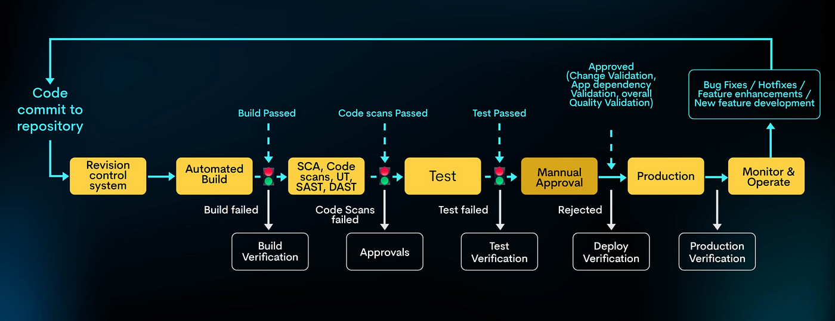

Slide 3
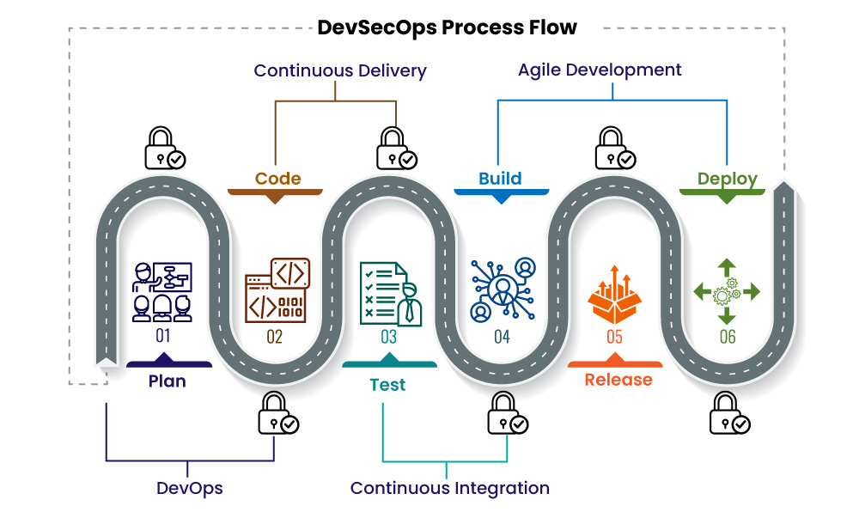

Slide 4
Why DevSecOps is Required?
Traditional security practices are too slow for agile/DevOps pipelines.
Early detection of vulnerabilities reduces cost and time.
Growing threat landscape requires proactive and continuous security.
Ensures compliance and governance across development lifecycle.
Reduces the risk of breaches and security incidents.

Slide 5
What is Shift-Left Mechanism?
Shift Left = Testing & security activities are moved earlier in the SDLC.
Instead of securing at the end, integrate security from the beginning.
Key Aspects:
Early integration of security in development and build phases
Automated scanning and testing during CI/CD pipelines
Empowering developers with secure coding practices
Continuous feedback loops for faster resolution
Benefits:
Faster feedback
Reduced vulnerabilities
Cost-effective issue resolution
Improved code quality
Reduced risk of breaches

Slide 6
DevSecOps Tools
Static Application Security Testing (SAST): SonarQube, Checkmarx, Fortify
Software Composition Analysis (SCA): WhiteSource, Snyk, Black Duck
Dynamic Application Security Testing (DAST): OWASP ZAP, Burp Suite
Infrastructure as Code (IaC) Scanning: Checkov, Tfsec, Terrascan
Container Security: Trivy, Aqua Security, Clair
Secrets Management: HashiCorp Vault, AWS Secrets Manager, Doppler
CI/CD Security Integrations: GitHub Actions, GitLab CI, Jenkins with Security Plugins

Slide 7
Software Composition Analysis (SCA)
Software Composition Analysis (SCA) is a security practice used in DevSecOps to identify and manage open-source components within a software project. It scans your application's dependencies to detect:
Known vulnerabilities in open-source libraries
License compliance issues
Outdated or deprecated packages
Why SCA is Important:
Most modern applications use a large number of third-party libraries.
Vulnerabilities in these libraries can lead to significant security breaches.
Keeping track of all licenses and versions manually is not feasible.

Slide 8
Dynamic Application Security Testing (DAST)
Dynamic Application Security Testing (DAST) is a type of black-box security testing that analyzes a running application to identify security vulnerabilities by simulating external attacks.
SQL Injection
Cross-Site Scripting (XSS)
Cross-Site Request Forgery (CSRF)
Insecure Authentication
Information Disclosure
Broken Access Controls

