Slide 1
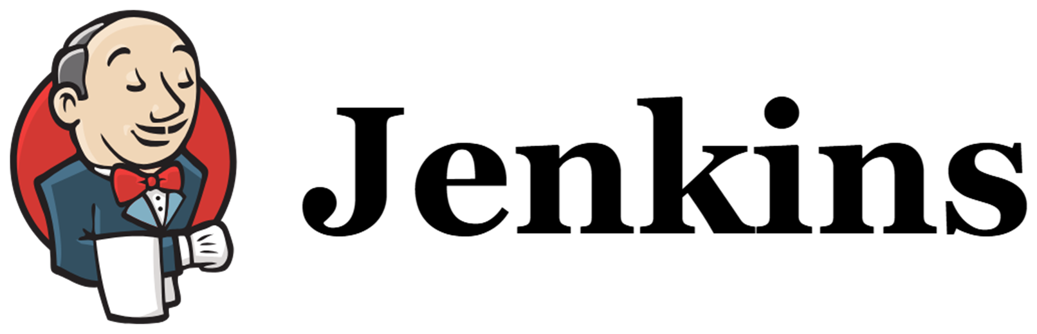

Slide 2
Jenkins History
Jenkins is an open source automation server.
Jenkins, initially named Hudson
It was created by Kohsuke Kawaguchi as an automation tool for continuous integration in 2004, while he was working at Sun Microsystems
After Sun's acquisition by Oracle, a dispute arose, leading to the forking and renaming of the project to Jenkins in 2011.
Initial release date: 2 February 2011
Developer: Kohsuke Kawaguchi
Stable Release: 2.386 / 10 January 2023

Slide 3
What is Jenkins and why we use it?
Jenkins is an open-source automation tool written in Java with plugins built for continuous integration.
It helps automate the parts of software development related to building, testing, and deploying, facilitating continuous integration and continuous delivery.
It is a server-based system that runs in servlet containers such as Apache Tomcat.
With Jenkins, organizations can accelerate the software development process through automation. Jenkins integrates development life-cycle processes of all kinds, including build, document, test, package, stage, deploy, static analysis, and much more.
When ever developers write code, We integrate all that code of all developers at that point of time and we build, test and deliver/deploy to the client. This process is called CI & CD.

Slide 4
Jenkins helps in achieving this.
So instead of doing night builds, build as and when commit occurs by integrating all code in SCM tool, build, test and checking the quality of that code is what Continuous Integration.
So, in a day, there will be so many integrations, builds, tests & deliveries/deployments.
So, bugs will be reported fast and get rectified fast. So, development happens fast.
Jenkins achieves Continuous Integration with the help of plugins. Plugins allow the integration of Various DevOps stages. If you want to integrate a particular tool, you need to install the plugins for that tool.

Slide 5
Benefits of CI
Detect bugs as soon as possible.
If you want you can stop the SDLC process at any stage.
Eg: You can stop at test stage only or you can continue till deployment.
Maintains history (Logs) for reference

Slide 6
Why only Jenkins?
It has so many plug-ins.
You can write your own plug-in.
Jenkins is not just a tool. It is a framework. i.e. You can do what ever you want. All you need is plug-ins.
We can attach slaves(nodes) to Jenkins master.
Jenkins also acts as crone server replacement. i.e. can-do repeated tasks automatically • Running some scripts regularly Eg: Automatic daily alarm.
Can create Labels (Can restrict where the project has to run).
You will be accessing Jenkins through web only.

Slide 7
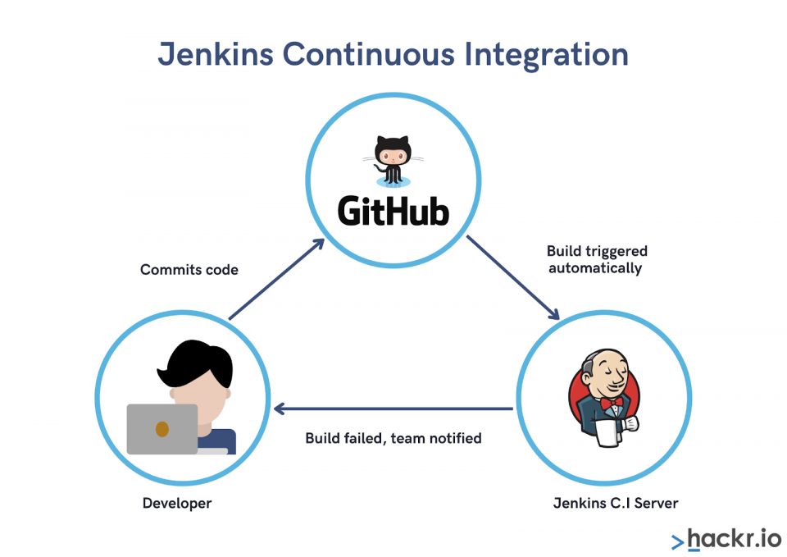

Slide 8
