Slide 1
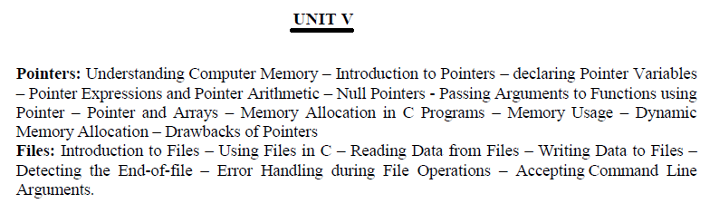

Slide 2
Passing Pointer as an argument to a Function
When we pass a pointer as an argument instead of a variable then the address of the variable is passed instead of the value. So any change made by the function using the pointer is permanently made at the address of passed variable. This technique is known as call by reference in C.

Slide 3
Example
#include <stdio.h>
void salaryhike(int *var, int b)
{
*var = *var+b;
}
int main()
{
int salary=0, bonus=0;
printf("Enter the employee current salary:");
scanf("%d", &salary);
printf("Enter bonus:");
scanf("%d", &bonus);
salaryhike(&salary, bonus);
printf("Final salary: %d", salary);
return 0;
}

Slide 4
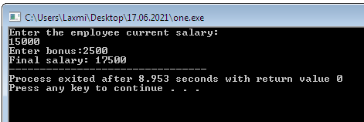
Output:

Slide 5
Example
#include <stdio.h>
void swapnum(int *num1, int *num2)
{
int tempnum;
tempnum = *num1;
*num1 = *num2;
*num2 = tempnum;
}
int main( )
{
int v1 = 11, v2 = 77 ;
printf("Before swapping:");
printf("\nValue of v1 is: %d", v1);
printf("\nValue of v2 is: %d", v2);
/*calling swap function*/
swapnum( &v1, &v2 );
printf("\nAfter swapping:");
printf("\nValue of v1 is: %d", v1);
printf("\nValue of v2 is: %d", v2);
}

Slide 6
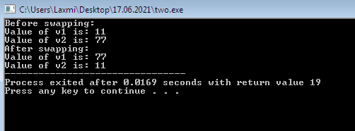
Output:

