Slide 1
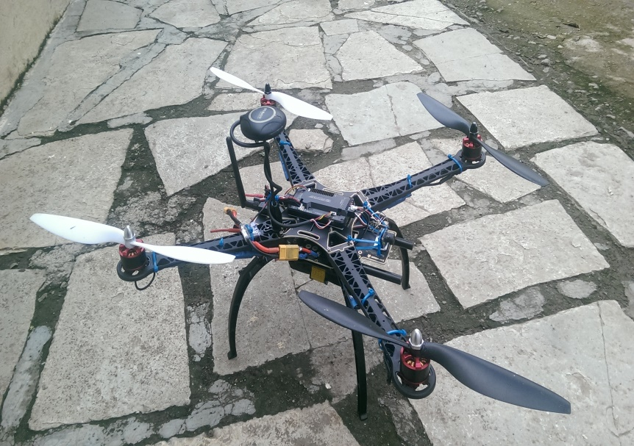

UNMANNED COMBAT AERIAL VEHICLE
type

Slide 2
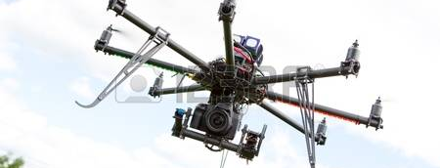
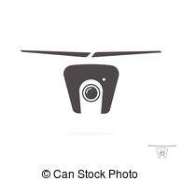
UAV MULTIROTOR
Students: Rohan A. Koli
Prathmesh salinkhe
Sushant patil
Rajiv shiralkar

Slide 3
Presentation Agenda
Project Description
Project Scope
Applications Areas
Results
Hardware & Software Requirment
Architecture
Problems faced during project setup
Test
Status
future

Slide 4
Project Description
Project based on multirotor UAVs with 6 blade rotor having 2 digital on
board camera 1 for pilot and other one for gunner
It also has a 3 axis robotic arm which can move freely carrying a payload of
Gun.
The total weight of body is considered around 2.5kg to 3kgs and the total thrust
Developed by hexacopter will be 6kgs so we maintained thrust to weight ratio
2:1
UAV: an unmanned aerial vehicle (an aircraft piloted by remote
control or onboard computers)
Statement: To demonstrate some feature of UAV using onboard computers

Slide 5
Project Scope
Self flying multirotor
On board video transmission for survey, digital mapping many more
Programmable missions for particular tasks
Aviation
UAVs can be used for autonomous flights, this being based on pre-programmed
flight plans or through the help of more complex dynamic automation systems.
It is good to appreciate the increasing role of Unmanned Aircraft Systems (UAS)
in solving certain conflicts and the execution of high-profile attacks just as is
the case for the present day military planners

Slide 6
Application areas
Multirotor UAV Drones are utilised in a huge variety of
applications; we really are only limited by our imagination!
Drones offer the unprecedented ability to go where you could
never go before, and experience perspectives never seen
Aerial Photography & Videography
Real estate photography
Mapping & Surveying
Payload carrying
Agriculture
Bird Control
Crop spraying
Crop monitoring
Multispectral/thermal/NIR cameras
Live streaming events
Roof inspections
Emergency Response
Search and Rescue
Marine Rescue
Disaster zone mapping
Disaster Relief
Firefightin
Product Delivery

Slide 7
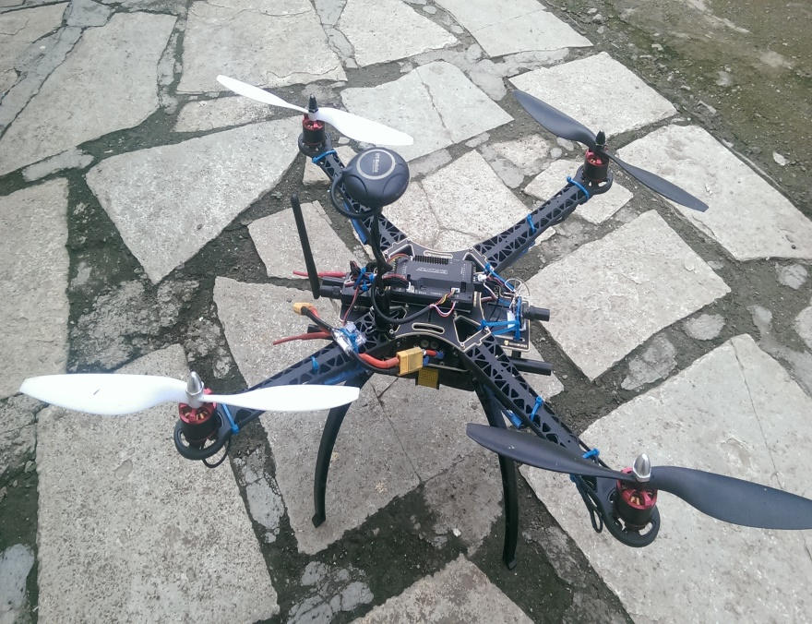
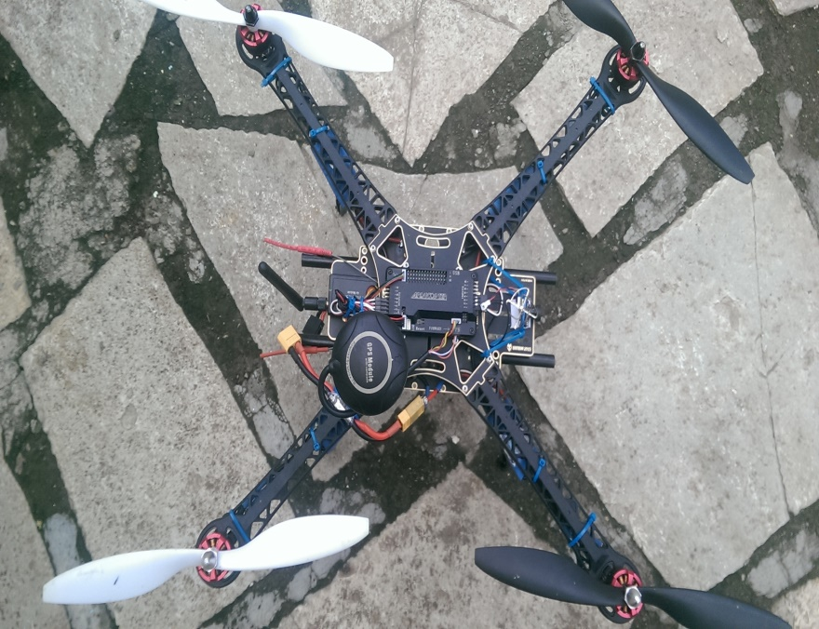
Actual design of UAV
Working model
.

Slide 8
Hardware & Software Requirement
Hardware:
Arduino mega (flight controller)
GPS with Compass
Accelerometer and Gyro
Radio transmitter and receiver
Video transmitter and receiver
BLDC motor
Electronic speed controller
Other material
3 axis robotic arm
Propellers
Base frame for mountings all compo
-nents
Software:
Mission planner
Hex loader(firmware)

Slide 9
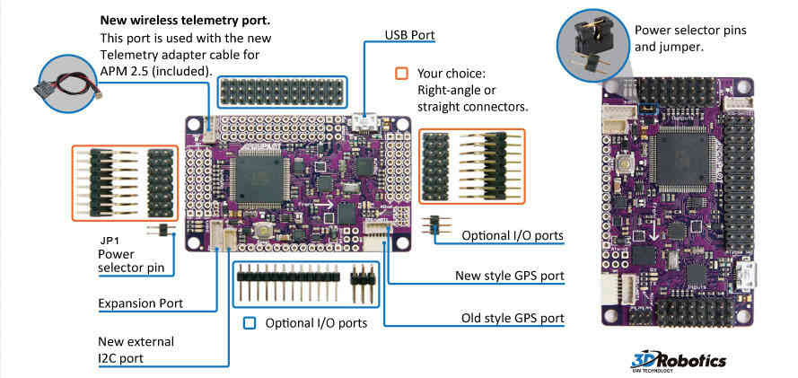
The flight controller

Slide 10
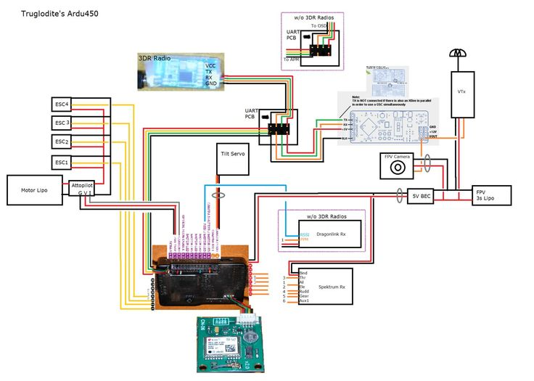
Wiring diagram

Slide 11
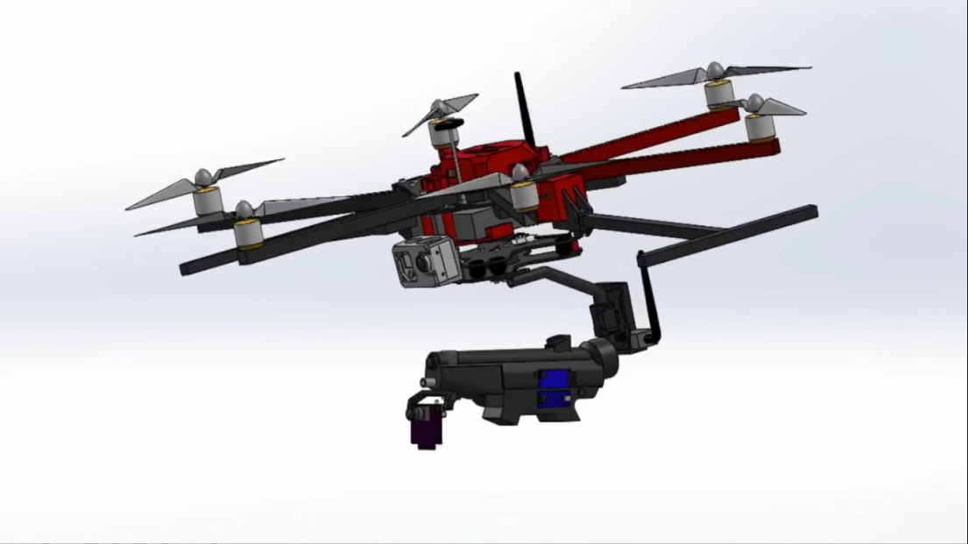
Actual methodology
Theory consideration
Frame design
Motor selection
Propellers selection
Robotic arm design

Slide 12
Where to start
Knowing the weight of multiorotor is the first thing we need to know. When we are building, or planning your next drone build knowing the exact weight can be difficult. However we will need to start somewhere and as choose and change components you can slowly refine the weight estimation
Thrust to weight ratio 2:1
With multi rotors it’s important to make sure that your motors can produce around 50% more thrust than the total weight of your drone. Or in other words your drone should be able to hover at just over half throttle. This is an important rule to follow is it means that you motors will have enough extra thrust to control your multi-rotor in wind and during aggressive flight maneuvers. If you are always going to by flying gently and smoothly increase the weight so that you hover at around 70% throttle for a less responsive drone. So if your total weight of your quadcopter is 800g, your motors on a Hexacopter will need to produce 1.6Kg of thrust in total, or 400g max thrust per motor

Slide 13
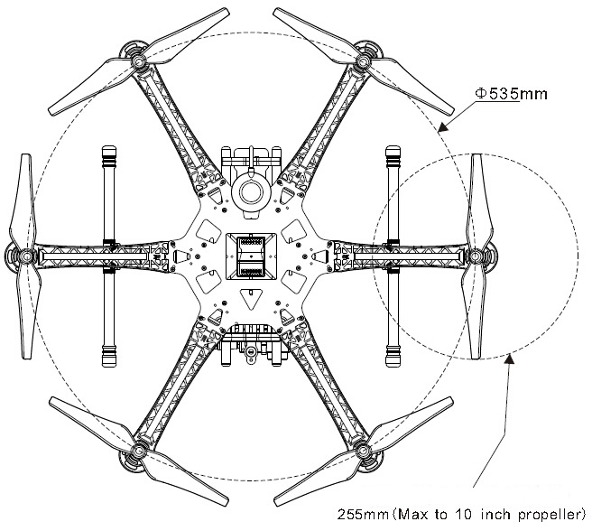
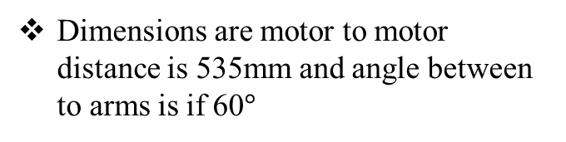
Multirotor frame overview
The frame consist of 6 arms with 6 motors Mounted on each arm
Dimensions are motor to motor distance is 535mm and angle between to arms is if 60$°$
The arm dimensions are :
1.Lenght :350mm
2.Width : 40mm
3.Height : 40mm
4.wall thickness : 2.5mm

Slide 14
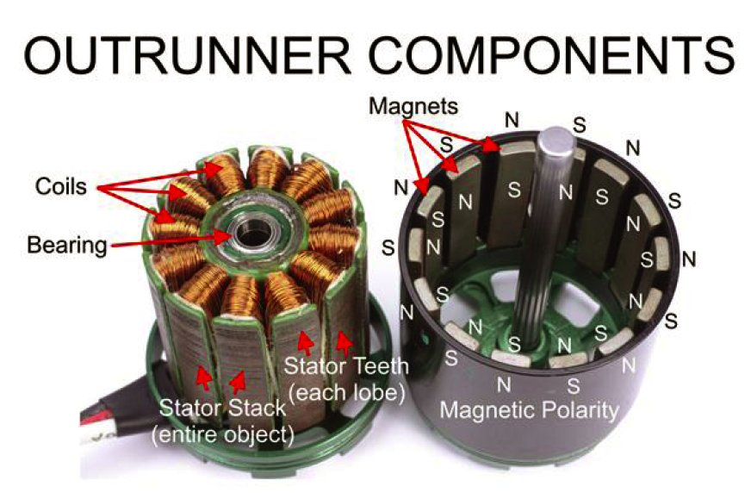
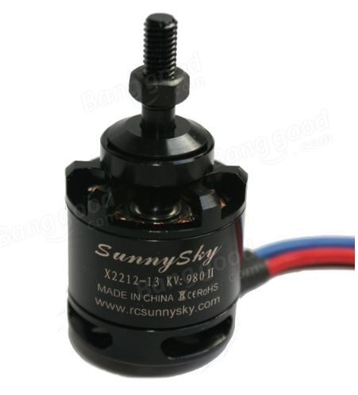
Motor selection
Internal structure
Selected motor
It consist of
1.Stator
2.Rotor
3.Coils
4.Magnets
5.casing
It is BLDC motor
1.The motor is x2212
2.Having 980kv rating
3.Having 13 turns of coils around stator
With rotation of ccw and cw

Slide 15
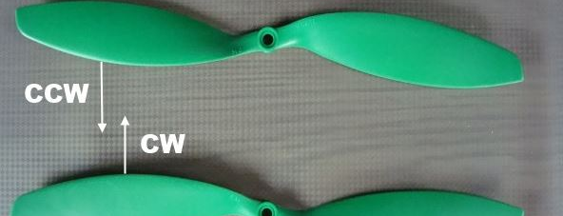
Options A: Select Propeller 1st and decide motor and Lipo battery accordingly. Option B: Select Battery 1st and decide motor and Propeller accordingly. Option C: Select Motor 1st and decide Lipo Battery and Propeller accordingly
There are 2 type of propellers ccw and cw
Here we choose 1145 rated propeller of material plastics as it is cheap and easily available

Slide 16
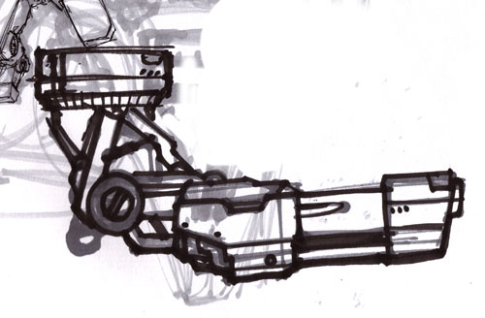
a three degree of freedom manipulator having variable programmed motions to carry out variety of tasks in diverse environments is chosen. This is a three axis articulate manipulator designed to control payload movement like machine parts, tools, specialized devices
The 3DOF arm is operated by 3 servo motors , With 3 diff motions
1.360 rotation movement
2. pan and tilt motion
The most suitable material to fabricate the structure of the arm has to be light and strong. Otherwise, the servo motor will not be able to pull up the arm and to perform the desired turning degree

Slide 17
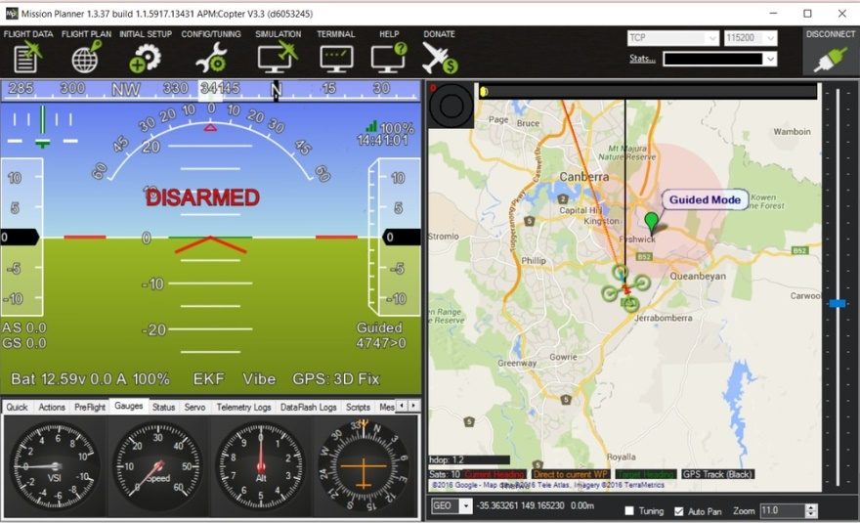

Software: Mission planner
Mission Planner is a Ground Control Software (GCS) system for the APM and Pixhawk series of low-cost open source/open hardware autopilot systems

Slide 18
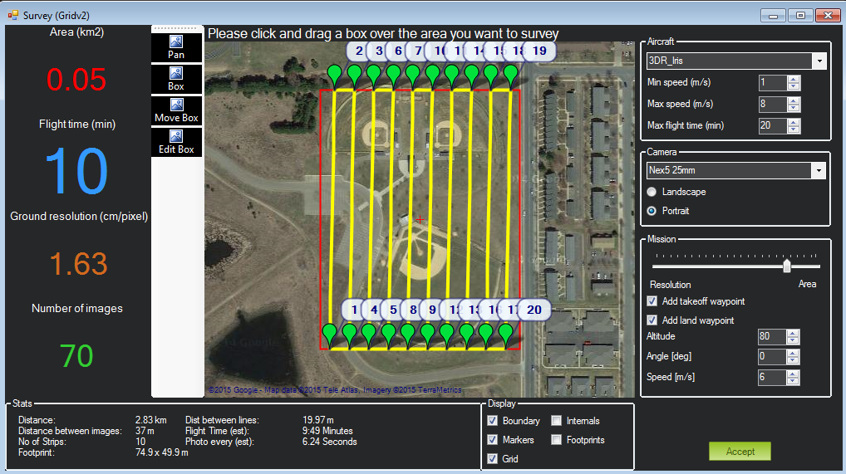
Real time gps guided path for automatic take of and survey and land to launch position

Slide 19
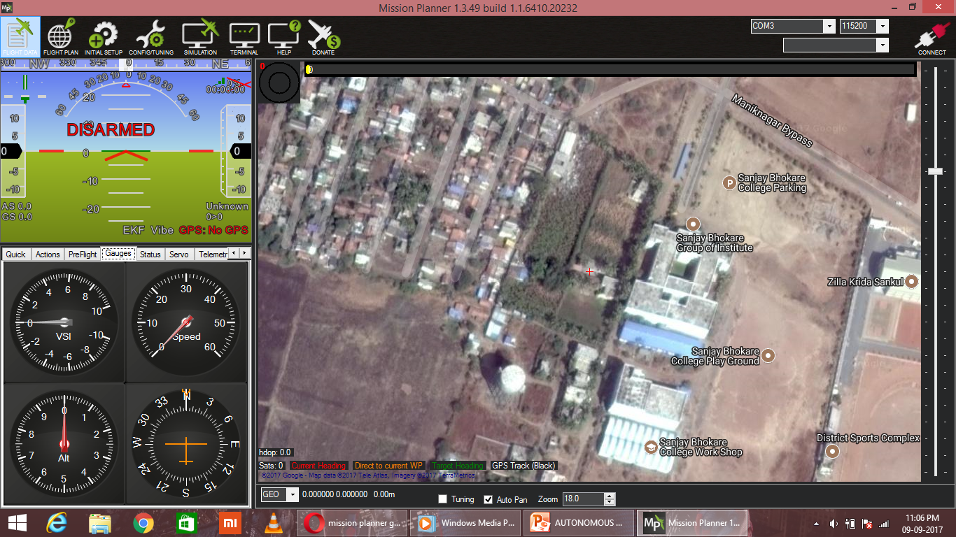
Status
Completed modules:
GPS guided path
Real time video transmission
Altitude hold
Loitering on specific area
Failsafe : return to launch position
Future modules plans:
Sonar module for obstacle avoidance
Thermal vision
Night vision for military purposes

Slide 20
Conclusion
A military purpose hexacopter system was designed for and implemented on an autonomous hexacopter. The modular design made this system flexible and adaptable. The use of protect resources across threads makes the design robust
The system was proved to successfully control a hexacopter in autonomous flight. GPS waypoint navigation was achieved with a path deviation comparable to Camera image processing streamlined
This system is currently in use with a variety of simultaneous projects, including field searching and multiple object tracking, all tied in together with a web based user interface.

Slide 21
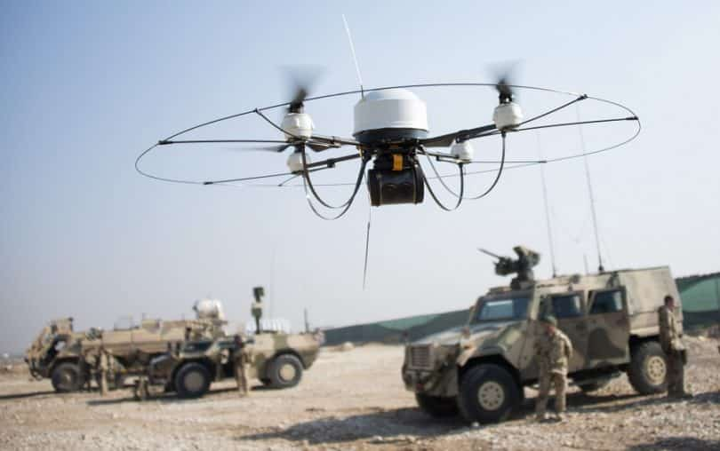
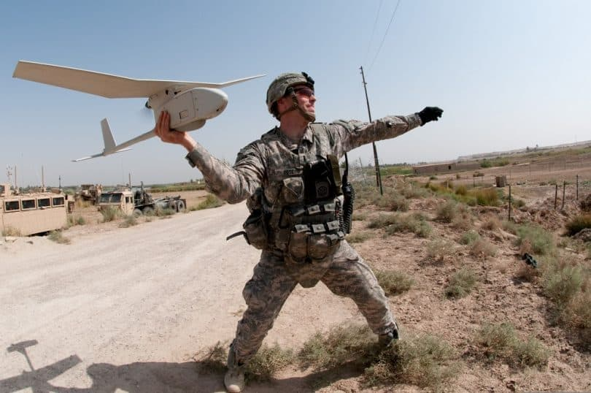
Future scope: hydrogen powered fuel cell
Military purpose for provide ground as well as aerial gunnery at a target which simulates an enemy missile or aircraft.

Slide 22
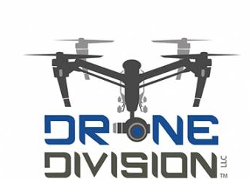
Thank you
Any questions !!!

