Slide 1

NFL Draft Pick
Travonna Wilson
CST-105
07/30/2017

Slide 2
NFL Draft
This storyboard will contain the illustrations on how to pick a Defensive or Offensive Player in the NFL Draft.

Slide 3
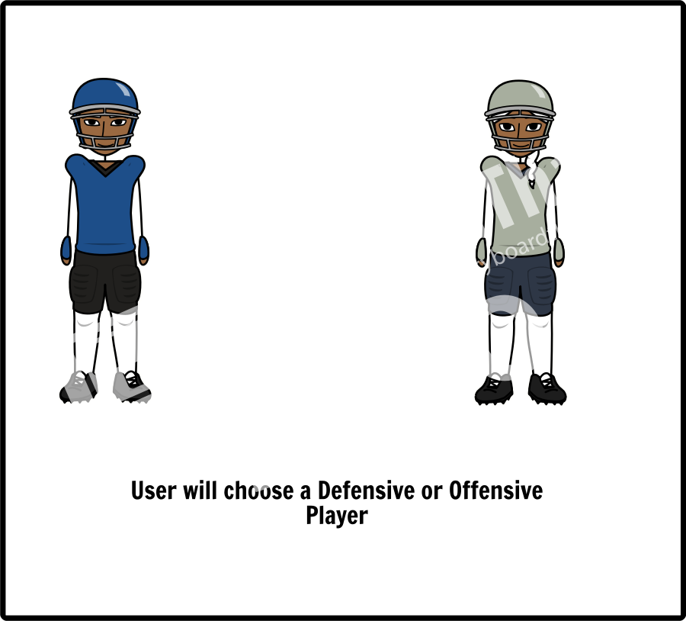
NFL Player
Add Text Here

Slide 4
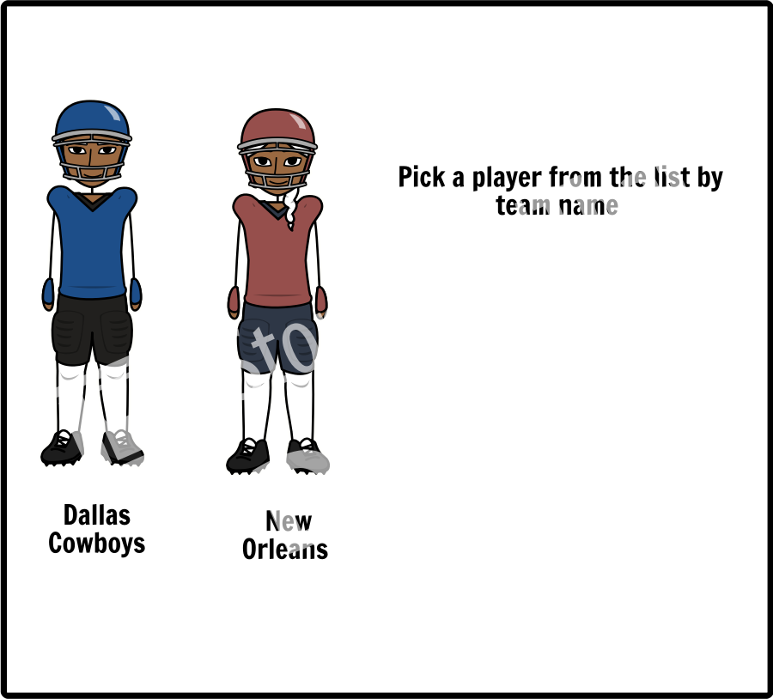
NFL Draft Team
Add Text Here

Slide 5
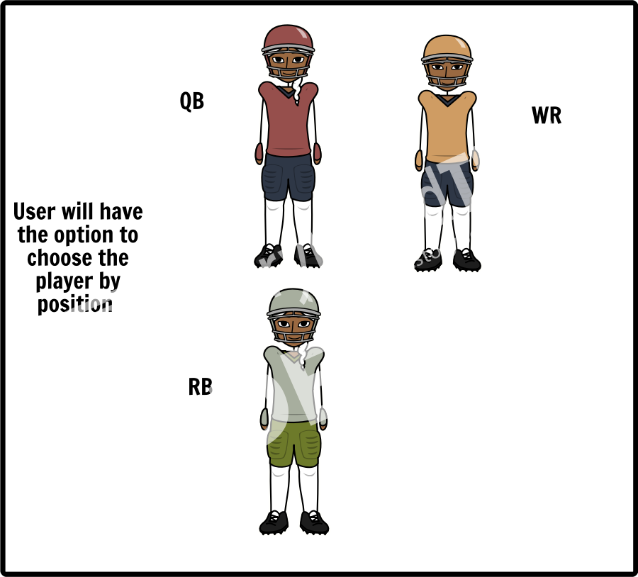
NFL Player Position

Slide 6
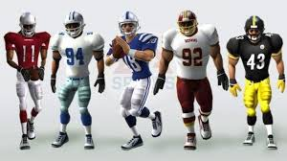
NFL Draft Players
Once the user has selected the team
And position they will have there final
Pick for their NFL Draft

