Slide 1

CST Storyboard

Slide 2
What is a Storyboard
A storyboard is a visual representation of how a user will interact with an application or interface. A storyboard is also used to demonstrate the process that the user will go through when using a product. Storyboards can be useful for determining user requirements of a product and are displayed in a narrative and chronological form.

Slide 3
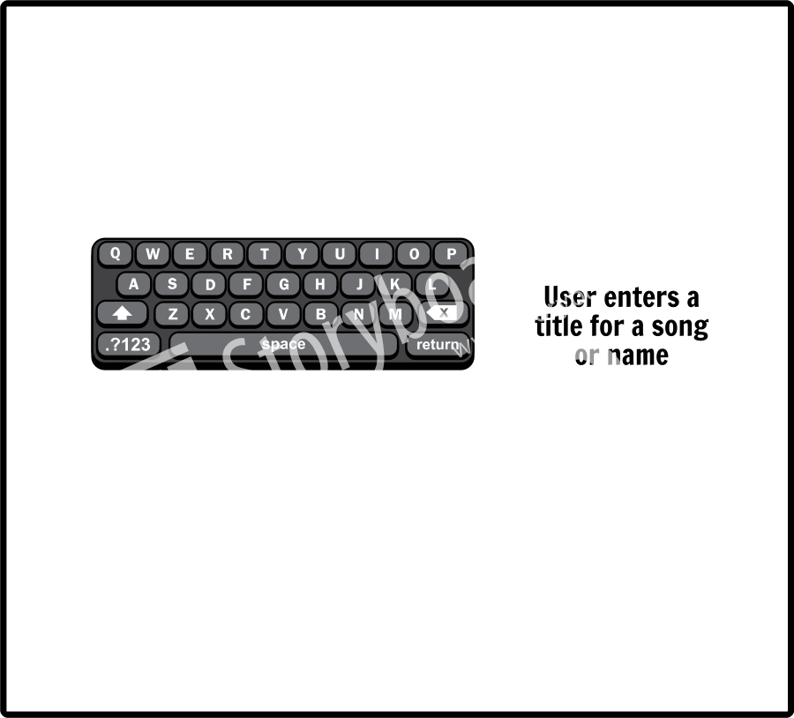
Storyboard

Slide 4
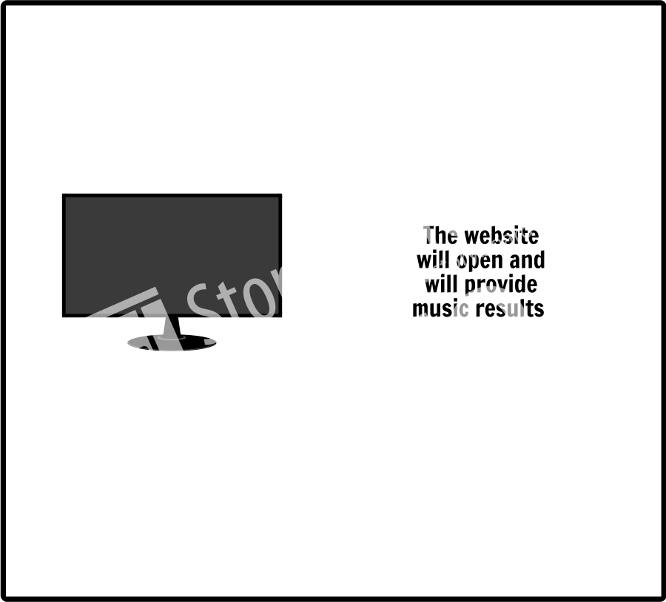
Storyboard

Slide 5
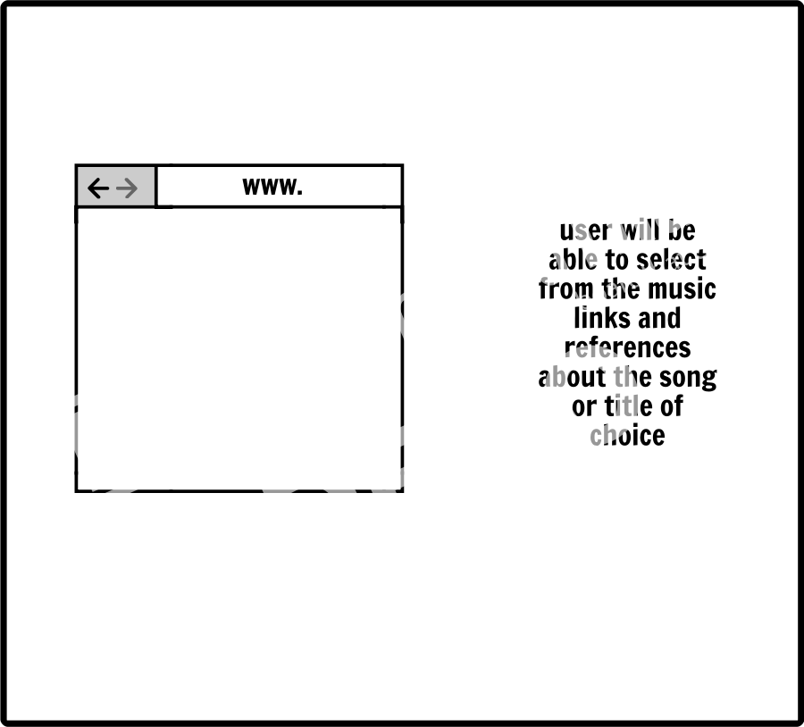
Storyboard
Add Text Here

Slide 6
Reference
Pidoco - The Rapid Prototyping Tool. (n.d.). Retrieved June 28, 2017, from https://pidoco.com/en/help/ux/storyboard

