Slide 1
GARBAGE TOWN
the dream
or
maybe
the nightmare
will
come true

Slide 2
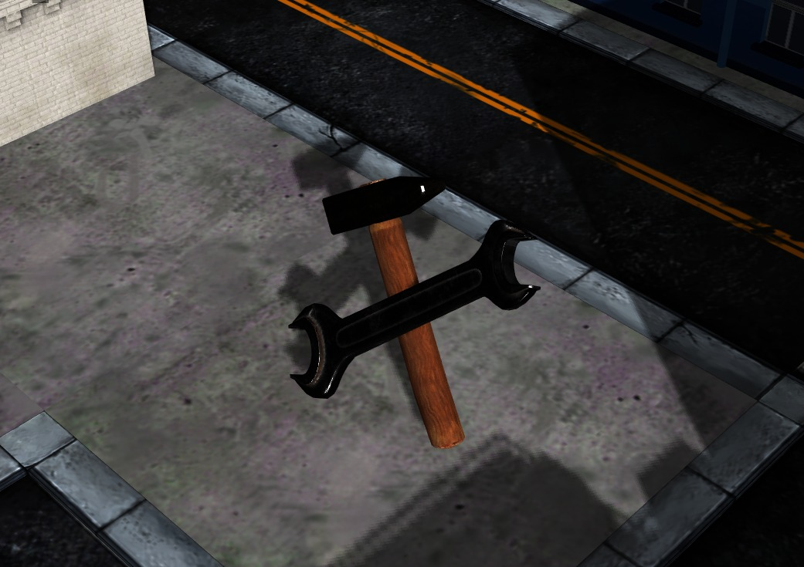
Prepared by
Yusuf SARITEPECI 21990538
Batuhan SEKERCI 21990982
Muhammet SUBASI 21627601

Slide 3
Contents
Game Introduction
Minimum Requirements
Extra Features
Theoretical background

Slide 4
Game Introduction
Map
Environment
Game Logic
Gameplay

Slide 5
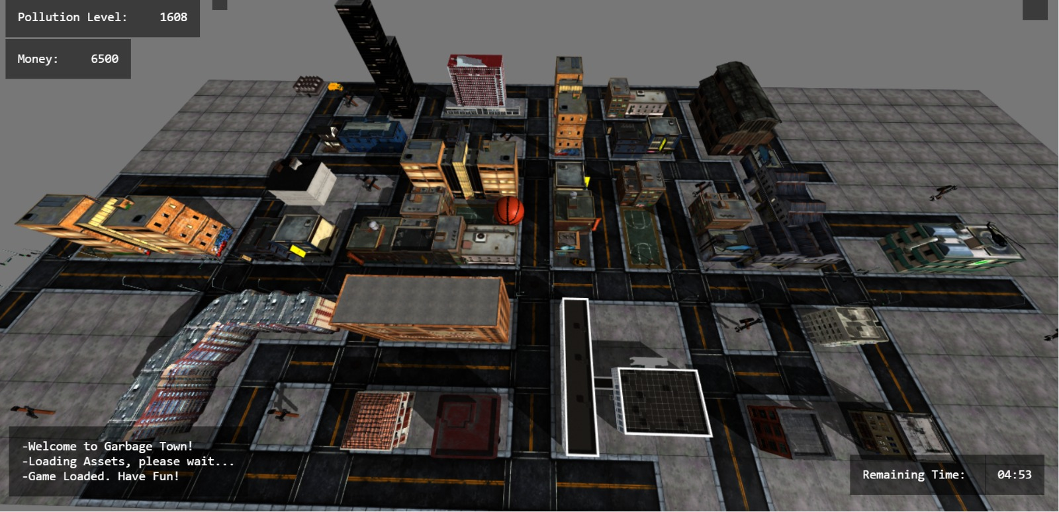
Map

Slide 6
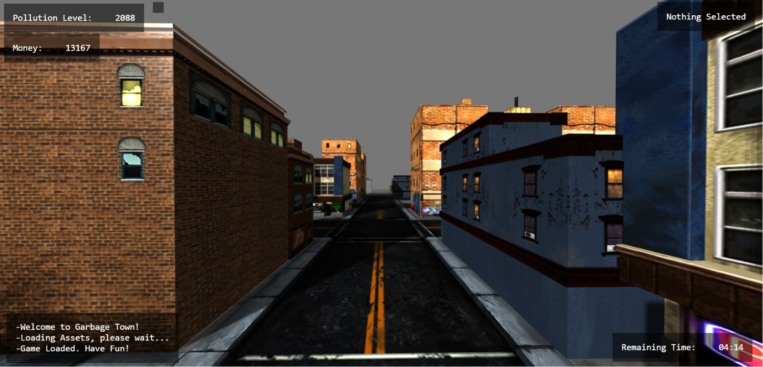

Slide 7
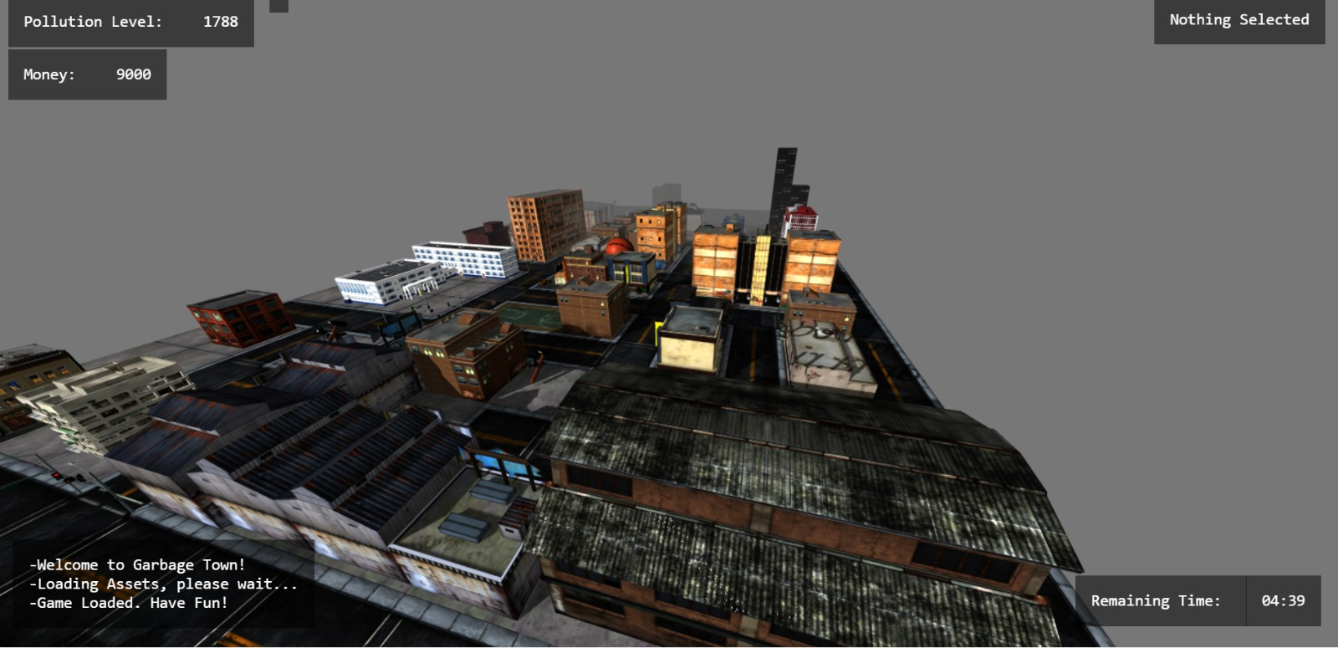

Slide 8
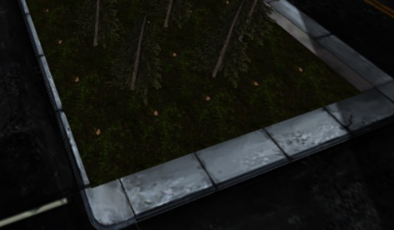
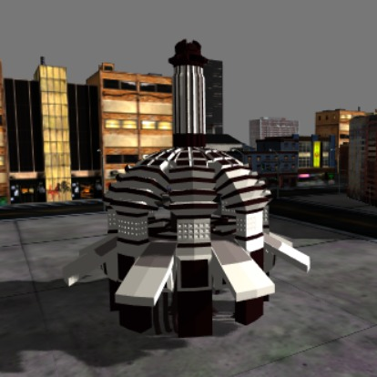
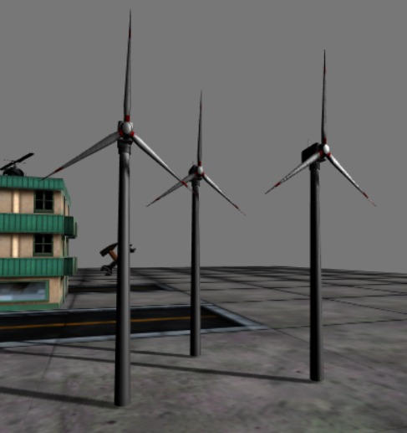
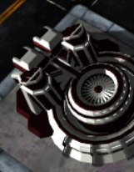
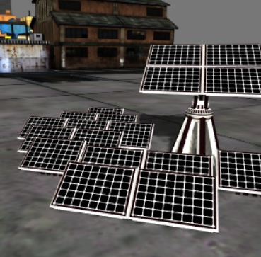
Facilities

Slide 9
Game Logic
In the game you have 5 minutes
In game you have to follow two variable –MONEY AND POLLUTION
There is a small window in left bottom for informing about the events.
You have to collect garbage and build green-power facilities.
The goal is keep pollution low.

Slide 10
Gameplay
Garbage Collection
Controls

Slide 11
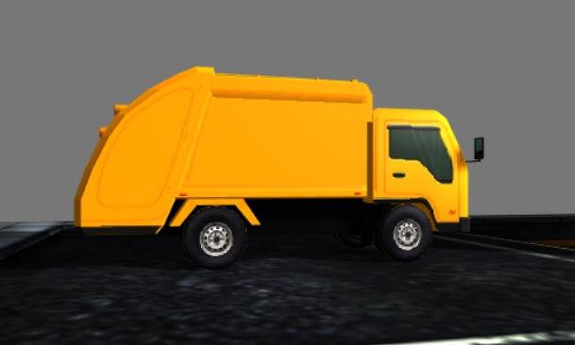
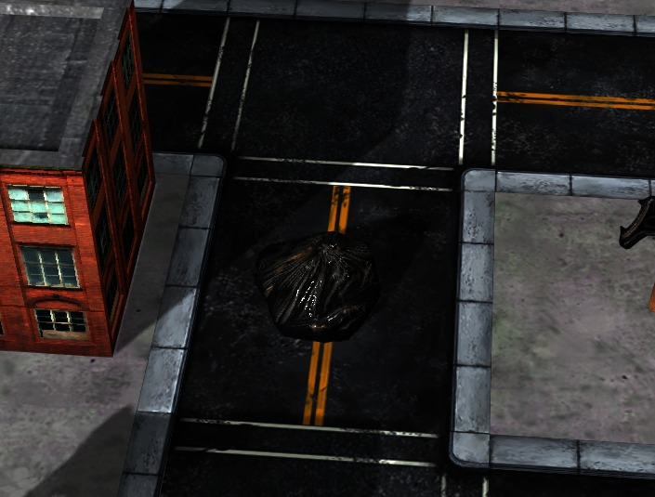
Garbage Collection
By clicking the garbage that appears random location on map,
you earn money and reduce pollution.
Truck will go to that location after you clicked.
Upgrading recycling facility increases truck speed

Slide 12
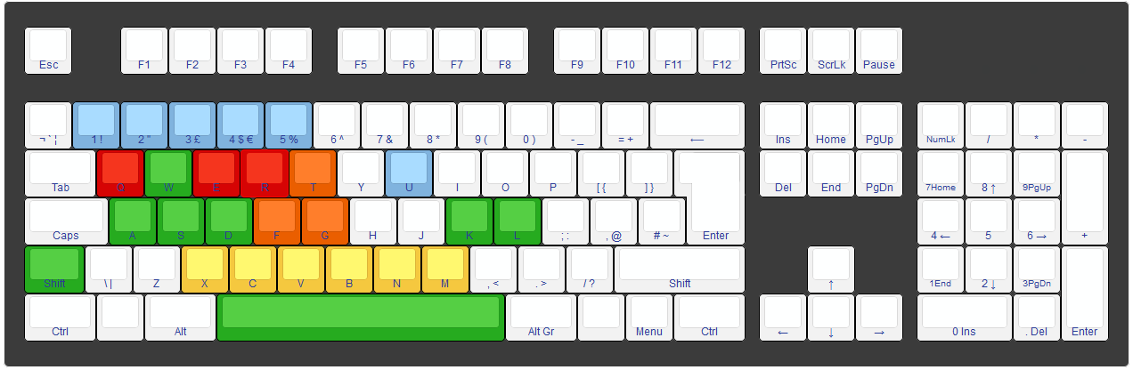
Controls
-W -A -S -D : Horizontal Camera Movement -Q : Switch Shader
-Shift -Space : Vertical Camera Movement -F : Toggle Spotlight
-K –L : Rotate Camera around Z axis -R : Reset Camera
-G –T : Spotlight Intensity -E : Toggle Pointer Lock
-1 -2 -3 -4 -5 : Built Facilities -U : Upgrade Facilities

Slide 13
Minimum Requirements
Using Webgl 2.0
Completely 3D
Translate and Rotate Camera in 3 dimensions
3 Different Objects movable and scalable (Basketball,Trash Bin,Helicopter)
Spotlight
2 different Shaders

Slide 14
Extra Features
Tips
Sounds
Anti-aliasing
Shadow Mapping
Logger
Raycaster
Fog

Slide 15

Tips
After upgrading or building a facility a tip will be shown

Slide 16
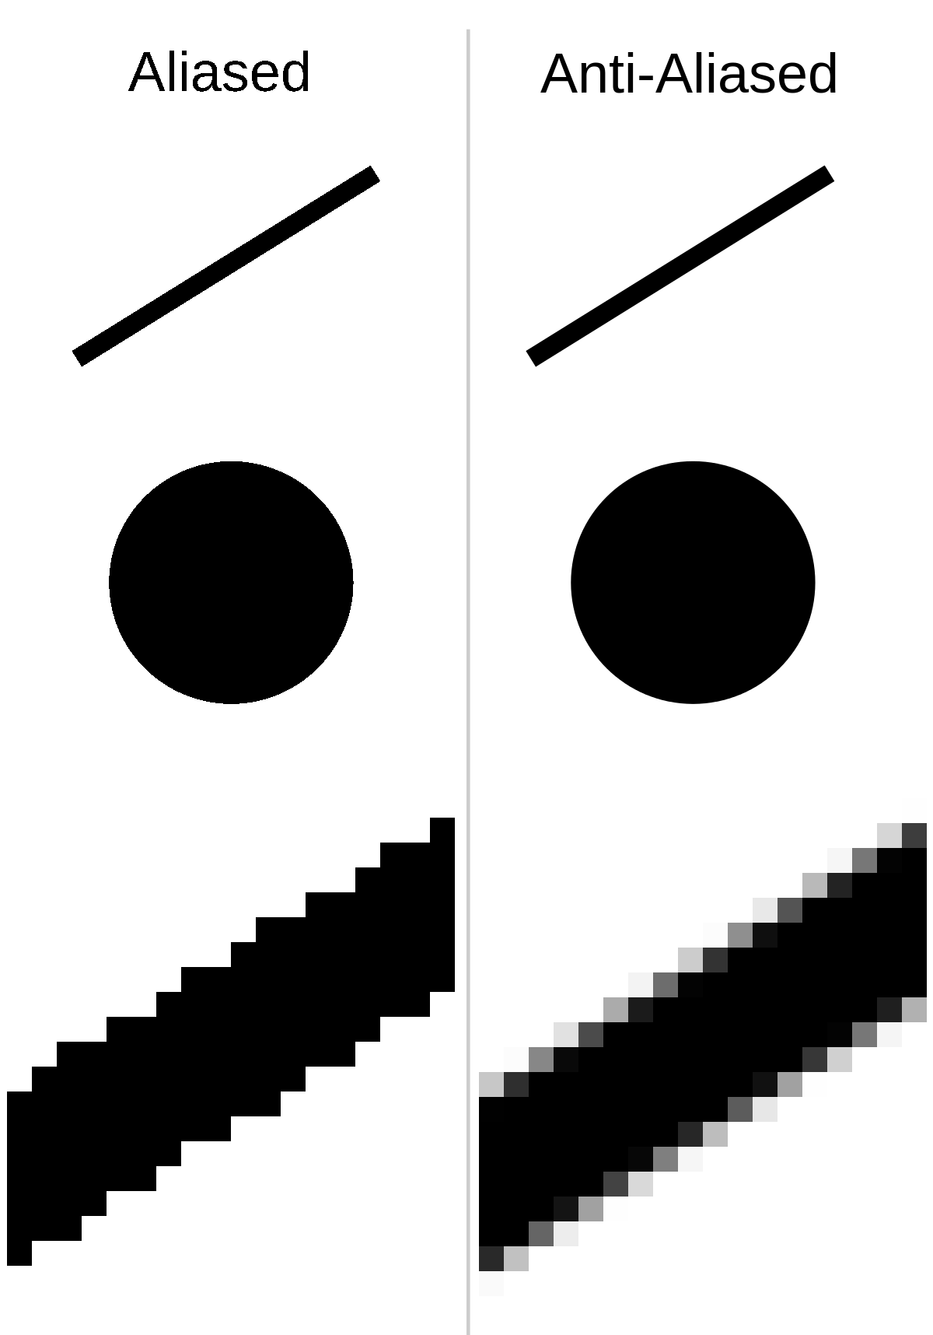
Anti-aliasing

Slide 17
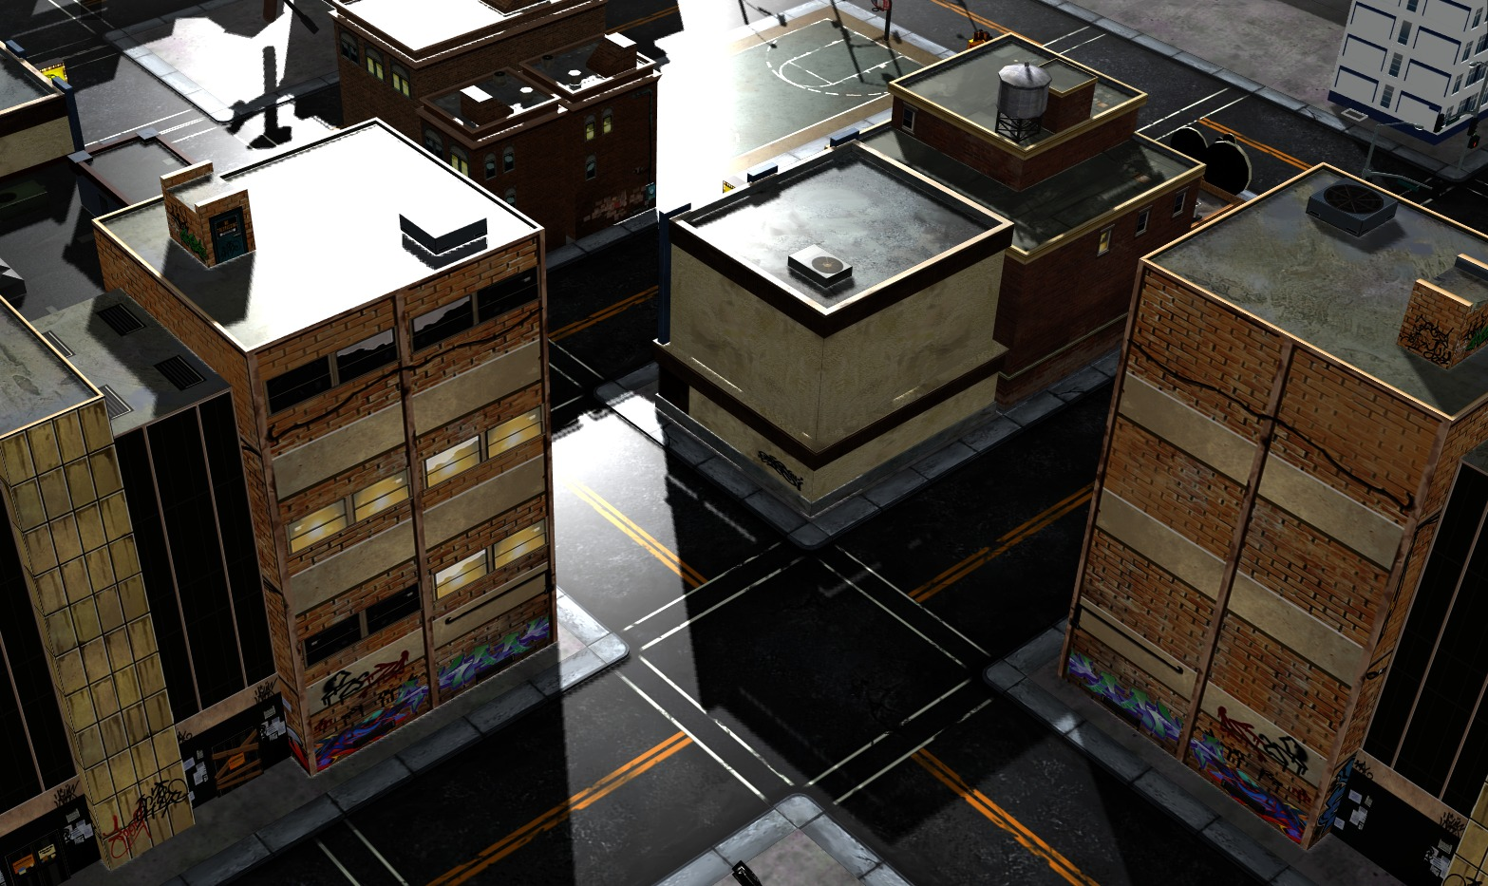
Shadow Mapping

Slide 18
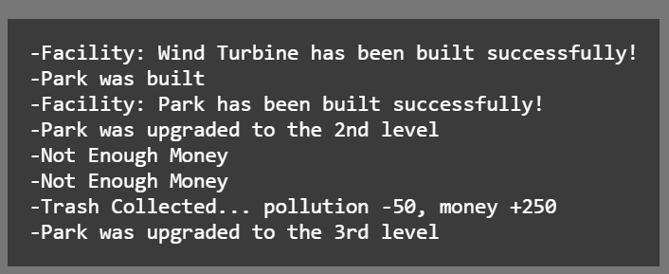
Logger

Slide 19
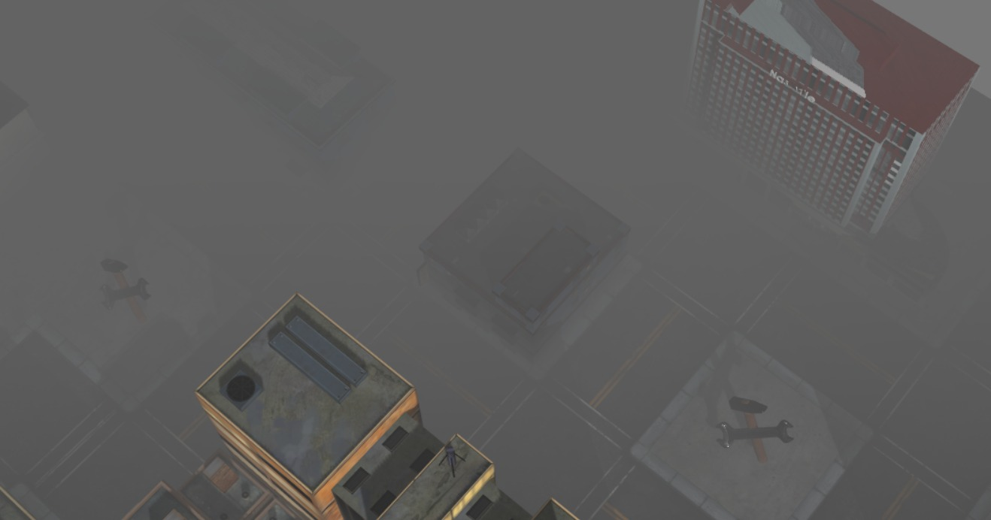
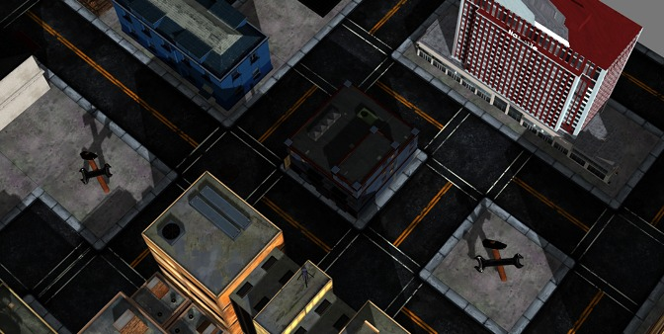
Fog

Slide 20
Theoretical Background
Advanced BFS
GameLoop

Slide 21
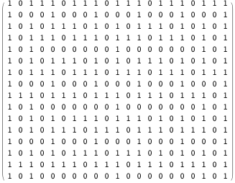
Advanced BFS
-create a queue which will store path(s)
-initialise the queue with first path starting from src
-Now run a loop till queue is not empty
get the front node from queue
check if the las tnode of this path is destination
if true then exit
run a loop for all the vertices connected to the
current vertex = last node extracted from path
if the vertex is not visited in current
a) create a new path from earlier path and
append this vertex
b) insert this new path to queue

Slide 22
Game Loop

Slide 23
References
Three.js
https://threejs.org/
https://sketchfab.com/MRowa
https://sketchfab.com/3d-models/ccity-building-set-1-a2d5c7bfcc2148fb8994864c43dfcc97
https://sketchfab.com/neberkenezer
https://threejsfundamentals.org/
https://sketchfab.com/rajibkc
https://sketchfab.com/jacky15621419
https://www.geeksforgeeks.org/

