Slide 1
Predicting Origin of Music
BBM406 Fundamentals of Machine Learning
Course Project
Muhammet Subasi, Harun Burkuk, Mustafa Korkmazlar

Slide 2
Overview
Our problem is predicting origin of music by looking at the characteristics of sound waves.
It can be done by two ways which are predicting country names and predicting latitude and longitude values. We did with both ways.

Slide 3

Problem Statements and Motivation

Slide 4

Problem
In the world there are huge variety of types of music. The reasons of this variety are historical, cultural and geographical diversity. Almost each geographic region has their own characteristics and melodies.
People often try to predict their region by just listening to the song but can machine learning do this job for you?

Slide 5

Motivation
There are only a few research about predicting origin of music by using machine learning .
The work done is not comprehensive and very successful.
We wanted to add a stone to this road less travelled before…

Slide 6

Key Techinal Ideas

Slide 7

2 APPROACH
Predicting Countries
Predicting Latitude and Longitude Values

Slide 8
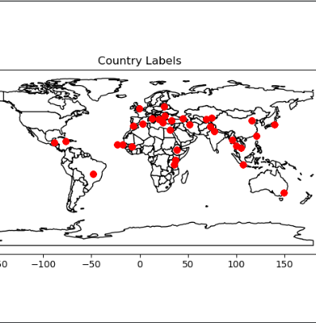
Predicting Countries
Uses classification algorithms to find origin country of musics
Methodology
Define Country Labels
Build up a Model for Classify Country Labels
Train Model
Test Model

Slide 9
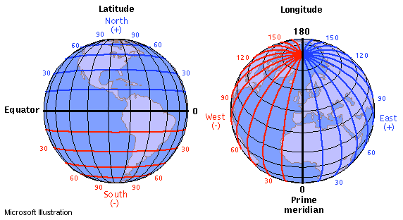
Predicting Latitude and Longitude Values
Uses regression algorithms to find origin coordinates of music
Methodology
1) Build up a Model for Regression
2)Train Model
3) Test Model
4) Find Average Distance

Slide 10

Experimental Set-up

Slide 11
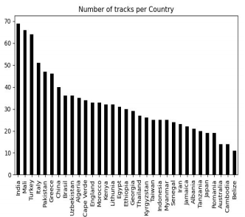
DataSet
We will use the Geographical Original of the Music Data Set from UCI
This dataset contains 1059 rows, each of which represents a music track, and there are 70 columns. 68 of the columns are features for each music track extracted by using MARSYAS.
The last 2 columns contain latitude and longitude information’s for geographical regions. There are 33 different countries.

Slide 12

Evaluation Metrics
For Classification
For Regression
Accuracy
Confusion Matrix
Precision
Recall
F1-Score
Great Circle
Distance

Slide 13

Applications
Train-Test Split (sklearn.model_selection)
Classification Algorithms
Logistic Regression
Random Forest
Support Vector Machine
Feature Selection
Regression Algorithm
Neural Network

Slide 14
Classification Algorithms
Logistic Regression
Max_iter=500
Random_state=1
Multi_class=multinomial
Random Forest
N_estimator =1000
Random_state=1
Min_samples_leaf=1
Support Vector Machine
Kernel=linear
Gamma =scale
C=0.1

Slide 15

Feature Selection
Permutation Importance (eli 5)
Permutation Importance is an algorithm
that turns each feature into noise data in the data set
and looks at the accuracy change.
Each feature that we send into the Permutation Importance
gave worse accuracy than the accuracy we get
when we we used all the features.
We clearly see that every single feature in our data set is valuable.
So we decided to all features should be in model.

Slide 16
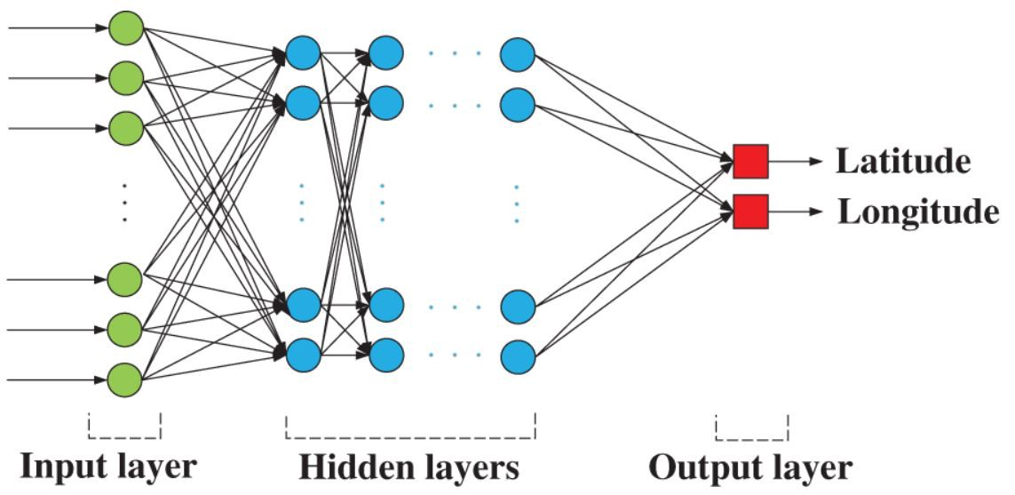
Neural Network
MLP REGRESSOR
Random State = 1234
Max_iter = 4000
Hidden_layer_sizes = 12
Num_of_hidden_layer = 2
Activation = identity
Solver = adam
Batch_size = 64
Alpha = 1000

Slide 17

Results
Results of Classifications
Results of Regression

Slide 18
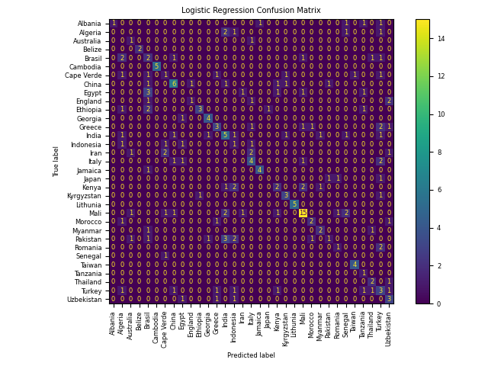
Logistic Regression
Evaluation Metrics | Score
Accuracy | 0.41
Precision | 0.45
Recall | 0.43
F1-Score | 0.41

Slide 19
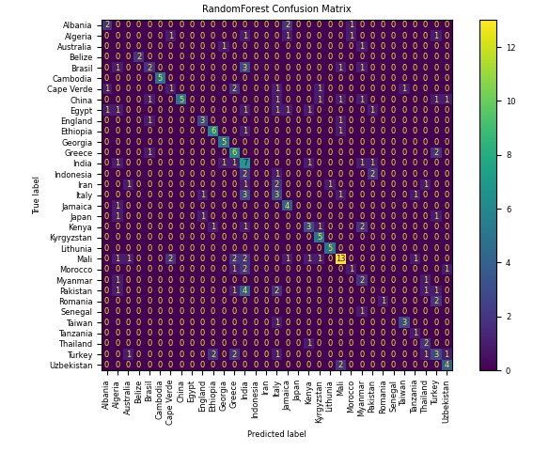
Random Forest
Evaluation Metrics | Score
Accuracy | 0.44
Precision | 0.44
Recall | 0.46
F1-Score | 0.44

Slide 20
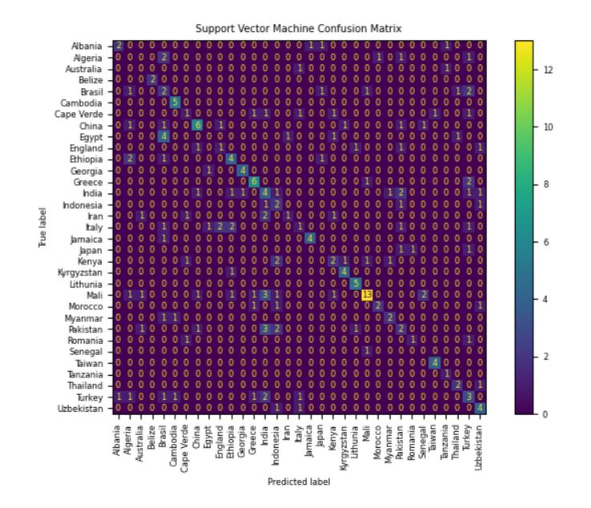
Support Vector Machines
Evaluation Metrics | Score
Accuracy | 0.42
Precision | 0.44
Recall | 0.45
F1-score | 0.42

Slide 21
Discussion of Classification Results
One of our related work doing this task by predicting continents of these countries.
Our accuracy is relatively low.
The data set is not well distributed and large enough to estimate the 33 countries.
We decided to take this a step further and investigate that a machine learning model can predict countries themselves.

Slide 22
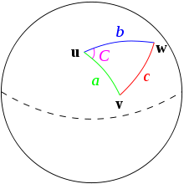
Regression
In this part of the project we predict latitude and longitude values of origin of music.
Because of the shape of World it is different from 2 dimension distance calculation.
We evaluate Great Circle Distance using an advanced form of haversine formula.

Slide 23
Discussion of Regression
Our great circle distance is small which is great because this means we predict coordinates with small error.
In our main related work the great circle distance is approximately 3300 km.
Our great circle distance is approximately 2700 km.

Slide 24
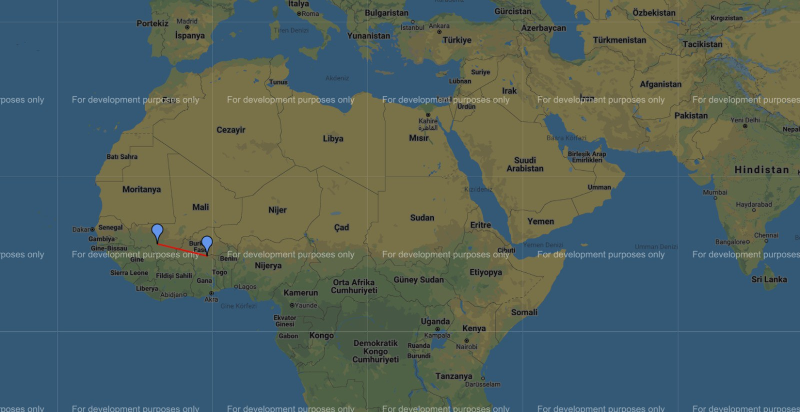
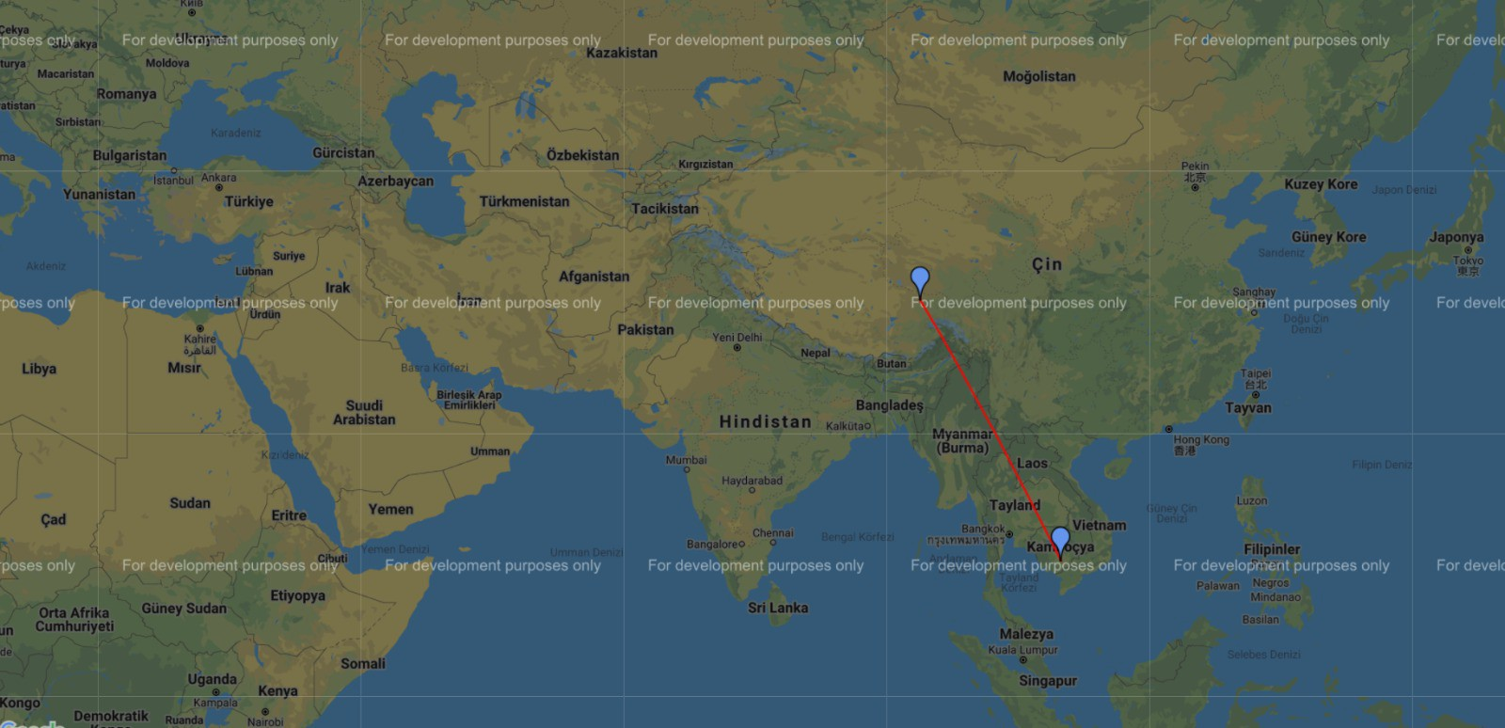
Samples from Testing
813.3 km
2591.8 km

Slide 25
References
https://en.wikipedia.org/wiki/Haversine_formula
https://ieeexplore.ieee.org/document/7023456/
https://github.com/radoslawregula/geo-music-classification/blob/master/geo_origins_music_notebook.ipynb
https://scikit-learn.org/stable/modules/generated/sklearn.metrics.accuracy_score.html
https://pypi.org/project/gmplot/

