Slide 1
Suhash M
Final Project
3/21/2024 Annual Review

Slide 2
PROJECT TITLE
Hand Gesture Virtual Mouse
3/21/2024 Annual Review

Slide 3


AGENDA
Introduction
Project Scope and deliverables
Research and Background
Hardware and Software Requirements
System Architecture
Implementation Plan
User Interface Design
Testing and Evaluation
Documentation and Reporting
closing
3/21/2024 Annual Review

Slide 4

PROBLEM STATEMENT
In modern computing environments, traditional input devices such as mice and touchpads are widely utilized for navigating digital interfaces. However, these devices may not always be suitable for all users, especially those with mobility impairments or in scenarios where space is limited. Additionally, the reliance on physical hardware presents challenges related to portability and cost.
Addressing these limitations, hand gesture-based virtual mouse systems have emerged as a promising alternative. These systems utilize cameras or sensors to track hand movements, enabling users to interact with digital interfaces through intuitive gestures. Despite their potential benefits, several challenges persist in the development and adoption of hand gesture virtual mouse systems
Despite the advancements in technology, conventional input devices like mice and touchpads still present challenges for certain users, particularly those with disabilities or mobility impairments. Additionally, in scenarios where users need to interact with computers from a distance, such as during presentations or while operating multimedia systems, traditional input devices may not be practical.
3/21/2024 Annual Review

Slide 5

PROJECT OVERVIEW
The Hand Gesture Virtual Mouse project aims to create a novel interface for computer interaction by allowing users to control their devices using hand gestures captured by a camera. This innovative approach leverages computer vision and machine learning techniques to interpret hand movements in real-time, translating them into cursor movements and interactions on the screen. By eliminating the need for physical input devices such as mice and touchpads, the hand gesture virtual mouse offers a more intuitive, accessible, and versatile means of interacting with computers and devices.
Hardware Setup: The project usually begins with setting up the necessary hardware components. This may include a webcam or specialized depth-sensing camera capable of capturing hand movements accurately. Additionally, any other required sensors or peripherals may be integrated depending on the specific requirements of the project.
Computer Vision: Computer vision algorithms are employed to process the video feed from the camera and detect the presence of a hand within the frame. Techniques such as background subtraction, contour detection, and hand segmentation are commonly used to isolate the hand from the background.
Hand Tracking: Once the hand is detected, the system tracks its movement in real-time. Various tracking algorithms, such as Kalman filters or optical flow, may be employed to estimate the position and velocity of the hand accurately.
3/21/2024 Annual Review

Slide 6

WHO ARE THE END USERS?
Individuals with Disabilities
Elderly Users
Presenters and Speakers
Game enthusiasts
Digital Artists and Designers
Office Workers
Home Entertainment Users
Education Sector
Healthcare Providers
3/21/2024 Annual Review

Slide 7

YOUR SOLUTION AND ITS VALUE PROPOSITION
Real-time Hand Tracking: The system should be capable of accurately tracking the movements of the user's hand in real-time using a camera or depth sensor.
Gesture Recognition: The ability to recognize and interpret various hand gestures performed by the user, such as pointing, clicking, dragging, scrolling, zooming, rotating, and other custom gestures.
Multi-Gesture Support: Support for recognizing and distinguishing between multiple gestures simultaneously, allowing for complex interactions and multitasking.
Customizable Gestures: Users may have different preferences or requirements for gestures. Providing options for users to customize or define their own gestures can enhance usability and accessibility.
Dynamic Gesture Mapping: The system should map recognized gestures to corresponding actions in the user interface dynamically. For example, a pointing gesture might move the cursor, while a pinching gesture might simulate a mouse click.
3/21/2024 Annual Review

Slide 8

THE WOW IN YOUR SOLUTION
Natural Interaction: Hand gestures mimic real-world movements, making interaction with a virtual environment more intuitive and natural compared to traditional input devices like mice or touchpads.
Accessibility: Hand gesture-based interfaces can be particularly beneficial for individuals with mobility impairments who may find traditional input devices challenging to use. Gestures require minimal physical effort and can accommodate a wide range of users.
Gesture Recognition: Advanced gesture recognition technologies can accurately interpret various hand movements, allowing for precise control over virtual objects or interfaces. This enhances user experience and reduces frustration associated with misinterpretation of inputs.
No Physical Hardware Required: Unlike traditional mice or touchpads, hand gesture-based interfaces typically don't require any additional hardware, apart from a camera or sensor to capture the gestures. This reduces costs and eliminates the need for carrying and maintaining physical devices.
Space Efficiency: Hand gestures can be performed in the air without the need for a physical surface, making them suitable for use in environments where space is limited, such as in vehicle cockpits or during presentations.
3/21/2024 Annual Review
8

Slide 9
MODELLING
Teams cam add wireframes
Designing a hand gesture virtual mouse system involves several components and considerations. Here's a high-level overview of the modeling process:
1. Gesture Recognition Model:
- Develop a machine learning or computer vision model capable of accurately detecting and recognizing hand gestures from input data captured by a camera or sensor.
2. Hand Tracking and Localization:
- Implement algorithms to track and localize the user's hand in real-time within the camera or sensor's field of view.
3. Gesture Mapping and Interaction:
- Define a mapping between detected hand gestures and corresponding actions or commands in the virtual environment (e.g., cursor movement, clicking, dragging).
4. User Interface Design:
- Design a user-friendly interface that provides visual feedback to users about the status of their gestures and the resulting actions in the virtual environment.
5. Integration with Operating Systems and Applications:
- Develop software drivers or middleware to integrate the hand gesture virtual mouse system with popular operating systems (e.g., Windows, macOS, Linux) and application software.
3/21/2024 Annual Review
9

Slide 10
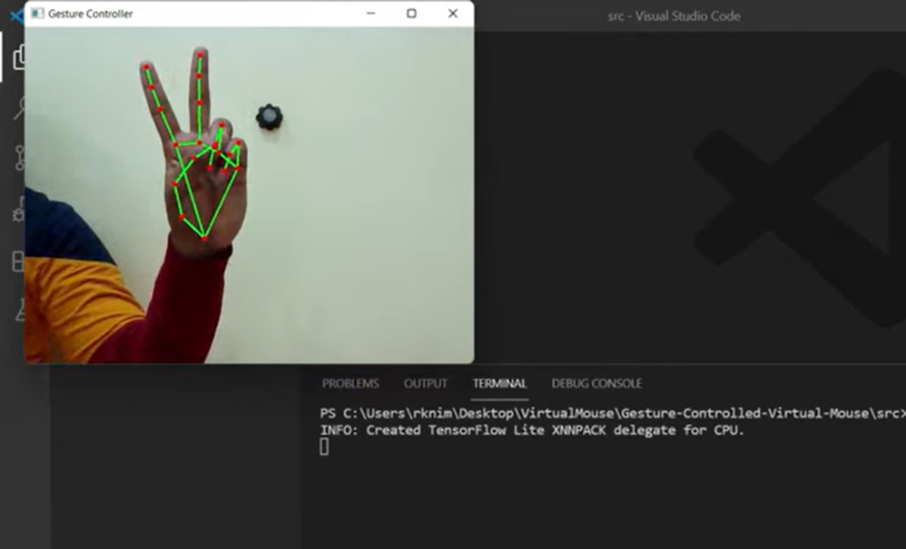
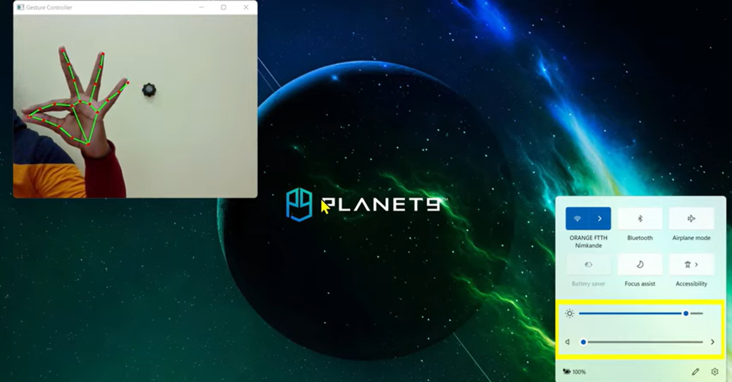
RESULTS
Demo Link
3/21/2024 Annual Review
10

