Slide 1

Master of Science (M.Sc.) in Digital Sciences
Technical Dashboard Creation in Celonis
From raw files to a deployed process dashboard
Group 07
1. Malik Mohsin Azhar
2. Samira Aghajani
3. Muhammad Suhan
Process Mining Seminar, TH Köln
9 November 2026
Technical Dashboard Creation in Celonis
Process Mining
1

Slide 2
Master of Science (M.Sc.) in Digital Sciences
Topics today
1
Foundations: Celonis, event logs and a pizza example
Malik
2
The orders dashboard: model, PQL, charts, export
Samira
3
Object-centric view and custom KPIs
Suhan
4
Lessons, references and questions
All
Technical Dashboard Creation in Celonis
Process Mining
2

Slide 3
Master of Science (M.Sc.) in Digital Sciences
1
PART 1
Foundations: from raw data to a first dashboard
Malik Mohsin Azhar
Why Celonis and how the pipeline works
The key terms of process mining
A pizza event log, step by step
A first look at PQL
Technical Dashboard Creation in Celonis
Process Mining
3

Slide 4
Master of Science (M.Sc.) in Digital Sciences
Why Celonis, and what we built
Classic BI tools show numbers. Celonis rebuilds the real process from event logs, so we see how work actually flows, where it waits and where it deviates.
Raw files
CSV / XLSX
Data Pool
storage
Data Model
case, activity, time
Studio
space, package, view
Version
and deploy
>
>
>
>
WHY Every stage has one job. If a dashboard looks wrong, we know which of the five stages to check first.
Technical Dashboard Creation in Celonis
Process Mining
4

Slide 5
Master of Science (M.Sc.) in Digital Sciences
Key terms in one minute
Event log
One row per event: what happened, to which case, and when.
Case
One run of the process. In our orders data one order is one case (10,000).
Activity
One step of the process, such as place order or bake in oven.
Timestamp
When the event happened. It puts the events of a case in order.
Variant
A distinct path through the process. The pizza log has 111.
PQL
Process Query Language: how Celonis counts and slices process data.
Technical Dashboard Creation in Celonis
Process Mining
5

Slide 6
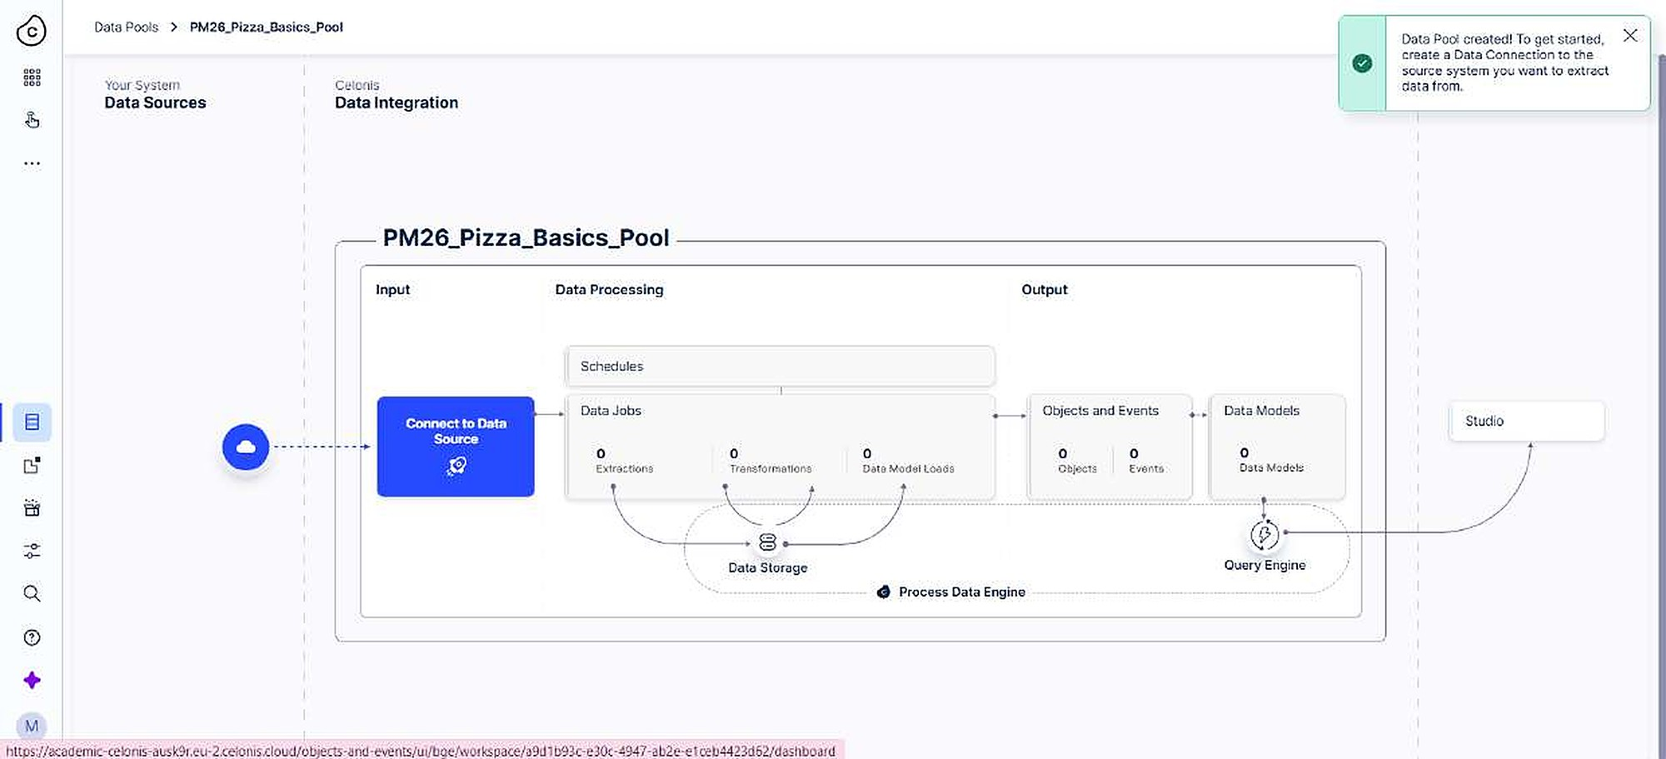
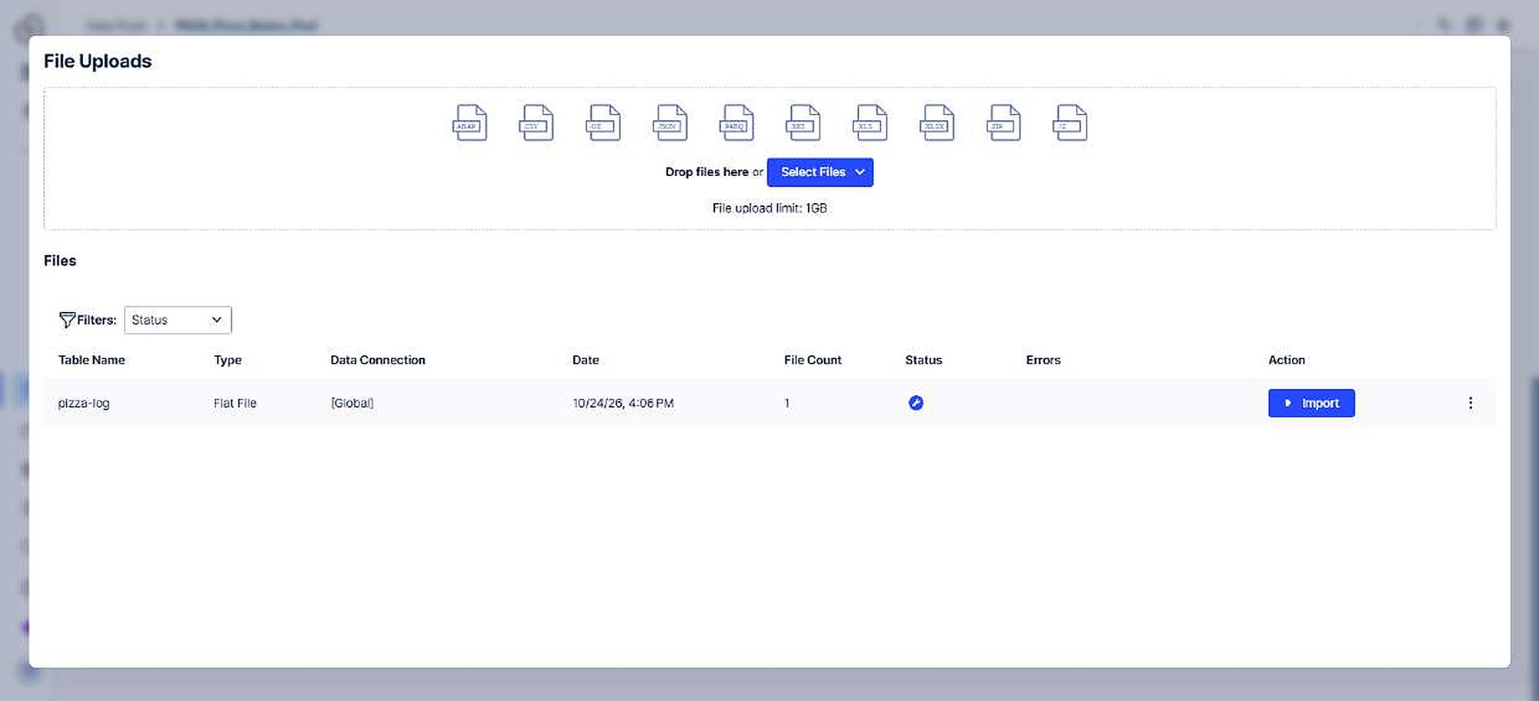
Master of Science (M.Sc.) in Digital Sciences
Pizza: data pool and upload
1
2
We created a data pool: PM26_Pizza_Basics_Pool
pizza-log.csv came in through Upload Files
Import turns the staged file into a real table
WHY Celonis can only model data that has been imported into a pool.
Technical Dashboard Creation in Celonis
Process Mining
6

Slide 7
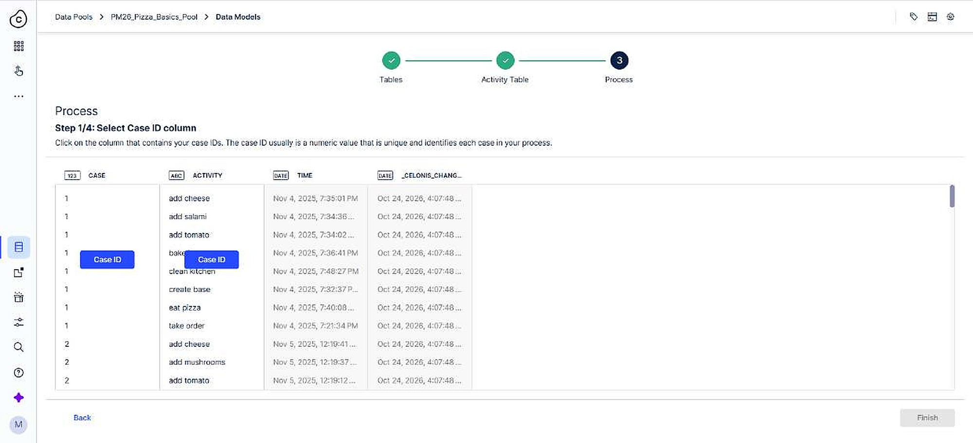
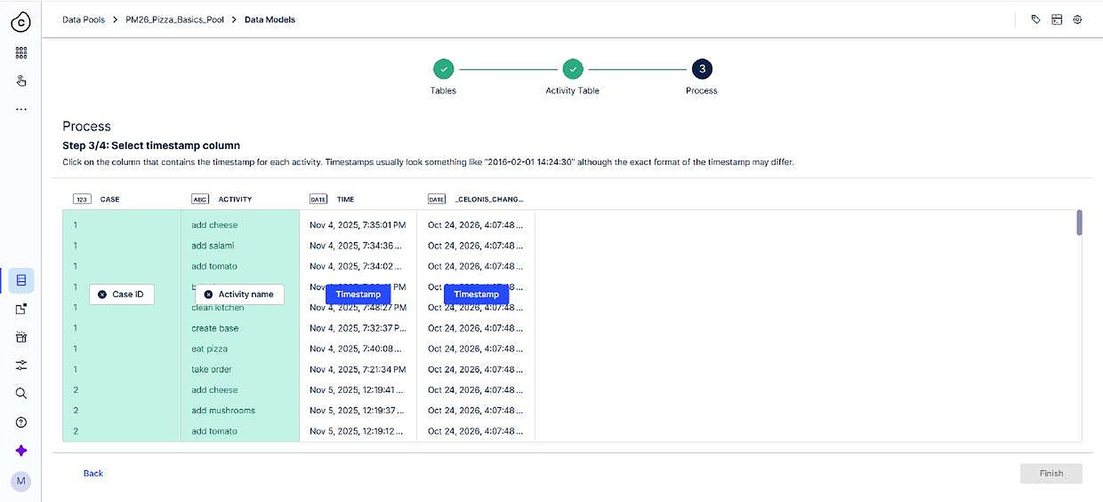
Master of Science (M.Sc.) in Digital Sciences
Teaching Celonis what an event is
1
2
Case ID: which pizza order the event belongs to
Activity: what happened, such as add cheese
Timestamp: when it happened
WHY Case, activity and time are the minimum an event log needs.
Technical Dashboard Creation in Celonis
Process Mining
7

Slide 8
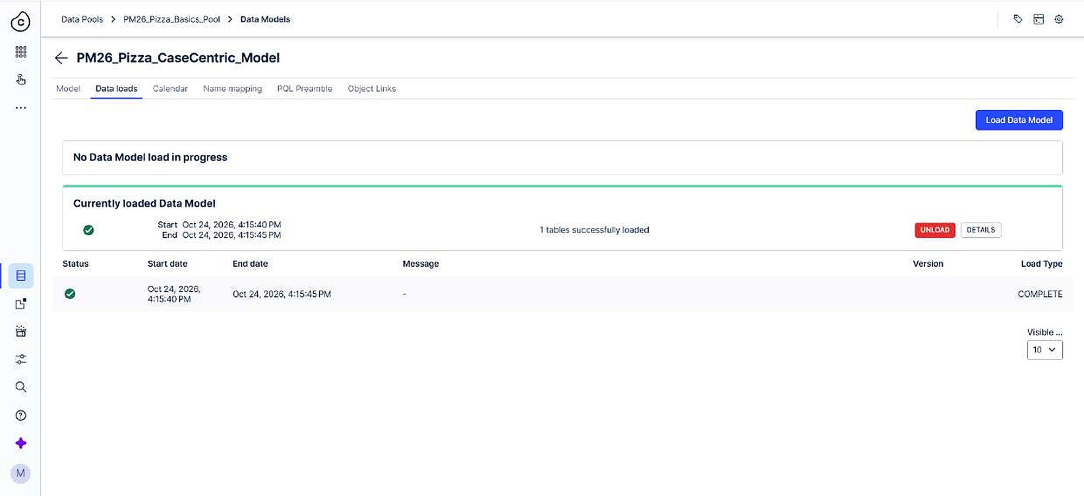
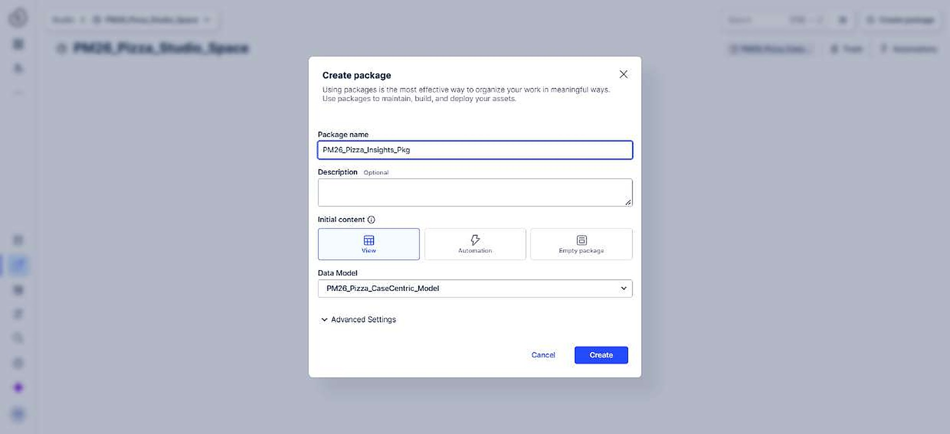
Master of Science (M.Sc.) in Digital Sciences
Load the model, then open Studio
1
2
A full load pushed the model into the in-memory engine
Studio is organised as Space, Package, View
PM26_Pizza_Studio_Space holds PM26_Pizza_Insights_Pkg
WHY Without a load there is nothing for the dashboard to query.
Technical Dashboard Creation in Celonis
Process Mining
8

Slide 9
Master of Science (M.Sc.) in Digital Sciences
Quick question
How many different paths (variants) do 1,280 pizza orders follow?
A
11 variants
B
111 variants
C
1,280 variants
B: 111 variants. The most common path covers only 72 cases (6%), so the process is very diverse.
Technical Dashboard Creation in Celonis
Process Mining
9

Slide 10
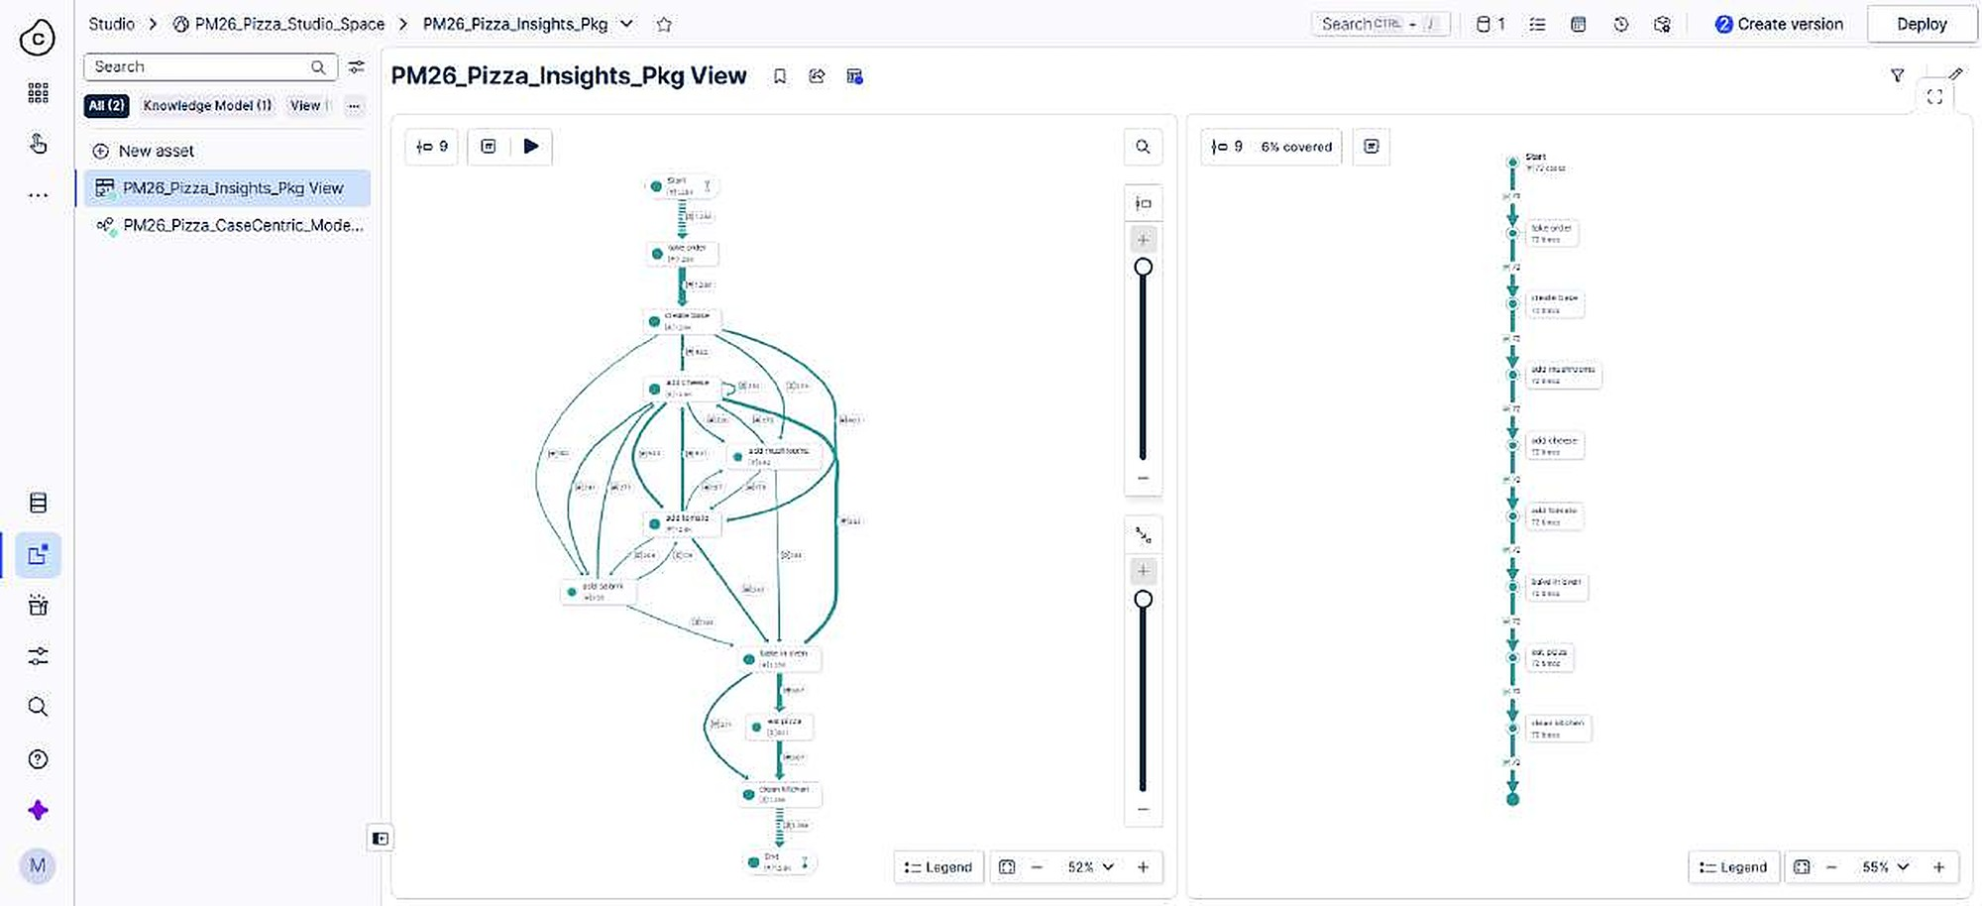
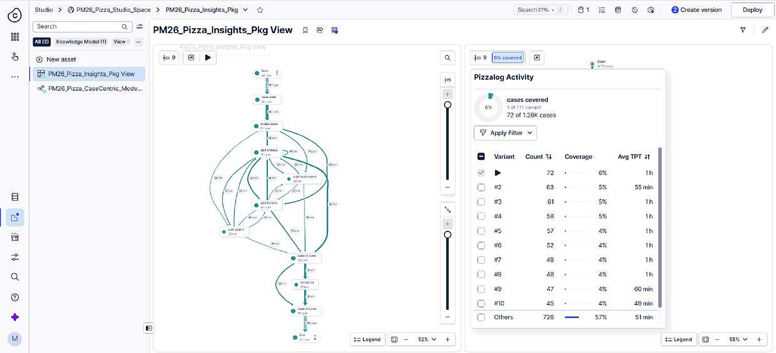
Master of Science (M.Sc.) in Digital Sciences
The pizza process map
1
2
Process Explorer draws the real flow: take order, create base, toppings, bake, eat
1.28K cases and 111 different variants
The most common variant covers 72 cases (6%)
WHY It shows how the process really runs, not how we assume it runs.
Technical Dashboard Creation in Celonis
Process Mining
10

Slide 11
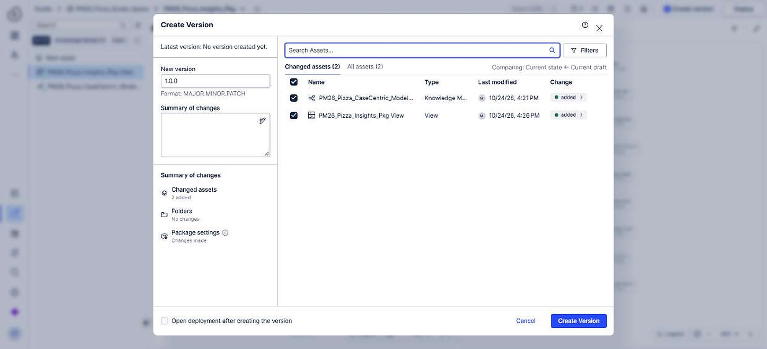
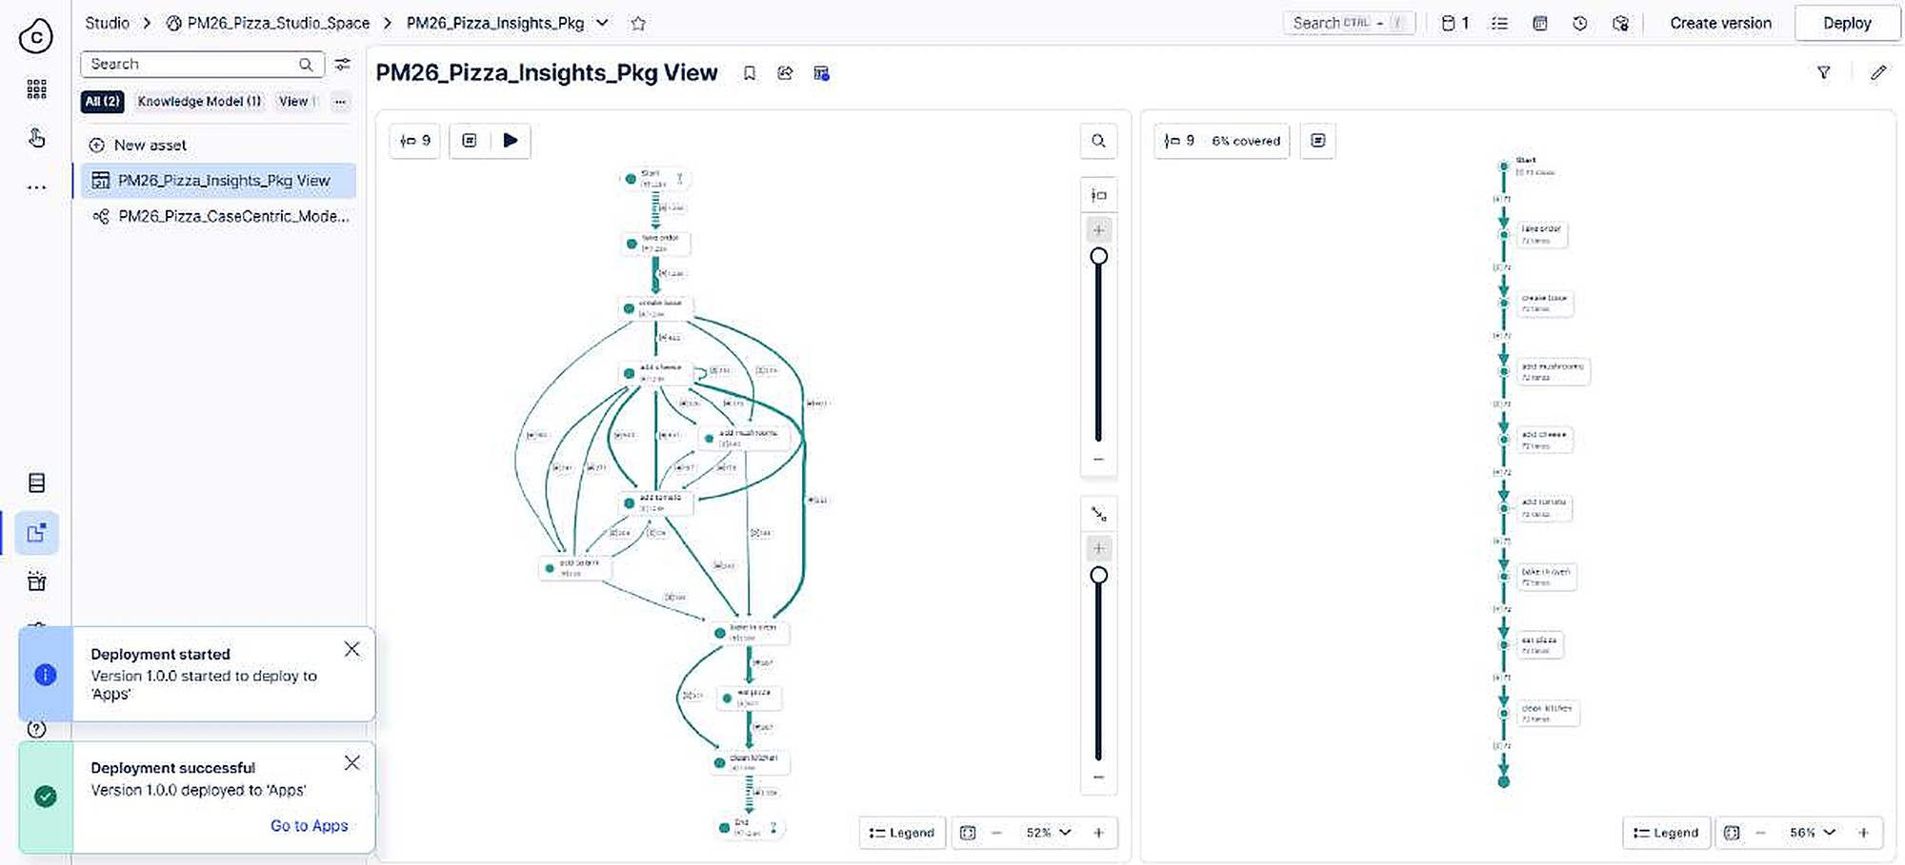
Master of Science (M.Sc.) in Digital Sciences
Version first, then deploy
1
2
Deploy asked for a version before anything else
Version 1.0.0 with the view and the knowledge model
Success banner: the dashboard is live in Apps
WHY A version is a frozen snapshot, so editing never breaks what users see.
Technical Dashboard Creation in Celonis
Process Mining
11

Slide 12
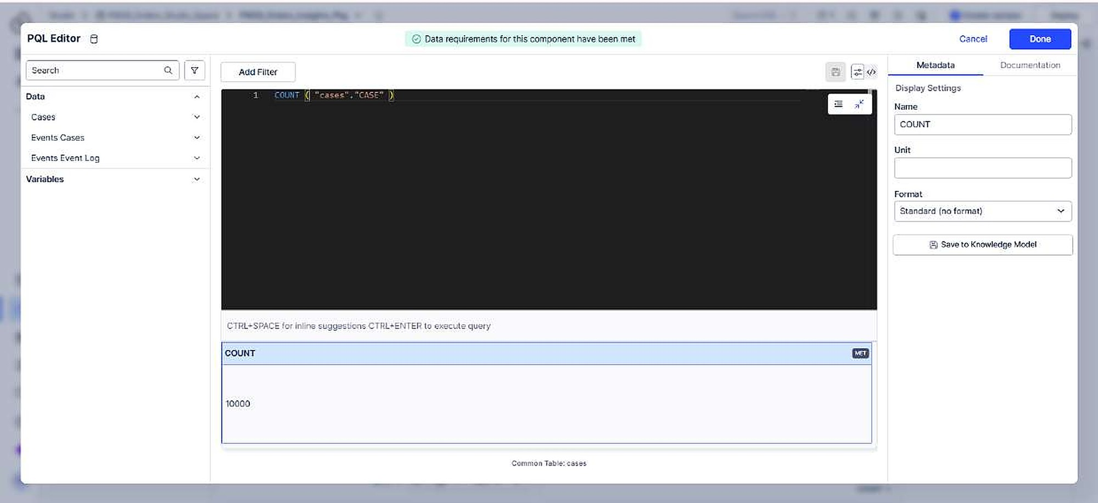
Master of Science (M.Sc.) in Digital Sciences
A first look at PQL: Total Cases
COUNT("cases"."CASE")
Result: 10,000 cases
COUNT turns a column into one number
A column from the data tree inserts its exact name
A bare column fails
WHY Every KPI needs an aggregation such as COUNT, SUM or AVG.
Technical Dashboard Creation in Celonis
Process Mining
12

Slide 13
Master of Science (M.Sc.) in Digital Sciences
2
PART 2
The orders dashboard: model, PQL, charts and export
Samira Aghajani
Two tables, one process
Linking and loading the model
OLAP table, chart and filter
A PQL KPI and the release
Technical Dashboard Creation in Celonis
Process Mining
13

Slide 14
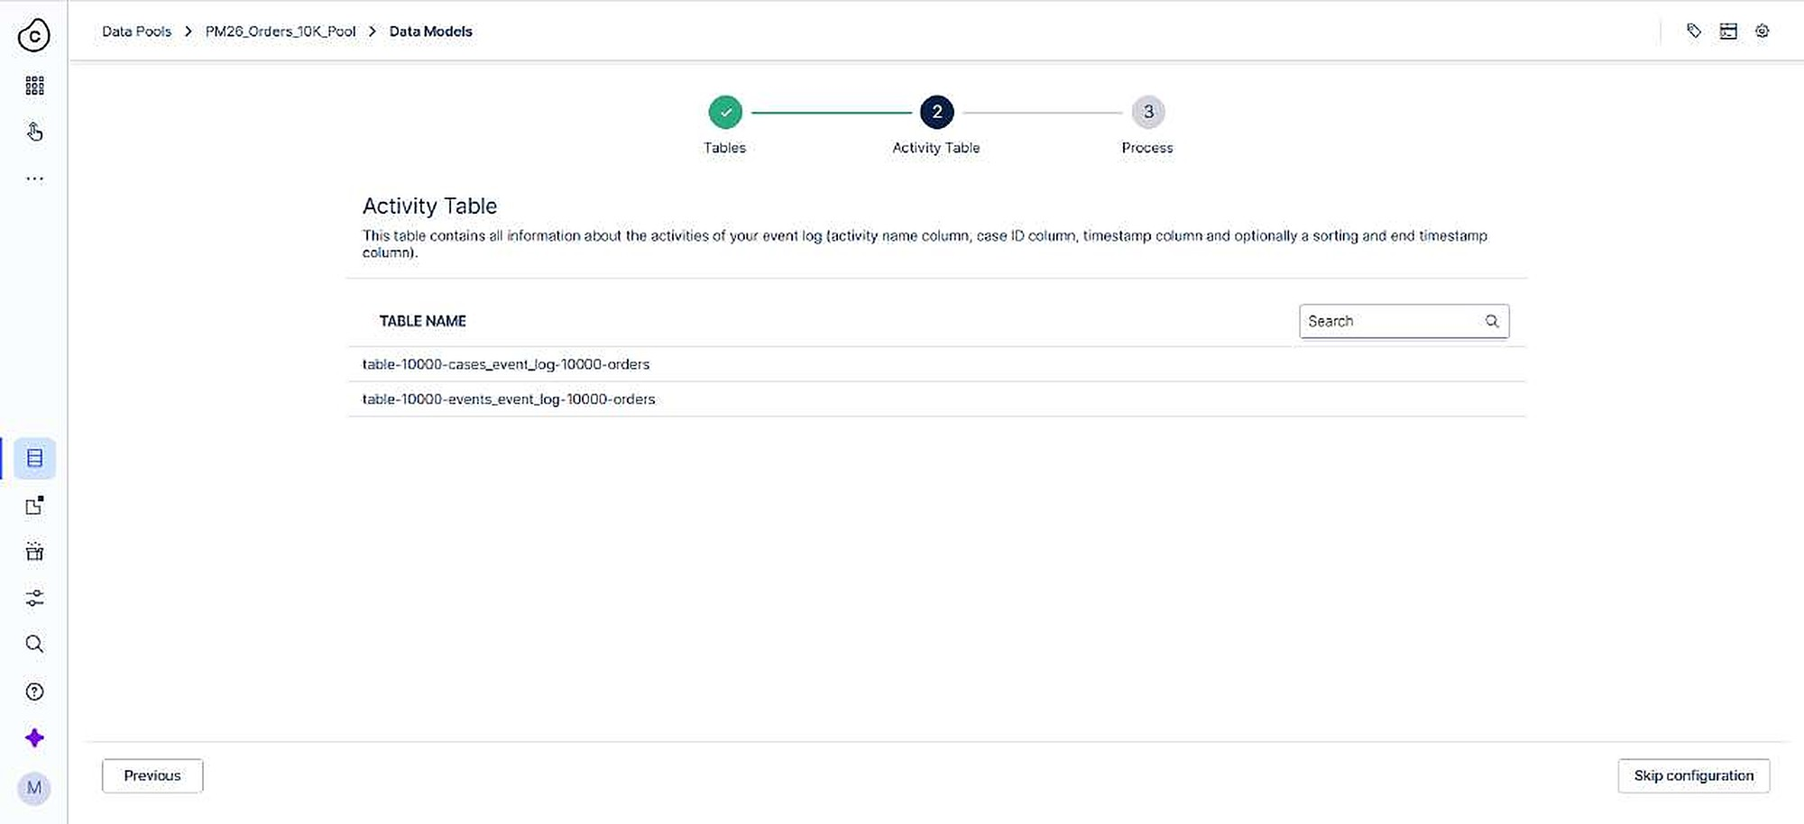
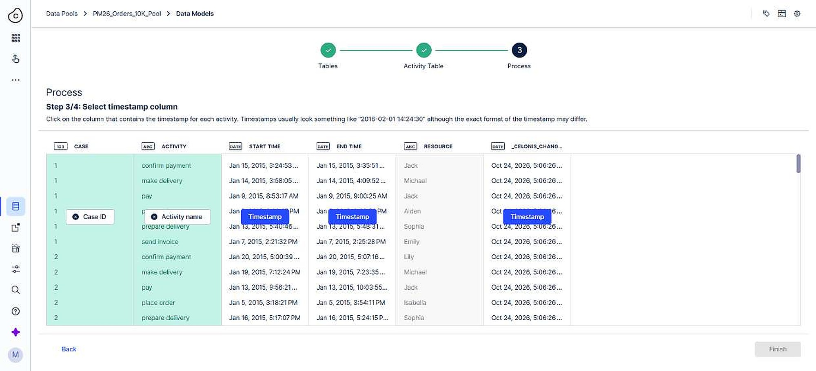
Master of Science (M.Sc.) in Digital Sciences
Orders: 10,000 cases, two tables
1
2
cases table: product, price, quantity, address
events table: case, activity, start and end time, resource
The events table is the activity table
WHY The activity table is the one where a single case has many rows.
Technical Dashboard Creation in Celonis
Process Mining
14

Slide 15
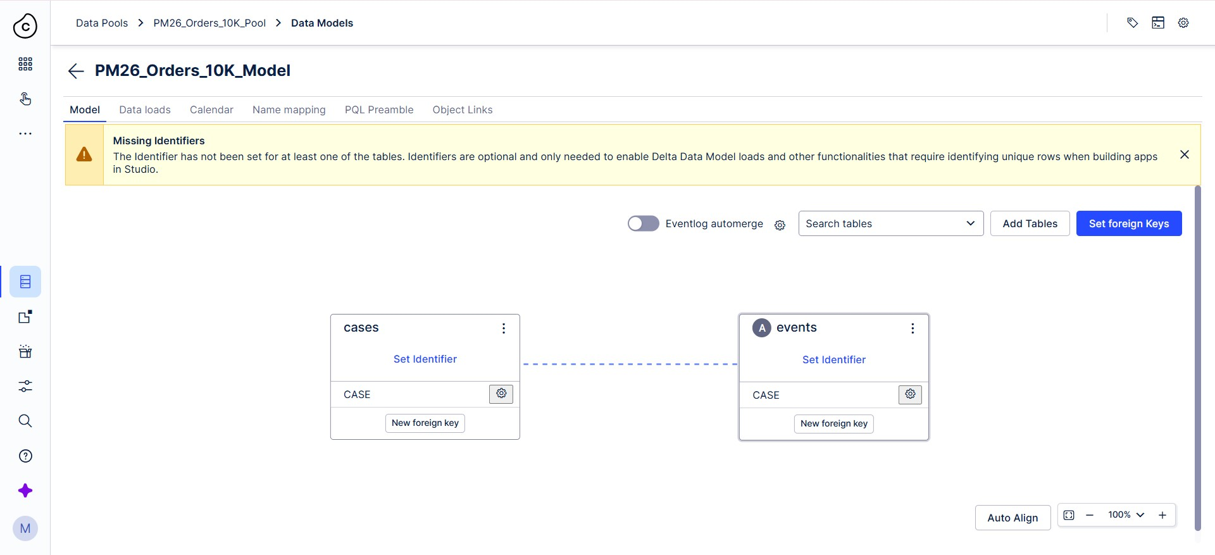
Master of Science (M.Sc.) in Digital Sciences
Linking the two tables
Foreign key on CASE: cases (dimension, 1) to events (fact, N)
One order has many events, so the join is 1:N
Aliases cases and events keep PQL short
WHY Now every event can be sliced by order attributes such as product.
Technical Dashboard Creation in Celonis
Process Mining
15

Slide 16
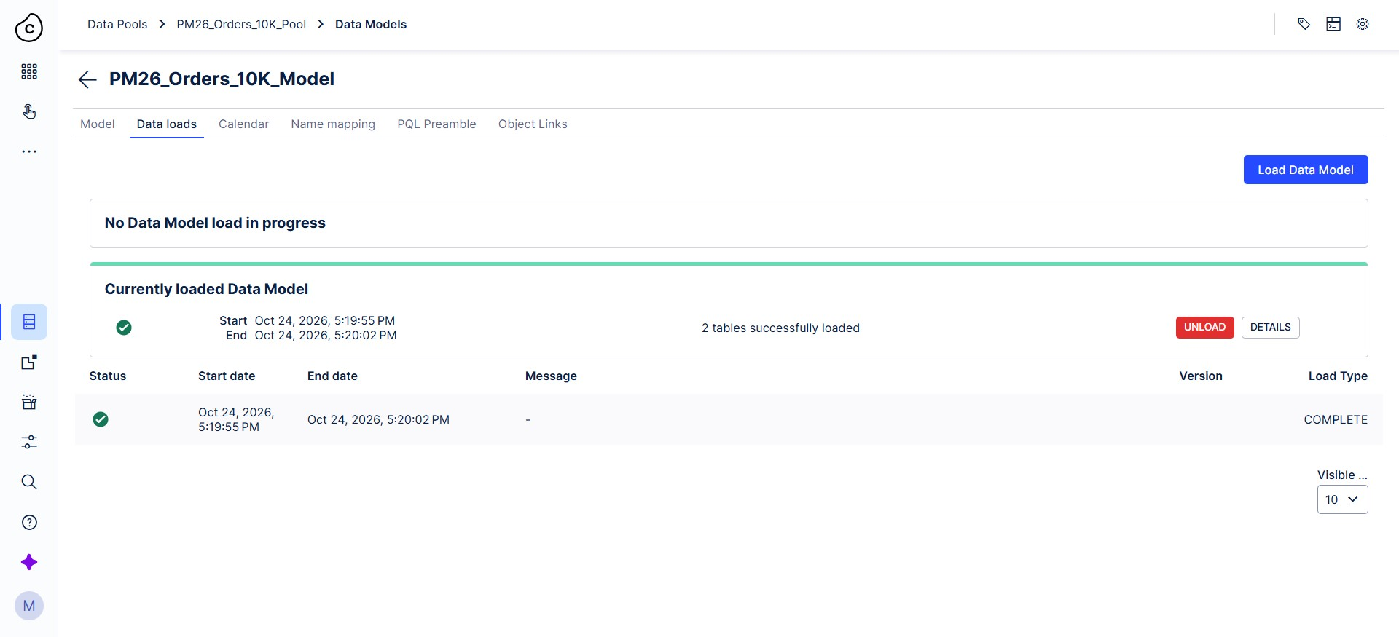
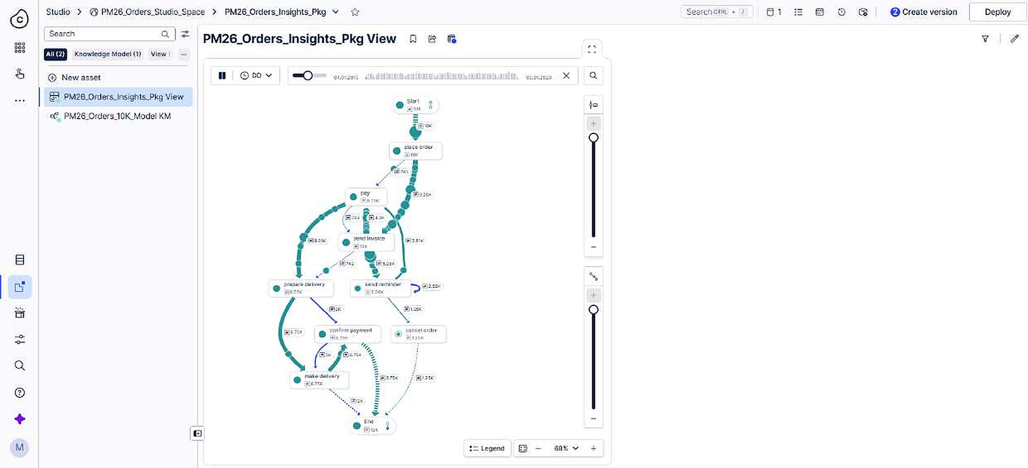
Master of Science (M.Sc.) in Digital Sciences
Load, then check the process
1
2
2 tables loaded, status COMPLETE
The map shows business steps: place order, send invoice, confirm payment, make delivery, pay
cancel order appears as its own path
WHY Business step names on the map confirm we chose the right activity table.
Technical Dashboard Creation in Celonis
Process Mining
16

Slide 17
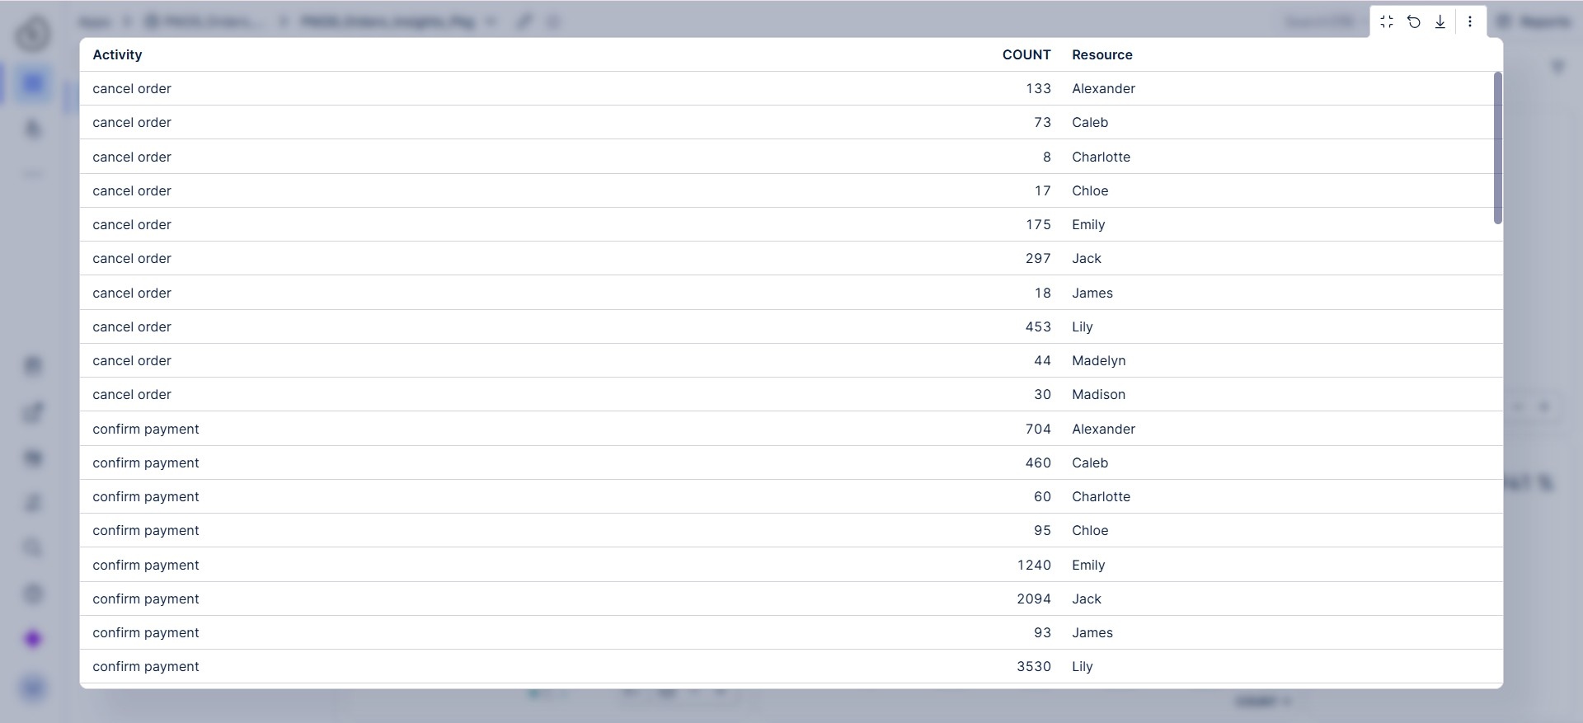
Master of Science (M.Sc.) in Digital Sciences
OLAP table: numbers per activity
Dimensions: Activity and Resource
Metric: case count, a COUNT over the case column
Exact numbers next to the charts
WHY An OLAP table works like GROUP BY: dimensions form groups, the metric gives the number.
Technical Dashboard Creation in Celonis
Process Mining
17

Slide 18
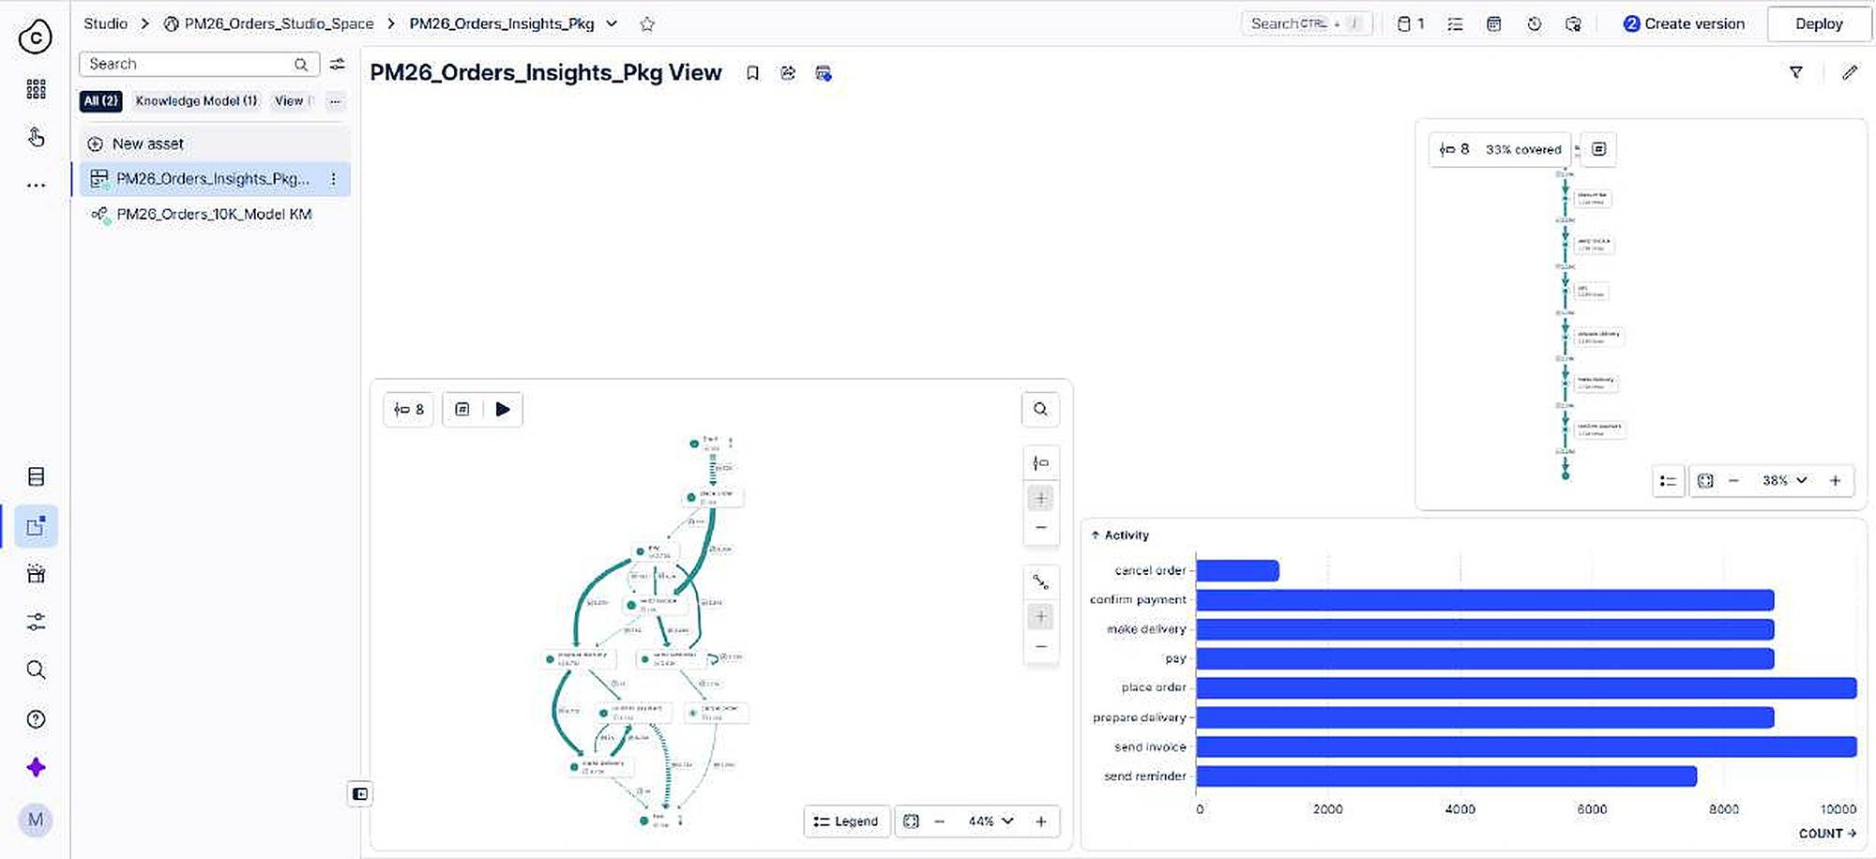
Master of Science (M.Sc.) in Digital Sciences
Bar chart: cases per activity
Dimension: Activity
Metric: COUNT of cases
One COUNT formula in the metric, nothing else
WHY Putting dimension and metric in one editor field causes a syntax error.
Technical Dashboard Creation in Celonis
Process Mining
18

Slide 19
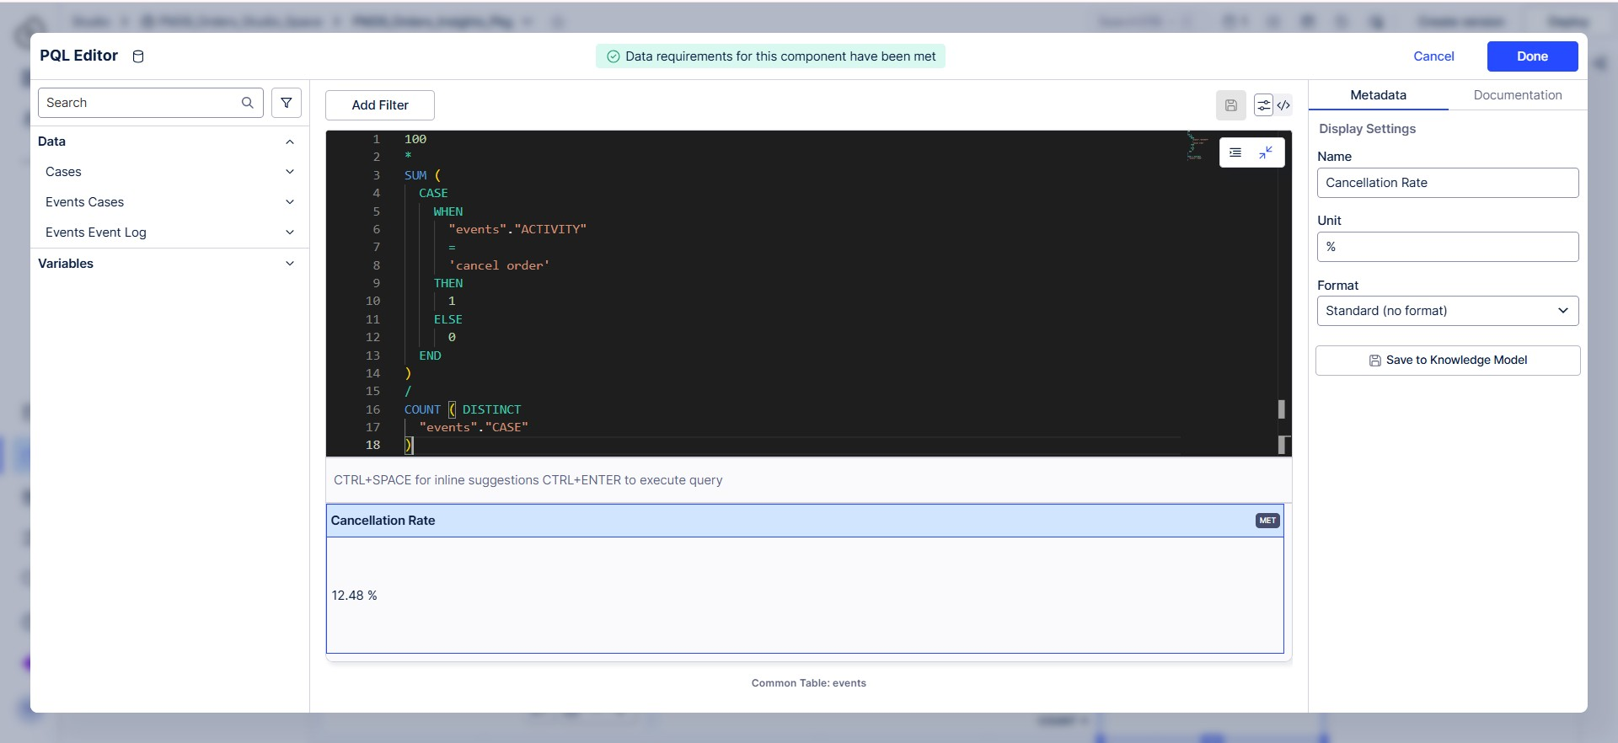
Master of Science (M.Sc.) in Digital Sciences
PQL KPI: Cancellation Rate
100 * SUM(CASE WHEN "events"."ACTIVITY" = 'cancel order' THEN 1 ELSE 0 END) / COUNT(DISTINCT "events"."CASE")
Result: 12.48%
CASE WHEN keeps only cancel order events
COUNT(DISTINCT ...) counts the cases
Both parts use the events table
WHY KPIs are defined by us, not only chosen from a list.
Technical Dashboard Creation in Celonis
Process Mining
19

Slide 20
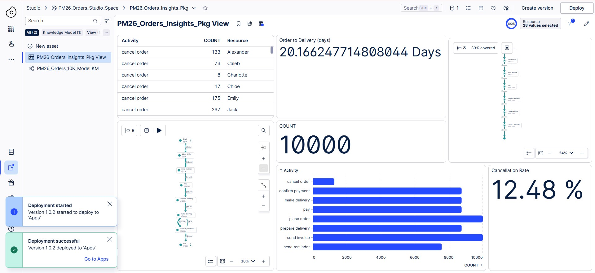
Master of Science (M.Sc.) in Digital Sciences
Release: version 1.0.2 and deploy
Create a version, then deploy
Banner: Deployment successful, version 1.0.2 deployed to Apps
The dashboard is now live for end users
WHY One clean release after all components are in place.
Technical Dashboard Creation in Celonis
Process Mining
20

Slide 21
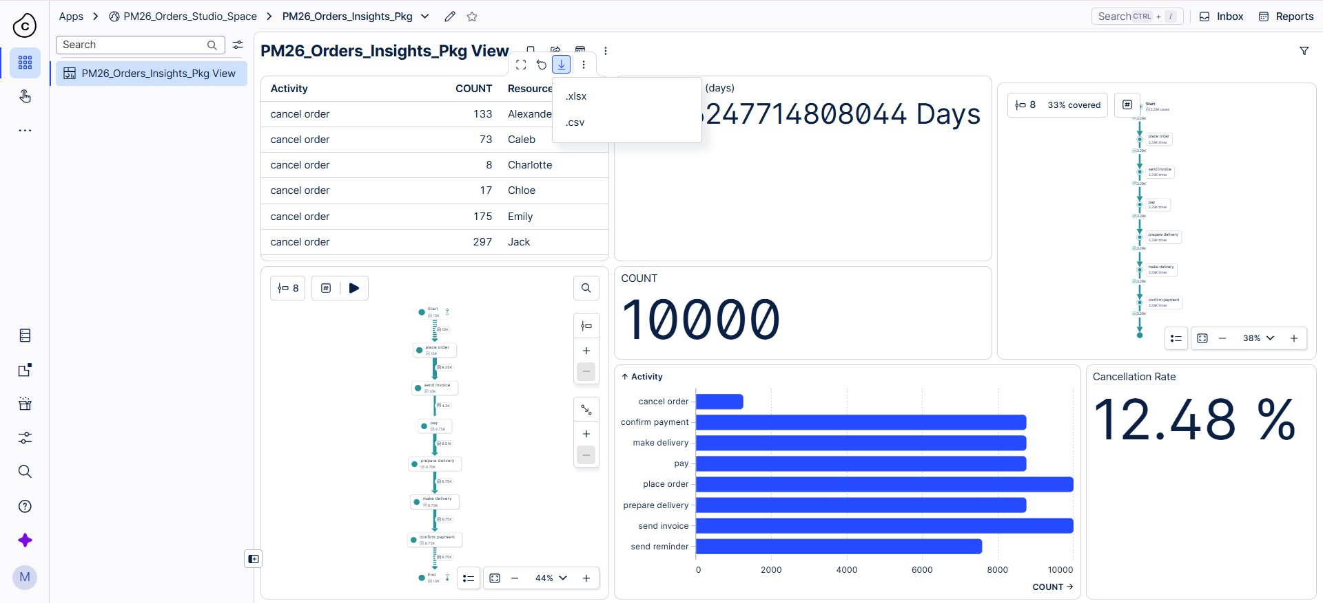
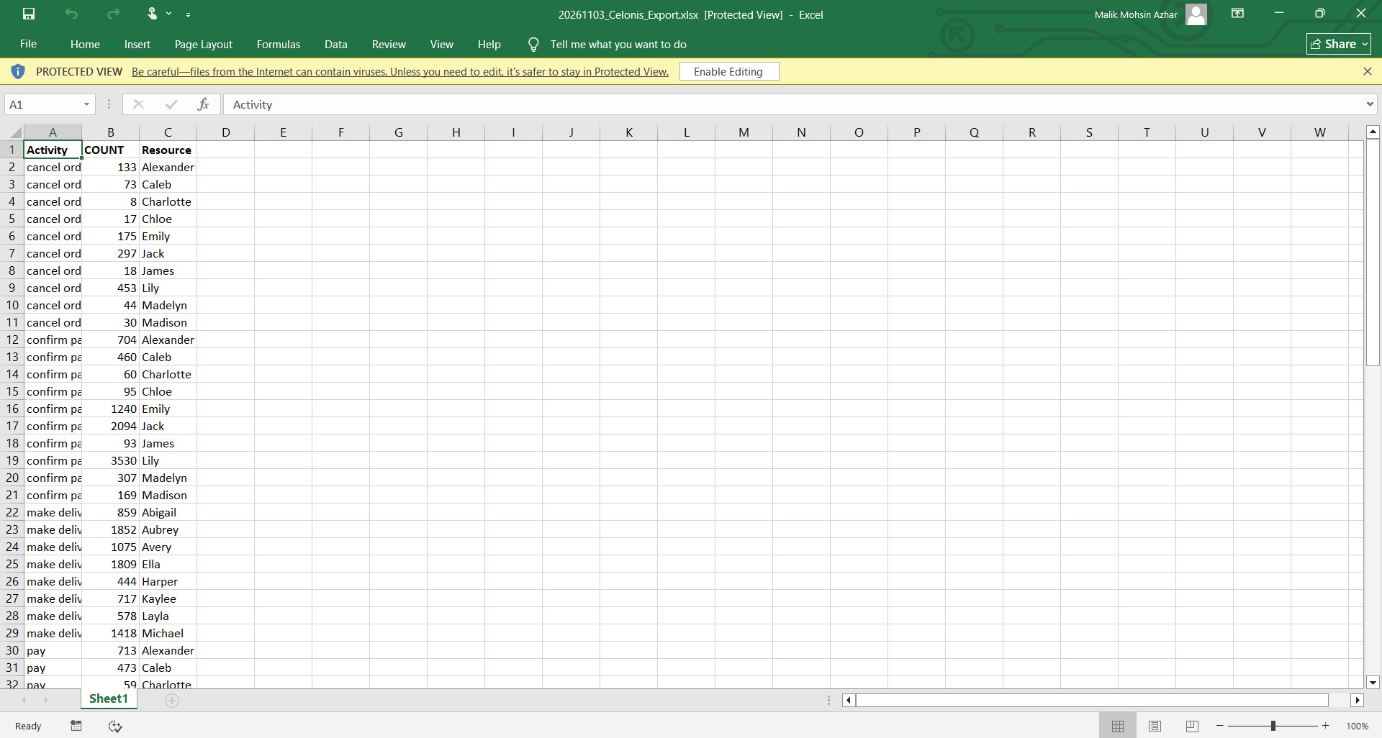
Master of Science (M.Sc.) in Digital Sciences
Filter and export
1
2
A Resource filter (28 values) slices every component
Hover over the table and use the download icon
.xlsx or .csv, opened in Excel
WHY Analysts can take the exact numbers into their own tools.
Technical Dashboard Creation in Celonis
Process Mining
21

Slide 22
Master of Science (M.Sc.) in Digital Sciences
Interactive moment
???
Samira Aghajani
Replace this slide with your own interactive element: a question to the audience, a short quiz or a live reveal.
Example Quiz: "Which table is the activity table, cases or events?" Reveal: events, because one case has many rows. Show what happens with the wrong table: products become activities.
Technical Dashboard Creation in Celonis
Process Mining
22

Slide 23
Master of Science (M.Sc.) in Digital Sciences
3
PART 3
Object-centric view and custom KPIs
Muhammad Suhan
One event, several objects
Objects, events and a perspective
A throughput time component
A custom KPI with PQL
Technical Dashboard Creation in Celonis
Process Mining
23

Slide 24
Master of Science (M.Sc.) in Digital Sciences
From cases to objects
In Part 2 every event belongs to exactly one case: the order
In real processes one event can involve several objects: order, item and package
Object-centric process mining keeps all of these links
A perspective chooses which objects and events to analyse
Order
Event
Item
Package
WHY The same order data can be viewed with different objects as the lead.
Technical Dashboard Creation in Celonis
Process Mining
24

Slide 25
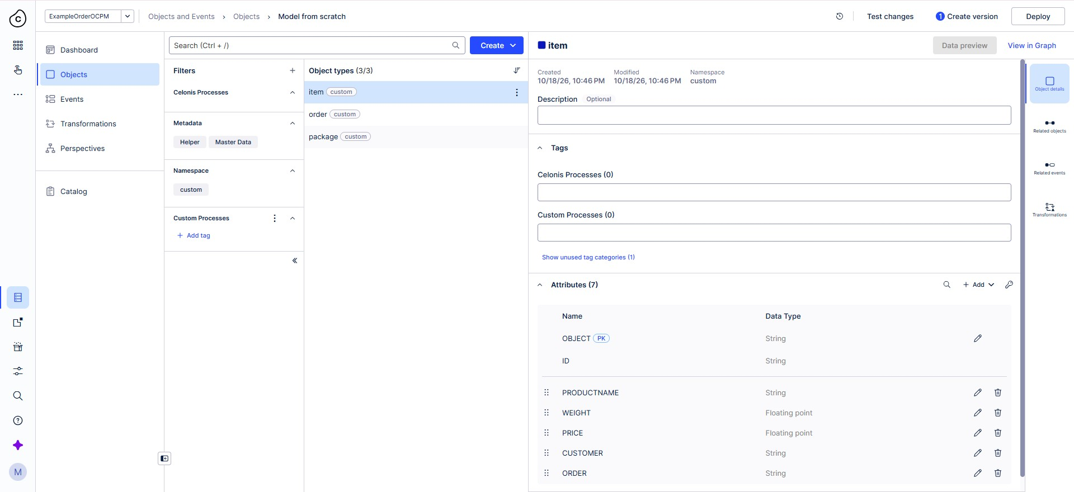
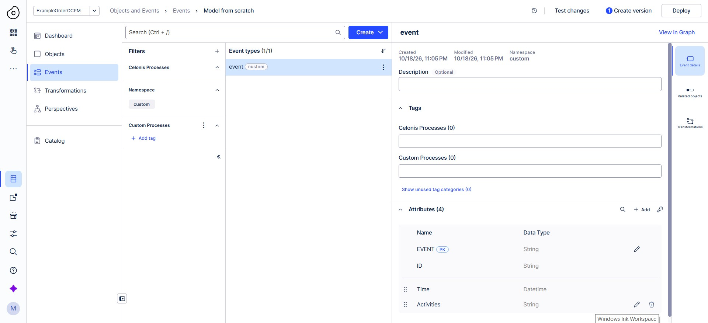
Master of Science (M.Sc.) in Digital Sciences
Objects and events
1
2
Pool ExampleOrderOCPM (provided by Celonis): 3 objects, 1 event type
Objects: item, order and package
Event type: event, with ID, Time and Activities
WHY Knowing which objects and events exist comes before building a perspective.
Technical Dashboard Creation in Celonis
Process Mining
25

Slide 26
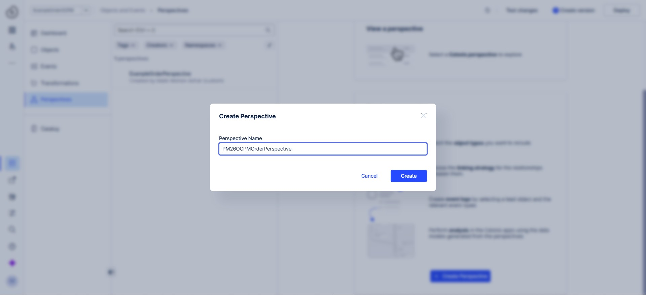
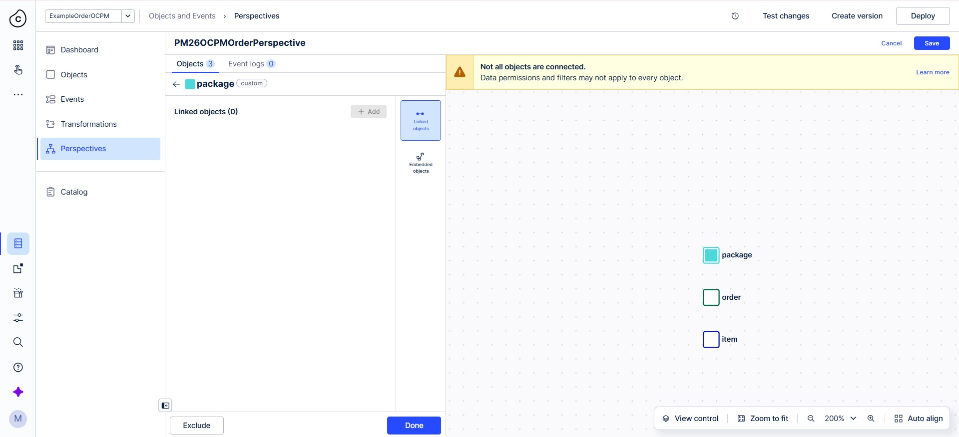
Master of Science (M.Sc.) in Digital Sciences
A perspective of our own
1
2
Name: PM26OCPMOrderPerspective (letters and numbers only)
We added item, order and package
Celonis detected the object relationships itself
WHY Only the objects in a perspective appear in its analysis.
Technical Dashboard Creation in Celonis
Process Mining
26

Slide 27
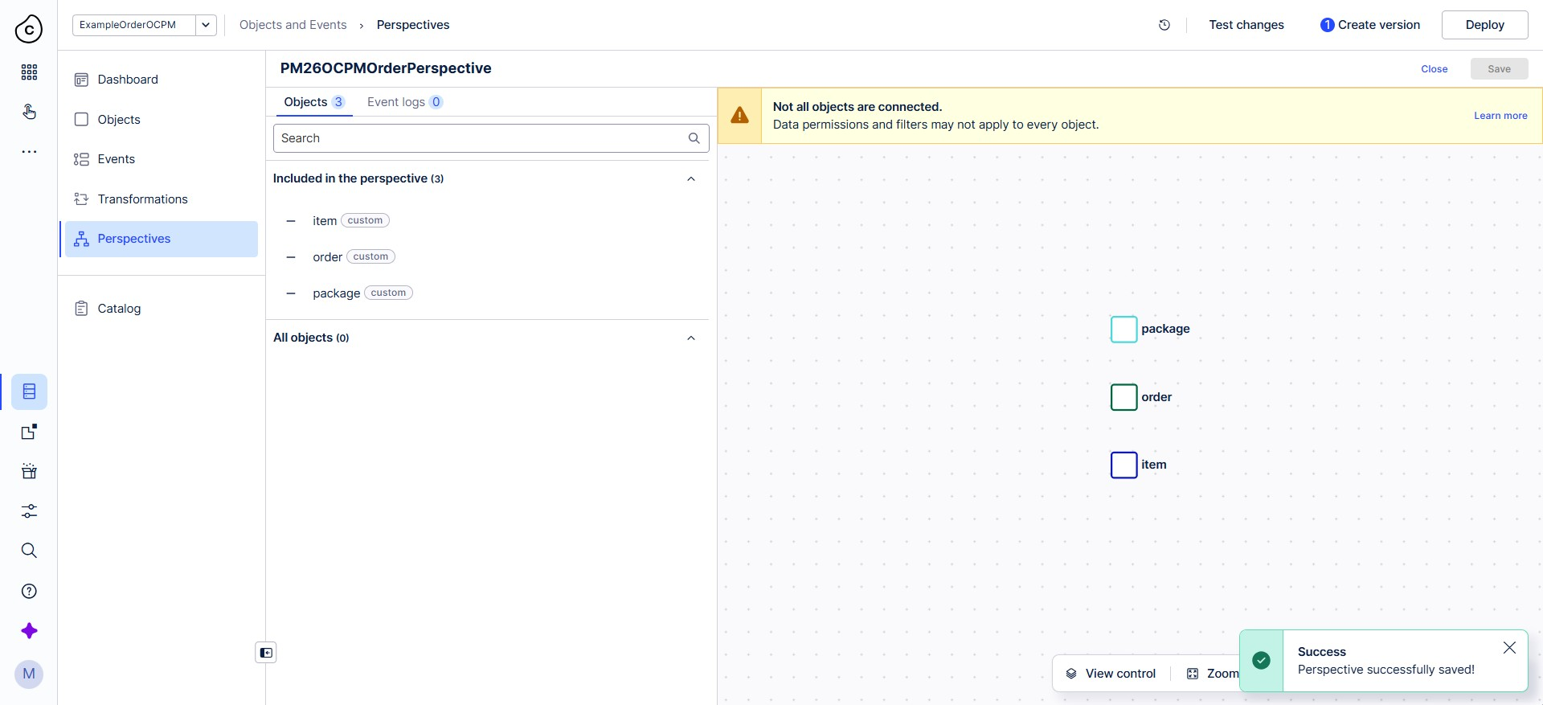
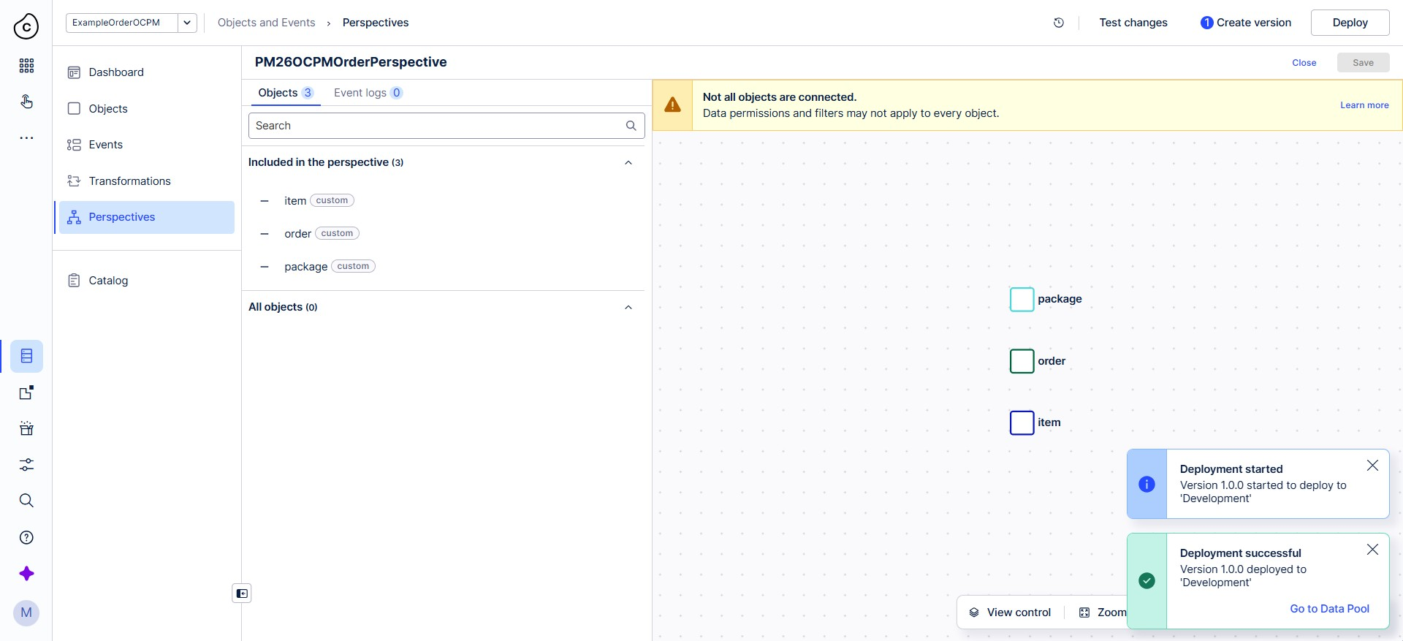
Master of Science (M.Sc.) in Digital Sciences
Save and deploy the perspective
1
2
Saved: Perspective successfully saved
Deployed to the target Development
Notifications: deployment started, then successful
WHY Deployment makes the perspective available as a deployed asset.
Technical Dashboard Creation in Celonis
Process Mining
27

Slide 28
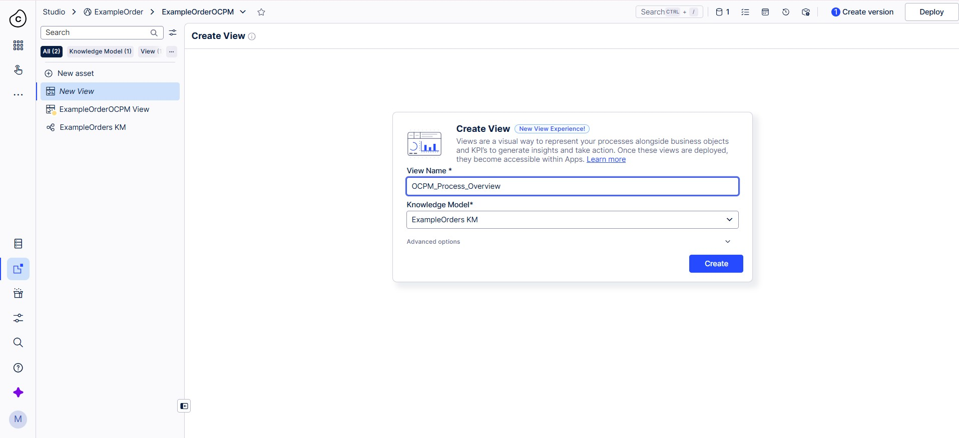
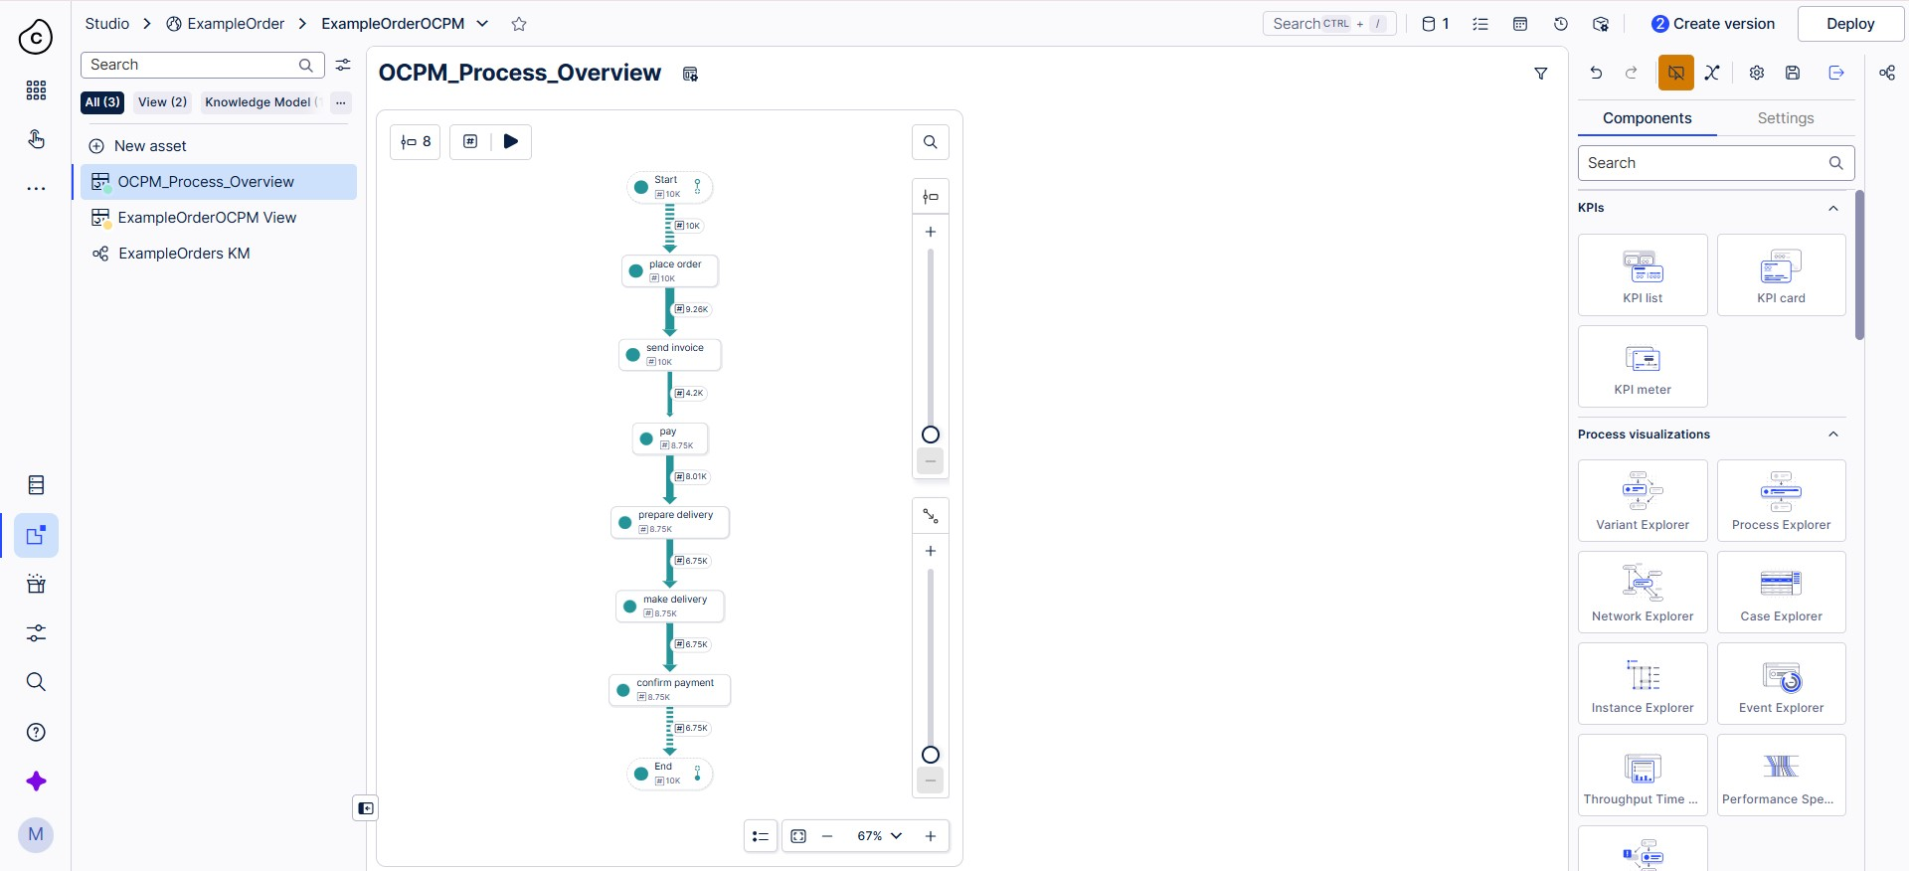
Master of Science (M.Sc.) in Digital Sciences
A new view in the example package
1
2
Package ExampleOrderOCPM is provided by Celonis
New view OCPM_Process_Overview, built from scratch
It uses the ExampleOrders knowledge model: the same order data as in Part 2
WHY The object-centric part is the perspective; the dashboard analyses the same order data.
Technical Dashboard Creation in Celonis
Process Mining
28

Slide 29
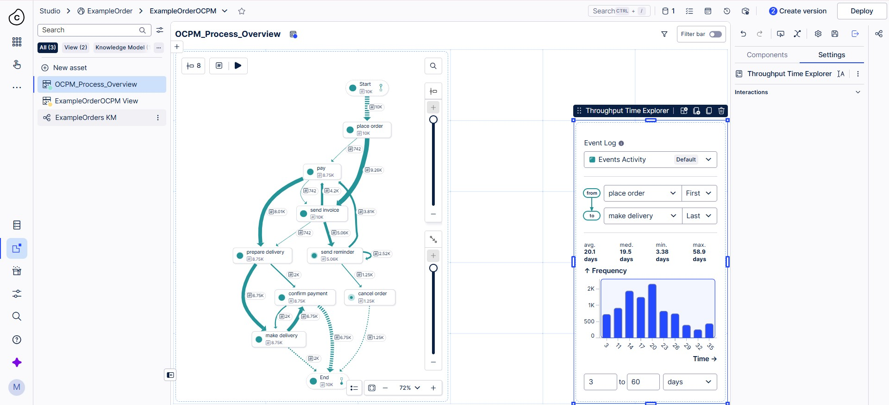
Master of Science (M.Sc.) in Digital Sciences
Throughput Time Explorer
From place order (first) to make delivery (last)
Average 20.1 days, median 19.5 days
Minimum 3.38 days, maximum 58.9 days
WHY The map shows what happens; throughput time shows how long it takes.
Technical Dashboard Creation in Celonis
Process Mining
29

Slide 30
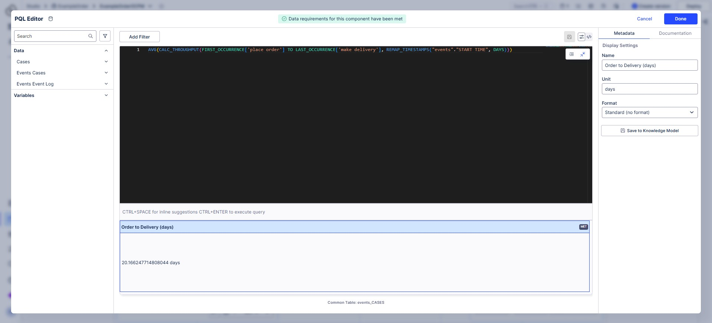
Master of Science (M.Sc.) in Digital Sciences
PQL KPI: Order to Delivery
AVG(CALC_THROUGHPUT(FIRST_OCCURRENCE['place order'] TO LAST_OCCURRENCE['make delivery'], REMAP_TIMESTAMPS("events"."START TIME", DAYS)))
Result: 20.17 days
CALC_THROUGHPUT: time between two events
REMAP_TIMESTAMPS: converts to days
Matches the widget average (20.1 days)
WHY Our own formula agrees with the built-in component, so it is correct.
Technical Dashboard Creation in Celonis
Process Mining
30

Slide 31
Master of Science (M.Sc.) in Digital Sciences
Interactive moment
???
Muhammad Suhan
Replace this slide with your own interactive element: a question to the audience, a short quiz or a live reveal.
Example Scenario: "An order has 3 items. How many cases do we get in a case-centric model, and how many in an object-centric one?" Reveal the difference with a drawing.
Technical Dashboard Creation in Celonis
Process Mining
31

Slide 32
Master of Science (M.Sc.) in Digital Sciences
What we learned
1
Check the preview
Look at the sample rows before choosing the activity table. Product names mean the wrong table.
2
Aggregate in PQL
KPI and chart values need COUNT, SUM or AVG. Check ratios against a second number.
3
One expression per field
Dimension and metric belong in separate editors, or the syntax breaks.
4
Unique names, versions
Space names must be unique, and deploy needs a version first.
Technical Dashboard Creation in Celonis
Process Mining
32

Slide 33
Master of Science (M.Sc.) in Digital Sciences
What we built
2
datasets
pizza log and 10,000 orders
3
KPIs
Total Cases, Cancellation Rate, Order to Delivery
1
perspective
objects: item, order, package
3
releases
pizza, orders and the new view
WHY The same stages carried us from a 1.28K-case warm-up to a 10,000-order dashboard and an object-centric view.
Technical Dashboard Creation in Celonis
Process Mining
33

Slide 34
Master of Science (M.Sc.) in Digital Sciences
References
Process Mining (PMI), WiSe 26/27, TH Köln: ILIAS course material and ProcessMining YouTube course
van der Aalst, W. (2016). Process Mining: Data Science in Action. Springer
van der Aalst, W. et al. (2012). Process Mining Manifesto. In: Business Process Management Workshops, Part I, LNBIP 99, pp. 169-194. Springer
Celonis documentation: PQL function CALC_THROUGHPUT, docs.celonis.com/en/calc_throughput.html
Dataset, screenshots and runbook (GitHub): Paste a link here
Technical Dashboard Creation in Celonis
Process Mining
34

Slide 35
Master of Science (M.Sc.) in Digital Sciences
AI-assisted workflow: prompts used
The prompts we used while building the dashboard and the answers we received.
Paste the chat here
Technical Dashboard Creation in Celonis
Process Mining
35

Slide 36
Master of Science (M.Sc.) in Digital Sciences
Thank you
Questions?
Malik Mohsin Azhar | Samira Aghajani | Muhammad Suhan
Technical Dashboard Creation in Celonis
Process Mining
36

