Slide 1
Part Two
Database Design

Slide 2
Chapter 6
Database Design and E-R Model

Slide 3
Design Process
Modeling
Constraints
E-R Diagram
Design Issues
Weak Entity Sets
Extended E-R Features
Design of the Bank Database
Reduction to Relation Schemas
Database Design
UML

Slide 4
Parts in Chapter 7
Part 1. DB/DBS/DBAS design process (§7.1/7.10 + Supplementary)
  DB design phases (§7.1)
    requirement analysis, conceptual design, logical design, physical design
  DBAS life-cycle model (生命周期模型)
Part 2. Entity-Relationship Model
  basic E-R model
    modeling elements (§7.2.1-7.2.3): entity sets, relationship sets, attributes
    constraints (§7.3.1-7.3.3): mapping cardinality, participation constraint, keys
    weak entity sets(§7.5.6)
    removing redundant attributes in entity sets (§7.4)
    E-R diagram(§7.5.1-7.5.5) and alternative notations(§7.9)

Slide 5
Parts in Chapter 6/7
  extended E-R Features (§7.8)
    (§7.8.1-7.8.4) OO features in E-R model, i.e specialization, generalization, attributes inheritance, constraints on generalization
    (§7.8.5) aggregation: relationship among relationships
Part 3. Reduction to Relational Schemas(§7.6, 7.8.6)
  mapping elements in E-R model to that in relational models, i.e. conceptual schema →initial logical schema
Part 4. E-R design issues (§7.7)
  when applying E-R model to model the objects in real worlds, some issues (considerations and principles) should be addressed, to guarantee DBS effectiveness and efficiency for data

Slide 6
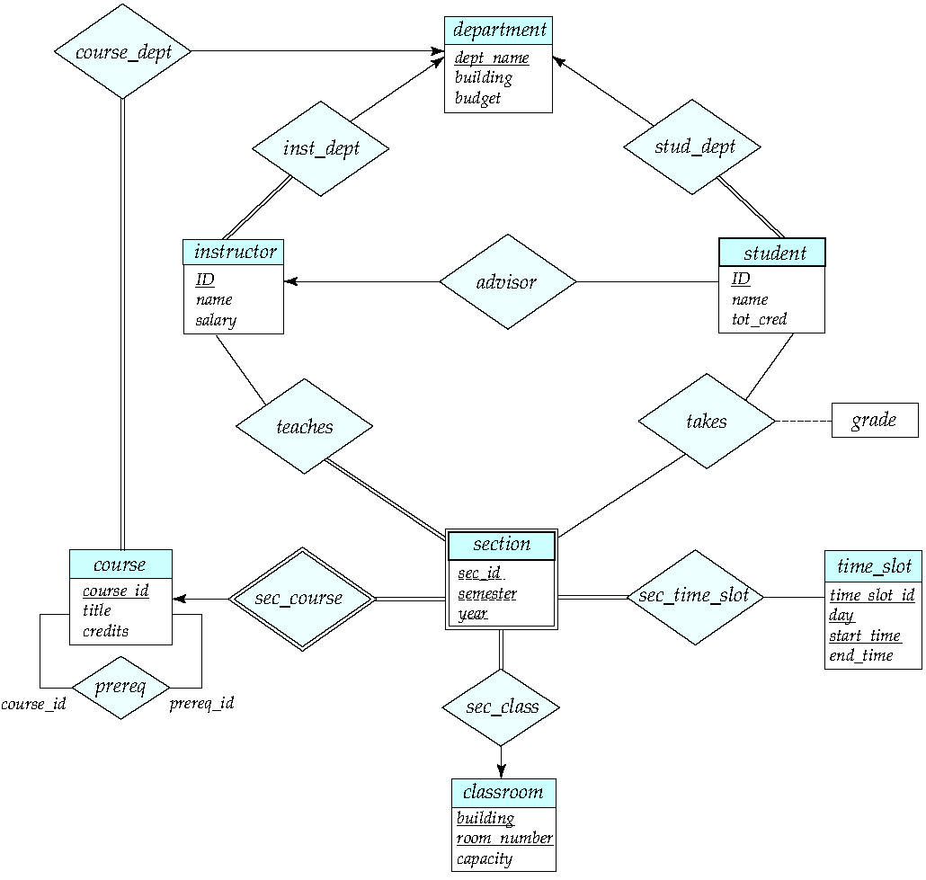
E-R Diagram for a University Enterprise

Slide 7
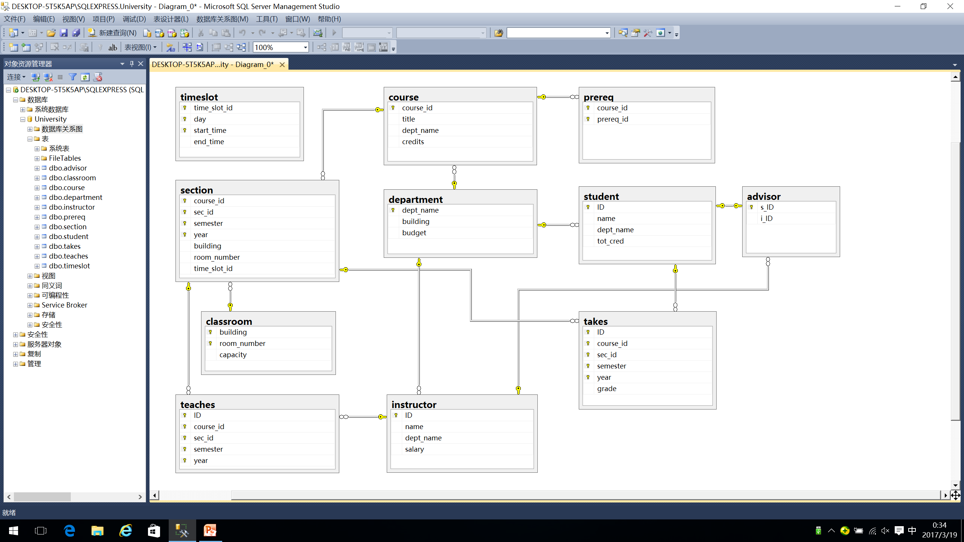
Relational schemas/tables in database systems

Slide 8
§7.1 Overview of the Design Process
Database design consists of two sequential phases
  analyzing of user requirements
    what data should be stored in the database
    what operations/transaction, such as insert, delete, update and retrieve are needed to conducted on these data
  designing of DB schemas , in accordance with the three-level of data abstract (refer to Fig. 1.1)
    conceptual design
    logical design, at the logical level and view level
    physical design, at the physical level
  refer to Fig.1.0.1

Slide 9
Application areas/problems
in real worlds
Requirements analysis
Specification of user requirements (需求分析说明书)
Conceptual DB design
DB conceptual schema , i.e. E-R diagram (chapter 6)
initial relational schema generating(§7.6)
Logical DB design
relational schema normalizing (chapter 8)
DB logical schema , i.e. relational data schema
Physical DB design
DB physical schema,
e.g. physical storage structure and access method (chapter 10, 11)
Fig. 7.0.1 DB design phases

Slide 11
Overview of the Design Process (cont.)
数据库应用系统DBAS设计
  DB, DBMS, users, application programs
  refer to Fig. 7.0.2 电信网管系统示意图
DBAS设计
  refer to Fig. 7.0.3 DBAS 生命周期模型
  参照软件工程中软件开发瀑布模型原理，DBAS的生命周期由项目规划、需求分析、系统设计、实现与部署、运行管理与维护等5个基本活动组成
  根据DBAS的软件组成和各自功能，分为数据组织与存储设计、数据访问与处理设计、应用设计三条设计主线，分别用于设计数据库、数据库事务和应用程序

Slide 12
Overview of the Design Process (cont.)
  根据数据库系统三级模式结构，DBAS设计阶段分为概念设计、逻辑设计、物理设计三个步骤，每一步设计内容涵盖了三条设计主线

Slide 13
人机界面模块
配置管理
性能管理
故障管理
安全管理
计费管理
配置数据
访问事务
性能数据
访问事务
故障数据
访问事务
安全数据
访问事务
计费数据
访问事务
ODBC/JDBC 数据库接口
SQL SERVER/DB2数据库管理系统
数据库DB：
配置数据、性能数据、故障数据
、安全数据、计费数据
Fig. 7.0.2 电信网管系统示意图

Slide 14
项目规划
规划与分析
数据组织与存储
数据访问与处理
应用 程序
性能/存储/安全需求
需求分析
数据项分析
数据流与事务分析
程序需求分析
概念
设计
DB概念模式设计
系统总体设计
设计
逻辑
设计
DB逻辑模式设计
事务概要设计
程序概要设计
物理
设计
DB物理模式设计
事务详细设计
程序详细设计
构造原型(可选)
系统实现
系统实现
和部署
数据转换与加载
系统测试、部署与交付
运行维护
系统运行维护
Fig. 7.0.3 DBAS 生命周期模型

Slide 15
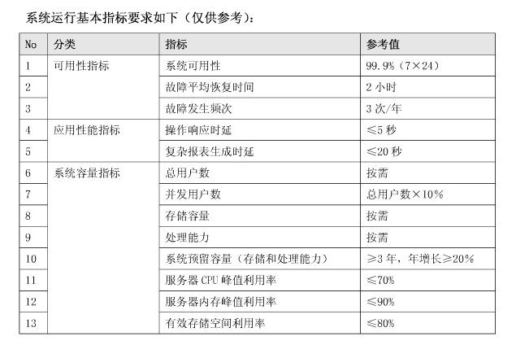
中国移动网管支撑系统规范CMOSS2.0——性能指标要求

Slide 16
7.2 The Entity-Relationship Model
The ER data mode was developed to facilitate database design by allowing specification of an enterprise schema that represents the overall logical structure of a database.
The ER model is very useful in mapping the meanings and interactions of real-world enterprises onto a conceptual schema Because of this usefulness, many database-design tools draw on concepts from the ER model
The ER data model employs three basic concepts
  entity sets
  relationship sets
  attributes
The ER model also has an associated diagrammatic representation, the ER diagram, which can express the overall logical structure of a database graphically

Slide 17
E-R 模型 vs 知识图谱
2018年校内信息化创新应用项目申报指南
  研究内容：
  研究知识图谱技术在智慧校园平台中的应用
    1. 对院系、课程、教师、科研方向等重要的实体建立图
    2. 利用校园网内部的数据和外网的数据，深入挖掘这些实体的关联和隶属关系
，为学科建设和校务决策提供支撑。
知识图谱（Knowledge Graph）
  机器学习，自动建立

Slide 18
7.2.1 Entity Sets（实体集，实体型）
An entity is an object that exists and is distinguishable from other objects.
  Example: a specific person, company, event, plant
An entity set is a set of entities of the same type that share the same properties.
  Example: set of all persons, companies, trees, holidays
An entity is represented by a set of attributes; i.e., descriptive properties possessed by all members of an entity set.
  Example:
  instructor = (ID, name, street, city, salary )
  course= (course_id, title, credits)
A subset of the attributes form a primary key of the entity set; i.e., uniquely identifying each member of the set.

Slide 19
Entity Sets (cont.)
A entity consists of all values of its all attributes
  e.g. Fig 7.1
Entity-set
customer-set = {< ID-value, name-value, street - value,
city -value>
| ID-value ∈D₁, name-value ∈D₂,
street -value∈D₃, city -value D₄}
⊆ D₁ ╳ D₂ ╳ D₃ ╳ D₄

Slide 20
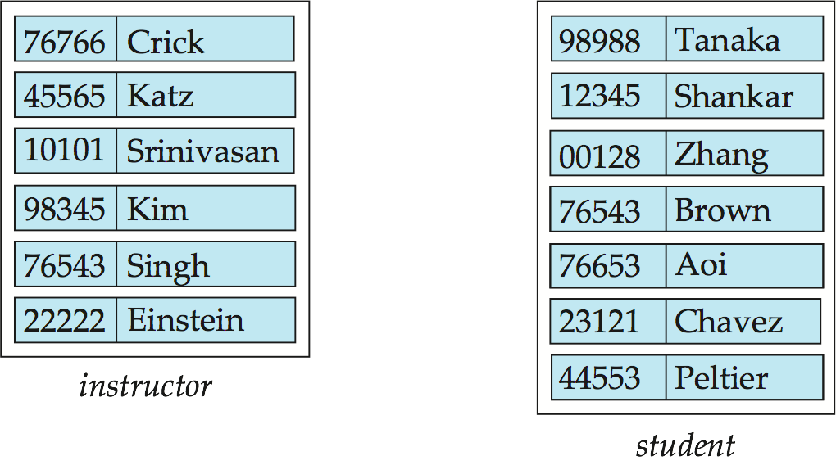
Entity Sets
instructor_ID instructor_name student-ID student_name

Slide 21
§7.2.2 Relationship Sets
A relationship is an association among several entities
Example:
44553 (Peltier) advisor 22222 (Einstein)
student entity relationship set instructor entity
A relationship set is a mathematical relation among n ≥ 2 entities, each taken from entity sets
{(e₁, e₂, … e_{n}) | e₁ ∈ E₁, e₂ ∈ E₂, …, e_{n} ∈ E_{n}}
where (e₁, e₂, …, e_{n}) is a relationship
  Example:
  (44553,22222) ∈ advisor
  note: more than one relationship set among the same entity sets

Slide 22
Relationship Sets (cont.)
The entity sets E₁, E₂, …, E_{n} participate in relationship set R
A relationship instance in an E-R schema represents an association between the named entities in the real-world enterprise that is being modeled
  e.g. in Fig. 7.2, the relationship instance between Crick and the Tanaka

Slide 23
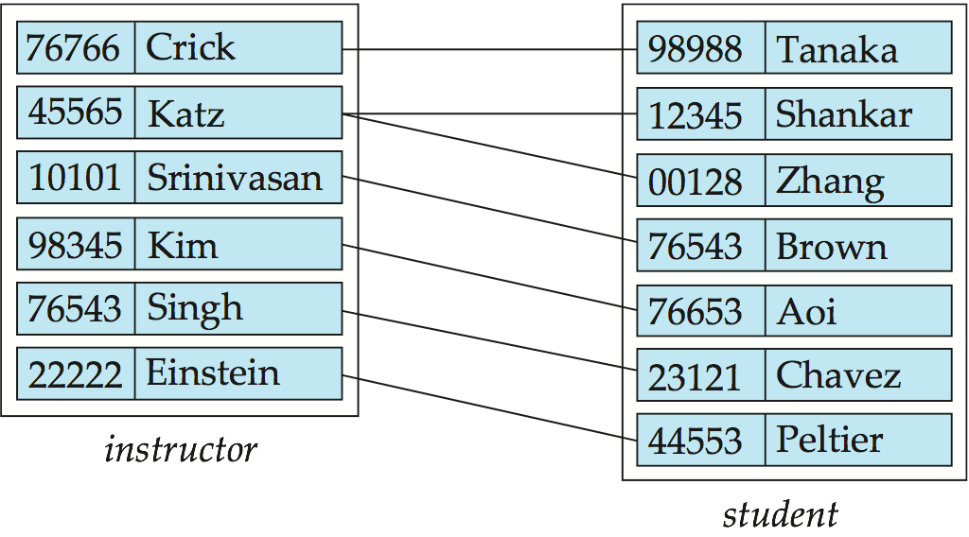
Relationship Set advisor
Fig.7.2

Slide 24
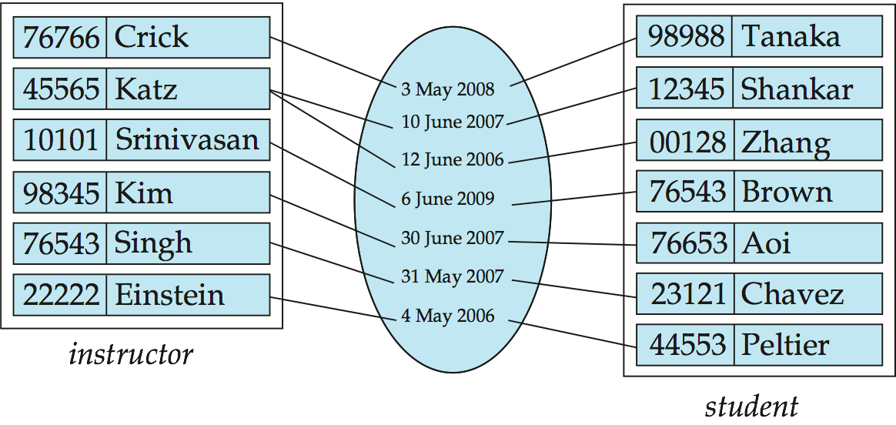
Relationship Sets (Cont.)
An attribute can also be associated with a relationship set.
For instance, the advisor relationship set between entity sets instructor and student may have the attribute date which tracks when the student started being associated with the advisor

Slide 25
Degree of a Relationship Set
Binary relationship
  involve two entity sets (or degree two).
  most relationship sets in a database system are binary.
Relationships between more than two entity sets are rare. Most relationships are binary. (More on this later.)
  Example: students work on research projects under the guidance of an instructor
  relationship proj_guide is a ternary relationship between instructor, student, and project

Slide 26
Relationship Sets (cont.)
∈⊇⊆
Role
  the functions that an entity plays in a relationship is called that entity’s role
teaching
听课者
讲授者
instructor
student

Slide 27
§7.2.3 Attributes
The domain or value set of the attribute
  the set of permitted values for the attribute
Attribute types:
  simple and composite attributes.
  single-valued and multivalued attributes
    Example: multivalued attribute: phone_numbers
  derived attributes
    Can be computed from other attributes
    Example: age, given date_of_birth

Slide 28
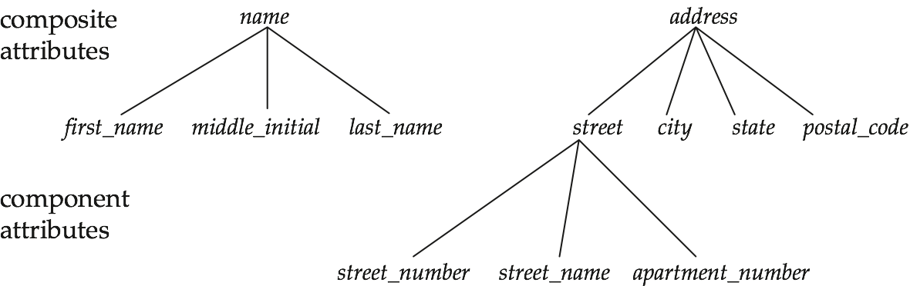
Composite Attributes

Slide 29
Attributes (cont.)
Null value for a attribute means
  the attribute “ not applicable “ for the entity, not existing
  the value for the attribute exists, but is “unknown”

Slide 30
Redundant Attributes
Suppose we have entity sets:
  instructor, with attributes: ID, name, dept_name, salary
  department, with attributes: dept_name, building, budget
We model the fact that each instructor has an associated department using a relationship set inst_dept
The attribute dept_name appears in both entity sets. Since it is the primary key for the entity set department, it replicates information present in the relationship and is therefore redundant in the entity set instructor and needs to be removed.
BUT: when converting back to tables, in some cases the attribute gets reintroduced, as we will see later.

Slide 31
§7.3 Constraints
Semantic/constraints
  as integrity constraints in DBS, to maintain DBS consistency
Integrity constraints in E-R model, on E or R
  keys (§7.3.3)
  mapping cardinalities (§7.3.1)
  participation-constraints (§7.3.2)
  cardinality limits

Slide 32
7.3.1 Mapping Cardinalities
Mapping cardinalities
  semi-quantitatively expressing the number of entities to which another entity can be associated via a relationship set
For a binary relationship set R, the mapping cardinality must be one of the following types: Fig.7.5, Fig.7.6, from A to B
  one to one
  one to many
  many to one
  many to many

Slide 33
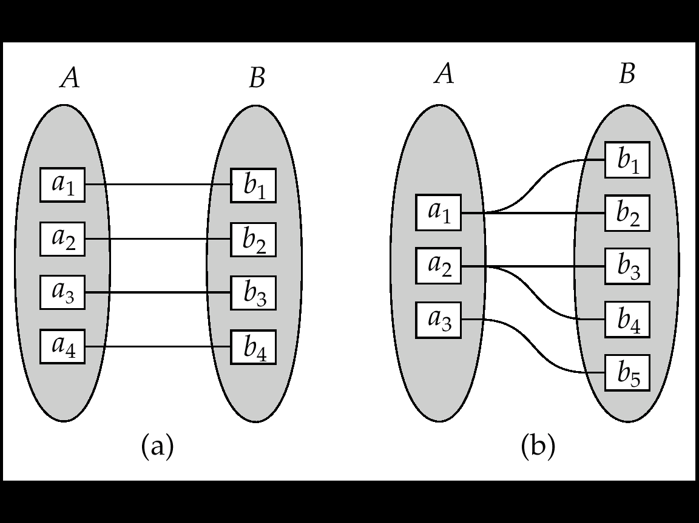
        注意many-to-one和one-to-many 定义和方向！
a₅
a₄
One to one
One to many
Note: some elements in A or B may not be mapped to any
elements in the other set
Fig. 7.5 Mapping cardinalities

Slide 34
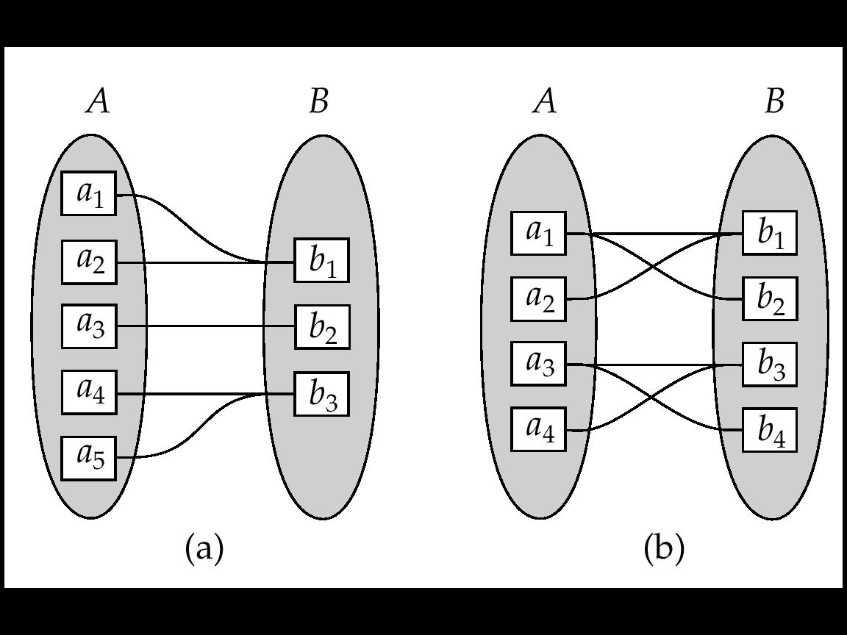
        注意many-to-one和one-to-many 定义和方向！
b₄
Many to one
Many to many
Note: Some elements in A or B may not be mapped to any
elements in the other set
Fig. 7.6 Mapping cardinalities

Slide 35
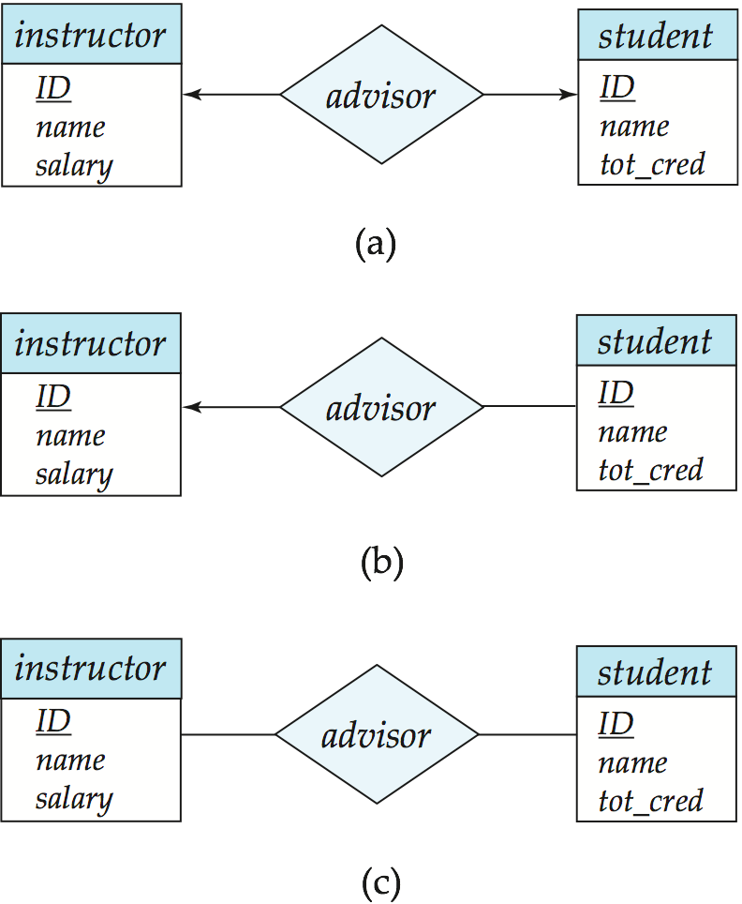
Cardinality Constraints
We express cardinality constraints by drawing either a directed line (→), signifying “one”， or an undirected line (—), signifying “many” between the relationship set and the entity set.
One-to-one relationship between an instructor and a student :
  A student is associated with at most one instructor via the relationship advisor
  A student is associated with at most one department via stud_dept

Slide 36
One-to-Many Relationship
one-to-many relationship between an instructor and a student
  an instructor is associated with several (including 0) students via advisor
  a student is associated with at most one instructor via advisor,

Slide 37
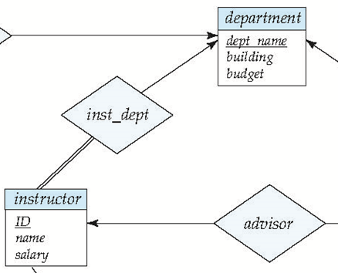
Many-to-One Relationships
In a many-to-one relationship between an instructor and a department,
  an instructor is associated with at most one department via inst_dept,
  and a department is associated with several (at least one) instructor via inst_dept

Slide 38
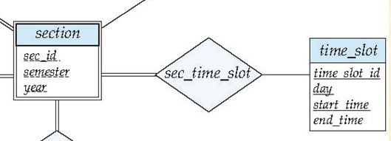
Many-to-Many Relationship
A section is associated with several (at least one) timeslots via sec_time_slot
A timeslot is associated with several (possibly 0) sections via sec_time_slot

Slide 39
7.3.3 Keys
Key is a set of attributes ( of a entity set or relationship set)
, in which there are one or more attributes
  the values of these attributes in one entity can be used to uniquely distinguish this entity from others , or
  the values of these attributes in one relationship are used to uniquely identify the relationship
Keys include
  superkey (超键), candidate key (候选键), primary key (主键)

Slide 40
Keys For Entity Sets
A super key of an entity set is a set of one or more attributes, whose values uniquely determine each entity in the entity set
  e.g. {instructor_id , instructor_name}
  the super key may contain extraneous attributes
    e.g instructor_name
A candidate key is the minimal super key
  non-redundant super key
    e.g. instructor-id is the candidate key of instructor

Slide 41
Keys For Entity Sets (cont.)
The primary key is a candidate key chosen by the database designer as the principal means of identifying entities within an entity set
  although several candidate keys may exist, one of the candidate keys is selected to be the primary key
  need to consider semantics of relationship set in selecting the primary key in case of more than one candidate key
构造关系表时，如果有多个候选键，最好选取数值型（int, float）候选键作为关系表主键，便于提高基于主键的查询速度
—不要选字符串型属性，如varchar、datetime
—e.g. studentname, instructorName

Slide 42
Keys For Relationship Sets
Keys for relationship sets R on entities E₁, E₂, …, E_{n}
  R = {(e₁, e₂, …, e_{n}) | e₁∈E₁,…, e_{n}∈E_{n}}
⊆E₁ ╳ E₂ ╳ … ╳ E_{n}
  , how to uniquely distinguish each relationship instances {(e₁, e₂, …, e_{n}) ?
  R is the combination of E₁, E₂, …, E_{n}, each E_{i} can be uniquely distinguished by primary_key(E_{i}), 1 ≤i ≤n, so the set of all attributes in primary_key(E₁), primary_key(E₂), …, primary_key(E_{n}) can be used to recognize (e₁, e₂, …, e_{n})

Slide 43
Keys For Relationship Sets (cont.)
The super_key for R
  primary_key(E₁) ∪ primary_key(E₂) ….∪ primary_key(E_{n})
  e.g. in Fig.7.3, (InstructorID, StudentIDr) is the super key of advisor
  note
    if the attribute names of primary-keys are not unique, the attributes with the same names should be renamed
The candidate keys for R
  minimal, non-redundant super keys

Slide 44
Keys For Relationship Sets (cont.)
The candidate keys or the primary key for a binary relationship set R among entity sets A and B can be decided as follows, in accordance with the mapping cardinality of R
  R is many-to-many,
  primary_key(R) = primary_key(A) ∪ primary_key(B)
  R is many-to-one from A to B, !!
  primary_key(R) = primary_key(A)
  R is one-to-many, !!
  primary_key(R) = primary_key(B)

Slide 45
Keys For Relationship Sets (cont.)
  R is one-to-one,
  primary_key(R) = primary_key(A)
  or: primary_key(R) = primary_key(B)

Slide 46
7.3.3 Participate Constraints
The participation of an entity E in a relationship R is total, if
  every entity in E participates in at least one relationship in R
  e.g. participation of instructor in inst_dept is total
    refer to Fig.7.15
    every instrctor must have a department associated to it via inst_dept
The participation of an entity E in a relationship R is partial, if
  some entities in E may not participate in any relationship in R
  e.g. participation of student in advisor is partial, because some students maybe have no advisors
    refer to Fig.7.15

Slide 47
Participate Constraints (cont.)
.
.
R
R
A
B
A
B
(a) partial participation
(b) total participation
Fig. 7.0.4 Total/participation participation

Slide 48
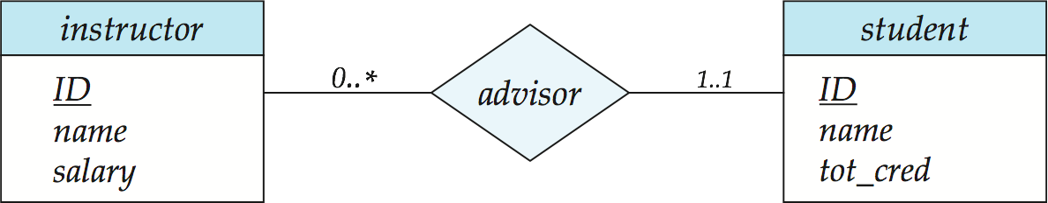
Cardinality Limits for Participation
(§7.5.2, pp277)
Cardinality limits (参与的基数界限) are used to express quantitative constraints on participation
E.g. instructor, student, advisor
  每个student最少有1个指导instructor，最多也只有1个指导instructor
  每个instructor最多可以指导多个student, 最少可以指导0个student
Fig.7.10
Instructor can advise 0 or more students. A student must have 1 advisor; cannot have multiple advisors

Slide 49
Cardinality Limits for Participation
/* 设联系R关联了entity sets A和B, 为定量描述A参与R的 total/partial participation 和A中的entity与B中的entity的mapping cardinality, 引入实体参与联系的cardinality limits
A参与R的基数下界l_{A}和上界h_{A} , refer to Fig.7.0.5
  A中的每个实体a通过R关联了最少l_{A}个、最多h_{A}个B中实体b
    l_{A} : 对A中的每个实体a, B中至少有l_{A}个实体b通过R与其对应/关联
    h_{A}:对A中的每个实体a, B中至多有h_{A}个实体b通过R与其对应/关联

Slide 50
A
R
B
l_{A}….h_{A}
l_{B}….h_{B}
a₁
b₁
b₂
a₂
b₃
…
b_{j}
a₃
…
…
b_{n-1}
a_{m}
b_{n}
l_{A}=1, h_{A}=3
l_{B}=0, h_{B} =2
Fig.7.0.5 Illustration for cardinality limits

Slide 51
Cardinality Limits for Participation
(cont.)
Note
  A maximum value of * indicates no limit
  in some textbooks, < l_{A} ,h_{A} > is put at the side of the entity B
Cardinality limits vs total/partial participation
  A minimum value l_{A} =0: A is partial participation of R
  A minimum value l_{A} > 0: A is total participation of R, equivalent to double line

Slide 52
Cardinality Limits for Participation
(cont.)
Cardinality limits vs mapping cardinality
  设联系R关联了实体集A和B, 利用A的基数界限<l_{A} , h_{A}>中的h_{A} 、B的基数界限<l_{B} , h_{B}>中的h_{B} , 可推导出联系R的映射基约束
  < h_{B} , h_{A} > 表示了联系R的从A到B的映射基约束 !!!!
  e.g. in Fig.7.10 , considering mapping cardinality form instructor to student
    mapping cardinality form instructor to student an depends on <h_{student}, h_{instructor}>
    for customer, h_{student}=1, for instructor, h_{instructor} =*
    so, <h_{student}, h_{instructor}> = <1, *>, and is one to many

Slide 53
Cardinality Limits for Participation
(cont.)
The associations between cardinality limits and the mapping cardinality are classified as follows, and illustrated by Fig.7.0.6

Slide 54
a₄
b₅
From A to B, one to one (1:1),
<l_{A} , h_{A} > = <1, 1>,
<l_{B} , h_{B} > = <0, 1>;
From A to B, one to many (1:2),
<l_{A} , h_{A} > = <0, 2>,
<l_{B} , h_{B} > = <1, 1>
Fig.7.0.6-1 Associations between cardinality
limits and mapping cardinality

Slide 55
Form A to B, many to one (2:1),
<l_{A} , h_{A} > = <1, 1>,
<l_{B} , h_{B} > = <1, 2>
Form A to B, many to many (2:2)
<l_{A} , h_{A} > = <1, 2>
<l_{B} , h_{B} > = <1, 2>

Slide 56
§7.5.6 Weak Entity Sets
An entity set that does not have a primary key is referred to as a weak entity set
  e.g. section(sec_id, semester, year) in Fig.7.14 in next slide, and Fig. 7.0.10
A weak entity set E₁ can only be distinguished through another (strong) entity set E₂, called identifying/owner entity set, which has association/ relationship R with E₁
  E₂ owns E₁ , E₁ must be related to E₂ via an instance of R, called the identifying relationship.
  R is many-to-one ( or one-to-one) from the weak entity set E₁ to the identity set E₂

Slide 57
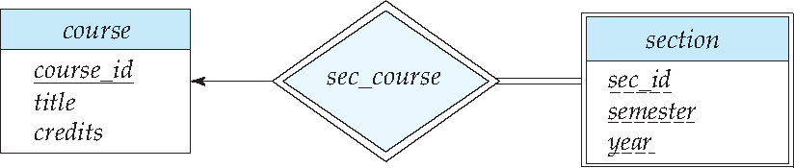
Weak Entity Sets (cont.)
  E₁ is of total participation in the relationship set R
  R is depicted using a double diamond
  weak entity set is depicted as double rectangles.
total
E₂
one
E₁
many
Fig.7.14 E-R diagram with a weak entity set

Slide 58
E₂:course
E₁:section/course-offering
(周1/3-4, Spring, 2021)
(#1, DBS, 3)
(周4/1-2, Spring, 2021)
(#2, Algorithm, 2)
(周1/3-4, Spring, 2021)
(周2/3-4, Spring, 2021)
(#3, OS, 4)
(周4/1-2, Spring, 2021)
one
many
Fig.7.0.10 A example of weak entity set

Slide 59
Weak Entity Sets (cont.)
The discriminator (or partial key) of a weak entity set is the set of attributes that distinguishes among all those entities in the weak entity set that depending on a particular strong entity
  e.g. sec_id, semester, year
  the discriminator of a weak entity set is underlined with a dashed line

Slide 60
Weak Entity Sets (cont.)
The primary key of a weak entity set is formed by the primary key of the strong entity set on which the weak entity set is existence dependent, plus the weak entity set’s discriminator
  primary key for weak entity set E₁
  = discriminator ∪ primary_key(E₂) .
  e.g. sec_id, semester, year, course_id
Weak entity set E₁ with several identifying entity sets E₂, E₃, .., E_{n}, primary key for weak entity set E₁ =
discriminator ∪ primary_key(E₂) ∪… primary_∪key(E_{n}) .

Slide 61
§7.5 E-R diagrams
Rectangles represent entity sets
Diamonds represent relationship sets
Lines link attributes to entity sets and entity sets to relationship sets.
Ellipses represent attributes
  double ellipses represent multivalued attributes
  dashed ellipses denote derived attributes
Underline indicates primary key attributes
Double rectangles represent weak entity sets

Slide 62
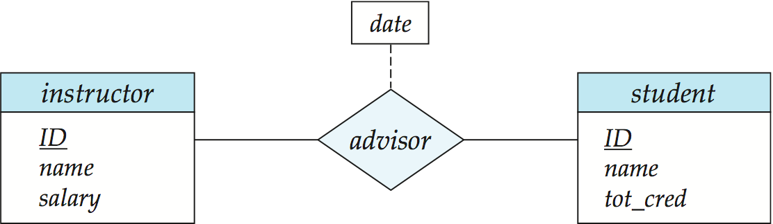
Relationship Sets with Attributes

Slide 63
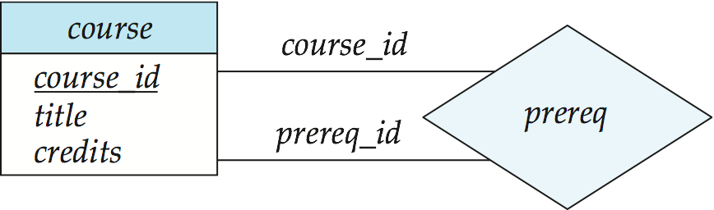
Roles
Entity sets of a relationship need not be distinct
  Each occurrence of an entity set plays a “role” in the relationship
The labels “course_id” and “prereq_id” are called roles.

Slide 64
Cardinality Constraints
We express cardinality constraints by drawing either a directed line (→), signifying “one,” or an undirected line (—), signifying “many,” between the relationship set and the entity set
One-to-Many Relationship

Slide 65
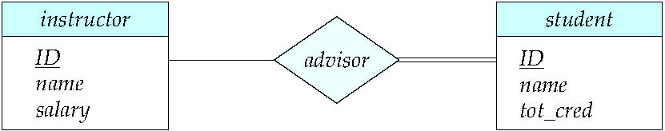
Total and Partial Participation
Total participation (indicated by double line): every entity in the entity set participates in at least one relationship in the relationship set
  participation of student in advisor relation is total
    every student must have an associated instructor
Partial participation: some entities may not participate in any relationship in the relationship set
  Example: participation of instructor in advisor is partial

Slide 66
Cardinality Limits
A line may have an associated minimum and maximum cardinality, shown in the form l..h, where l is the minimum and h the maximum cardinality
  A minimum value of 1 indicates total participation.
  A maximum value of 1 indicates that the entity participates in at most one relationship
  A maximum value of * indicates no limit.
Instructor can advise 0 or more students. A student must have 1 advisor; cannot have multiple advisors

Slide 67
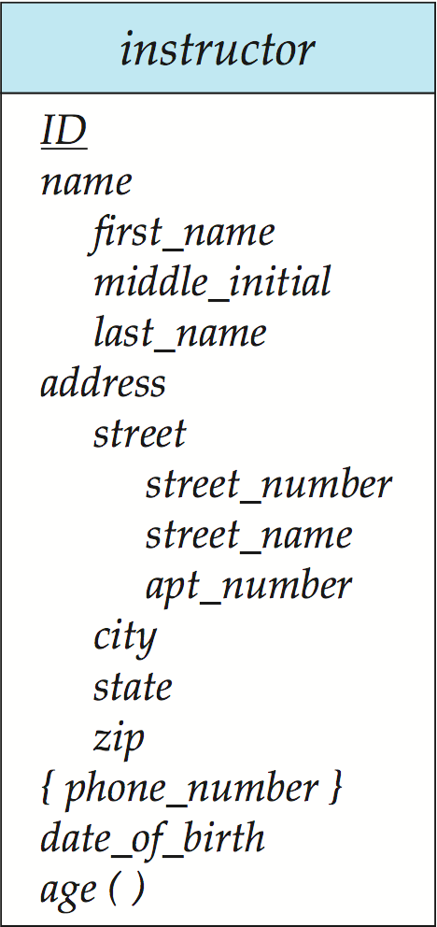
Entity with Complex Attributes

Slide 68
Expressing Weak Entity Sets
In E-R diagrams, a weak entity set is depicted via a double rectangle.
We underline the discriminator of a weak entity set with a dashed line.
The relationship set connecting the weak entity set to the identifying strong entity set is depicted by a double diamond.
Primary key for section :
(course_id, sec_id, semester, year)

Slide 69
E-R diagrams (cont.)
标注规则！！！
  由联系发出的有向箭头指向one 所对应的实体，无向线段指向many端所对应的实体。
  只有在many-to-many的情况下，E-R图中联系与实体间的线段 全部是无向线段，其他三种情况下必出现有向线段

Slide 70
§7.7 E-R Design Issues
7.7.1 Use of entity sets vs. attributes
Mapping “thing/object” in real world into entity sets or attribute sets
  e.g. for instructor and phone objects in real world
    model 1. entity:
    instructor(ID, name, salary, phone-number)
    implying that employees have precisely one phone number each, on less phone-number is multivalued;
    how to represent the other properties of “phone” object ?

Slide 71
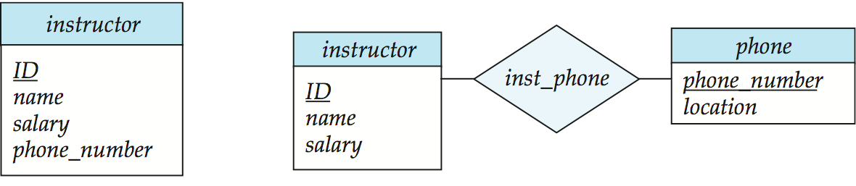
(a) model1
(b) model2
Fig.7.17 Alternatives for adding phone to the instructor entity set
    model 2. entity: instructor(ID, name, salary)
    phone(phone-number, location, …)
    relationship: inst-phone
Treating phone as an entity is more general, more information about phone can be modeled, e.g.
  Location
  plus multiple phone numbers

Slide 72
Entity Sets vs. Attributes (cont.)
Rule1. Not to use the primary-key of an entity set as an attributes of another entity set (to represent implicitly association between these two entity sets), it is better to use an relationship set to explicitly show this association
  e.g. for the entity student, do not use instructor.id as its attribute, in stead of, representing association among student and instructor using relationship advisor

Slide 73
Entity Sets vs. Attributes (cont.)
Rule2. If E participate in R, not to designate the primary-key(E) as attributes of R, to avoid information redundancy
  for example, an ill modeling of advisor
inst_id
student_ID
Fig.7.0.7 Anti-example:
Data redundancy in advisor

Slide 74
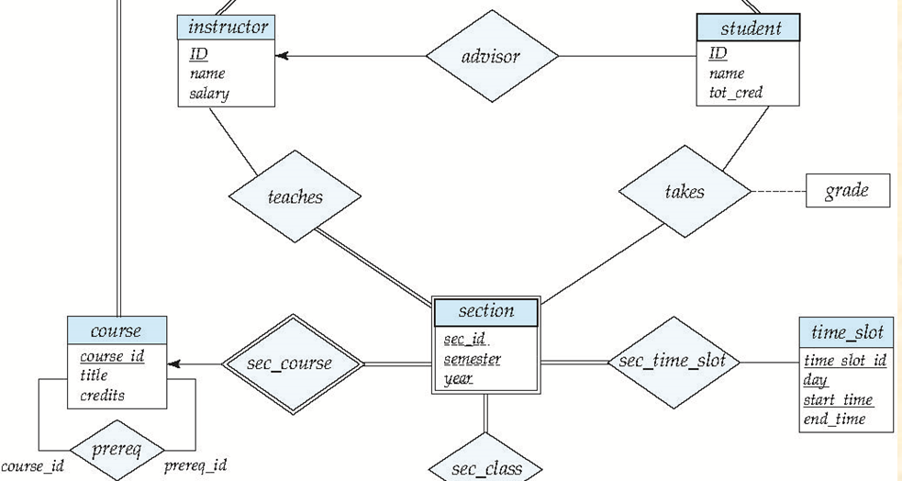
7.7.2 Use of Entity Set vs. Relationship Set
Rule3. Use the relationship set to describe the action occurring between entities
  e.g.
in Fig.7.15 the takes relationship is used to model the situation where a student takes a section of a course

Slide 75
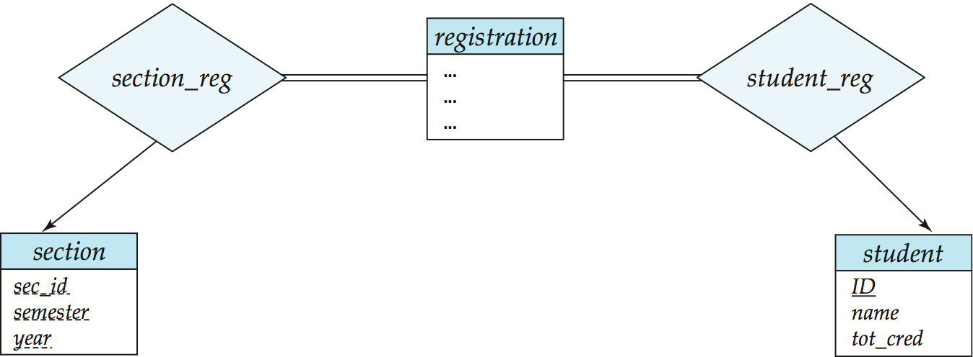
Entities vs. Relationship sets
An alternative is to design a course-registration record, represented by a entity set named registration, for each course that each student takes
In Fig.7.18, more information can be associated with the entity set registration than the relationship set takes
Fig.7.18
Notes:
75

Slide 76
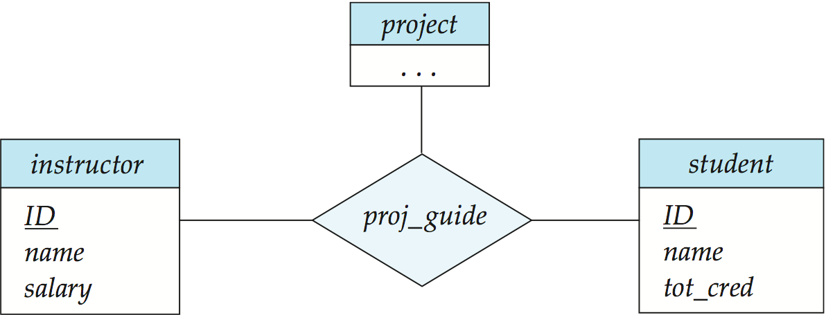
7.7.3 Binary vs N-ary Relationship Sets
Rule4. Prefer to using the binary relationship set, and replace a non-binary relationship set by a number of binary relationship set if possible
  child-father-mother is replaced with
  child-father, child-mother and husband-wife

Slide 77
Binary vs N-ary Relationship Sets
Translating a non-binary relationship set into several binary relationship sets
  for 3-ary relationship set R = {(a_{i} , b_{i} , c_{i} ) | a_{i} ∈ A , b_{i} ∈ B，c_{i} ∈ C }among entity sets A, B , C, i.e. R ⊆ A ╳ B ╳ C, replace R by an entity set E = { e_{i} } and three binary relationship set R_{a}, R_{b}, R_{c}

Slide 78
C
C
A
R
B
R_{c}
Attr-R
A
R_{a}
E
R_{b}
B
Attr-R
e
(a)
(b)
Fig.7.0.8 Non-binary relationship set translating

Slide 79
Binary vs N-ary Relationship Sets
(cont.)
    E = { e_{i} } , | E |= | R |, i.e. each (a_{i} , b_{i} , c_{i} ) in R corresponds to one e_{i} in E, or E = { e_{i} }=R={(a_{i} , b_{i} , c_{i} ) }
    R_{a} = { (e_{i} , a_{i}) | e_{i} ∈E , a_{i} ∈ A }, relating E and A
    R_{b} = { (e_{i} , b_{i}) | e_{i} ∈E , b_{i} ∈ B } , relating E and B
    R_{c} = { (e_{i} , c_{i}) | e_{i} ∈E , c_{i} ∈ B }, relating E and C
    E has an identifying attribute e ( candidate key) to distinguish each e_{i} in E
    all attributes of R, i.e. attr-R, are assigned to E
  refer to Fig.7.0.8 (a) , (b)

Slide 80
Cardinality Constraints on Ternary Relationship
略
We allow at most one arrow out of a ternary (or greater degree) relationship to indicate a cardinality constraint
For exampe, an arrow from proj_guide to instructor indicates each student has at most one guide for a project
If there is more than one arrow, there are two ways of defining the meaning.
  For example, a ternary relationship R between A, B and C with arrows to B and C could mean
    1. Each A entity is associated with a unique entity from B and C or
    2. Each pair of entities from (A, B) is associated with a unique C entity, and each pair (A, C) is associated with a unique B
  Each alternative has been used in different formalisms
  To avoid confusion we outlaw more than one arrow

Slide 81
7.7.4 Placement of Relationship Attributes
The attributes of a relationship sets R may be associated with one of its participating entity sets
For the attribute attr-A in relationship set R between E₁ and E₂ (R ⊆ E₁ ╳ E₂ , if the cardinality of R is
  one-to-one : attr-A can be assigned as the attribute of either E₁ or E₂, rather than relationship set R
  one-to-many from E₁ to E₂ : attr-A can only be assigned as the attribute of the entity set E₂ (the many-side), rather than the relationship set R

Slide 82
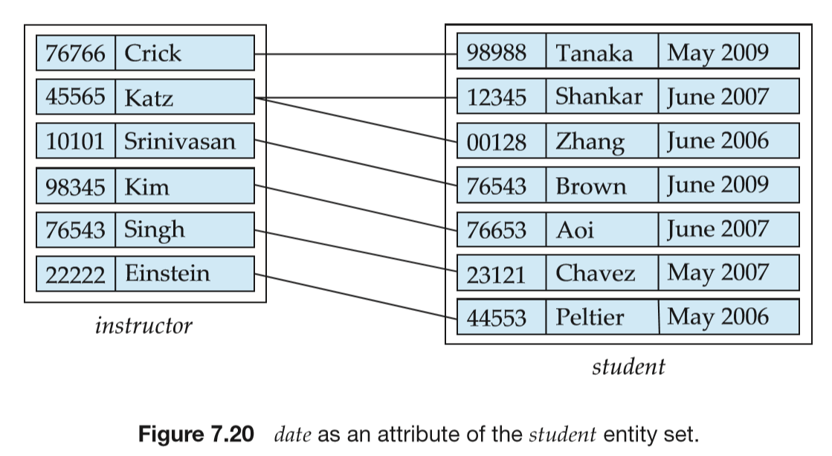
Placement of Relationship Attributes
    e.g. the relationship advisor in Fig.7.20 from instructor to student is one to many, the attribute date of advisor, which specifies when the instructor became the advisor of the student, can be made as an attribute of student, instead of the attribute of the relationship advisor

Slide 83
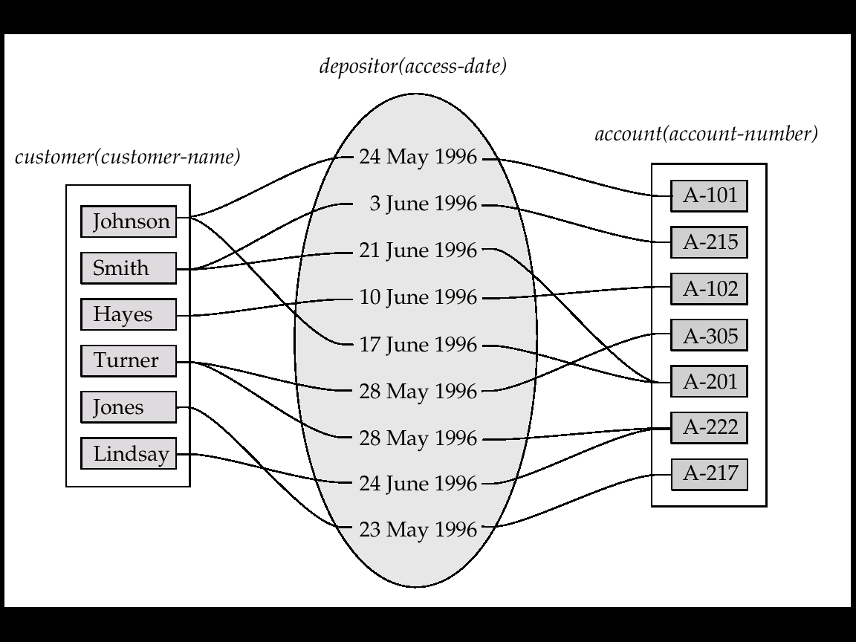
Placement of Relationship Attributes
    many-to-many: attr-A may only be assigned as the attribute of R, not of its participating entity sets E₁ or E₂
many
many
Fig.8.0.9 Access-date as attribute of the depositor relationship set

Slide 84
§7.8 Extended E-R model
Object-oriented (OO) E-R
  specialization (特化，特殊化，例化）
  generalization (概括化，泛化，普遍化)
  attributes inheritance (属性继承）
7.8.1 Specialization
Specialization
  top-down design process of designating subgroups within an entity set, according to differences between entities in the entity set, each subgroup is distinctive from other entities in the set

Slide 85
Specialization (cont.)
Refer to Fig.7.21
These subgroupings become lower-level entity sets that may have attributes or may participate in relationships that do not apply to the higher-level entity set
  attributes and relationships specific to the lower level entity sets
In the E-R model, specialization is depicted by a triangle component labeled ISA
  e.g. student “is a” person in Figure 7.21

Slide 86
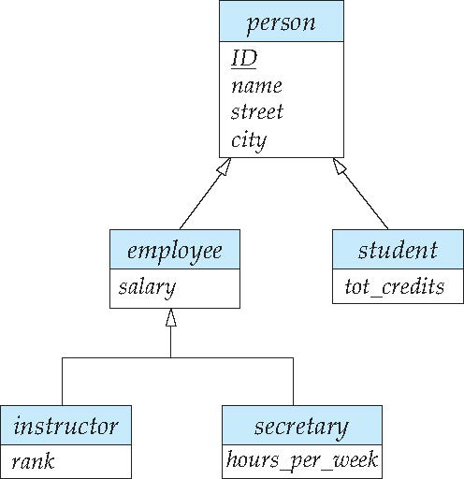
residence
takes
undergraduate
graduate
Overlapping – employee and student
Disjoint – instructor and secretary
Fig. 7.21 Specialization and generalization

Slide 87
7.8.2 Generalization
Generalization
  a bottom-up design process that combines a number of entity sets that share the same features into a higher-level entity set
  e.g. Fig.7.21
Specialization and generalization are simple inversions of each other; they are represented in an E-R diagram in the same way
  the terms specialization and generalization are used interchangeably

Slide 88
Superclass vs Subclass
The ISA relationship, or containment, is also referred to as superclass-subclass relationship
Superclass and subclass
  for the entity sets A and B, if A is the generalization of B, i.e. B is the specialization of A , then A is the superclass of B, and B is the subclass of A

Slide 89
7.8.3 Attribute Inheritance
A lower-level entity set inherits all the attributes and relationship participation of the higher-level entity set to which it is linked
  a higher-level entity’s attributes and relationship can apply to all of its lower-level entities

Slide 90
7.8.4 Constraints on Generation/Specialization
How to determine the membership of subclass/lower-level entities, i.e., how to divide superclass/higher-level entity set into lower-level entity sets
  condition-defined , attribute-defined generalization
    on the basis of explicit condition/predicate/attributes-value
    e.g. student_type= graduate, undergraduate
  user-defined
    e.g. all instructors are divided into four teams based on their assigned works, and each team becomes a subclass of the instructor entity set

Slide 91
Constraints on Specialization/Generalization
Completeness constraint -- specifies whether or not an entity in the higher-level entity set must belong to at least one of the lower-level entity sets within a generalization.
  total: an entity must belong to one of the lower-level entity sets, e.g. student generalization
  partial: an entity need not belong to one of the lower-level entity sets, e.g. .person specialization
Partial generalization is the default. We can specify total generalization in an ER diagram by adding the keyword total in the diagram and drawing a dashed line from the keyword to the corresponding hollow arrow-head to which it applies (for a total generalization), or to the set of hollow arrow-heads to which it applies (for an overlapping generalization).
The student generalization is total: All student entities must be either graduate or undergraduate. Because the higher-level entity set arrived at through generalization is generally composed of only those entities in the lower-level entity sets, the completeness constraint for a generalized higher-level entity set is usually total

Slide 92
Constraints on Generation/Specialization (cont.)
    depicted in E-R diagram as
H-entity-set
H-entity-set
total
partial
L-entity-set-1
L-entity-set-2
L-entity-set-1
L-entity-set-2
Fig.7.0.12 Completeness constraints

Slide 93
6.7.4 Constraints on Generation/Specialization (cont.)
Constraints on whether or not a high-level entity may belong to more than one lower-level entity set within a single specialization, e.g. in Fig. 7.21
  disjoint
    a high-level entity can belong to only one lower-level entity set, i.e., L-entity-set-1 ∩ L-entity-set-2 = Φ
    E.g. instructor and secretary

Slide 94
Constraints on Generation/Specialization (cont.)
  overlapping
    a high-level entity can belong to more than one lower-level entity sets
    L-entity-set-1∩L-entity-set-2 ≠ Φ
    E.g. employee and student
  depicted in E-R diagram as
H-entity-set
H-entity-set
overlapping
disjoint
L-entity-set-1
L-entity-set-2
L-entity-set-1
L-entity-set-2
Fig.7.0.11 disjoint and overlapping in generalization

Slide 95
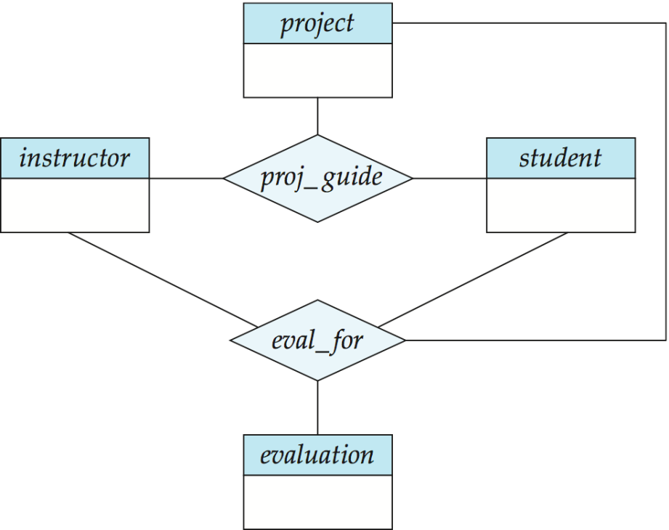
7.8.5 Aggregation
Aggregation
  to express relationship among relationships
  an abstraction (methodology) through which relationships are treated as high-level entities
(a)
(b)

Slide 96
Examples
A database used in an ordering (订货，订购) system, which contains information about customers, products and orders
Two steps in DB design
  E-R modeling
  table reduction
For more details about this example, refer to Appendix D E-R Modeling and Table Reductions in Ordering Database

Slide 97
7.6 Reduction to Relational Schemas
Table = relation
Two steps in logical database design
  generating of the initial relational schema from the E-R diagram, as illustrated in§7.6
  relational schema normalization, in Chapter 8
Converting an E-R diagram to a table format is the basis for deriving a relational database design from an E-R diagram

Slide 98
Principles
An E-R diagram describing a database can be represented by a collection of relational tables
For each entity set and relationship set, there is a unique table which is assigned the name of the corresponding entity set or relationship set
Each table has a number of columns; the columns generally corresponding to entities’ or relationships’ attributes, and have unique names

Slide 99
7.6.1/3 Representation of Strong/Weak Entity Sets
A strong entity set reduces to a schema with the same attributes
Student(ID, name, tot_cred)
A weak entity set becomes a table that includes a column for the primary key of the identifying strong entity set
Section ( course_id, sec_id, sem, year )

Slide 100
Representation of Weak Entity Sets
For a weak entity set A(a₁, a₂,…, a_{m}), its owner entity set is B, primary-key (B) is b₁, b₂, …, b_{n}, then
  table A with one column for each attribute in {a₁, a₂,…, a_{m} }∪{b₁, b₂, …, b_{n} }
  the primary key of table A is the union of discriminator/partial key of weak entity set A and primary-key(B)

Slide 101
7.6.2 Representation of Entity Sets with Composite Attributes
Composite attributes are flattened out by creating a separate attribute for each component attribute
E.g. Given entity set instructor with composite attribute name with component attributes first_name, middle_initial and last_name, the schema corresponding to the entity set has three attributes:
  name_first_name, middle_initial and name_last_name
    Prefix omitted if there is no ambiguity (name_first_name could be first_name)
Notes:
101

Slide 102
7.6.2 Representation of Entity Sets with Composite Attributes
Ignoring multivalued attributes, extended instructor schema is
  instructor(ID,
  first_name, middle_initial, last_name,
  street_number, street_name,
  apt_number, city, state, zip_code,
  date_of_birth, age)
Notes:
102

Slide 103
Representation of Entity Sets with Multivalued Attributes
A multivalued attribute M of an entity E is represented by a separate schema EM
Schema EM has attributes corresponding to the primary key of E and an attribute corresponding to multivalued attribute M
Example: Multivalued attribute phone_number of instructor is represented by a schema:
inst_phone= ( ID, phone_number)
Each value of the multivalued attribute maps to a separate tuple of the relation on schema EM
  For example, an instructor entity with primary key 22222 and phone numbers 456-7890 and 123-4567 maps to two tuples:
  (22222, 456-7890) and (22222, 123-4567)
Notes:
103

Slide 104
Example
For entity set customer(c-id, c-name, d-names, street, city), each entity customer may have several dependents, so d-names (i.e., dependent-name) is a multivalued attribute
c-id | c-name | d-names | street | city
321-12-2 | John | {Hayes, Adams} | North | Rye
322-10-4 | Smith | {Mary, Elice} | Spring | Princeton
Fig.6.0.18 Entity set customer with multivalued attribute

Slide 105
  the entity set customer is reduced into two tables
    c-table, which has no multivalued attribute d-names
    d-table, which has primary key {c-id, d-names}, and is as follows
c-id | c-name | street | city
321-12-2 | John | North | Rye
322-10-4 | Smith | Spring | Princeton

Slide 106
Reduction of Multivalued Attributes (cont.)
c-id | d-names
321-12-2 | Hayes
321-12-2 | Adams
322-10-4 | Mary
322-10-4 | Elice

Slide 107
7.6.4 Representation of Relationship Sets
Reduction of a relationship set into tables are strongly dependent on the mapping cardinality constraint and total/partial constraints related to this relationship set
A many-to-many relationship set is represented as a table with columns for the primary keys of the two participating entity sets, and any descriptive attributes of the relationship set

Slide 108
Example
instructor(ID, name, salary)
student(ID, name, tot_cred)
teaches(instrctor.ID, student.ID)
Fig.8.0.14 Reduced teaches table

Slide 109
Many-to-many
For relationship set R between entity set A and B, primary-key(A)∪primary-key(B) = {a₁, a₂,…, a_{m}}, descriptive attributes of R are b₁, b₂, …, b_{n}, then R can be reduced to
  table R with one column for each attribute in {a₁, a₂,…, a_{m} }∪{b₁, b₂, …, b_{n} }

Slide 110
Many-to-one/One-to-many
Many-to-one and one-to-many relationship sets that are total on the many-side can be represented by adding an extra attribute to the “many” side, containing the primary key of the “one” side
For a relationship sets R, which satisfies that (refer to Fig.7.0.15)
  many-to-one mapping from entity set A to B, and
  the many-side entity set A totally participates in R
  , then R should not be represented as an independent table, it can be reduced to the table A from entity set A, by
    adding the primary key of B into table A
    adding descriptive attributes of R into table A
For a one-to-many relationship sets R from A to B, the similar reduction can be conducted on the basis of table B.

Slide 111
A
R
B
r₁(a₁, b₁)
r₂(a₂, b₁)
b₁
b₂
b3
a₁
a₂
a₃
a₄
a₅
r₃(a₃, b₂)
r₄(a₄, b₂)
r₅(a₅, b₂)
total
partial
many
one
Fig. 7.0.15 A many-to-one relationship set R

Slide 112
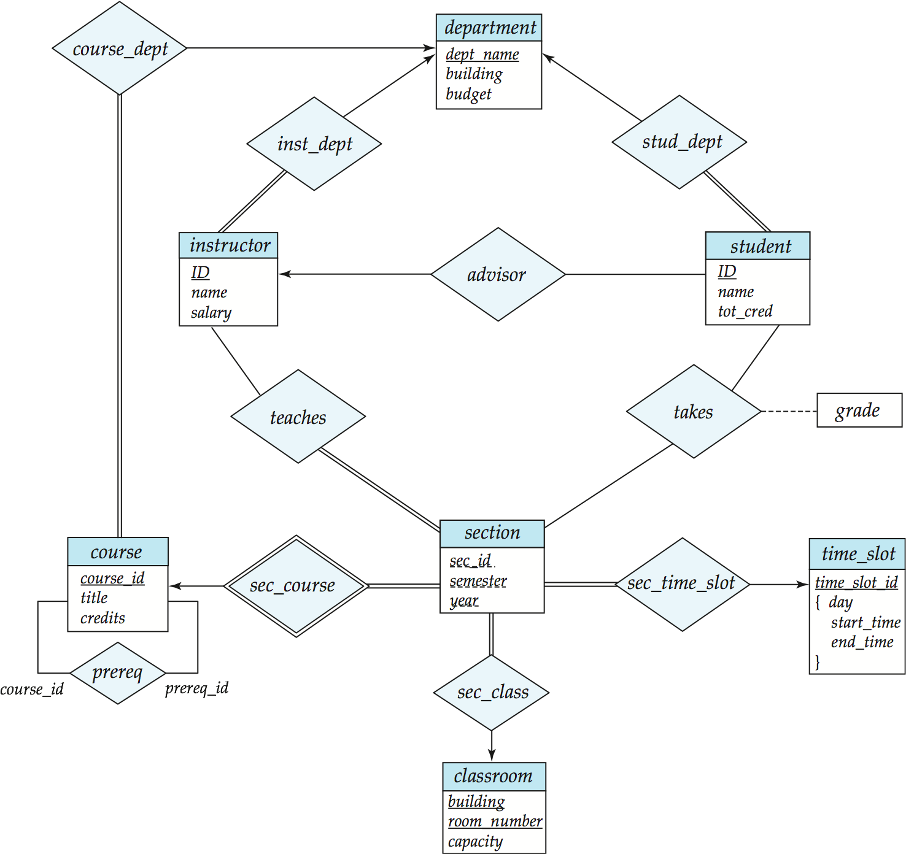
Example
Instead of creating a schema for relationship set inst_dept, add an attribute dept_name to the schema arising from instructor
  instructor( ID, name, salary, dept_name)
  department(dept_name, building, budget)
foreign key referencing constraint between
instructor and department
one
total
many
Fig.6.0.16 E-R diagram

Slide 113
Many-to-one Relationship Sets
with partial participation
The relationship is reduced to a independent table
A(u₁, u₂, u₃)
R
B (v₁, v₂, …)
r₁{a₁, b₁}
r₂{a₂, b₁}
b₁
b₂
b3
实际应用中也可以归到多端实体，避免过多的表
a₁
a₂
a₃
a₄
a₅
r₃{a₃, b₂}
r₄{a₄, b₂}
r₅{a₅, b₃}
a₆
?
partial
partial
many
one
Fig.6.0.17-1 Why not reducing R into table A

Slide 114
实际数据库系统中，尽可能避免关系表中的空值null
—用default value 代替null
If R={r₁, r₂, r₃, r₄, r₅} is reduced to table
A’(u₁, u₂, u₃ , v₁) ={a₁’, a₂’, a₃’, a₄’, a₅’, a₆’},
  a₆ does not participate in R
  thus, a₆’ will has null on the attribute v₁
Table A’ ={a₁’, a₂’, a₃’, a₄’, a₅’, a₆’}
u₁ | u₂ | u₃ | v₁
* | * | * | *
* | * | * | *
* | * | * | *
* | * | * | *
* | * | * | *
* | * | * | null
a₁’
a₂’
a₃’
a₄’
a₅’
a₆’
r₁{a₁, b₁}
r₂{a₂, b₁}
r₃{a₃, b₂}
r₄{a₄, b₂}
r₅{a₅, b₃}
Fig.7.0.17-2 Why not reducing R into table A

Slide 115
Reduction of one-to-one Relationship Sets
One-to-one relationship can be viewed as a specialized instance of many-to-one relationship.
For one-to-one relationship set R relating entity set A and B, assuming one of two entity sets, i.e. A is totally participating R, then
  R is represented by adding R’s primary key to the table A of entity set A
  R’s descriptive attributes are also added to table A

Slide 116
Reduction of Specialization/Generalization
Method 1:
  Form a schema for the higher-level entity
  Form a schema for each lower-level entity set, include the primary key of the higher-level entity set and local attributes
  Drawback: getting information about, an employee requires accessing two relations, the one corresponding to the low-level schema and the one corresponding to the high-level schema
schema attributes
person ID, name, street, city
student ID, tot_cred
employee ID, salary
Notes:
116

Slide 117
Method one
  for the three entity sets, creating three tables
d₁, d₂, …,d_{j}
c₁, c₂, …, c_{k}
H-entity-set
a₁, a₂, …,a_{m}
overlapping OR partial
ISA
L-entity-set-1
L-entity-set-2
b₁,b₂, …,b_{n}
Fig.8.0.19 E-R diagram with generalization /specialization

Slide 118
Representation of Generalization (cont.)
  T₁ (c₁, c₂, …, c_{k}, d₁, d₂, …,d_{j}) for H-entity-set
  T₂ (a₁, a₂, …,a_{m}, c₁, c₂, …, c_{k} ) for L-entity-set1
  T₃ (b₁,b₂, …,b_{n} , c₁, c₂, …, c_{k} ) for L-entity-set2
  note:
    c₁, c₂, …, ck are primary attributes of H-entity-set
    c₁, c₂, …, ck are the foreign key from T₂ and T₃ referencing T₁, representing the association between H-entity-set and L-entity-set1/ L-entity-set2.

Slide 119
Representing Specialization via Schemas
Method 2:
  Form a schema for each entity set with all local and inherited attributes
  Drawback: name, street and city may be stored redundantly for people who are both students and employees
schema attributes
person ID, name, street, city
student ID, name, street, city, tot_cred
employee ID, name, street, city, salary
Notes:
119

Slide 120
Representation of Generalization (cont.)
Method 3. if generalization/specialization is disjoint and complete, creating two tables
d₁, d₂, …,d_{j}
c₁, c₂, …, c_{k}
H-entity-set
a₁, a₂, …,a_{m}
disjoint AND complete
ISA
L-entity-set-1
L-entity-set-2
b₁,b₂, …,b_{n}
Fig.8.0.20 E-R diagram with generalization /specialization (II)

Slide 121
Representation of Generalization (cont.)
  T₂ (a₁, a₂, …,a_{m}, c₁, c₂, …, c_{k}, d₁, d₂, …,d_{j} ) for L-entity-set1
  T₃ (b₁,b₂, …,b_{n}, c₁, c₂, …, c_{k}, d₁, d₂, …,d_{j}) for L-entity-set2
  a₁, a₂, …,a_{m}, are attributes of L-entity-set1, b₁,b₂, …,b_{n} are attributes of L-entity-set2, and c₁, c₂, …, c_{k}, d₁, d₂, …,d_{j} are all attributes of H-entity-set
  replacing high-level entity set H-entity-set with T2 and T₃ of lower-level entity sets.
E.g. Student, graduate, undergraduate

Slide 122
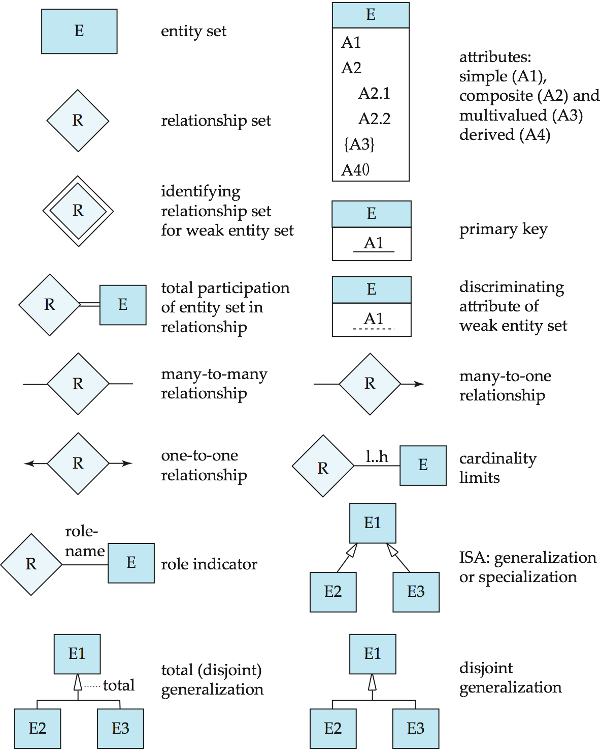
7.9 Symbols Used in E-R Notation
略

Slide 123
Symbols Used in E-R Notation (Cont.)

Slide 124
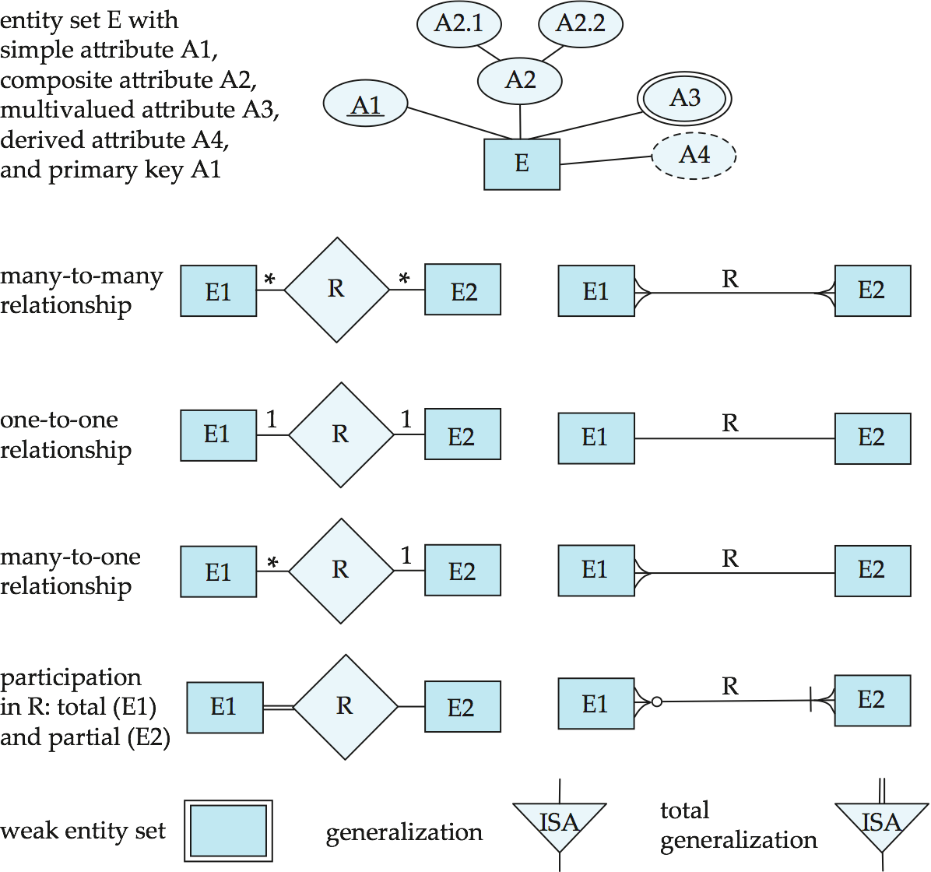
Alternative ER Notations
Chen, IDE1FX, …

Slide 125
Alternative ER Notations
Chen IDE1FX (Crows feet notation)

Slide 126
UML
UML: Unified Modeling Language
UML has many components to graphically model different aspects of an entire software system
UML Class Diagrams correspond to E-R Diagram, but several differences.

Slide 127
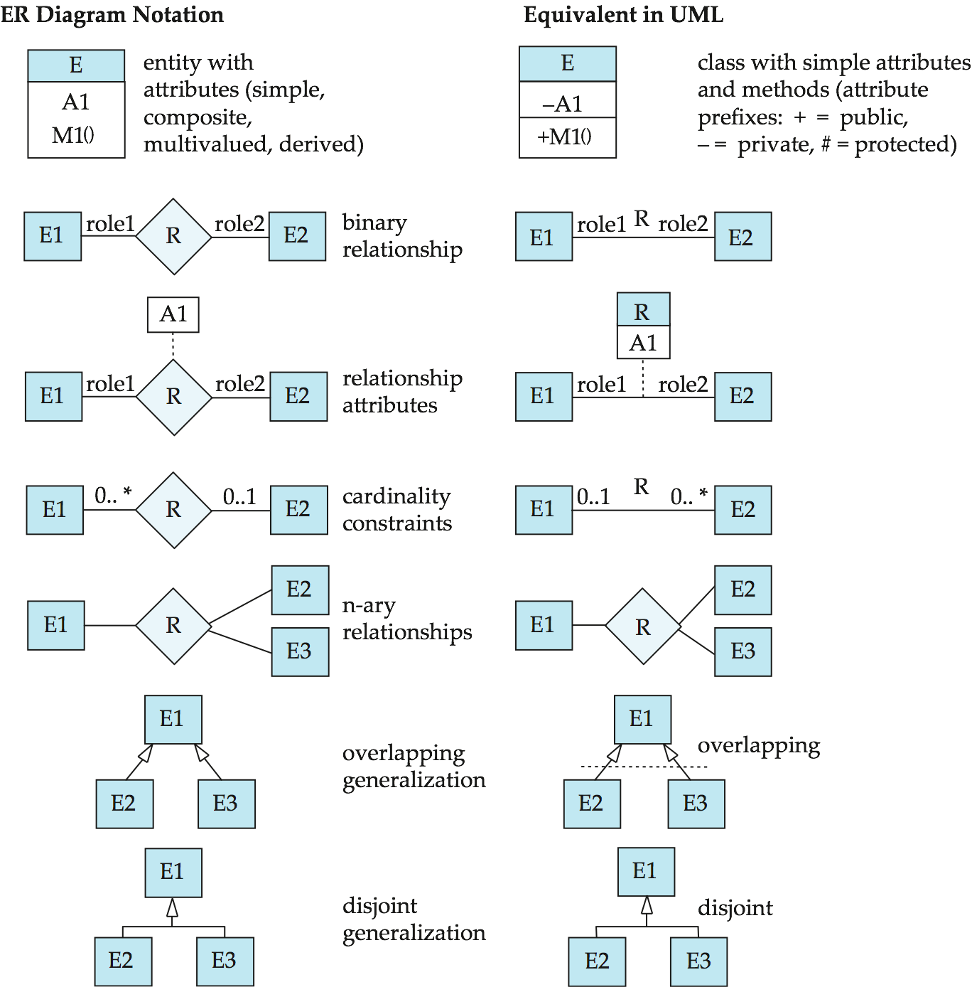
ER vs. UML Class Diagrams
*Note reversal of position in cardinality constraint depiction

Slide 128
ER vs. UML Class Diagrams
ER Diagram Notation
Equivalent in UML
*Generalization can use merged or separate arrows independent
of disjoint/overlapping

Slide 129
UML Class Diagrams (Cont.)
Binary relationship sets are represented in UML by just drawing a line connecting the entity sets. The relationship set name is written adjacent to the line.
The role played by an entity set in a relationship set may also be specified by writing the role name on the line, adjacent to the entity set.
The relationship set name may alternatively be written in a box, along with attributes of the relationship set, and the box is connected, using a dotted line, to the line depicting the relationship set.

Slide 130
注意
画E-R图时，mapping cardinality、participation和cardinality limits约束的画法必须统一，不允许混用
  反例
1..*
m
1

Slide 131
Schema Diagram in Relational Model
SQL Server生成的模式图
表示关系模式及其相互间的外键关联关系，不是E-R图！！

Slide 132
Appendix 7-1 E-R Modeling and
Table Reductions in Ordering Database
A database used in an ordering (订货/订购) system contains information about customers, products and orders. The following information is to be included:
  for each customer
    customer-number, ship-to-addresses (several per customer), name, balance, discount
  for each order（订单）
    order number, customer number, ship-to address (one per order), date of ordering (including year, month, and day), products (several kinds per order), and quantity ordered of each product

Slide 133
Appendix 7-1 E-R Modeling and
Table Reductions in Ordering Database (cont.)
  for each kind of product
    product-number, name, manufacturing-plant, quantity on hand
  Entity sets: Customer, Order, Product and their attributes.
  In Customer, ship-to addresses is a multi-valued attribute, but in Order, ship-to addresses is a single-valued attribute. In Order, date is a composite attribute
Some constraints(i.e., integrity constraints) about this ordering system are as follows
  a customer may make one or more orders, and some customers may make no orders
  each order must be for one (and only one) customer

Slide 134
Appendix 7-1 E-R Modeling and
Table Reductions in Ordering Database (cont.)
  relationship sets
    relationship set make between Customer and Order
    Customer partly participate make, and Order totally participate make
    in relationship set make, mapping cardinality from Customer to Order is one-to-many
  each order must contain at least one kind of products
  a kind of product may appear in several orders, but some kinds of products may not be ordered by any customers
  relationship set
    relationship set contain between Order and Product, and

Slide 135
Appendix 7-1 E-R Modeling and
Table Reductions in Ordering Database (cont.)
    descriptive attributes quantity of ordered for relationship set contain
    Product partly participate contain, and Order totally participate contain
    In relationship set contain, mapping cardinality from Order to Product is many-to-many
E-R diagram of the ordering DB is shown in Fig. C.1

Slide 136
C-name
O-number
P-number
C-number
quantity
of ordered
balance
P-name
Customer
make
Order
contain
Product
address
address
date
quantity
on hand
discount
plant
day
year
month
Fig. C.1. E-R diagram of the ordering DB is shown in

Slide 137
Appendix 7-1 E-R Modeling and
Table Reductions in Ordering Database (cont.)
The E-R diagram in Fig. C.1 is then reduced to some relational tables, according to the methodologies mentioned in §6.9
For entity set Customer and its multi-valued attribute ship-to addresses, there are two tables
  customer=(C-number, c-name, discount, balance)
  ship-to-addresses = (C-number, ship-to-addresses)
For entity set Order and its composite attribute date which should be decomposed , there is a table
  order1=(O-number, ship-to-address, year, month, day)

Slide 138
Appendix 7-1 E-R Modeling and
Table Reductions in Ordering Database (cont.)
For entity set Product, there is a table
  product=(P-number, p-name, plant, quantity-on-hand)
For relationship set make, there are no descriptive attributes, mapping cardinality from Customer to Order is one-to-many, and Order totally participate make. So, make should not be reduced into a separate table, and can be represented by adding the primary key C-number of Customer , that is C-number into the table order
  order2=(O-number, C-number, ship-to-address, year, month, day)
  note: the primary key C-number is already in the table order

Slide 139
Appendix 7-1 E-R Modeling and
Table Reductions in Ordering Database (cont.)
Supposing mapping cardinality from Order to Product is many-to-many, for relationship set contain, there is a descriptive attribute quantity of ordered, contain should be represented as a separate table with columns for the primary keys of the two participating entity and descriptive attribute
  contain=(O-number, P-number, quantity of ordered) )
Supposing mapping cardinality from Order to Product is one-to-many, because Product at the many side only partly participate relationship set contain , contain should also be represented as a separate table
  contain=(O-number, P-number, quantity of ordered) )

Slide 140
Appendix 7-1 E-R Modeling and
Table Reductions in Ordering Database (cont.)
So, the E-R diagram in Fig. C.1 can be reduced into the following five tables
  customer=(C-number, c-name, discount, balance)
  ship-to-addresses = (C-number, ship-to-addresses)
  order=(O-number, C-number, ship-to-address, year, month, day)
  product=(P-number, p-name, plant, quantity-on-hand)
  contain=(O-number, P-number, quantity of ordered) )

Slide 141
Appendix 7-2 Example
Convert the following E-R diagram to the proper relation schemas and identify the primary key of each relation

Slide 142
c₁
b₄
a₁
b₁
a₃
E₁
R₁
E₂
b₂
a₂
b₃
c₂
R₂
ISA
partial
E₅
E₃
E₄
g₂
g₁
c₃
c₄
c₅

Slide 143
Appendix 7-2 Example (cont. )
E₁(a₁, a₃, g₁), E₁₂(a₁, a₂)
E₂(b₁, b₃, b₄)
R₁(a₁, b₁, c₁), R₁₂(a₁, b₁, c₂)
E₃(b₁, c₃, c₄) , E4(b₁, c₅)
E₅(g₁, g₂)

Slide 144
c1
名
a1
学号
a3
E1
R1
学生
姓名
a2
姓
c2
R2
ISA
partial
E5
计算机
学生
信通院
学生
g2
g1
OS分数
DBS分数
通信原理分数

Slide 145
Have a break

