Slide 1
Matplotlib 数据绘图
Python程序设计

Slide 2
Matplotlib
Matplotlib 可能是 Python 2D-绘图领域使用最广泛的套件。它能让使用者很轻松地将数据图形化，并且提供多样化的输出格式。。
 | 优点 | 缺点
Matplotlib | 带有内置代码的默认绘图样式 与Python的深度集成 Matlab风格的编程接口（对一些人来说是优点，但对于其他人来说可能是缺点）。 图形绘制相较Gnuplot更加美观 | 高度依赖其他包，如Numpy。 只适用于Python：很难/不可能在Python以外的语言中使用。 （但可以从Julia通过PyPlot软件包使用）
Gnuplot | 跨语言解决方案：可以用作通过管道或文件以不同语言编写的应用程序（例如GNU Octave，Maxima，JavaGnuplotHybrid）中的绘图引擎。 独立程序：没有外部依赖。 处理大型数据集时非常快。 更容易操纵绘图细节 | 旧的默认绘图样式：通常需要小的调整以产生有吸引力的图。 在开发中活跃成员的数量较少（与Matplotlib相比）。

Slide 3
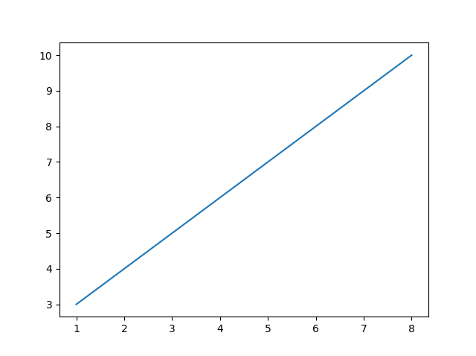
绘图示例
点图示例
import matplotlib.pyplot as plt import numpy as np xpoints = np.array([0, 6]) ypoints = np.array([0, 250]) plt.plot(xpoints, ypoints) plt.show()

Slide 4
Plotting x and y points
The plot() function is used to draw points (markers) in a diagram.
By default, the plot() function draws a line from point to point.
The function takes parameters for specifying points in the diagram.
Parameter 1 is an array containing the points on the x-axis.
Parameter 2 is an array containing the points on the y-axis.
If we need to plot a line from (1, 3) to (8, 10), we have to pass two arrays [1, 8] and [3, 10] to the plot function.
import matplotlib.pyplot as plt import numpy as np xpoints = np.array([1, 8]) ypoints = np.array([3, 10]) plt.plot(xpoints, ypoints) plt.show()

Slide 5
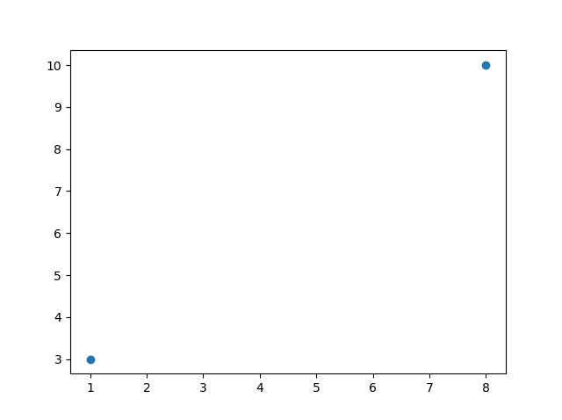
Plotting Without Line
To plot only the markers, you can use shortcut string notation parameter 'o', which means 'rings'.
import matplotlib.pyplot as plt import numpy as np xpoints = np.array([1, 8]) ypoints = np.array([3, 10]) plt.plot(xpoints, ypoints, 'o') plt.show()

Slide 6
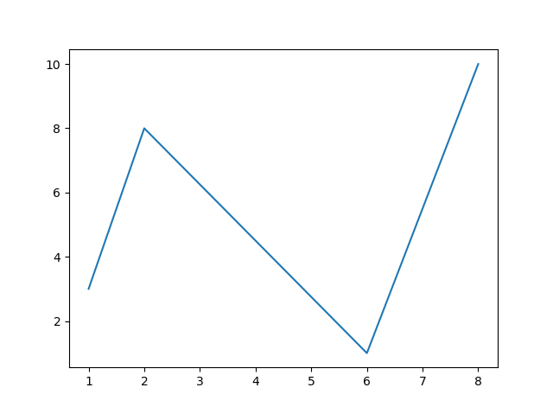
Multiple Points
Draw a line in a diagram from position (1, 3) to (2, 8) then to (6, 1) and finally to position (8, 10):
import matplotlib.pyplot as plt import numpy as np xpoints = np.array([1, 2, 6, 8]) ypoints = np.array([3, 8, 1, 10]) plt.plot(xpoints, ypoints) plt.show()

Slide 7
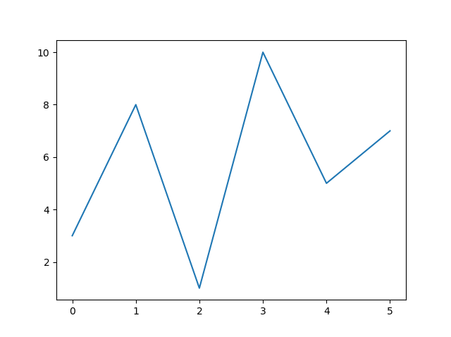
Default X-Points
If we do not specify the points in the x-axis, they will get the default values 0, 1, 2, 3, (etc. depending on the length of the y-points.
import matplotlib.pyplot as plt import numpy as np ypoints = np.array([3, 8, 1, 10, 5, 7]) plt.plot(ypoints) plt.show()

Slide 8
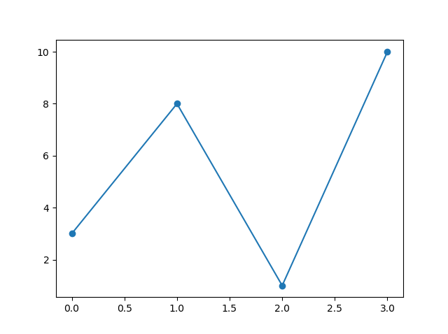
Matplotlib Markers
You can use the keyword argument marker to emphasize each point with a specified marker:
import matplotlib.pyplot as plt import numpy as np ypoints = np.array([3, 8, 1, 10]) plt.plot(ypoints, marker = 'o') plt.show()

Slide 9
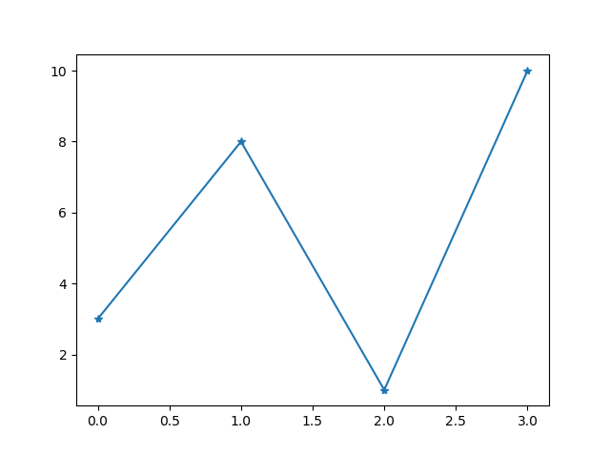
Matplotlib Markers
Mark each point with a star:
import matplotlib.pyplot as plt import numpy as np ypoints = np.array([3, 8, 1, 10]) plt.plot(ypoints, marker = '*') plt.show()

Slide 10
Marker Reference
Marker | Description
'o' | Circle
'*' | Star
'.' | Point
',' | Pixel
'x' | X
'X' | X (filled)
'+' | Plus
'P' | Plus (filled)
's' | Square
'D' | Diamond
'd' | Diamond (thin)
'p' | Pentagon
'H' | Hexagon
'h' | Hexagon
'v' | Triangle Down
'^' | Triangle Up
'<' | Triangle Left
'>' | Triangle Right

Slide 11
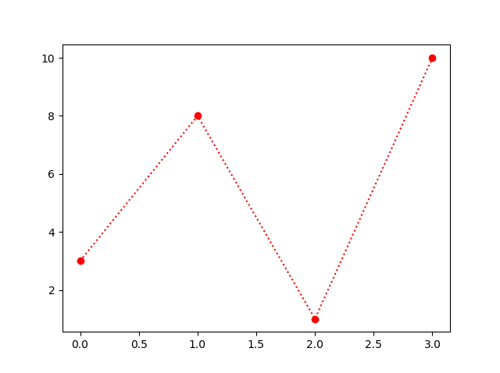
FormatString fmt
You can use also use the shortcut string notation parameter to specify the marker.
This parameter is also called fmt, and is written with this syntax:
marker|line|color
import matplotlib.pyplot as plt import numpy as np ypoints = np.array([3, 8, 1, 10]) plt.plot(ypoints, 'o:r') plt.show()

Slide 12
Line Reference
Line Syntax | Description
'-' | Solid line
':' | Dotted line
'--' | Dashed line
'-.' | Dashed/dotted line

Slide 13
Color Reference
Color Syntax | Description
'r' | Red
'g' | Green
'b' | Blue
'c' | Cyan
'm' | Magenta
'y' | Yellow
'k' | Black
'w' | White

Slide 14
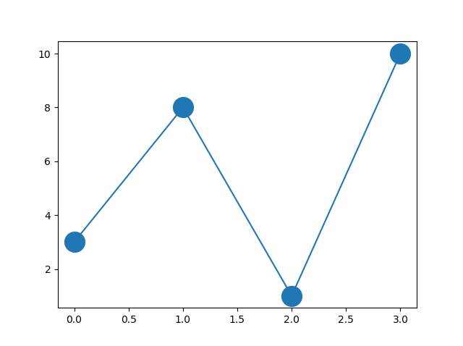
Marker Size
You can use the keyword argument markersize or the shorter version, ms to set the size of the markers:
import matplotlib.pyplot as plt import numpy as np ypoints = np.array([3, 8, 1, 10]) plt.plot(ypoints, marker = 'o', ms = 20) plt.show()

Slide 15
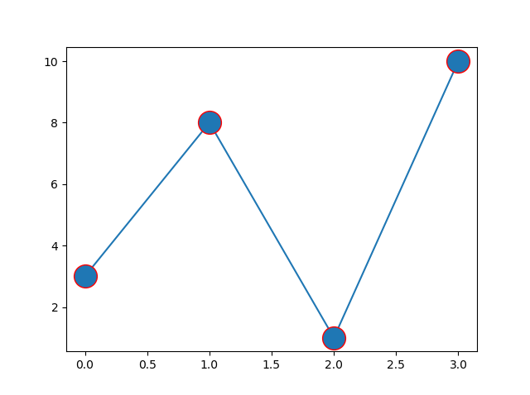
Marker Color
You can use the keyword argument markeredgecolor or the shorter mec to set the color of the edge of the markers:
import matplotlib.pyplot as plt import numpy as np ypoints = np.array([3, 8, 1, 10]) plt.plot(ypoints, marker = 'o', ms = 20, mec = 'r') plt.show()

Slide 16
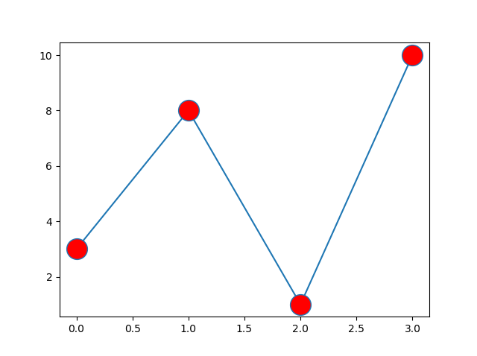
Marker Color
You can use the keyword argument markerfacecolor or the shorter mfc to set the color inside the edge of the markers:
import matplotlib.pyplot as plt import numpy as np ypoints = np.array([3, 8, 1, 10]) plt.plot(ypoints, marker = 'o', ms = 20, mfc = 'r') plt.show()

Slide 17
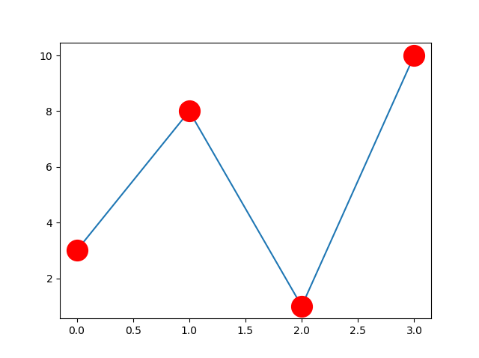
Marker Color
Use both the mec and mfc arguments to color of the entire marker:
import matplotlib.pyplot as plt import numpy as np ypoints = np.array([3, 8, 1, 10]) plt.plot(ypoints, marker = 'o', ms = 20, mec = 'r', mfc = 'r') plt.show()

Slide 18
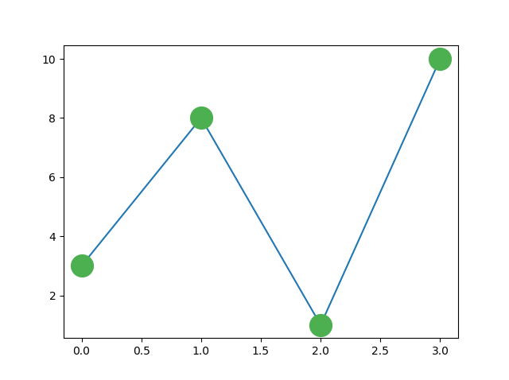
Marker Color
You can also use Hexadecimal color values:
import matplotlib.pyplot as plt import numpy as np ypoints = np.array([3, 8, 1, 10]) plt.plot(ypoints, marker = 'o', ms = 20, mec = '#4CAF50', mfc = '#4CAF50') plt.show()

Slide 19
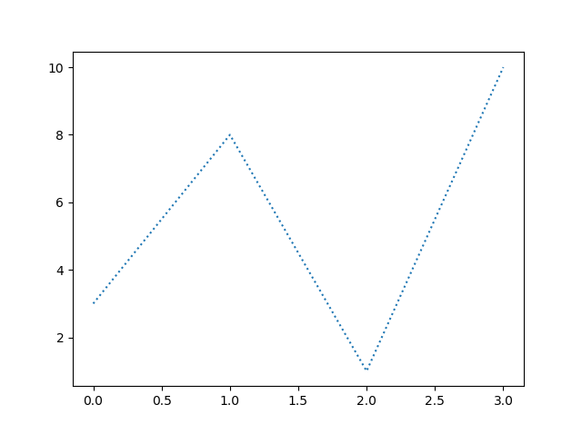
Linestyle
You can use the keyword argument linestyle, or shorter ls, to change the style of the plotted line:
import matplotlib.pyplot as plt import numpy as np ypoints = np.array([3, 8, 1, 10]) plt.plot(ypoints, linestyle = 'dotted') plt.show()

Slide 20
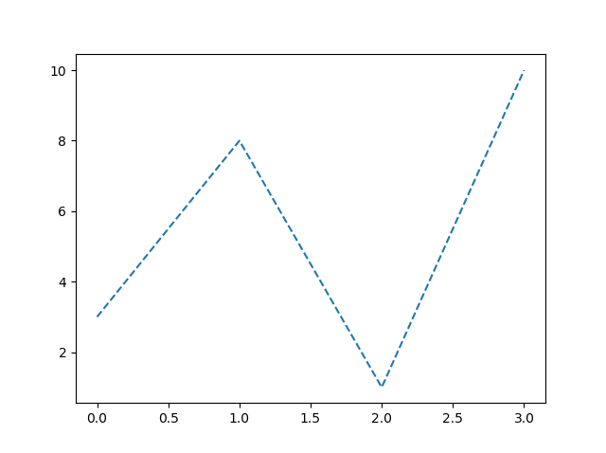
Linestyle
Use a dashed line:
import matplotlib.pyplot as plt import numpy as np ypoints = np.array([3, 8, 1, 10]) plt.plot(ypoints, linestyle = ‘dashed') plt.show()

Slide 21
Linestyle Shorter Syntax
The line style can be written in a shorter syntax:
linestyle can be written as ls.
dotted can be written as :.
dashed can be written as --.
import matplotlib.pyplot as plt import numpy as np ypoints = np.array([3, 8, 1, 10]) plt.plot(ypoints, linestyle = ':') plt.show()

Slide 22
Line Styles
Style | Or
'solid' (default) | '-'
'dotted' | ':'
'dashed' | '--'
'dashdot' | '-.'
'None' | '' or ' '

Slide 23
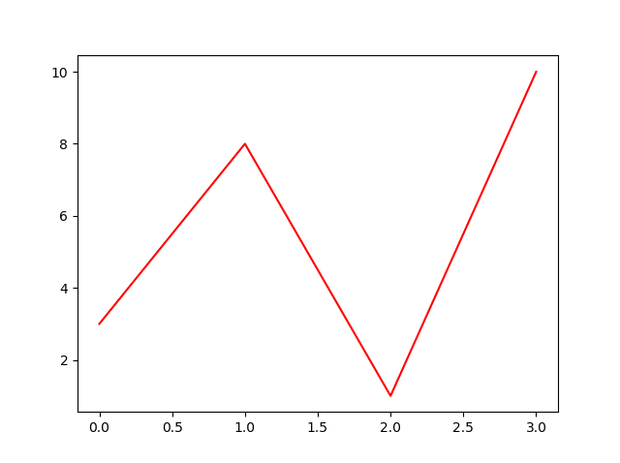
Line Color
You can use the keyword argument color or the shorter c to set the color of the line:
import matplotlib.pyplot as plt import numpy as np ypoints = np.array([3, 8, 1, 10]) plt.plot(ypoints, color = 'r') plt.show()

Slide 24
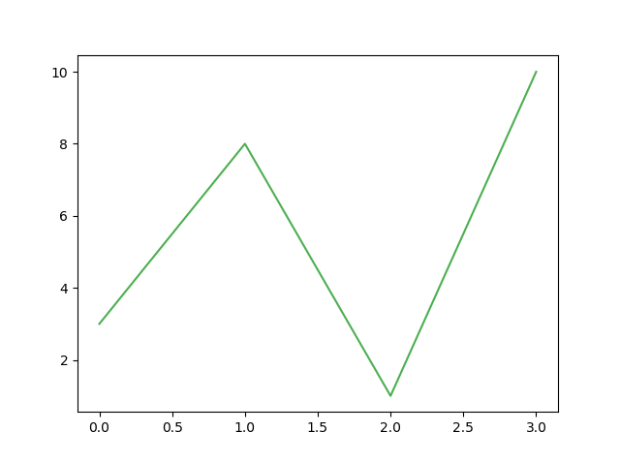
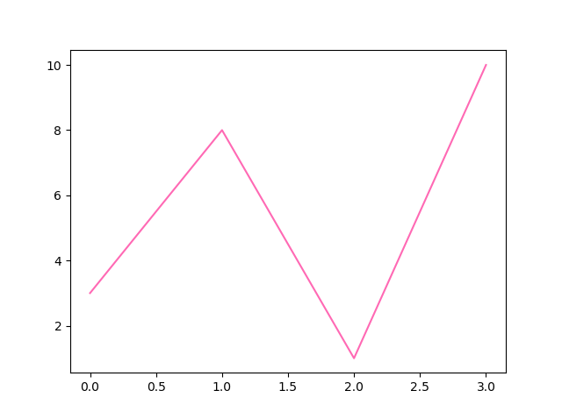
Line Color
You can also use Hexadecimal color values. Or any of the 140 supported color names.
import matplotlib.pyplot as plt import numpy as np ypoints = np.array([3, 8, 1, 10])
# plt.plot(ypoints, c = '#4CAF50') plt.plot(ypoints, color = ‘hotpink') plt.show()

Slide 25
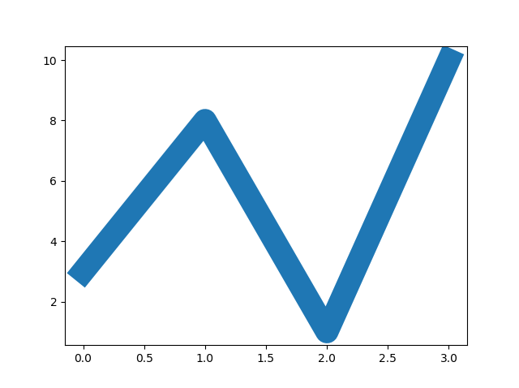
Line Width
You can use the keyword argument linewidth or the shorter lw to change the width of the line.
The value is a floating number, in points.
import matplotlib.pyplot as plt import numpy as np ypoints = np.array([3, 8, 1, 10]) plt.plot(ypoints, linewidth = '20.5') plt.show()

Slide 26
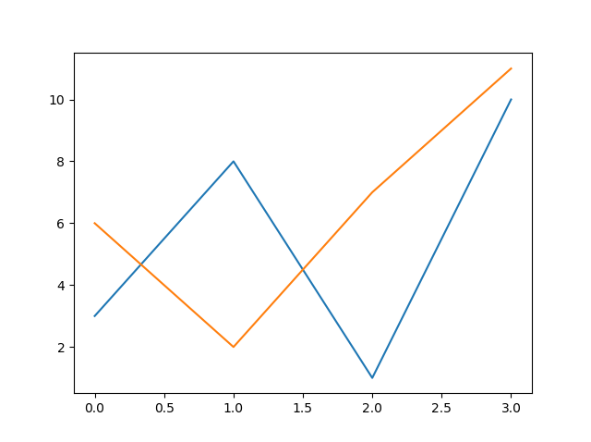
Multiple Lines
You can plot as many lines as you like by simply adding more plt.plot() functions:
import matplotlib.pyplot as plt import numpy as np y1 = np.array([3, 8, 1, 10]) y2 = np.array([6, 2, 7, 11]) plt.plot(y1) plt.plot(y2) plt.show()

Slide 27
Multiple Lines
You can also plot many lines by adding the points for the x- and y-axis for each line in the same plt.plot() function.
(In the examples above we only specified the points on the y-axis, meaning that the points on the x-axis got the the default values (0, 1, 2, 3).)
The x- and y- values come in pairs.
import matplotlib.pyplot as plt import numpy as np x1 = np.array([0, 1, 2, 3]) y1 = np.array([3, 8, 1, 10]) x2 = np.array([0, 1, 2, 3]) y2 = np.array([6, 2, 7, 11]) plt.plot(x1, y1, x2, y2) plt.show()

Slide 28
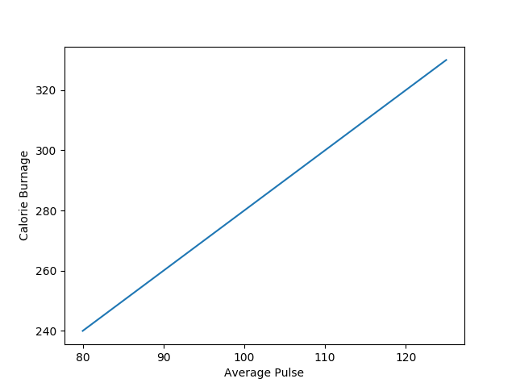
Create Labels for a Plot
With Pyplot, you can use the xlabel() and ylabel() functions to set a label for the x- and y-axis.
import numpy as np import matplotlib.pyplot as plt x = np.array([80, 85, 90, 95, 100, 105, 110, 115, 120, 125]) y = np.array([240, 250, 260, 270, 280, 290, 300, 310, 320, 330]) plt.plot(x, y) plt.xlabel("Average Pulse") plt.ylabel("Calorie Burnage") plt.show()

Slide 29
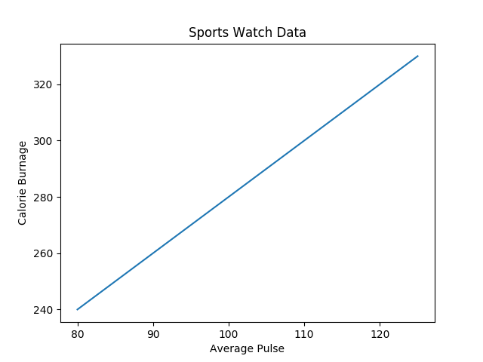
Create a Title for a Plot
With Pyplot, you can use the title() function to set a title for the plot.
import numpy as np import matplotlib.pyplot as plt x = np.array([80, 85, 90, 95, 100, 105, 110, 115, 120, 125]) y = np.array([240, 250, 260, 270, 280, 290, 300, 310, 320, 330]) plt.plot(x, y) plt.title("Sports Watch Data") plt.xlabel("Average Pulse") plt.ylabel("Calorie Burnage") plt.show()

Slide 30
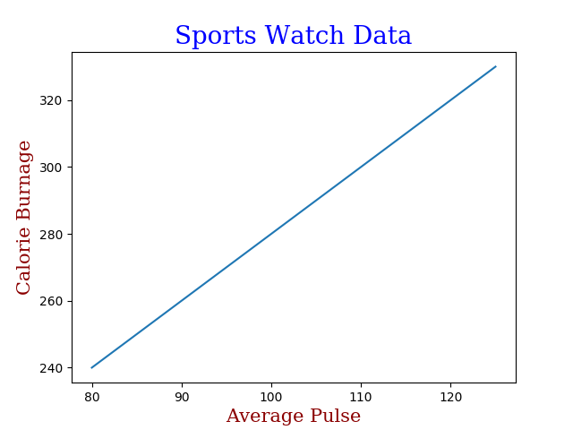
Set Font Properties for Title and Labels
You can use the fontdict parameter in xlabel(), ylabel(), and title() to set font properties for the title and labels.
import numpy as np import matplotlib.pyplot as plt x = np.array([80, 85, 90, 95, 100, 105, 110, 115, 120, 125]) y = np.array([240, 250, 260, 270, 280, 290, 300, 310, 320, 330]) font1 = {'family':'serif','color':'blue','size':20} font2 = {'family':'serif','color':'darkred','size':15} plt.title("Sports Watch Data", fontdict = font1) plt.xlabel("Average Pulse", fontdict = font2) plt.ylabel("Calorie Burnage", fontdict = font2) plt.plot(x, y) plt.show()

Slide 31

Add Grid Lines to a Plot
With Pyplot, you can use the grid() function to add grid lines to the plot.
import numpy as np import matplotlib.pyplot as plt x = np.array([80, 85, 90, 95, 100, 105, 110, 115, 120, 125]) y = np.array([240, 250, 260, 270, 280, 290, 300, 310, 320, 330]) plt.title("Sports Watch Data") plt.xlabel("Average Pulse") plt.ylabel("Calorie Burnage") plt.plot(x, y) plt.grid() plt.show()

Slide 32

Specify Which Grid Lines to Display
You can use the axis parameter in the grid() function to specify which grid lines to display.
Legal values are: 'x', 'y', and 'both'. Default value is 'both'.
import numpy as np import matplotlib.pyplot as plt x = np.array([80, 85, 90, 95, 100, 105, 110, 115, 120, 125]) y = np.array([240, 250, 260, 270, 280, 290, 300, 310, 320, 330]) plt.title("Sports Watch Data") plt.xlabel("Average Pulse") plt.ylabel("Calorie Burnage") plt.plot(x, y) plt.grid(axis = 'x') plt.show()

Slide 33
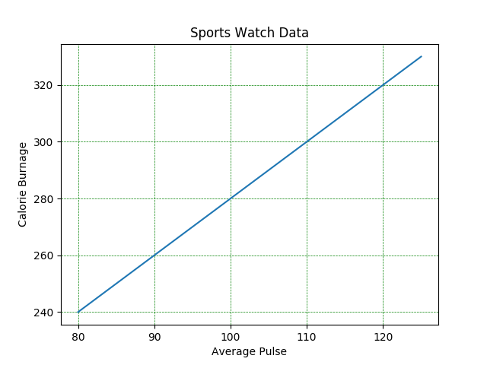
Set Line Properties for the Grid
You can also set the line properties of the grid, like this: grid(color = 'color', linestyle = 'linestyle', linewidth = number).
import numpy as np import matplotlib.pyplot as plt x = np.array([80, 85, 90, 95, 100, 105, 110, 115, 120, 125]) y = np.array([240, 250, 260, 270, 280, 290, 300, 310, 320, 330]) plt.title("Sports Watch Data") plt.xlabel("Average Pulse") plt.ylabel("Calorie Burnage") plt.plot(x, y) plt.grid(color = 'green', linestyle = '--', linewidth = 0.5) plt.show()

Slide 34
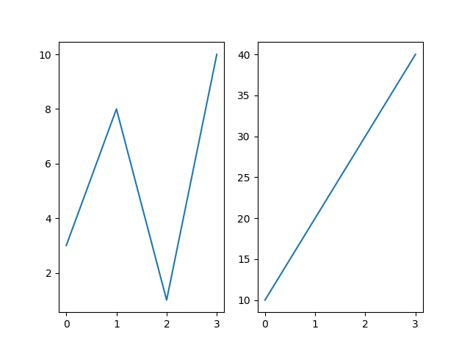
Subplots – Display Multiple Plots
With the subplots() function you can draw multiple plots in one figure:
import matplotlib.pyplot as plt import numpy as np #plot 1: x = np.array([0, 1, 2, 3]) y = np.array([3, 8, 1, 10]) plt.subplot(1, 2, 1) plt.plot(x,y) #plot 2: x = np.array([0, 1, 2, 3]) y = np.array([10, 20, 30, 40]) plt.subplot(1, 2, 2) plt.plot(x,y) plt.show()

Slide 35
The subplots() Function
The subplots() function takes three arguments that describes the layout of the figure.
The layout is organized in rows and columns, which are represented by the first and second argument.
The third argument represents the index of the current plot.
plt.subplot(1, 2, 1) #the figure has 1 row, 2 columns, and this plot is the first plot.
plt.subplot(1, 2, 2) #the figure has 1 row, 2 columns, and this plot is the second plot.

Slide 36
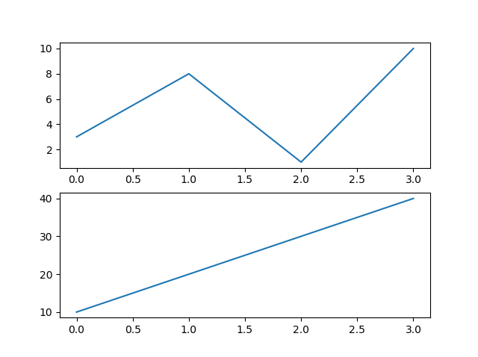
The subplots() Function
if we want a figure with 2 rows an 1 column (meaning that the two plots will be displayed on top of each other instead of side-by-side), we can write the syntax like this:
import matplotlib.pyplot as plt import numpy as np #plot 1: x = np.array([0, 1, 2, 3]) y = np.array([3, 8, 1, 10]) plt.subplot(2, 1, 1) plt.plot(x,y) #plot 2: x = np.array([0, 1, 2, 3]) y = np.array([10, 20, 30, 40]) plt.subplot(2, 1, 2) plt.plot(x,y) plt.show()

Slide 37
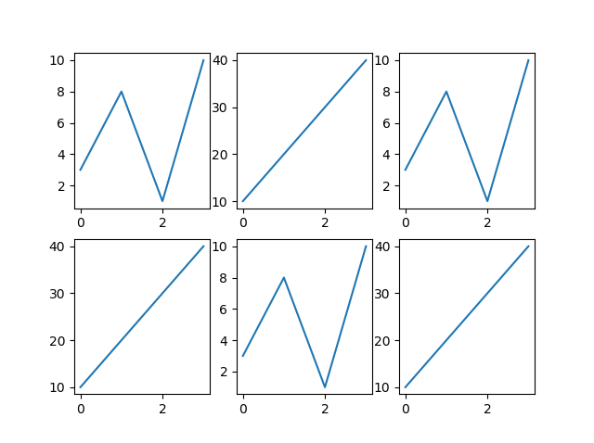
x = np.array([0, 1, 2, 3]) y = np.array([3, 8, 1, 10]) plt.subplot(2, 3, 1) plt.plot(x,y) x = np.array([0, 1, 2, 3]) y = np.array([10, 20, 30, 40]) plt.subplot(2, 3, 2) plt.plot(x,y) x = np.array([0, 1, 2, 3]) y = np.array([3, 8, 1, 10]) plt.subplot(2, 3, 3) plt.plot(x,y) x = np.array([0, 1, 2, 3]) y = np.array([10, 20, 30, 40]) plt.subplot(2, 3, 4) plt.plot(x,y) x = np.array([0, 1, 2, 3]) y = np.array([3, 8, 1, 10]) plt.subplot(2, 3, 5) plt.plot(x,y)

Slide 38
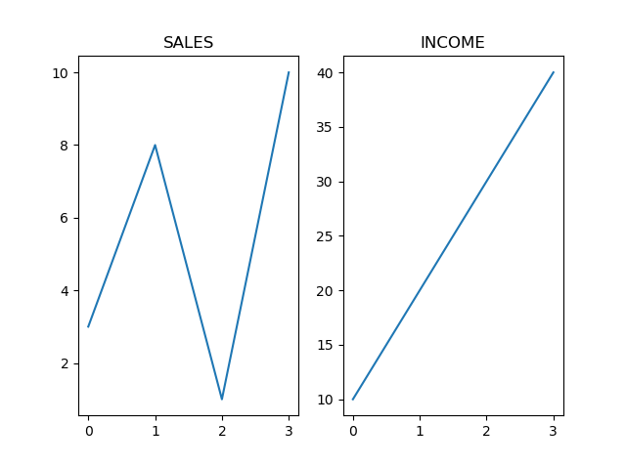
subplots Title
You can add a title to each plot with the title() function:
import matplotlib.pyplot as plt import numpy as np #plot 1: x = np.array([0, 1, 2, 3]) y = np.array([3, 8, 1, 10]) plt.subplot(1, 2, 1) plt.plot(x,y) plt.title("SALES") #plot 2: x = np.array([0, 1, 2, 3]) y = np.array([10, 20, 30, 40]) plt.subplot(1, 2, 2) plt.plot(x,y) plt.title("INCOME") plt.show()

Slide 39
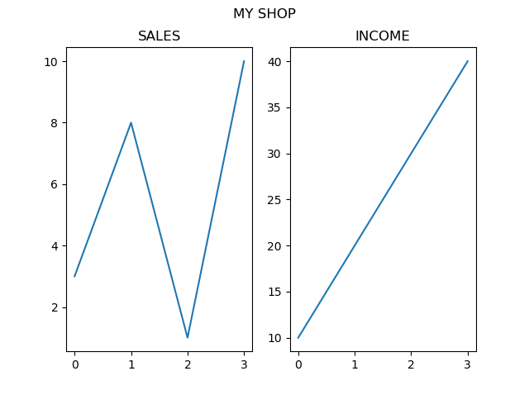
Super Title
You can add a title to the entire figure with the suptitle() function:
import matplotlib.pyplot as plt import numpy as np #plot 1: x = np.array([0, 1, 2, 3]) y = np.array([3, 8, 1, 10]) plt.subplot(1, 2, 1) plt.plot(x,y) plt.title("SALES") #plot 2: x = np.array([0, 1, 2, 3]) y = np.array([10, 20, 30, 40]) plt.subplot(1, 2, 2) plt.plot(x,y) plt.title("INCOME") plt.suptitle("MY SHOP") plt.show()

Slide 40
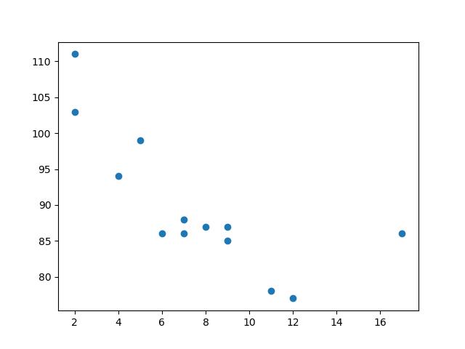
Scatter Plots
With Pyplot, you can use the scatter() function to draw a scatter plot.
The scatter() function plots one dot for each observation. It needs two arrays of the same length, one for the values of the x-axis, and one for values on the y-axis:
import matplotlib.pyplot as plt import numpy as np x = np.array([5,7,8,7,2,17,2,9,4,11,12,9,6]) y = np.array([99,86,87,88,111,86,103,87,94,78,77,85,86]) plt.scatter(x, y) plt.show()

Slide 41
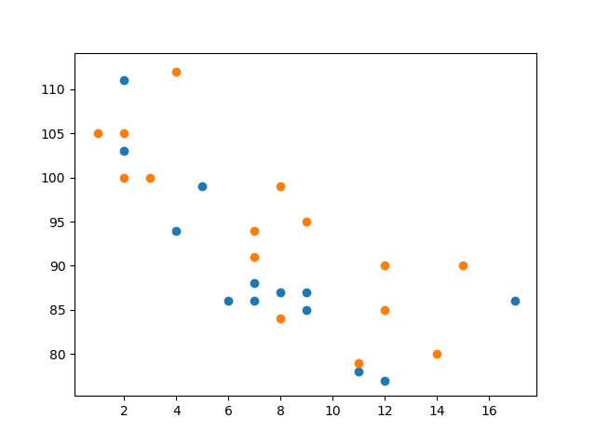
Compare Plots
In the example above, there seems to be a relationship between speed and age, but what if we plot the observations from another day as well? Will the scatter plot tell us something else?
import matplotlib.pyplot as plt import numpy as np #day one, the age and speed of 13 cars: x = np.array([5,7,8,7,2,17,2,9,4,11,12,9,6]) y = np.array([99,86,87,88,111,86,103,87,94,78,77,85,86]) plt.scatter(x, y) #day two, the age and speed of 15 cars: x = np.array([2,2,8,1,15,8,12,9,7,3,11,4,7,14,12]) y = np.array([100,105,84,105,90,99,90,95,94,100,79,112,91,80,85]) plt.scatter(x, y) plt.show()

Slide 42
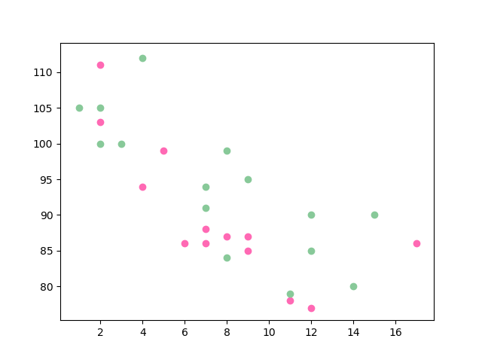
Colors
You can set your own color for each scatter plot with the color or the c argument:
import matplotlib.pyplot as plt import numpy as np x = np.array([5,7,8,7,2,17,2,9,4,11,12,9,6]) y = np.array([99,86,87,88,111,86,103,87,94,78,77,85,86]) plt.scatter(x, y, color = 'hotpink') x = np.array([2,2,8,1,15,8,12,9,7,3,11,4,7,14,12]) y = np.array([100,105,84,105,90,99,90,95,94,100,79,112,91,80,85]) plt.scatter(x, y, color = '#88c999') plt.show()

Slide 43
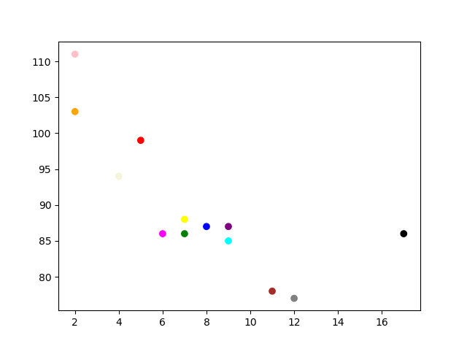
Color EachDot
You can even set a specific color for each dot by using an array of colors as value for the c argument:
You cannot use the color argument for this, only the c argument.
import matplotlib.pyplot as plt import numpy as np x = np.array([5,7,8,7,2,17,2,9,4,11,12,9,6]) y = np.array([99,86,87,88,111,86,103,87,94,78,77,85,86]) colors = np.array(["red","green","blue","yellow","pink","black","orange","purple","beige","brown","gray","cyan","magenta"]) plt.scatter(x, y, c=colors) plt.show()

Slide 44

ColorMap
The Matplotlib module has a number of available colormaps.
A colormap is like a list of colors, where each color has a value that ranges from 0 to 100.
This colormap is called 'viridis' and as you can see it ranges from 0, which is a purple color, and up to 100, which is a yellow color.

Slide 45
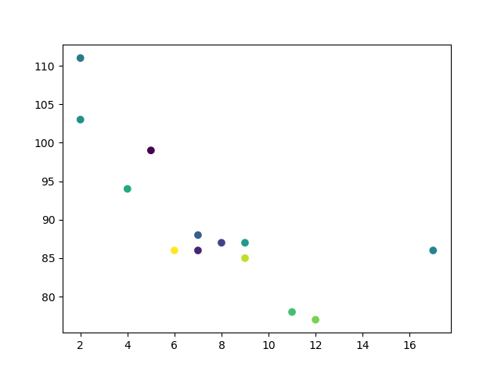
Use the ColorMap
You can specify the colormap with the keyword argument cmap with the value of the colormap, in this case 'viridis' which is one of the built-in colormaps available in Matplotlib.
In addition you have to create an array with values (from 0 to 100), one value for each of the point in the scatter plot
import matplotlib.pyplot as plt import numpy as np x = np.array([5,7,8,7,2,17,2,9,4,11,12,9,6]) y = np.array([99,86,87,88,111,86,103,87,94,78,77,85,86]) colors = np.array([0, 10, 20, 30, 40, 45, 50, 55, 60, 70, 80, 90, 100]) plt.scatter(x, y, c=colors, cmap='viridis') plt.show()

Slide 46
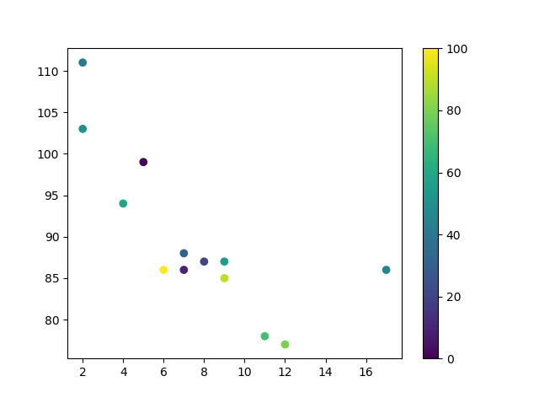
Use the ColorMap
You can include the colormap in the drawing by including the plt.colorbar() statement:
import matplotlib.pyplot as plt import numpy as np x = np.array([5,7,8,7,2,17,2,9,4,11,12,9,6]) y = np.array([99,86,87,88,111,86,103,87,94,78,77,85,86]) colors = np.array([0, 10, 20, 30, 40, 45, 50, 55, 60, 70, 80, 90, 100]) plt.scatter(x, y, c=colors, cmap='viridis') plt.colorbar() plt.show()

Slide 47
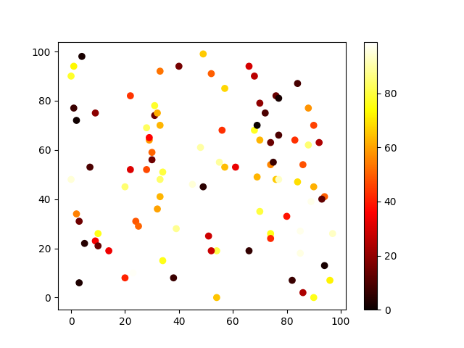
Available ColorMaps
You can choose any of the built-in colormaps:
import sys
import matplotlib
matplotlib.use('Agg')
import matplotlib.pyplot as plt
import numpy as np
x = np.random.randint(100, size=(100))
y = np.random.randint(100, size=(100))
colors = np.random.randint(100, size=(100))
plt.scatter(x, y, c=colors, cmap='hot')
plt.colorbar()
plt.show()

Slide 48
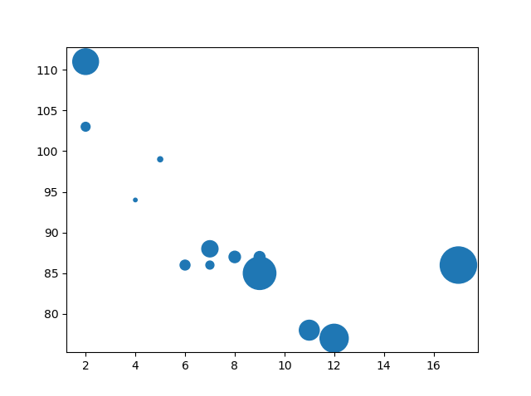
Dots Size
You can change the size of the dots with the s argument.
Just like colors, make sure the array for sizes has the same length as the arrays for the x- and y-axis
import matplotlib.pyplot as plt import numpy as np x = np.array([5,7,8,7,2,17,2,9,4,11,12,9,6]) y = np.array([99,86,87,88,111,86,103,87,94,78,77,85,86]) sizes = np.array([20,50,100,200,500,1000,60,90,10,300,600,800,75]) plt.scatter(x, y, s=sizes) plt.show()

Slide 49
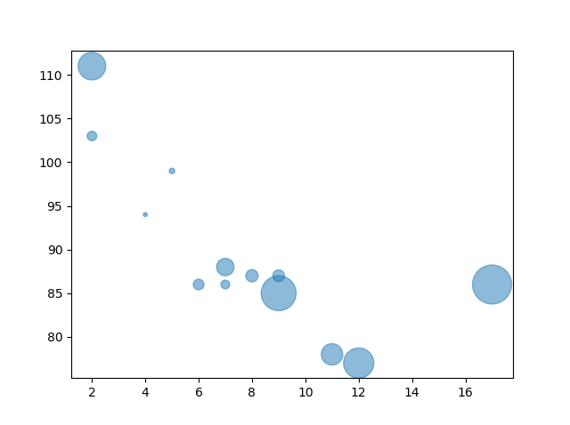
Alpha
You can change the size of the dots with the s argument.
Just like colors, make sure the array for sizes has the same length as the arrays for the x- and y-axis
import matplotlib.pyplot as plt import numpy as np x = np.array([5,7,8,7,2,17,2,9,4,11,12,9,6]) y = np.array([99,86,87,88,111,86,103,87,94,78,77,85,86]) sizes = np.array([20,50,100,200,500,1000,60,90,10,300,600,800,75]) plt.scatter(x, y, s=sizes, alpha=0.5) plt.show()

Slide 50
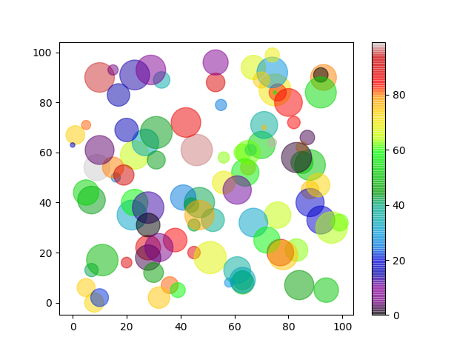
Combine Color Size and Alpha
import matplotlib.pyplot as plt import numpy as np x = np.random.randint(100, size=(100)) y = np.random.randint(100, size=(100)) colors = np.random.randint(100, size=(100)) sizes = 10 * np.random.randint(100, size=(100)) plt.scatter(x, y, c=colors, s=sizes, alpha=0.5, cmap='nipy_spectral') plt.colorbar() plt.show()

Slide 51
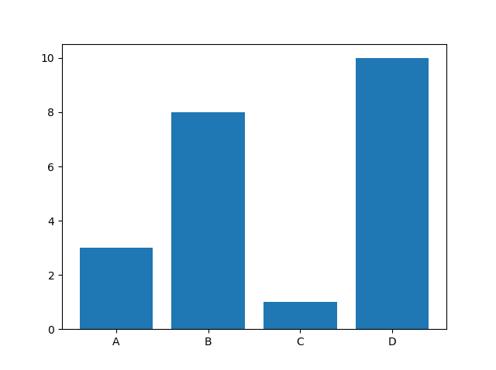
Creating Bars
With Pyplot, you can use the bar() function to draw bar graphs:
import matplotlib.pyplot as plt import numpy as np x = np.array(["A", "B", "C", "D"]) y = np.array([3, 8, 1, 10]) plt.bar(x,y) plt.show()

Slide 52
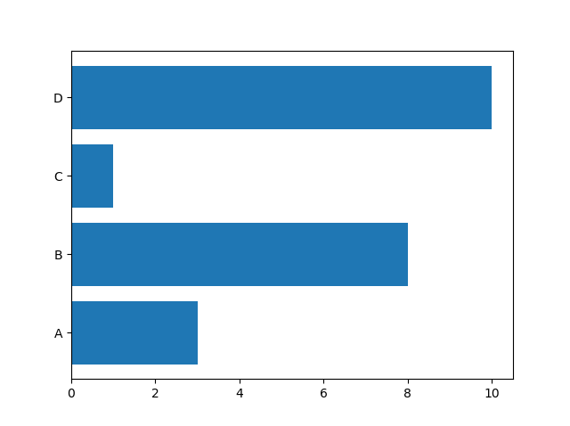
Horizontal Bars
If you want the bars to be displayed horizontally instead of vertically, use the barh() function:
import matplotlib.pyplot as plt import numpy as np x = np.array(["A", "B", "C", "D"]) y = np.array([3, 8, 1, 10]) plt.barh(x, y) plt.show()

Slide 53
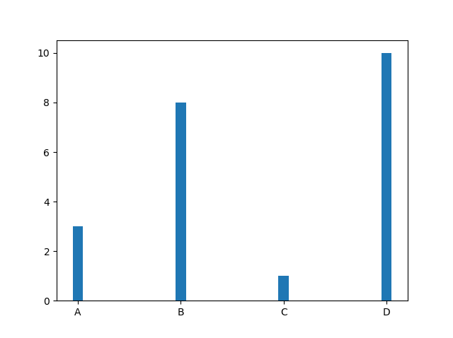
Bar Width
The bar() takes the keyword argument width to set the width of the bars:
import matplotlib.pyplot as plt import numpy as np x = np.array(["A", "B", "C", "D"]) y = np.array([3, 8, 1, 10]) plt.bar(x, y, width = 0.1) plt.show()

Slide 54
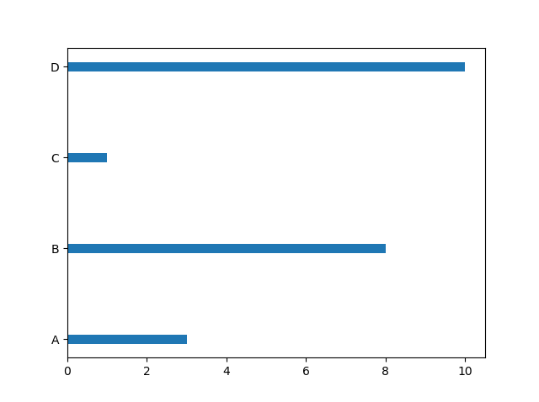
Bar Height
The barh() takes the keyword argument height to set the height of the bars:
import matplotlib.pyplot as plt import numpy as np x = np.array(["A", "B", "C", "D"]) y = np.array([3, 8, 1, 10]) plt.barh(x, y, height = 0.1) plt.show()

Slide 55
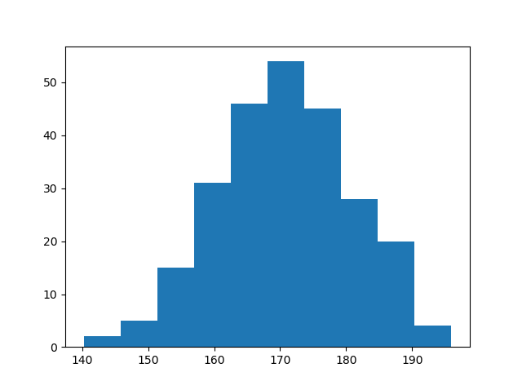
Histogram
A histogram is a graph showing frequency distributions.
It is a graph showing the number of observations within each given interval.
Example: Say you ask for the height of 250 people, you might end up with a histogram like this:
You can read from the histogram that there are approximately:
2 people from 140 to 145cm 5 people from 145 to 150cm 15 people from 151 to 156cm 31 people from 157 to 162cm 46 people from 163 to 168cm 53 people from 168 to 173cm 45 people from 173 to 178cm 28 people from 179 to 184cm 21 people from 185 to 190cm 4 people from 190 to 195cm

Slide 56
Histogram
A histogram is a graph showing frequency distributions.
It is a graph showing the number of observations within each given interval.
Example: Say you ask for the height of 250 people, you might end up with a histogram like this:
import matplotlib.pyplot as plt import numpy as np x = np.random.normal(170, 10, 250) plt.hist(x) plt.show()

Slide 57
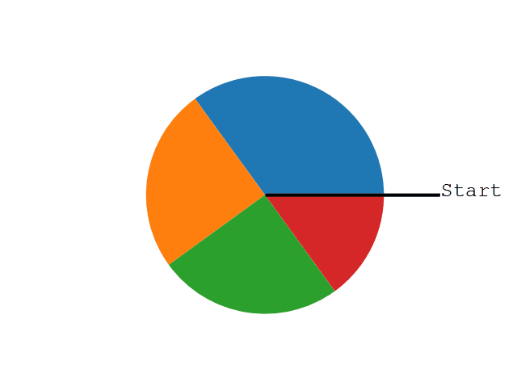
Pie Charts
With Pyplot, you can use the pie() function to draw pie charts:
import matplotlib.pyplot as plt import numpy as np y = np.array([35, 25, 25, 15]) plt.pie(y) plt.show()
By default the plotting of the first wedge starts from the x-axis and move counterclockwise:

Slide 58
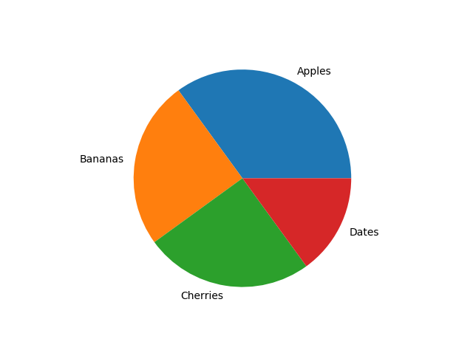
Labels
Add labels to the pie chart with the label parameter.
The label parameter must be an array with one label for each wedge
import matplotlib.pyplot as plt import numpy as np y = np.array([35, 25, 25, 15]) mylabels = ["Apples", "Bananas", "Cherries", "Dates"] plt.pie(y, labels = mylabels) plt.show()

Slide 59
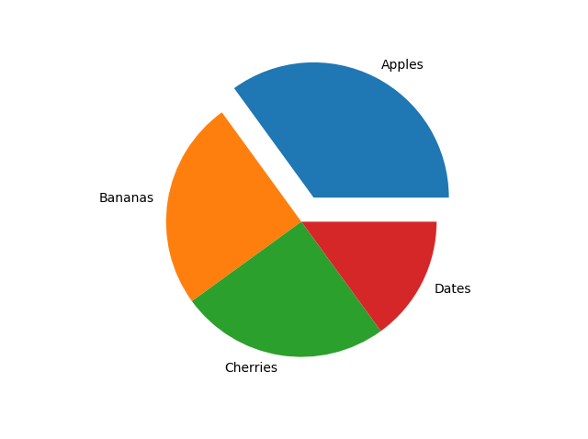
Explode
Maybe you want one of the wedges to stand out? The explode parameter allows you to do that.
The explode parameter, if specified, and not None, must be an array with one value for each wedge.
Each value represents how far from the center each wedge is displayed:
import matplotlib.pyplot as plt import numpy as np y = np.array([35, 25, 25, 15]) mylabels = ["Apples", "Bananas", "Cherries", "Dates"] myexplode = [0.2, 0, 0, 0] plt.pie(y, labels = mylabels, explode = myexplode) plt.show()

Slide 60
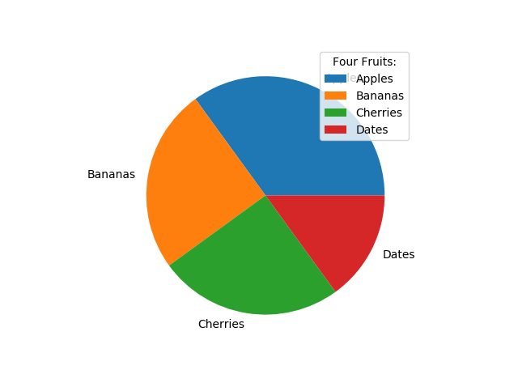
Legend
To add a list of explanation for each wedge, use the legend() function:
To add a header to the legend, add the title parameter to the legend function.
import matplotlib.pyplot as plt import numpy as np y = np.array([35, 25, 25, 15]) mylabels = ["Apples", "Bananas", "Cherries", "Dates"] plt.pie(y, labels = mylabels) plt.legend(title = "Four Fruits:") plt.show()

Slide 61
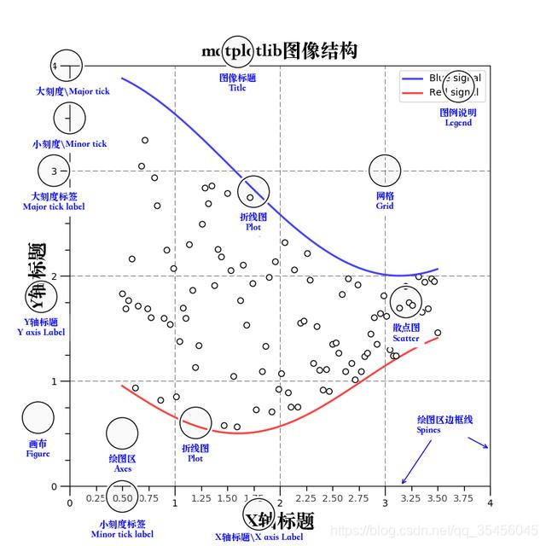

Slide 62
Matplotlib三层结构
容器层
容器层主要由Canvas、Figure、Axes组成。
Canvas画板（只有一个不用去管） Figure画布（只有一个不用去管，接受一下即可） Axes绘图区域（重点，有可能在旁边画好几个图，所以是一个二维数组）

Slide 63
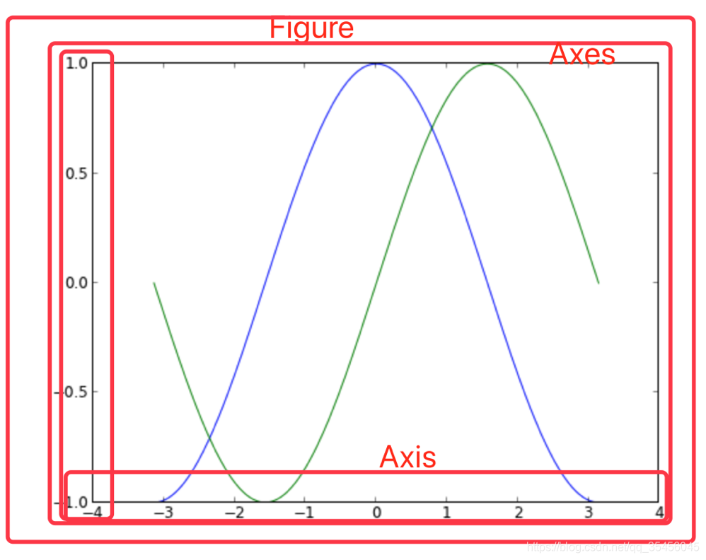

Slide 64
结束

