Slide 1
1
SOURCE RELIABILITY
2
DISTRIBUTIONAL SURFACE SPLATTING
3
VISIBILITY-GUIDED ROUTING
4
FUSED OUTPUT
Aₛ = [Iₛ, Fₛ]
C
κ
V
H
D̄
M
renderer-derived condition h
RGB
Iₛ
SPARSE
Dₛ
VALID
Mₛ
DETERMINISTIC σ SAMPLES
TARGET-PLANE
SPLATS
warped evidence
CALIBRATED
PROJECTION
TRANSPORT EXPERT
calibration Kₛ · Kₜ · Tₛ→ₜ
BOUNDED ROUTER
1−g
Kₛ → Tₛ→ₜ → Kₜ
warped evidence
+ bounded ΔRGB
physics
prior g⁰
+
learned
Δg
−σ
μ
+σ
DEPTH RELIABILITY ENCODER
zqk = clip(μ + ξkσ)
Jacobian + tilt
anisotropic footprint
soft nearest surface
FUSED OUTPUT
full-res
residual
¼-res
context
g ∈ [0,1]
SYNTHESIS EXPERT
blended RGB-D
+ predicted risk
ONE RASTERIZATION RETURNS BOTH
warped evidence + visibility statistics
g
local conv + FFT
RGB · depth · risk
μ
σ
n
c
Fₛ
μ mean · σ scale · n normal
c confidence · Fₛ feature
warp Iᵂ,Fᵂ
depth D̄
support S,C
variance V
collision H
SOFT FUSION
target reliability κ = f(C, V, H)
(1−g) transport + g synthesis
Îₜ · D̂ₜ · Uₜ
−σ
μ
+σ
TRAINING ONLY · DASHED
predicted RGB-D + risk
target RGB-D + mask
Lrgb · Ldepth · Lrouter · Lrisk
BACKWARD DSS
Tₜ→ₛ
source-view cycle Lcyc
supervision; not an inference input

Slide 2
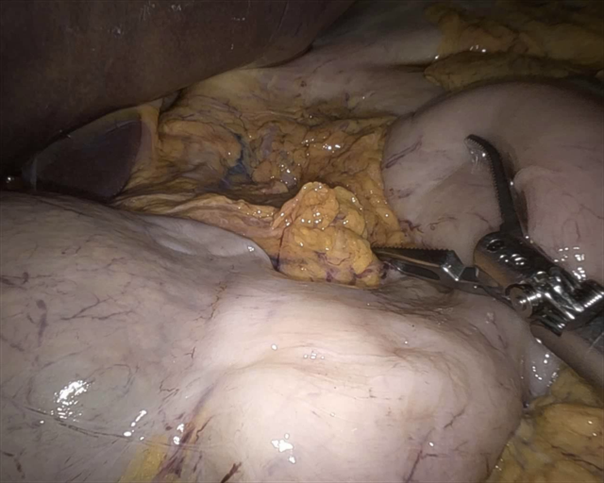
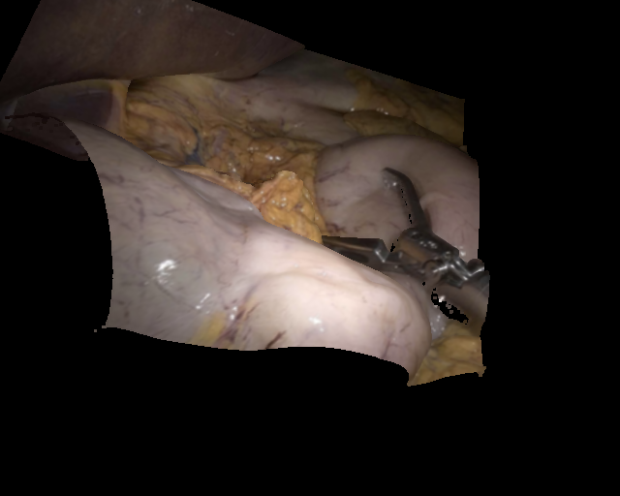
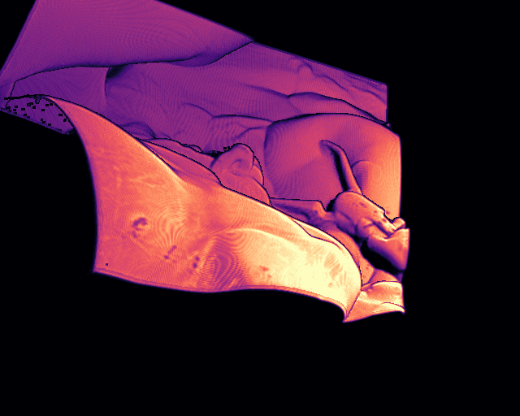
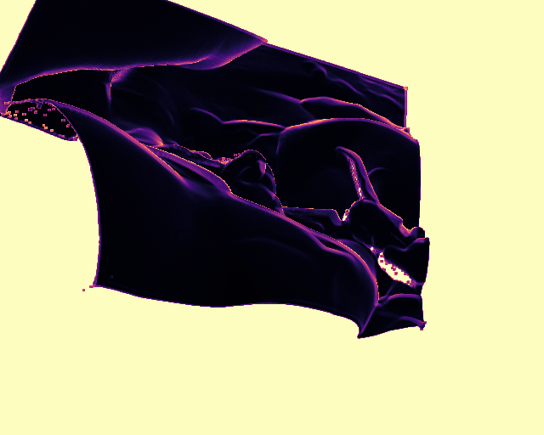
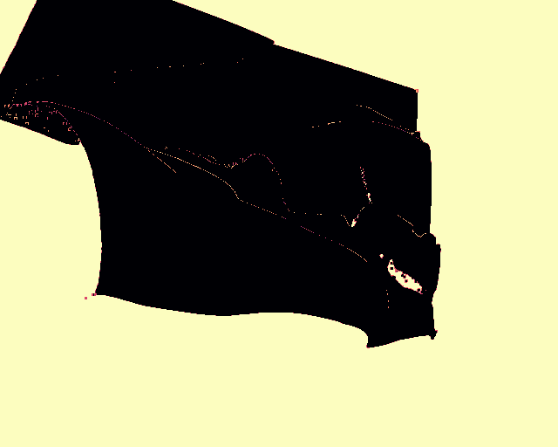
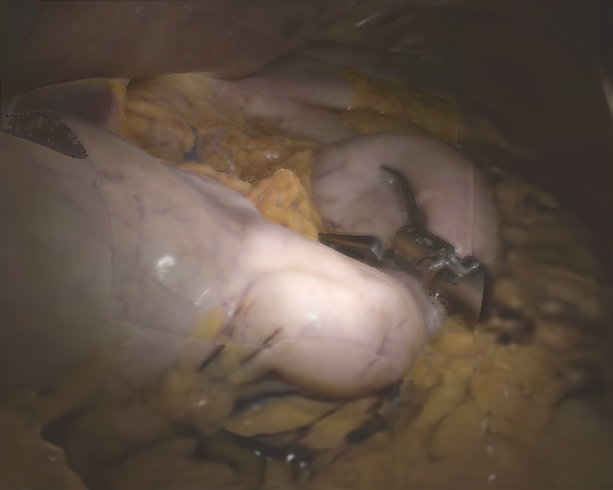
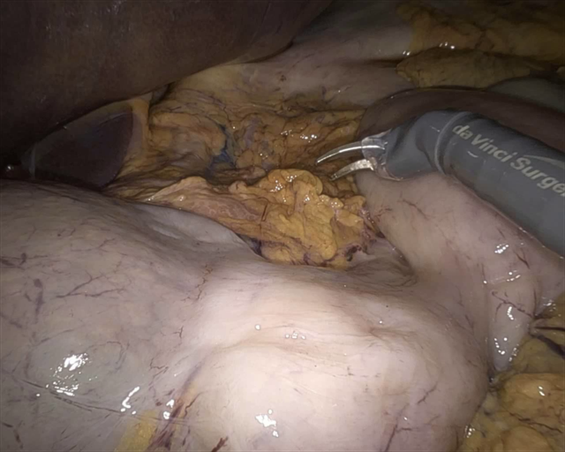
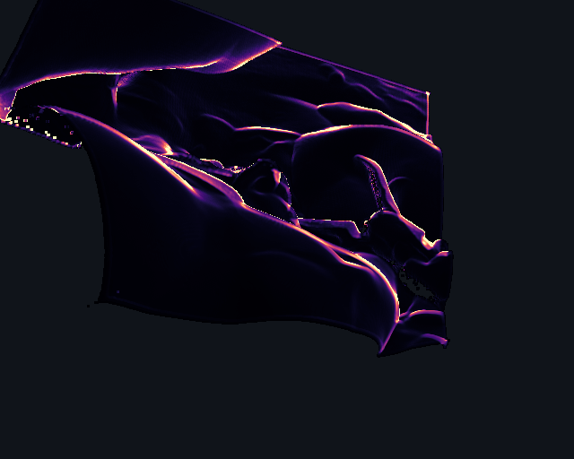
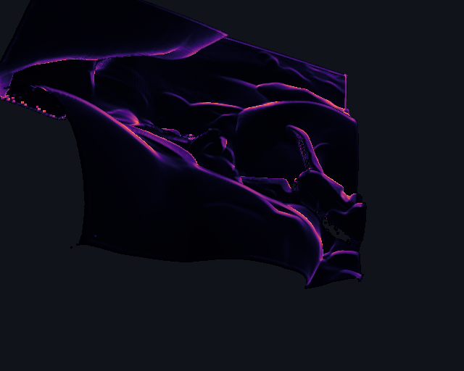
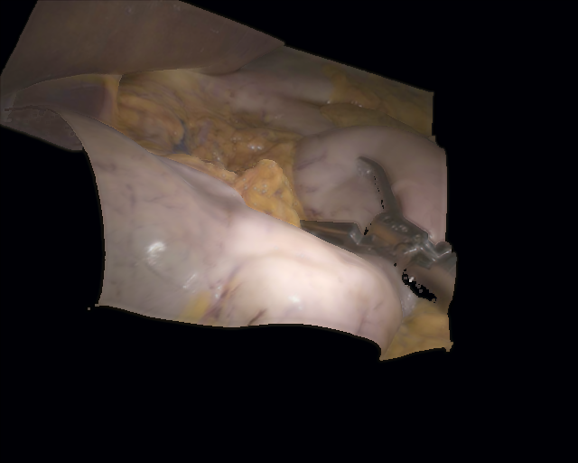
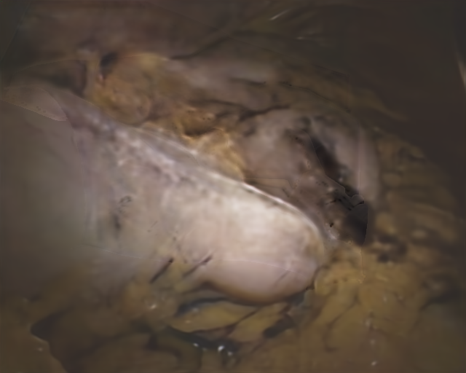
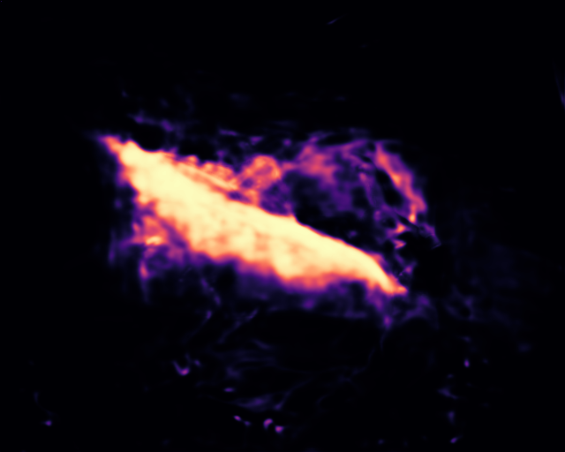
NO-HARD COMPOSITION · TRACEABLE SINGLE-FRAME INTERNALS
Matched forward pass: tool_3 / frame_000002 · step 10,000 · no post-processing · tool_4 is shown separately as a train-split appearance example
1
INPUT CONTEXT
2
DSS GEOMETRY
3
SOFT ROUTING + EXPERTS
4
OUTPUT
DSS warp Iₜʷ
support S
physics prior g⁰
synthesis gate g
soft-fused RGB
matched tool_3 source Iₛ
variance V
collision entropy H
transport expert
synthesis expert
predicted risk Uₜ
tool_4 RGB · TRAIN EXAMPLE

Slide 3
DistriNVS framework · editing guide
Recommended paper size: 183 × 76 mm (double column). Keep the renderer-derived statistics, constrained gate, two experts, fused output, and training-only cycle visually distinct.
source / depth
DSS / geometry
transport / fusion
synthesis / risk
endoscopic appearance
Suggested caption
DistriNVS framework. A reliability encoder predicts source geometry and features. DSS transports deterministic depth hypotheses through the calibrated cross-endoscope transform and jointly produces warped evidence and target-plane visibility statistics. These statistics condition a reliability-constrained soft mixture of a residual transport expert and a Fourier synthesis expert. Solid arrows denote inference; the dashed lower lane is used only during training.

