Slide 1

2021 Crime Rate vs prison Stats
Researched and compiled by
The Curious Conquerors
-Alisha -Mischa -Lindsay

Slide 2



Meet the Curious Conquerors
Alisha
I am a mom of an 8 month old and another on the way. My children’s father and I are engaged and plan to be married in October.
I currently work as a 911 dispatcher. I am originally from Florida, and then lived in Colorado, Idaho, California, and now Texas.

Slide 3
Meet the Curious Conquerors
Lindsay
Grew up and still currently resides in Northern Iowa. I am close to my family and friends. I do not have any children, just 3 dogs and a lot of plants.
I work in customer service and has always had a drive for technology.

Slide 4
Meet the Curious Conquerors
Mischa
First meet
Nervous, Shy, goofy, fast
At work
I am known to be every team’s go-to training and know-how expert.
Direct, formal, confident
At Home
I inspire my two daughters
by modeling:
Student
Family Member
Fulfilling Career
Motivation
Love for information and a better understanding of data to improve life.

Slide 5
Why crime rates vs prison rates?
With Alisha being an emergency dispatcher for a Sheriff’s office in Texas, we first attempted to do our project on crime rates within the country she works in. However, we were not able to access the data we desired in the timeframe needed, and so we decided to see what crime data we could find and go from there.
We were able to find a plethora of data and worked to wrangle the data to narrow down what we wanted to use. Some of the data we found involved individual states and their violent and property crime rates, and so we

Slide 7
Methods

Slide 8
Are unemployment rates correlated with crime rates?
Pearson’s Regression

Slide 9
How does the unemployment rate affect the correlation between police reports and prison rates?
Step Wise Linear Regression

Slide 10
Results

Slide 11
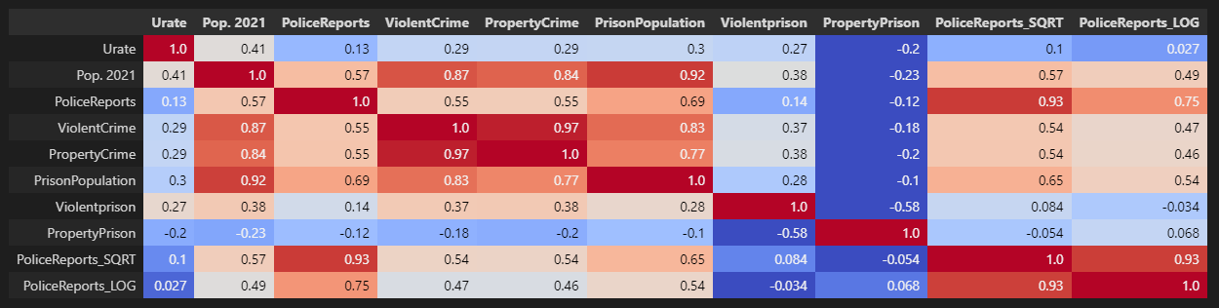
Chart of Correlations

Slide 12
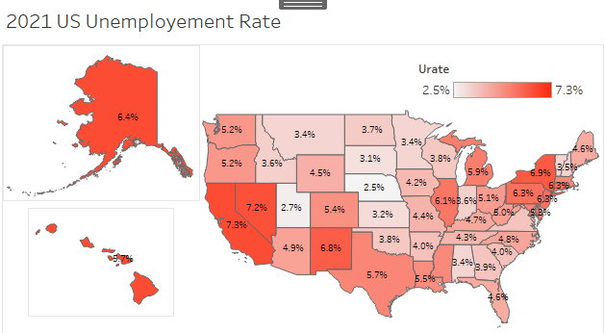
Unemployment rate vs Crime rate (based on police reports)
Texas and florida with significantly high police reports, iowa avg
Iowa has an average amount of police reports
Weak correlation

Slide 13
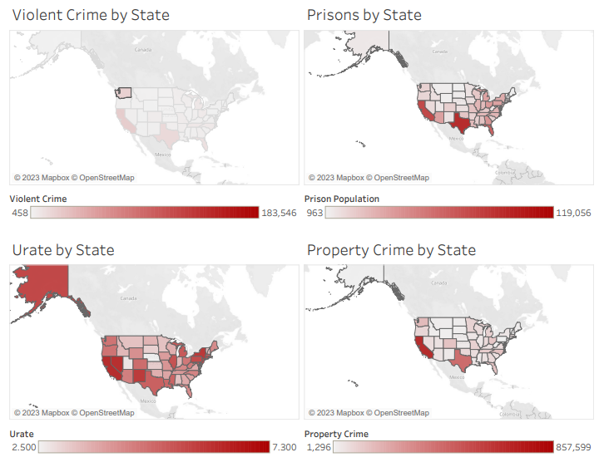

Slide 14
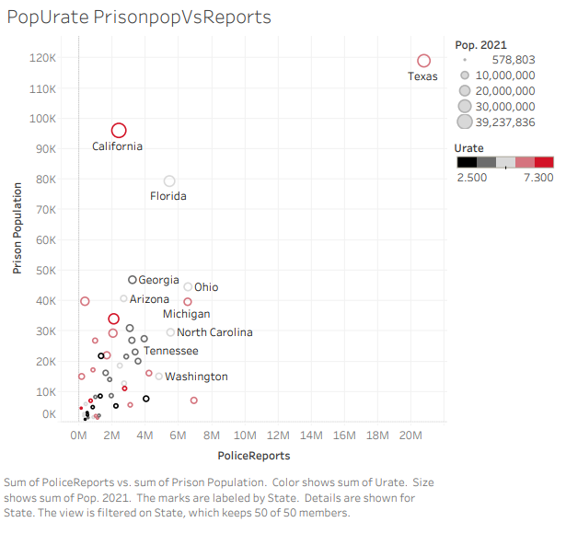
Urate vs prison population and police report correlation
hhh

Slide 15
Urate vs Prison Population – not significant
Urate vs Police Reports – not significant
Prison Population vs Police Reports – significant
Unemployment rate has a slightly significant relationship on prison population but not on police reports

Slide 16
Summary

Slide 18
Conclusion

Slide 19
Want to add time factor and state size factor

Slide 20
Questions?

