Slide 1

2021 Crime Rate vs prison Stats
Researched and compiled by
The Curious Conquerors
-Alisha -Mischa -Lindsay

Slide 2



Meet the Curious Conquerors
Alisha
I am a mom of an 8 month old and another on the way. My children’s father and I are engaged and plan to be married in October.
I currently work as a 911 dispatcher. I am originally from Florida, and then lived in Colorado, Idaho, California, and now Texas.

Slide 3
Meet the Curious Conquerors
Lindsay
Grew up and still currently resides in Northern Iowa. I am close to my family and friends. I do not have any children, just 3 dogs and a lot of plants.
I work in customer service and has always had a drive for technology.

Slide 4
Meet the Curious Conquerors
Mischa
hh

Slide 5
Why crime rates vs prison rates?
With Alisha being an emergency dispatcher for a Sheriff’s office in Texas, we first attempted to do our project on crime rates within the country she works in. However, we were not able to access the data we desired in the timeframe needed, and so we decided to see what crime data we could find and go from there.
We were able to find a plethora of data and worked to wrangle the data to narrow down what we wanted to use. Some of the data we found involved individual states and their violent and property crime rates, and so we

Slide 6
Methods

Slide 8
Results

Slide 9
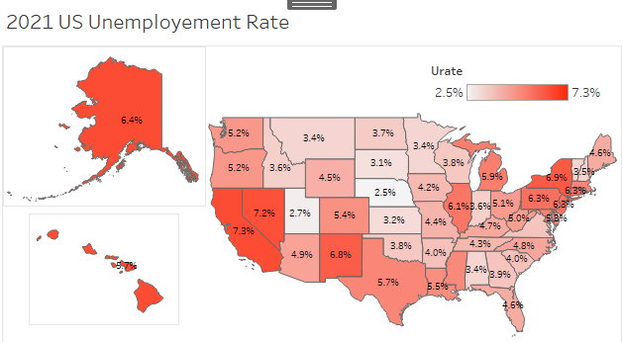
Unemployment

Slide 11
Summary

Slide 13
Conclusion

Slide 15
Questions?

