Slide 1

HandsOnL09
Mischa Hermes​​

Slide 2

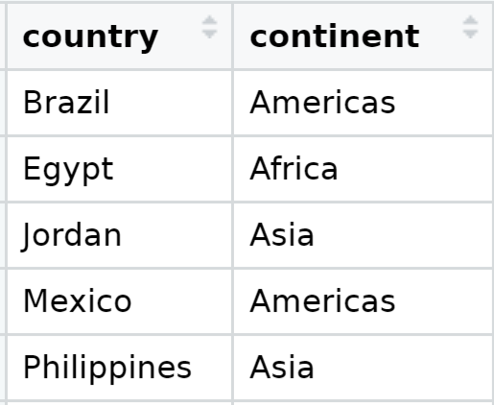
Data Exportation
Life Expectancy

Slide 3
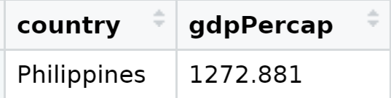
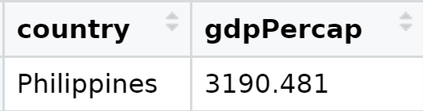
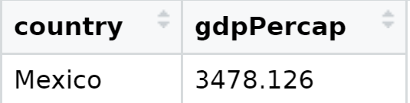
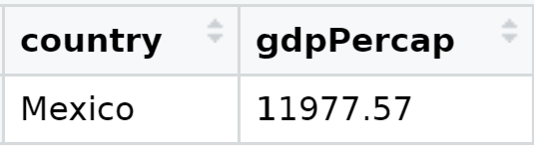

Gross Domestic Product per capita comparison
1952
2007
Philippines has the lowest average GDP in 1952
Philippines has the lowest average GDP in 2007
Mean GDP
2983.027
11,680.07
Out of the 5 country's , Mexico barely makes it above average in 2007
Mexico has the Highest GDP in 1952
Mexico has the Highest GDP in 2007
Does GDP have an effect on Life expectance?

Slide 4

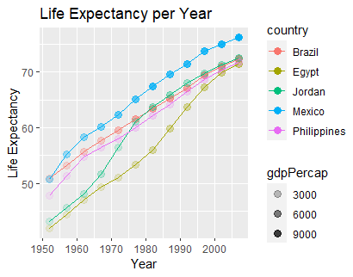
Business model
Time
As time goes by Life expectancy gets older.
GDP
AS capital products Increase so does Life expectancy
Deduction
As more money and opportunity increase so does the health and over all drive to live longer.

Slide 5

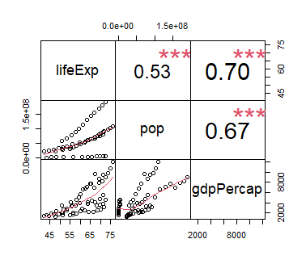
Its all connected
Capital
The more money you have the longer you live the more people you have
$3B​
Life expectancy
More money/product the easier it is to live longer
$2B
Population
Capital grows more with more population
The longer you live the more people there are
$1B

Slide 6
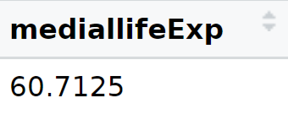
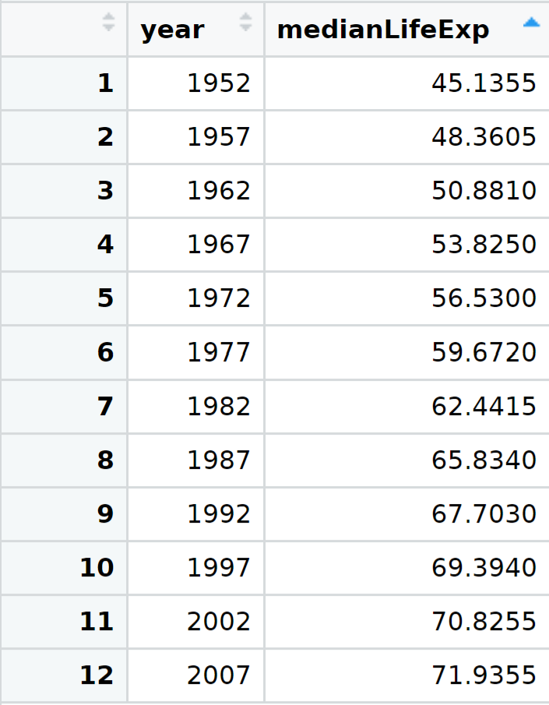
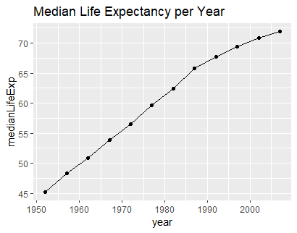

About us
We see here that Life Expectancy over all the data follows the same path. Hypothesis people grow as a whole. One come up others will soon follow suit. No regression continues progress.

Slide 7

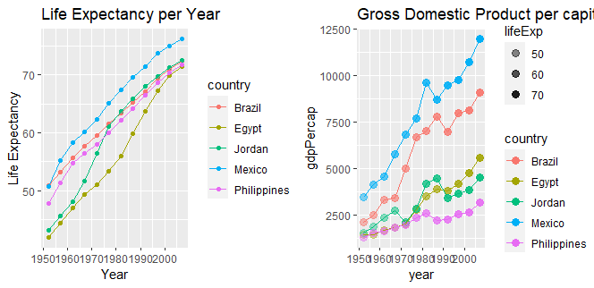
There is a strong correlation between life Expectancy and Gross Domestic Product per capita
Pearson's product-moment correlation
data: exp.5$lifeExp and exp.5$gdpPercap
t = 7.4333, df = 58, p-value = 5.479e-10
alternative hypothesis: true correlation is not equal to 0
95 percent confidence interval:
0.5404049 0.8089331
sample estimates:
cor
0.6984823
We also see that the Philippines has the lowest Gross Domestic Product per capita but maintains a high life expectancy even in the earlier years. Tells me there are other factors than money in life.

Slide 8
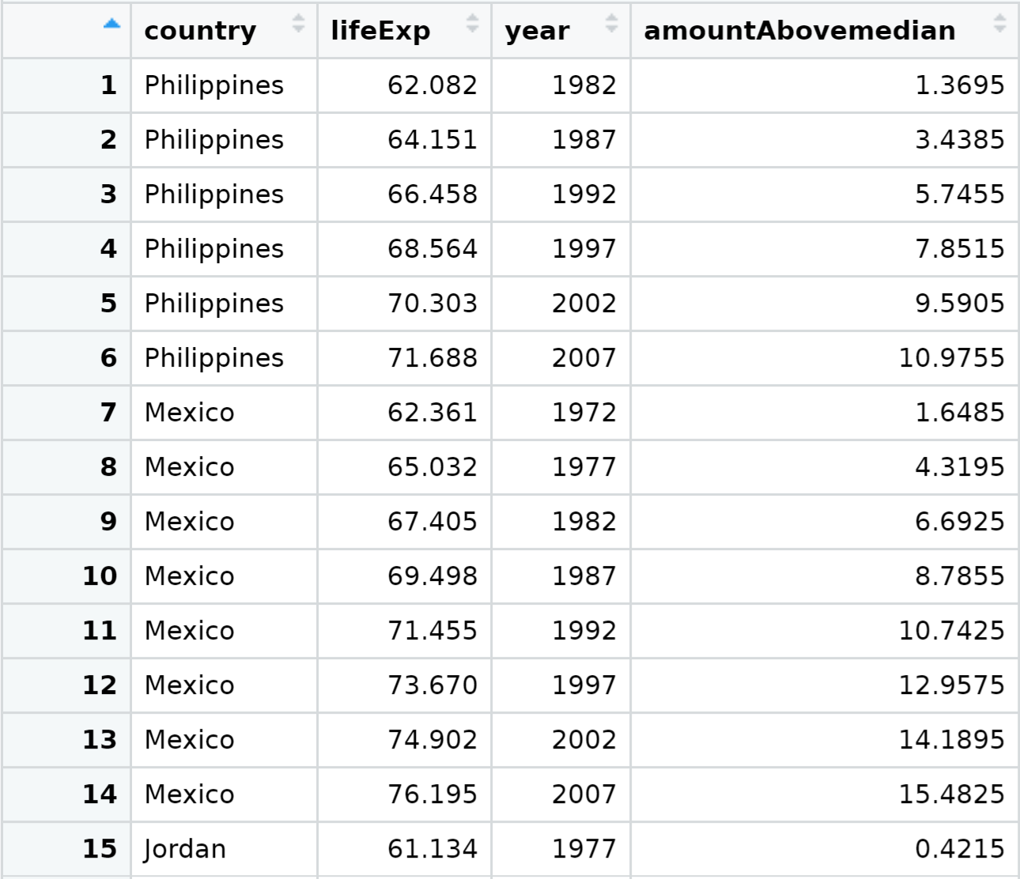

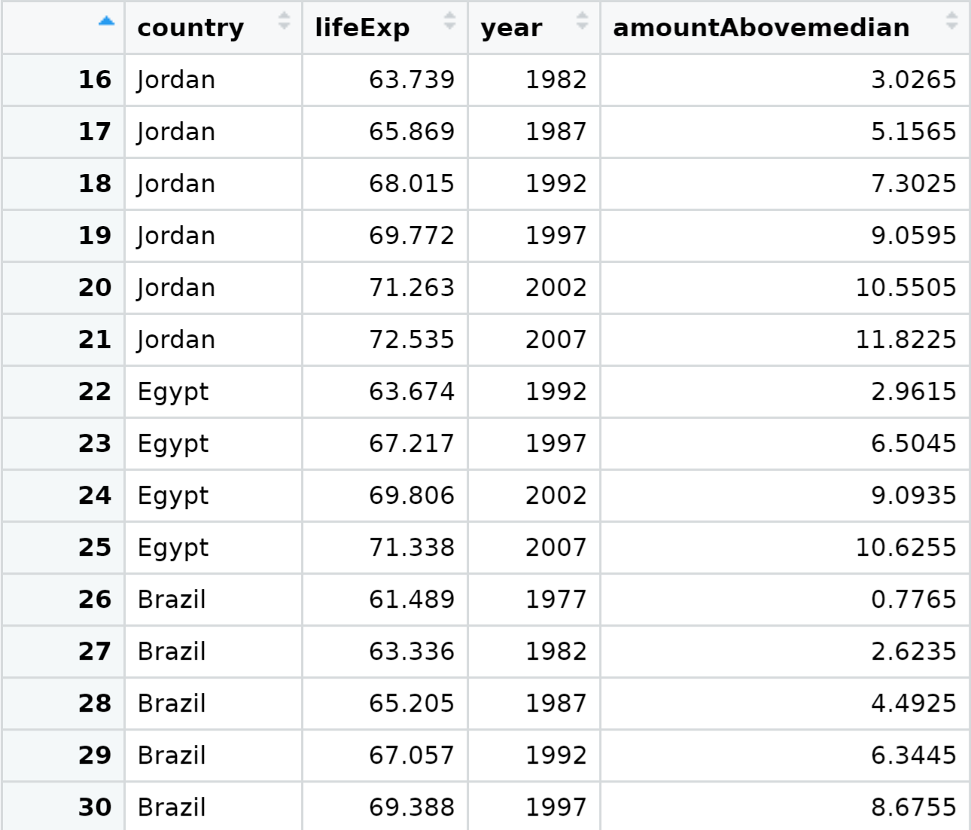
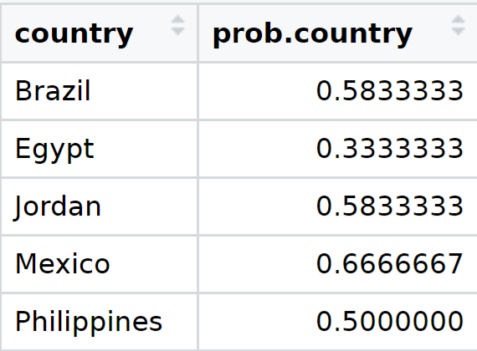
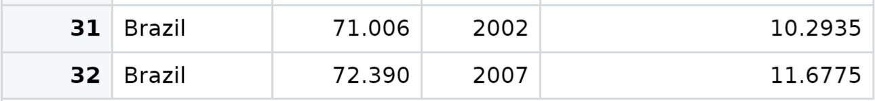
summary
In summary life expectancy is getting older and older by the years. The more we learn the more we can help each other live longer. From my data even in poorer country’s life is getting better.

