Slide 1
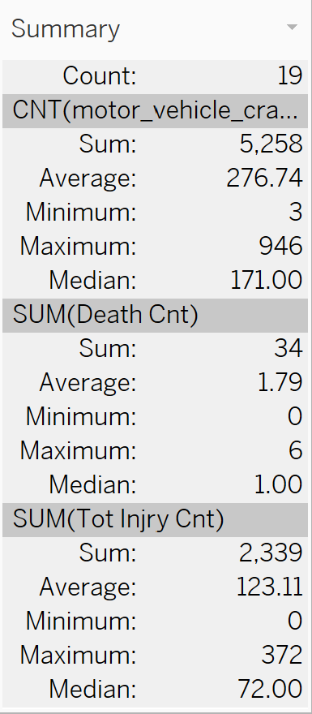
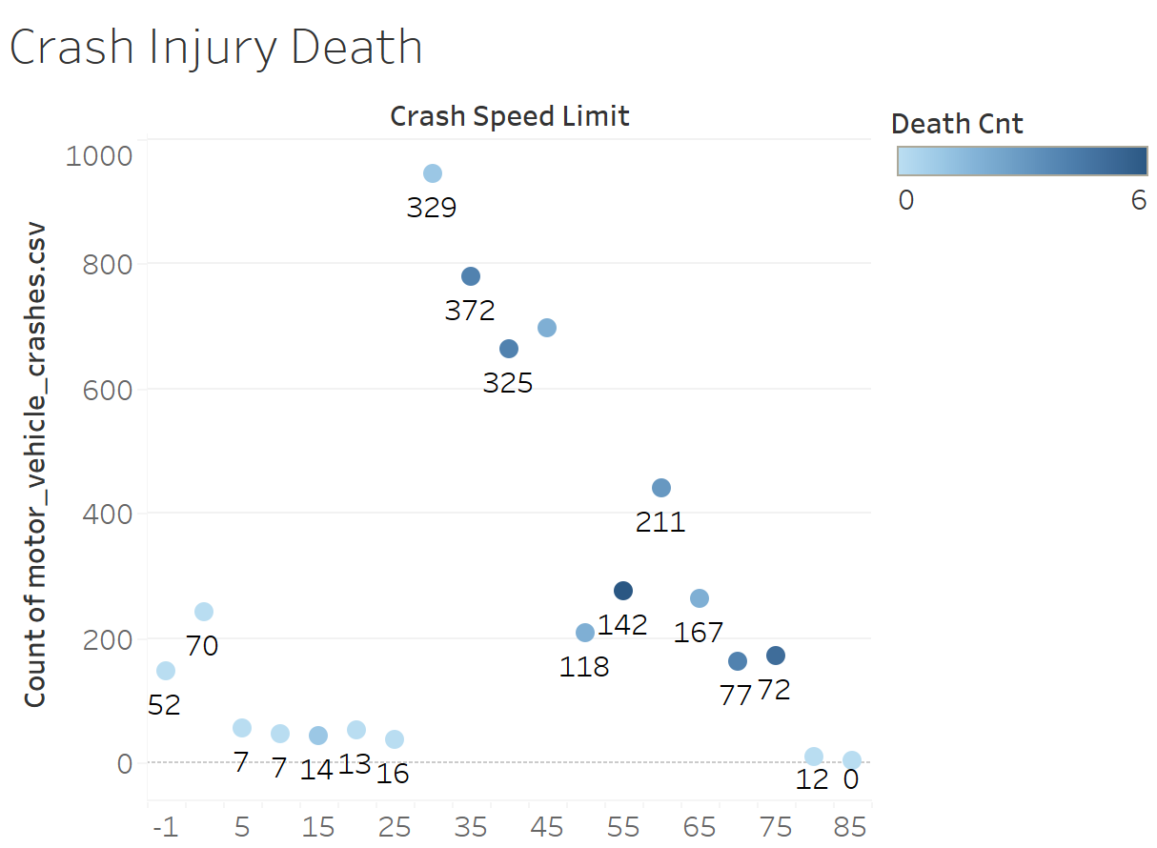
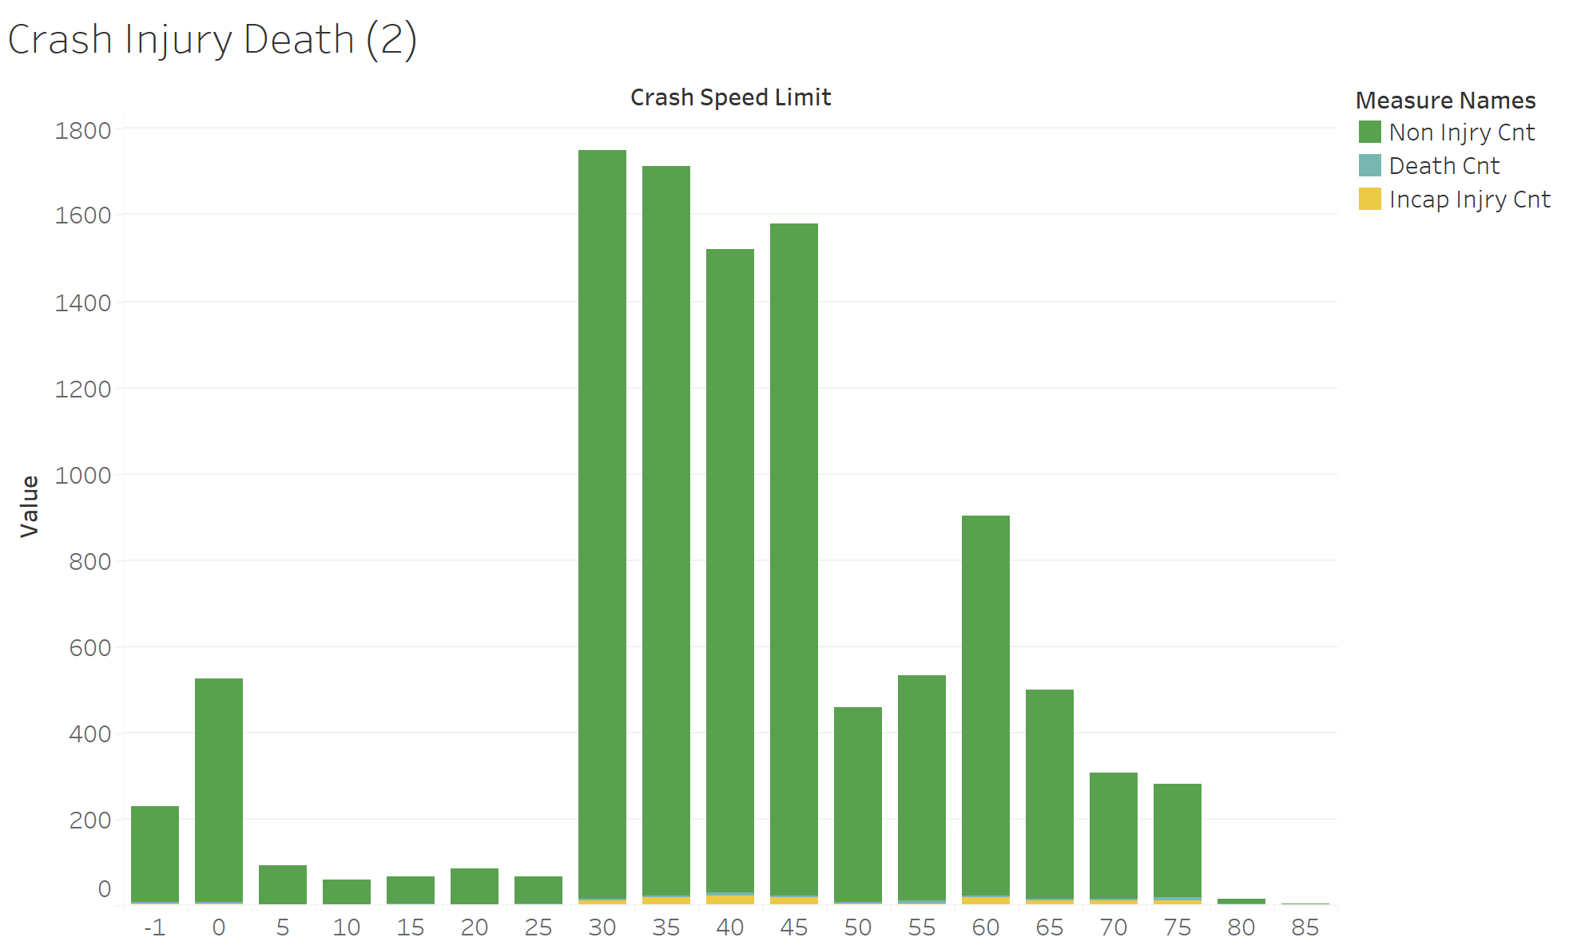

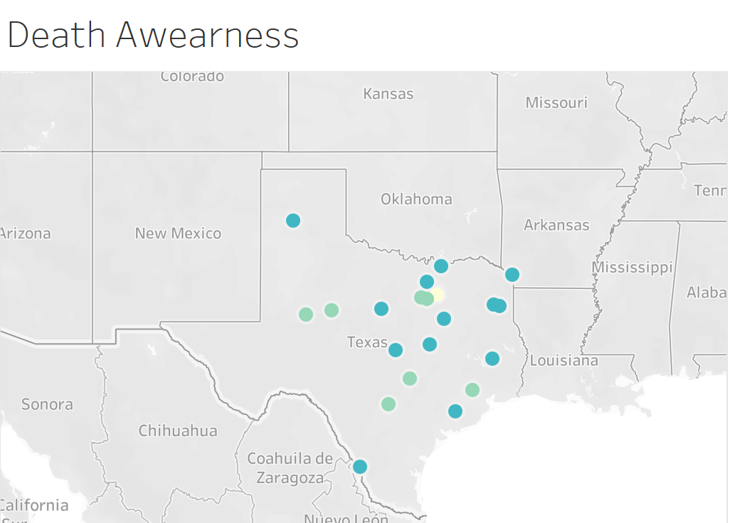
Infographic Resume
Texas Crash Information
104 Final
Database
2013
Front-End
Year
Backend
Community Awearness
Facts
Factors
Measures
Use this to enter information about your experience.
Want to change the image? Right click, choose Fill, then choose Picture.
PERSONAL
Education
Don’t be a stitictic drive safe.
The number of non injurys wash out my data of injurys but does not make the injurys and deaths any less important.
Accedents happen at any speed
Not all crashes have injurtys
Death are a small but significate

Slide 2

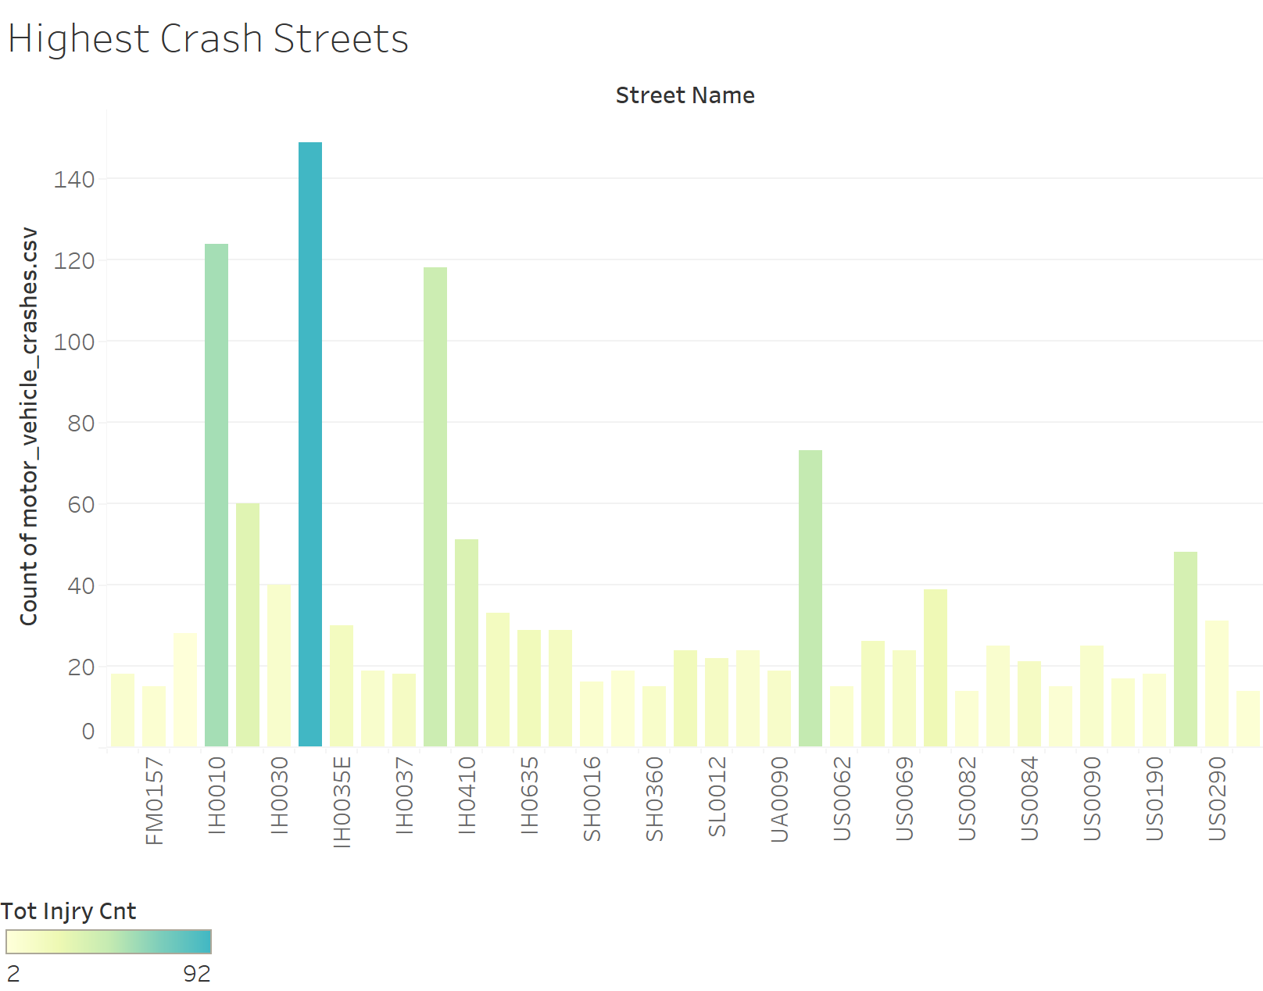
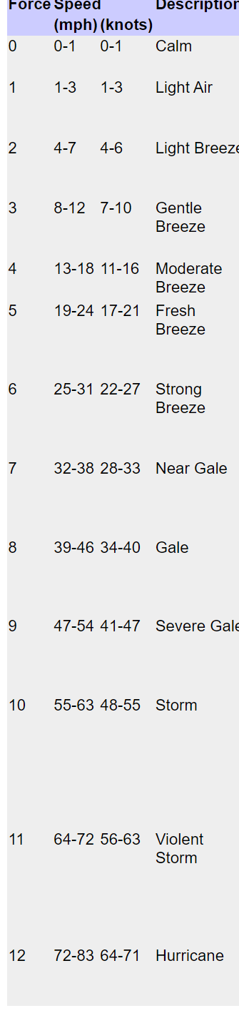
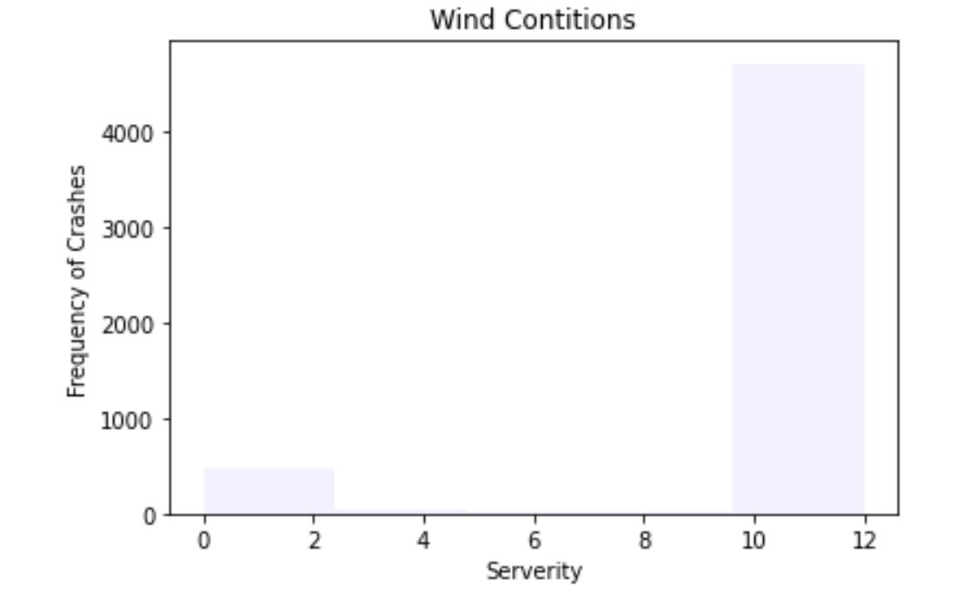
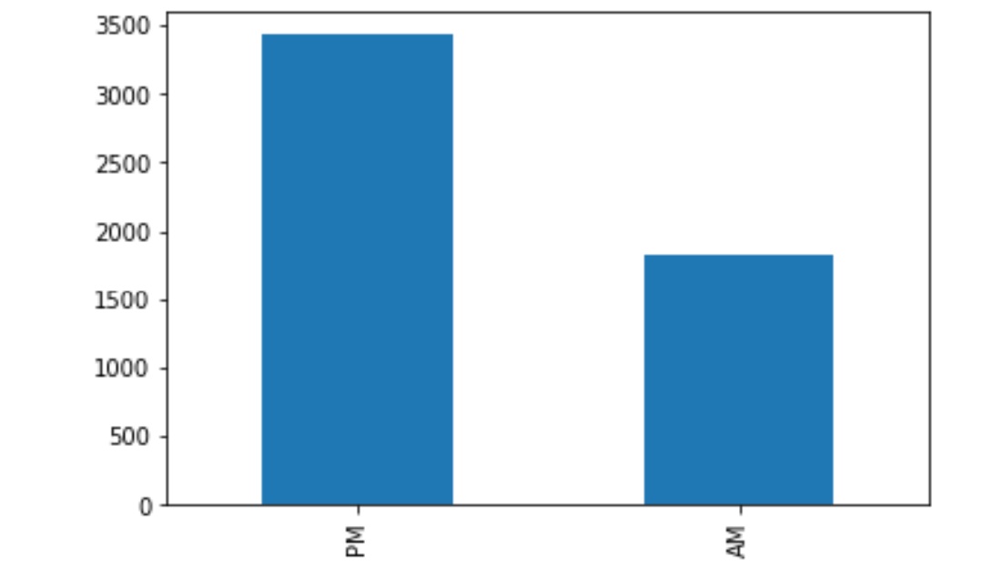
Condition Factors
The top amount of traffic crashes are found on the Highways
We see a few that needs another look at for further safety precautions
The more crashes the higher the chances of death.
Note:
This a graph of wind not temperature
Don’t go out in a violent storm
Looks like its obvious not to go out in the Hurricane
“The freaks come out at night”
Less crashes in the morning.

Slide 3
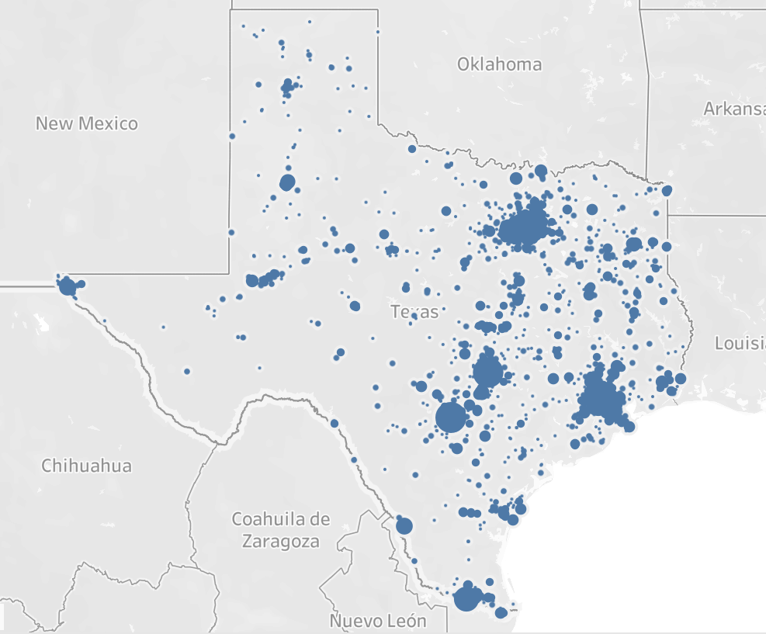
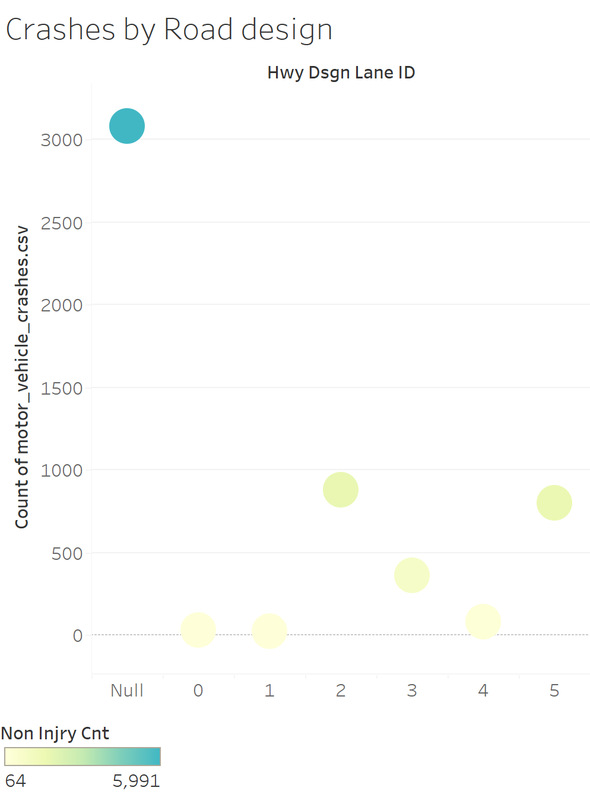
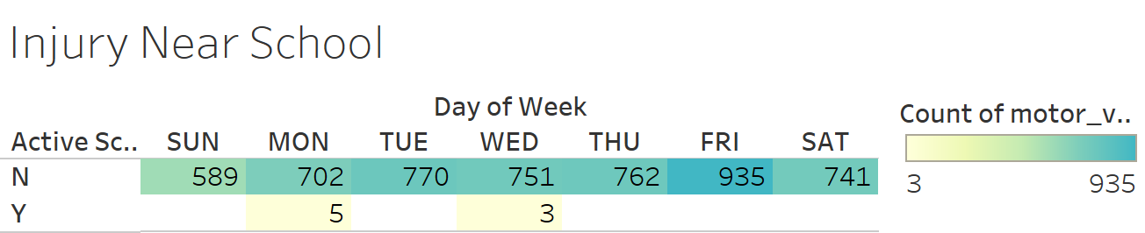
Safety Measures
Road design
The design play a big role .
We must do better on the measures we take to be safe and that start in the build and ends with you and me.
Facts
Factors
Measures
It is clear the that youth are valued in our society
Very few crashes happen in school areas
School Areas

