Slide 1

cv
DETECTION OF COUNTERFEIT MEDICAL PRODUCTS
Team Members:
1. Rachana L (1DS19CS122)
2. Ranjita Kiran Naik (1DS19CS125)
3. Rashmika Satish (1DS19CS126)
4. Saba Naseem (1DS19CS136)
Under the Guidance of
Ramya K M
Asst. Professor,
Dept of Computer Science and Engineering
Department of Computer Science & Engineering, DSCE

Slide 2
CONTENTS
Introduction
Objective
Design Details
Software tools
Individual Contribution
Co guide Suggestions
Project Management Tool
Screenshots
Department of Computer Science & Engineering, DSCE

Slide 3
INTRODUCTION
Counterfeiting of medical products is a serious problem that threatens public health and profitability.
Current methods for ensuring authenticity lack real-time tracking and rely on manufacturers for data control.
A proposed blockchain system would use decentralized technology to provide consumers with a way to verify authenticity without relying on merchants.
The blockchain system would provide real-time tracking and trust and security verification from third-party sources, while removing the need for FDA involvement in verification.
Department of Computer Science & Engineering, DSCE

Slide 4
OBJECTIVE
The goal of our project is to find whether a given product is fake or original using Blockchain Technology.
To ensure the identification and traceability of real products throughout the supply chain, we propose a fully functional blockchain system to prevent product counterfeiting, for that we are creating web interface for the user to scan the information of the product through the product QR Code.
Finally the records of transaction history will be stored in block chain which can never be modified.
Department of Computer Science & Engineering, DSCE

Slide 5
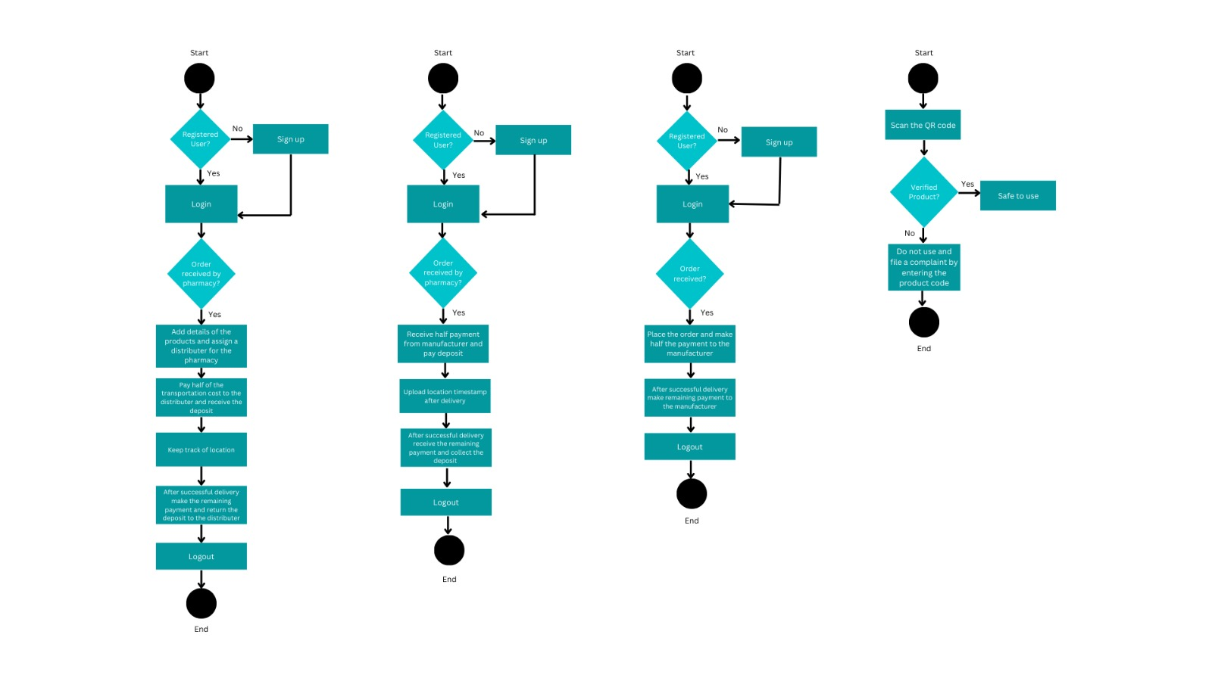
DESIGN DETAILS
Department of Computer Science & Engineering, DSCE

Slide 6
SOFTWARE TOOLS
Ethereum Blockchain
Smart Contracts
Web3.js
IPFS
HTML, CSS, and JavaScript
Node.js
PHP and SQL
MetaMask
Truffle Suite
Ganache
Department of Computer Science & Engineering, DSCE

Slide 7
SOFTWARE TOOLS-DESCRIPTION
Ethereum Blockchain: The Ethereum blockchain is used to store product authentication data, such as batch numbers, serial numbers, and product information.
Smart Contracts: Smart contracts are used to automate the verification and authentication of medical products, ensuring transparency and trust in the system.
Web3.js: Web3.js is a JavaScript library that provides an interface for interacting with the Ethereum blockchain. It is used to build web applications that communicate with the blockchain.
HTML, CSS, and JavaScript: These web technologies could be used to build the user interface for the web application.
Department of Computer Science & Engineering, DSCE

Slide 8
SOFTWARE TOOLS-DESCRIPTION
Node.js: Node.js is a JavaScript runtime that allows you to run JavaScript code outside of a web browser. It can be used to build server-side applications that interact with the Ethereum network. Node.js provides a number of modules for working with the Ethereum blockchain, such as the web3 module, which is similar to the Web3.js library.
PHP and SQL: These technologies could be used to store user details, such as user accounts and transaction histories.
MetaMask: MetaMask is a browser extension that allows users to manage their Ethereum accounts and sign transactions. It could be used to provide a seamless user experience for interacting with the blockchain.
Truffle Suite: Truffle Suite provides a suite of tools for developing and testing Ethereum-based applications. It includes a development environment, a testing framework, and a deployment tool.
Ganache: Ganache is used to deploy and test smart contracts locally, without the need for a connection to the actual Ethereum network.
Department of Computer Science & Engineering, DSCE

Slide 9
INDIVIDUAL CONTRIBUTION
RACHANA | RANJITA | RASHMIKA | SABA
Signup/Login MySQL Database | Homepage Check Products page | FDA page Scan shipment page | Home page Add products page
Department of Computer Science & Engineering, DSCE

Slide 10
CO-GUIDE SUGGESTIONS
Review 1:
Introduction to the project
Problem Statement
Synopsis of the project
Suggestions: To start with the implementation
Review 2:
Discussion of the base paper
Methodology and Design
Suggestions: Improvements in the design, include the QR code in the design
Review 3:
Design Details
Software tools used
60% Project implemented
Suggestions: To improve the UI and add details about the project in the application
Department of Computer Science & Engineering, DSCE

Slide 11
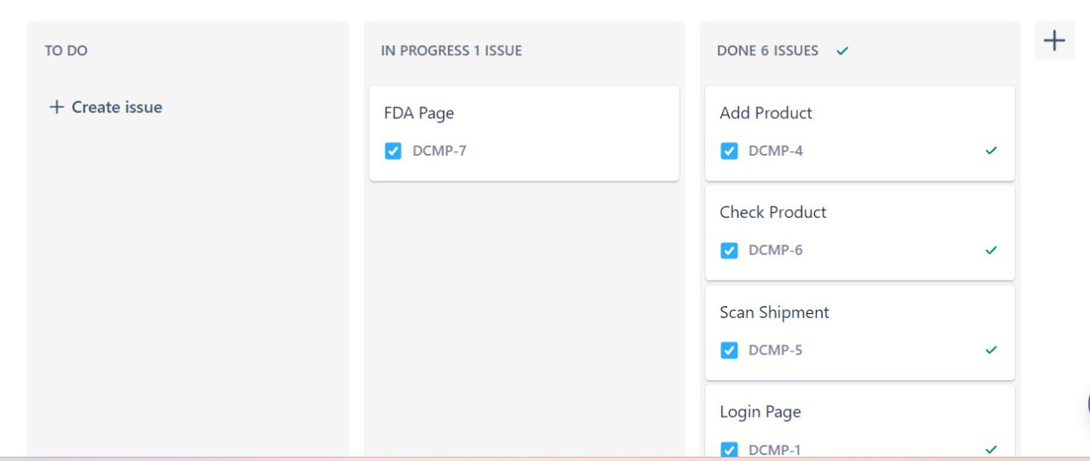
PROJECT MANAGEMENT TOOL
Department of Computer Science & Engineering, DSCE

Slide 12
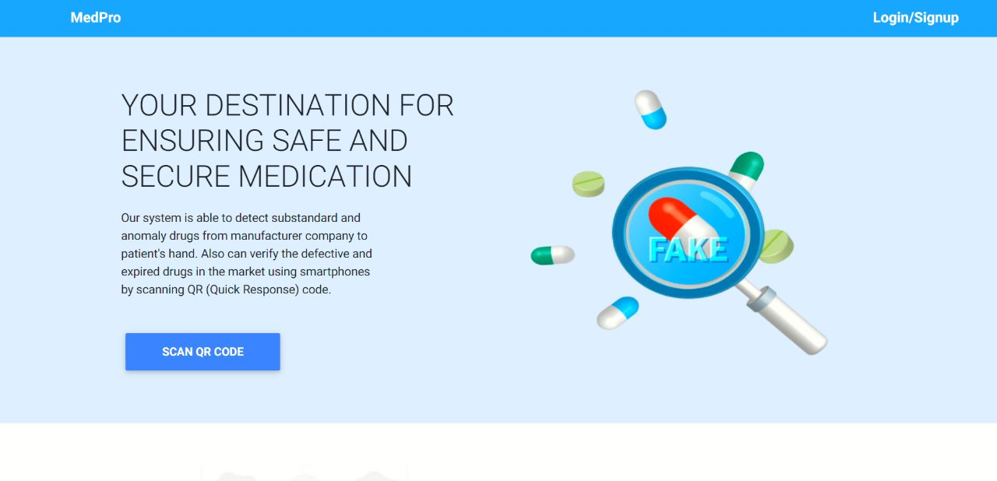
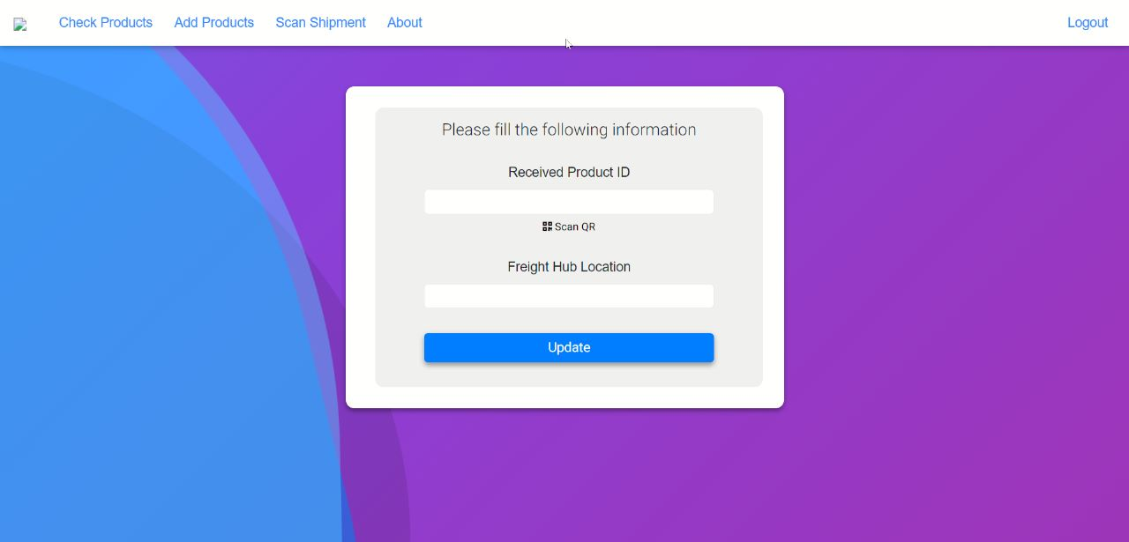
SCREENSHOTS
Department of Computer Science & Engineering, DSCE

Slide 13
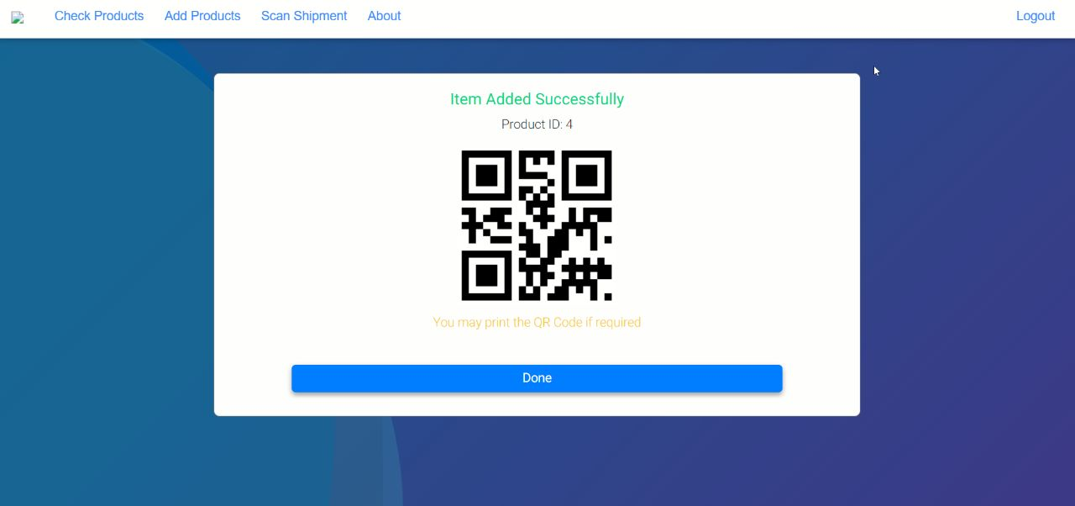
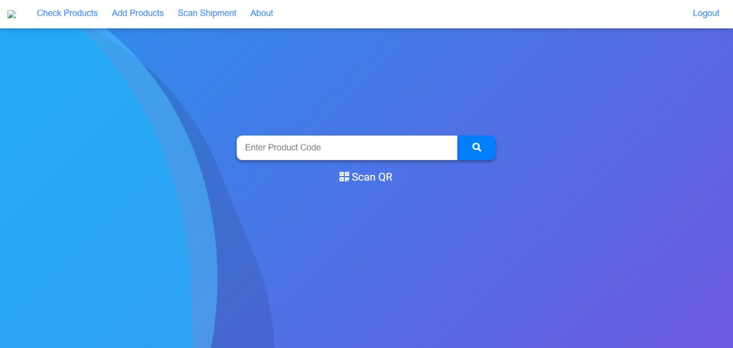
SCREENSHOTS
Department of Computer Science & Engineering, DSCE

Slide 14
THANK YOU
Department of Computer Science & Engineering, DSCE

