Slide 1

Pix2Pix Image-to-Image Translation
王清輝
2019.1.16

Slide 2
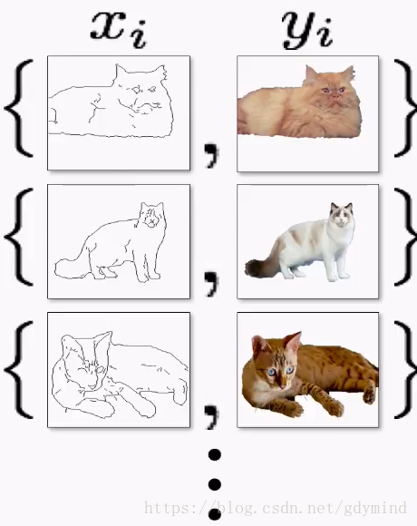
pix2pix
伯克利人工智慧研究室（BAIR）在 2016 年非常引人注目的研究 Image-to-Image Translation with Conditional Adversarial Networks 中，研究人員解決了圖像到圖像的生成問題。例如需要使用衞星圖像創建地圖，或使用素描創建逼真的目標紋理等。 pix2pix的核心是有了對應關係，這種網絡的應用範圍還是比較廣泛的

Slide 3
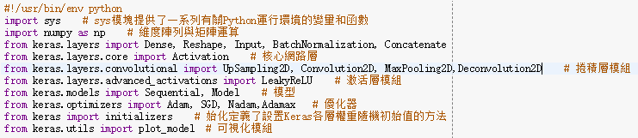
generator.py
Import Library

Slide 4
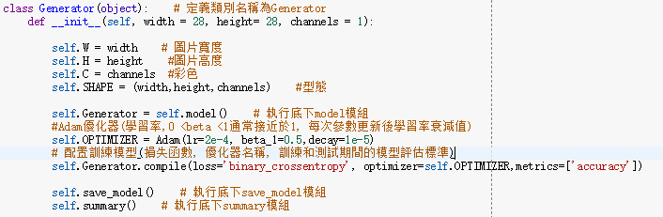
generator.py
Create the Generator object

Slide 5
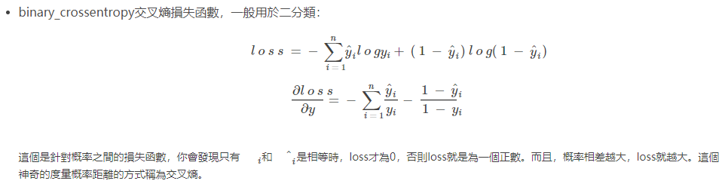
generator.py
binary_crossentropy
資料來源:https://blog.csdn.net/legalhighhigh/article/details/81409551

Slide 6
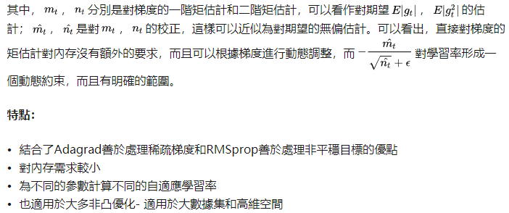
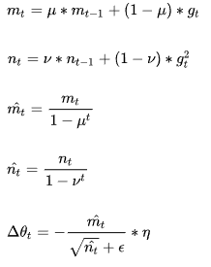
generator.py
Adam
Adam(Adaptive Moment Estimation)本質上是帶有動量項的RMSprop，它利用梯度的一階矩估計和二階矩估計動態調整每個參數的學習率。Adam的優點主要在於經過偏置校正後，每一次迭代學習率都有個確定範圍，使得參數比較平穩。

Slide 7
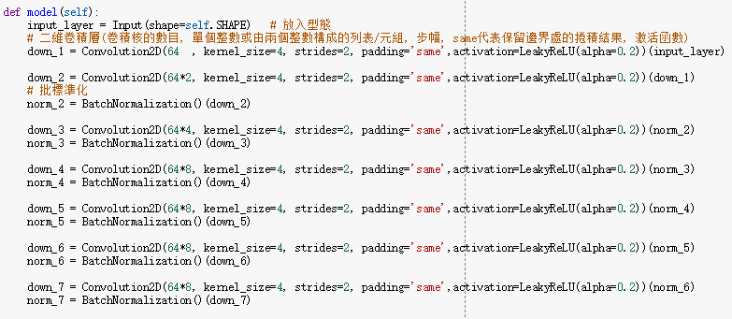
generator.py
generator model
We implement the top of the encoder with these first four layers:

Slide 8
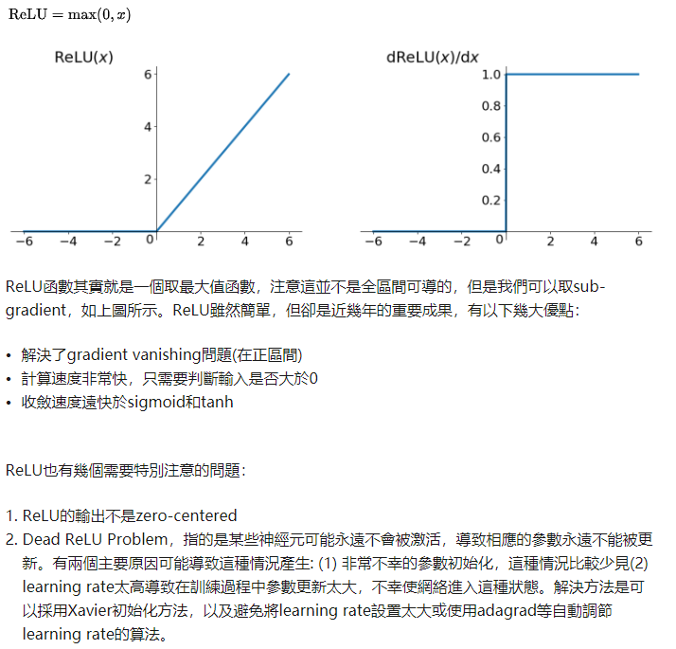
generator.py
ReLU函數
資料來源:https://zhuanlan.zhihu.com/p/25110450

Slide 9
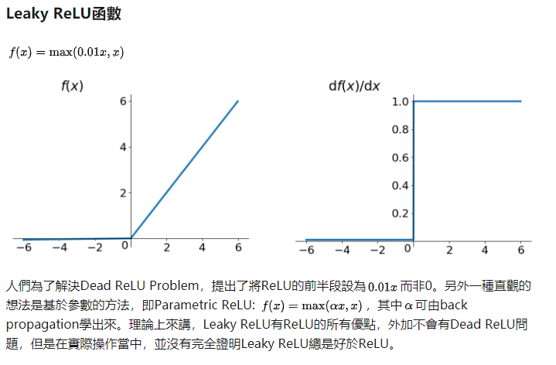
generator.py
Leaky ReLU函數
資料來源:https://zhuanlan.zhihu.com/p/25110450

Slide 10
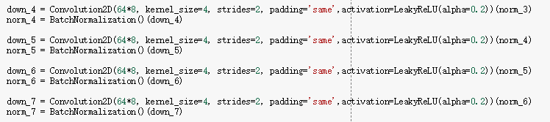
generator.py
We maintain the same four layers before moving on to the decoder:

Slide 11
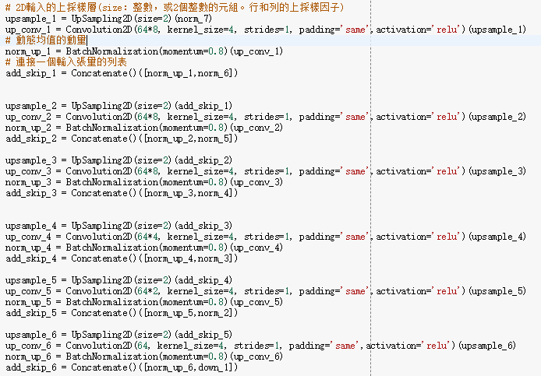
generator.py
In this step, we keep the same filter size but begin upsampling the encoder's:

Slide 12

generator.py
last_upsample and output_layer essentially define the output image:
There are two helper functions that we implement with every network we produce:

Slide 13
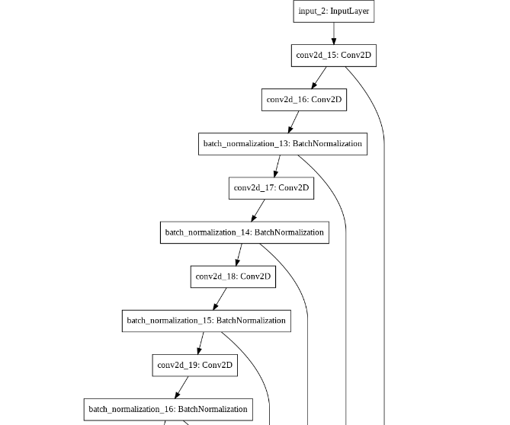
Generator_Model.png

Slide 14
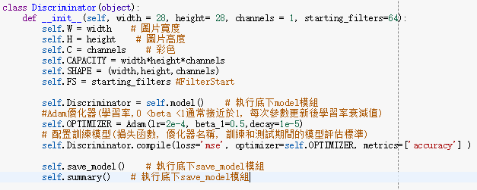
discriminator.py
Create a Discriminator class and initialize it with width, height, and channels and the number of starting_filters in Discriminator:

Slide 15
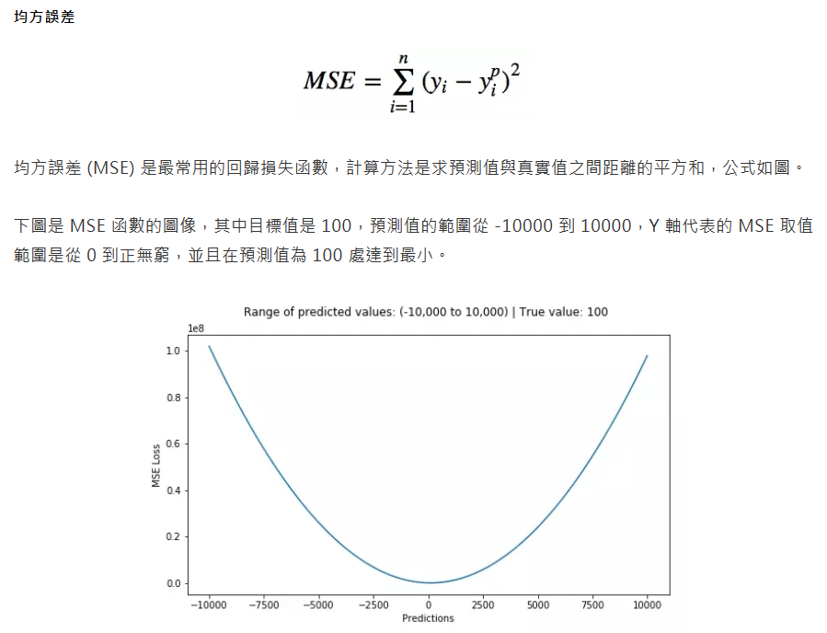
discriminator.py
MSE 均方誤差
資料來源:https://bigdatafinance.tw/index.php/news/607-5

Slide 16
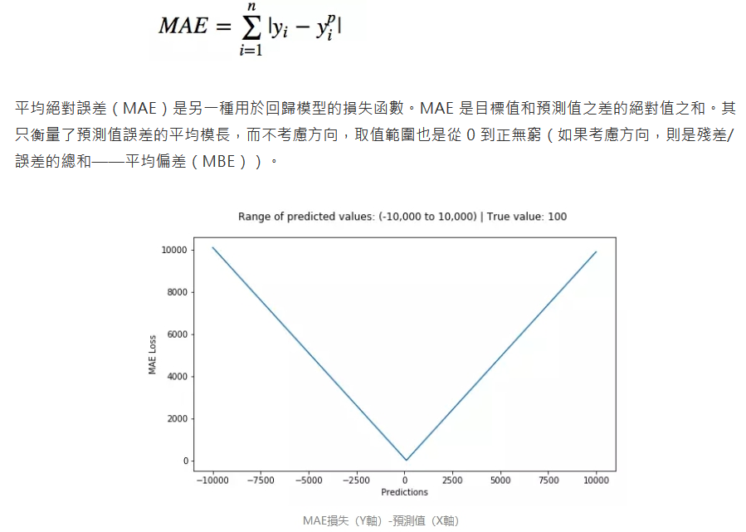
discriminator.py
MAE 平均絕對值誤差（也稱 L1 損失）
資料來源:https://bigdatafinance.tw/index.php/news/607-5

Slide 17
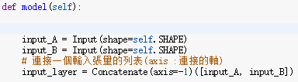
discriminator.py
This is different from previous networks, as it takes two images as input and concatenates them into a single tensor:

Slide 18
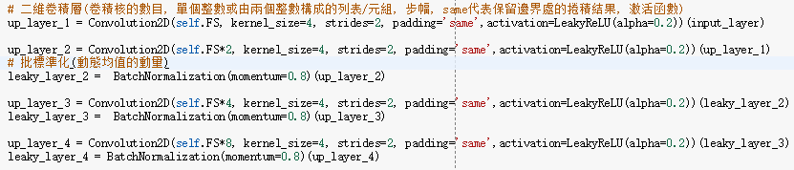
discriminator.py
We use a simple architecture with Convolutional2D layers and LeakyReLU:
The final output_layer is binary classification from 0 to 1 or fake to real:

Slide 19

discriminator.py
Use these two helper functions to return a summary and plot the model:

Slide 20
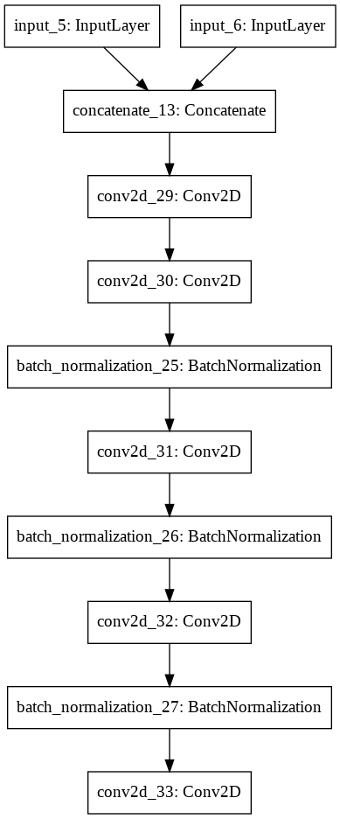
Discriminator_Model.png

Slide 21
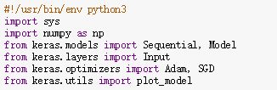
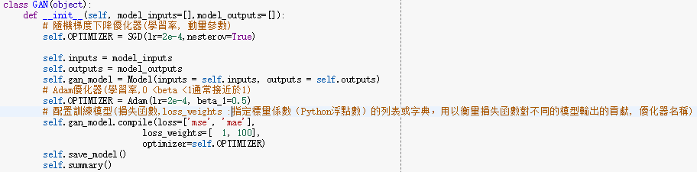
Gan.py
Import all of the libraries we need to use for this class:
Implement the init class with the Adam optimizer and then an array of model_inputs and model_outputs:
It's important to note that we need to have two separate loss functions because of the way the input is hooked into the network. In the training script, you'll see how we connect the generator and discriminator into this GAN network.

Slide 22

Gan.py
SGN
SGD就是每一次迭代計算mini-batch的梯度，然後對參數進行更新，是最常見的優化方法了。即：
其中，n是學習率，g_t是梯度SGD完全依賴於當前batch的梯度，所以n可理解為允許當前batch的梯度多大程度影響參數更新
缺點：
選擇合適的learning rate比較困難- 對所有的參數更新使用同樣的learning rate。對於稀疏數據或者特徵，有時我們可能想更新快一些對於不經常出現的特徵，對於常出現的特徵更新慢一些，這時候SGD就不太能滿足要求了
SGD容易收斂到局部最優，並且在某些情況下可能被困在鞍點。

Slide 23


Gan.py
Define a model to give us access outside of the class:
These are the normal helper functions from every one of our other chapters:

Slide 24
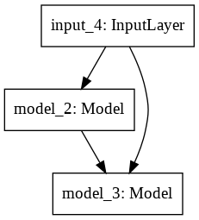
GAN_Model.png

Slide 25
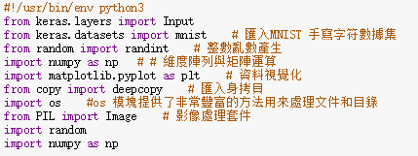
train.py
The imports in the training function are primarily not Keras and simply NumPy and other helper libraries:

Slide 26
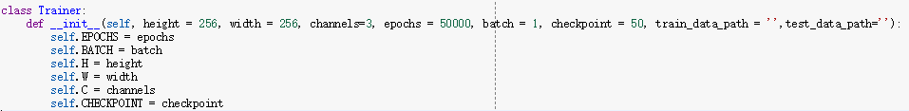
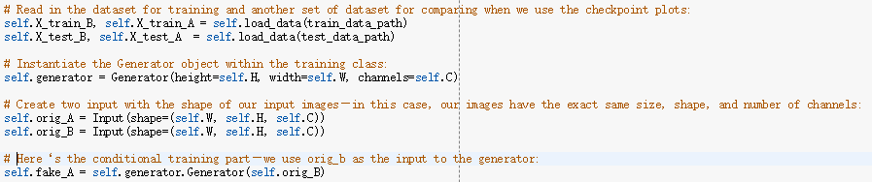
train.py
The Trainer class starts out with the same types of inputs from other models:

Slide 27
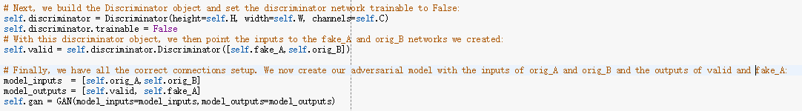
train.py

Slide 28
train.py

Slide 29
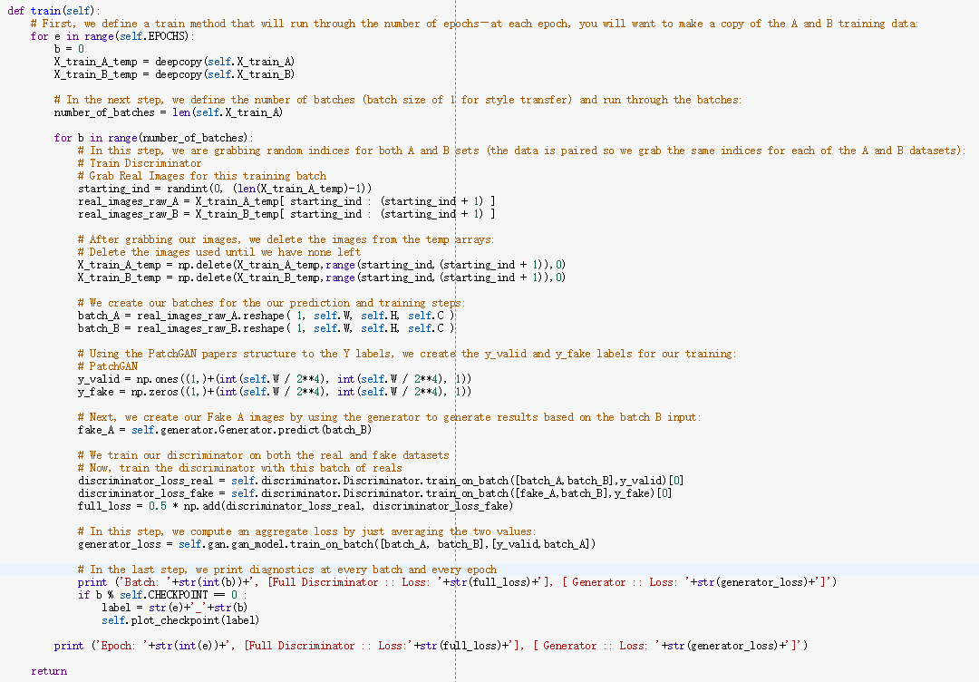
train.py

Slide 30
train.py

Slide 31
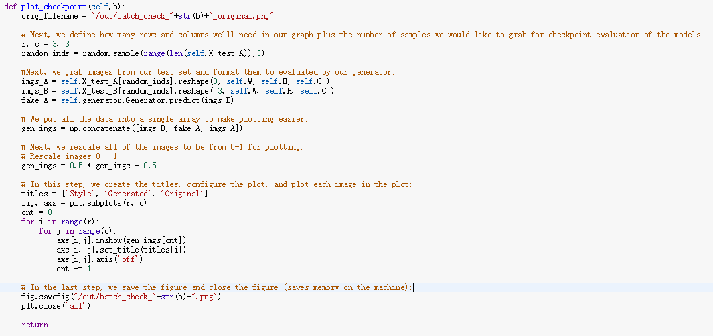
train.py
Define the function and create a filename to save at every batch:

Slide 32
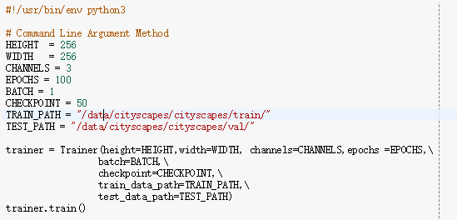
run.py

Slide 33
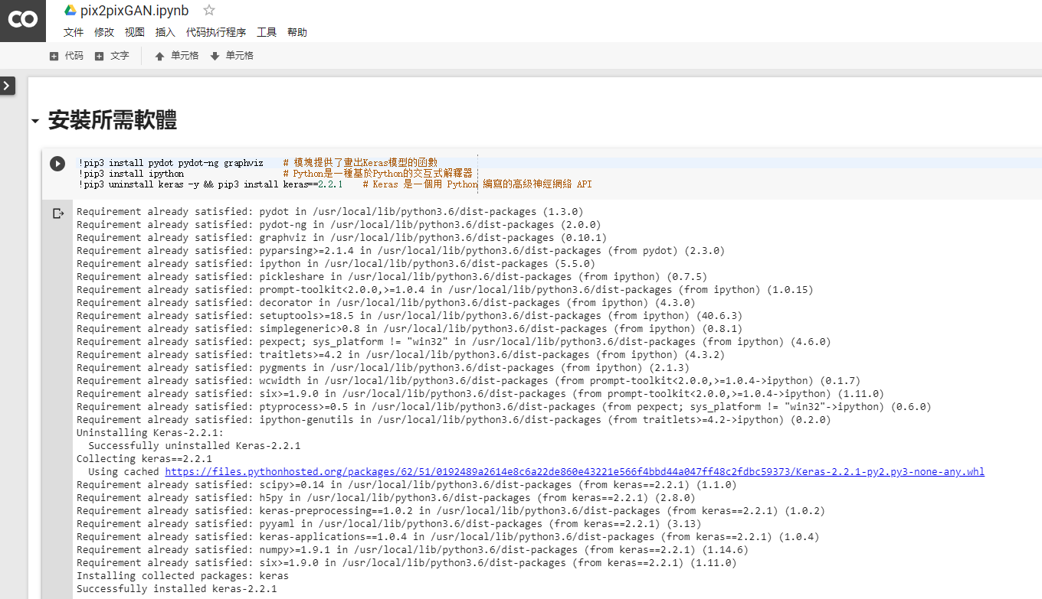
Github
https://github.com/MtFeather/AI-and-Security/blob/master/tensorflow/pix2pixGAN.ipynb

Slide 34
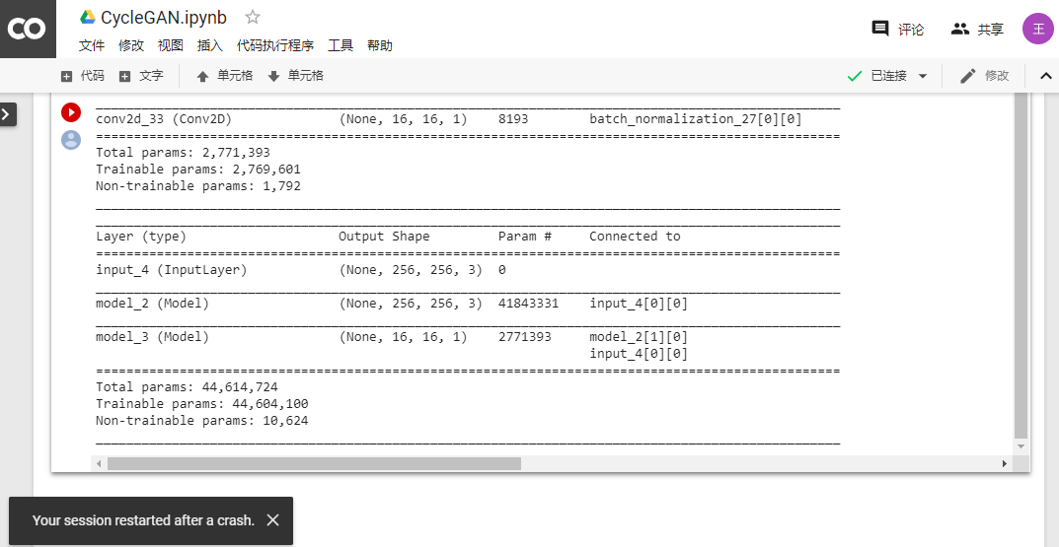
測試結果-崩潰

Slide 35
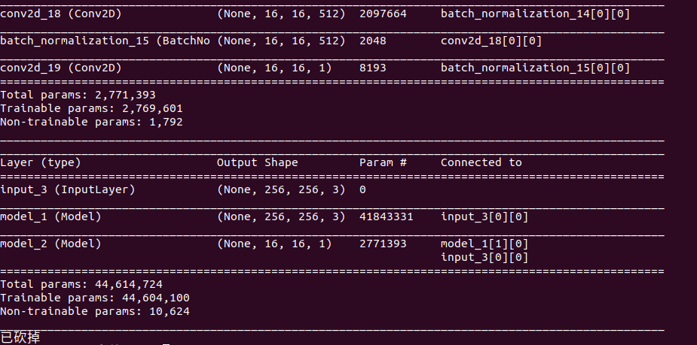
測試結果-崩潰

Slide 36
程式架構
系統主程式
run.py
核心程式
train.py
生成模型
generator.py
主要模型
gan.py
對抗模型
discriminator.py

