Slide 1

Pix2Pix Image-to-Image Translation
王清輝
2019.1.16

Slide 2

Generative Adversarial Network(GAN)
生成對抗網絡（英語：Generative Adversarial Network，簡稱GAN）是非監督式學習的一種方法，通過讓兩個神經網路相互博弈的方式進行學習。該方法由Ian Goodfellow等人於2014年提出。
GAN 由生成器 （Generator）和判斷器 (Discriminator) 兩個神經網絡所組成，這兩個神經網絡擁有不一樣的目標，相互對抗。很常聽到的形容是，Generator是負責做假鈔的人，Discriminator是警察檢驗是否為假鈔。因為之間的對抗關係，所以稱為生成對抗網絡。
那為什麼 GAN 產生的圖片會優於 VAE 所產生的呢？關鍵在於 VAE 作法的目標是圖片越相似越好，但實際上越相似可能不是最好。而 GAN 是透過 discriminator 來達成目標，不像 VAE 偏表面學習，GAN 是學習精神本質的。

Slide 3
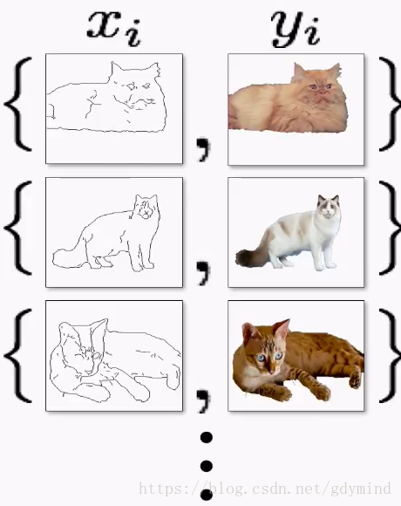
pix2pix
伯克利人工智慧研究室（BAIR）在 2016 年非常引人注目的研究 Image-to-Image Translation with Conditional Adversarial Networks 中，研究人員解決了圖像到圖像的生成問題。例如需要使用衞星圖像創建地圖，或使用素描創建逼真的目標紋理等。 pix2pix的核心是有了對應關係，這種網絡的應用範圍還是比較廣泛的

Slide 4
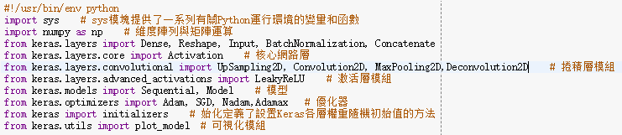
generator.py
Import Library

Slide 5
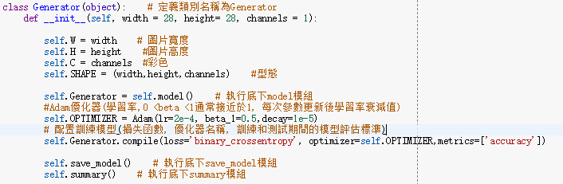
generator.py
Create the Generator object

Slide 6
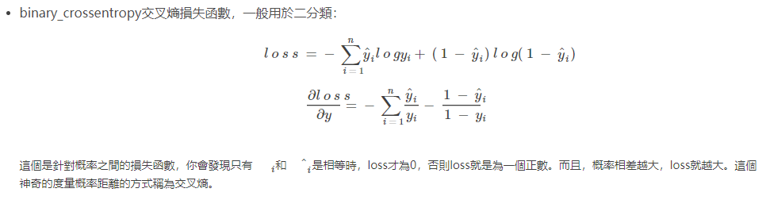
generator.py
binary_crossentropy
資料來源:https://blog.csdn.net/legalhighhigh/article/details/81409551

Slide 7
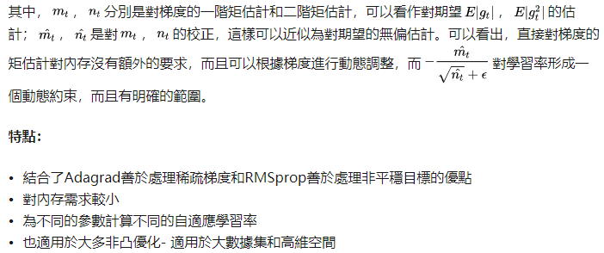
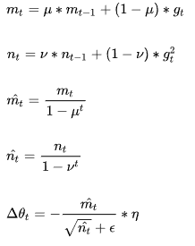
generator.py
Adam
Adam(Adaptive Moment Estimation)本質上是帶有動量項的RMSprop，它利用梯度的一階矩估計和二階矩估計動態調整每個參數的學習率。Adam的優點主要在於經過偏置校正後，每一次迭代學習率都有個確定範圍，使得參數比較平穩。

Slide 8
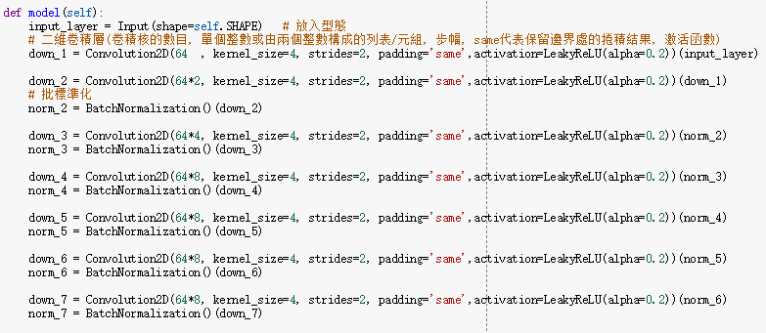
generator.py
generator model
We implement the top of the encoder with these first four layers:

Slide 9
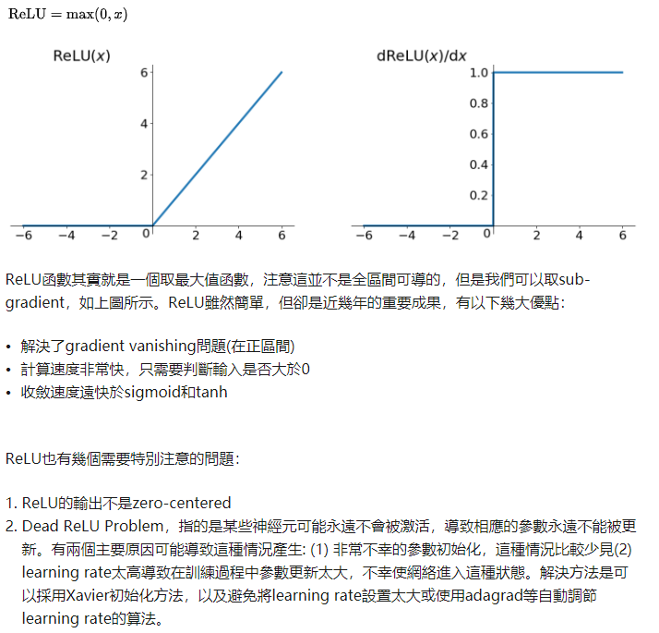
generator.py
ReLU函數
資料來源:https://zhuanlan.zhihu.com/p/25110450

Slide 10
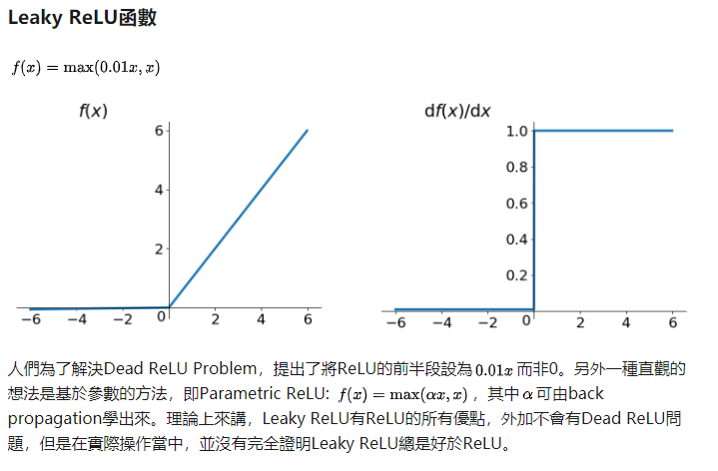
generator.py
Leaky ReLU函數
資料來源:https://zhuanlan.zhihu.com/p/25110450

Slide 11
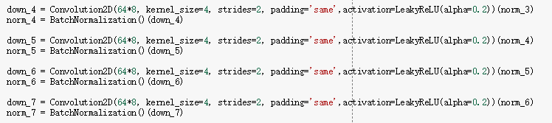
generator.py
We maintain the same four layers before moving on to the decoder:

Slide 12
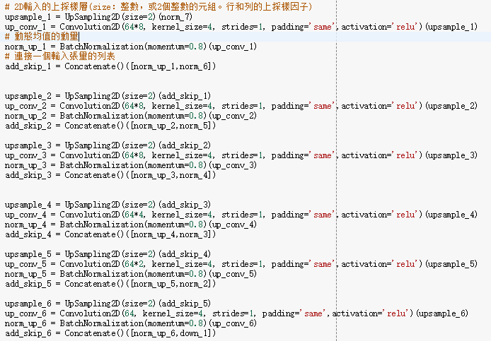
generator.py
In this step, we keep the same filter size but begin upsampling the encoder's:

Slide 13

generator.py
last_upsample and output_layer essentially define the output image:
There are two helper functions that we implement with every network we produce:

Slide 14
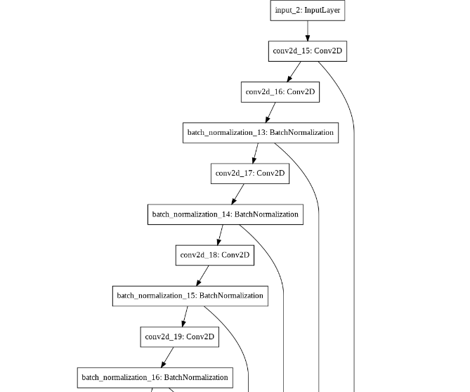
Generator_Model.png

Slide 15
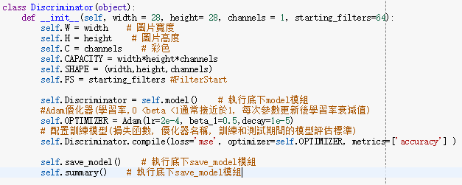
discriminator.py
Create a Discriminator class and initialize it with width, height, and channels and the number of starting_filters in Discriminator:

Slide 16
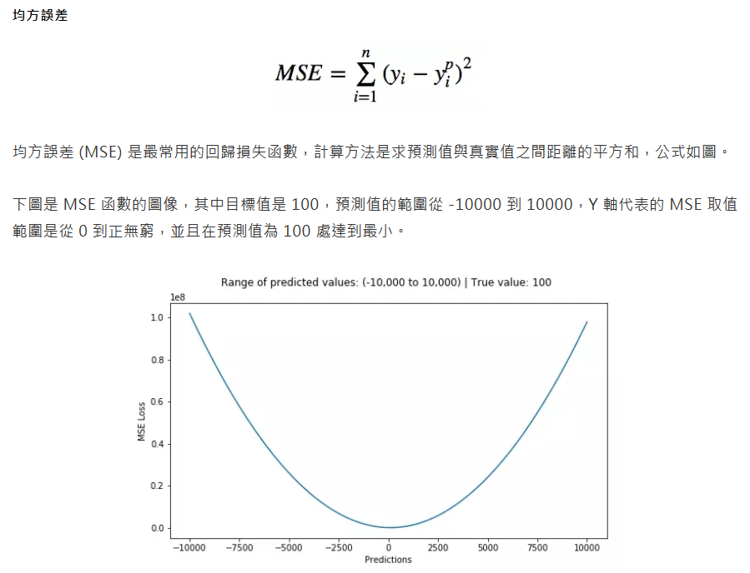
discriminator.py
MSE 均方誤差
資料來源:https://bigdatafinance.tw/index.php/news/607-5

Slide 17
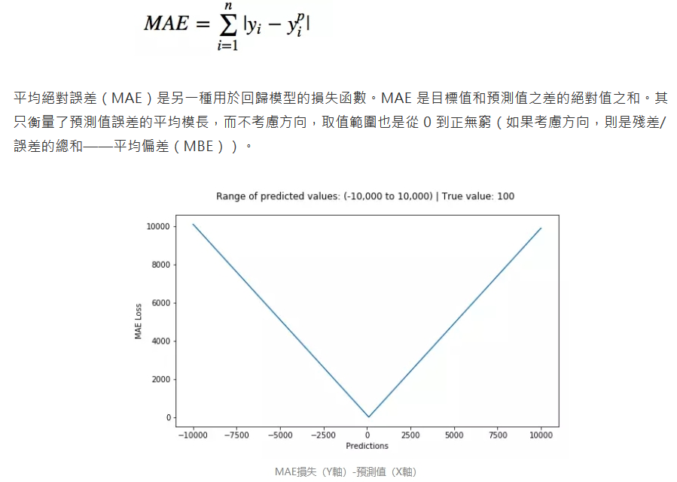
discriminator.py
MAE 平均絕對值誤差（也稱 L1 損失）
資料來源:https://bigdatafinance.tw/index.php/news/607-5

Slide 18
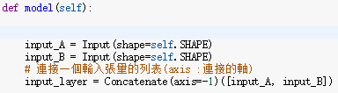
discriminator.py
This is different from previous networks, as it takes two images as input and concatenates them into a single tensor:

Slide 19
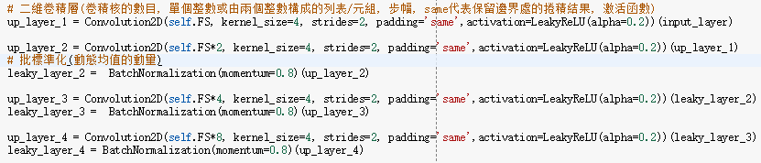
discriminator.py
We use a simple architecture with Convolutional2D layers and LeakyReLU:
The final output_layer is binary classification from 0 to 1 or fake to real:

Slide 20

discriminator.py
Use these two helper functions to return a summary and plot the model:

Slide 21
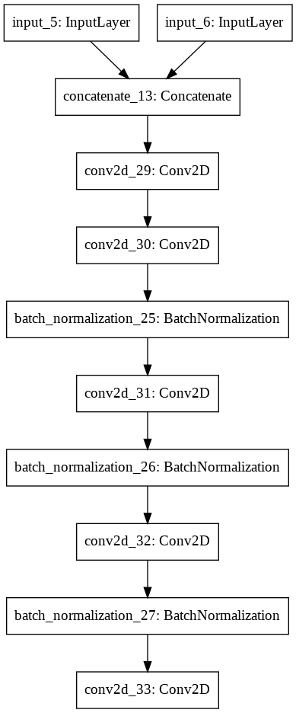
Discriminator_Model.png

Slide 22
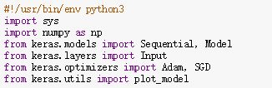
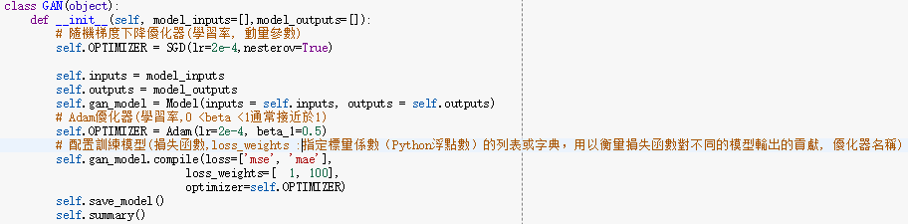
Gan.py
Import all of the libraries we need to use for this class:
Implement the init class with the Adam optimizer and then an array of model_inputs and model_outputs:
It's important to note that we need to have two separate loss functions because of the way the input is hooked into the network. In the training script, you'll see how we connect the generator and discriminator into this GAN network.

Slide 23

Gan.py
SGN
SGD就是每一次迭代計算mini-batch的梯度，然後對參數進行更新，是最常見的優化方法了。即：
其中，n是學習率，g_t是梯度SGD完全依賴於當前batch的梯度，所以n可理解為允許當前batch的梯度多大程度影響參數更新
缺點：
選擇合適的learning rate比較困難- 對所有的參數更新使用同樣的learning rate。對於稀疏數據或者特徵，有時我們可能想更新快一些對於不經常出現的特徵，對於常出現的特徵更新慢一些，這時候SGD就不太能滿足要求了
SGD容易收斂到局部最優，並且在某些情況下可能被困在鞍點。

Slide 24


Gan.py
Define a model to give us access outside of the class:
These are the normal helper functions from every one of our other chapters:

Slide 25
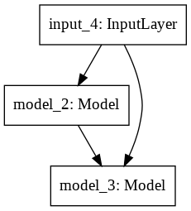
GAN_Model.png

Slide 26
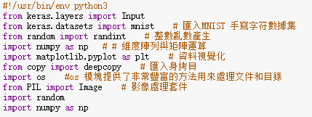
train.py
The imports in the training function are primarily not Keras and simply NumPy and other helper libraries:

Slide 27
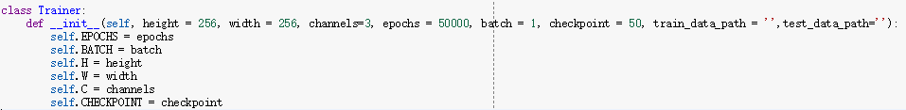
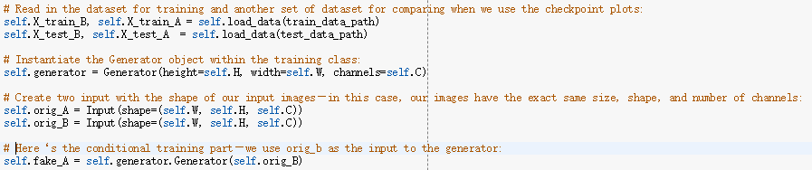
train.py
The Trainer class starts out with the same types of inputs from other models:

Slide 28
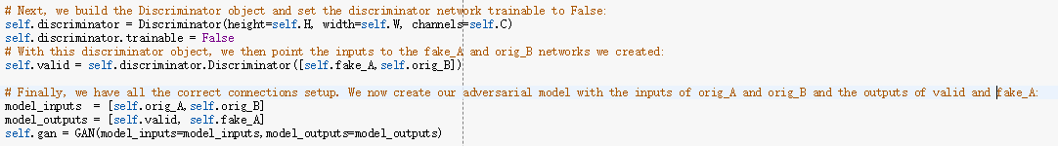
train.py

Slide 29
train.py

Slide 30
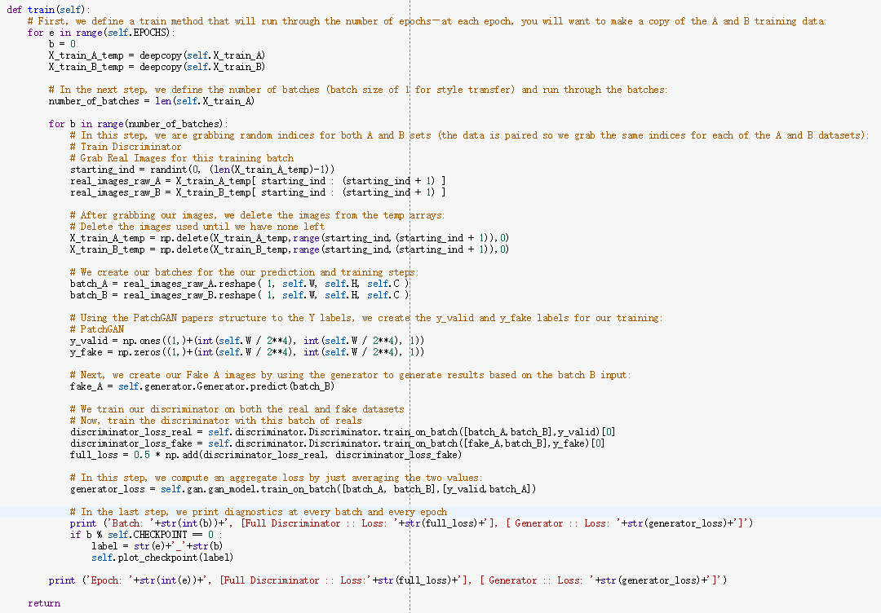
train.py

Slide 31
train.py

Slide 32
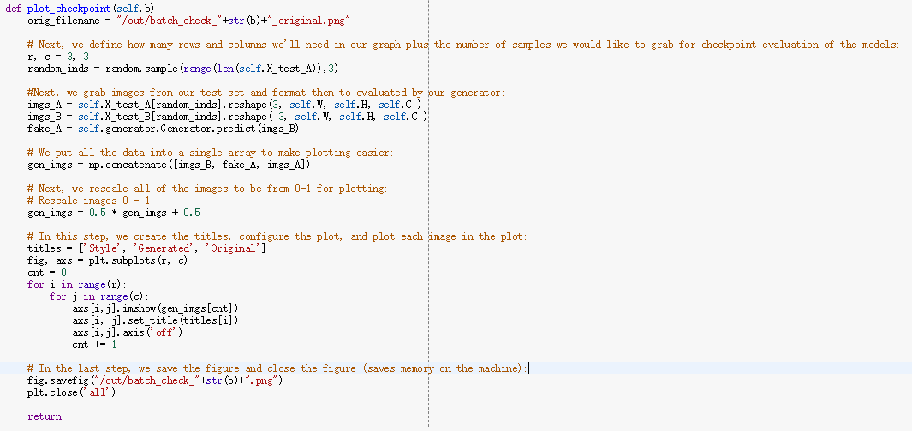
train.py
Define the function and create a filename to save at every batch:

Slide 33
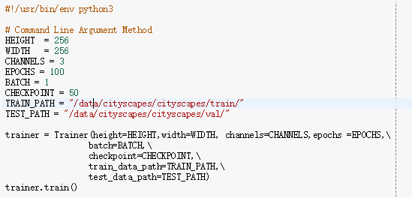
run.py

Slide 34
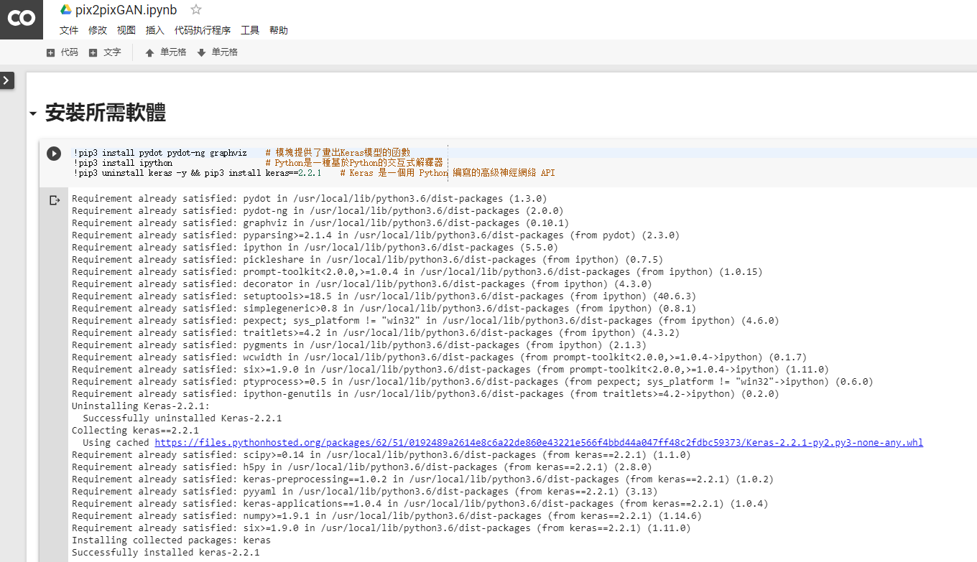
Github
https://github.com/MtFeather/AI-and-Security/blob/master/tensorflow/pix2pixGAN.ipynb

Slide 35
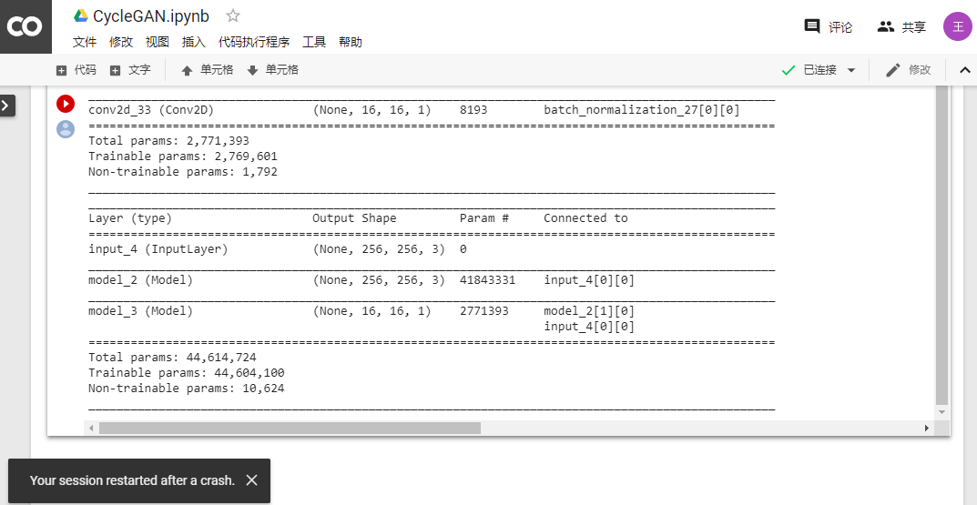
測試結果-崩潰

Slide 36
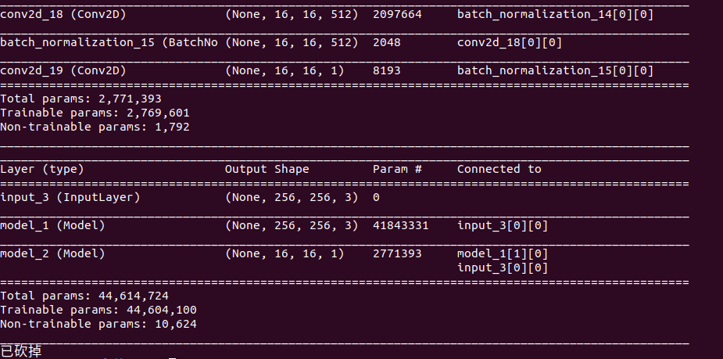
測試結果-崩潰

Slide 37
程式架構
系統主程式
run.py
核心程式
train.py
生成模型
generator.py
主要模型
gan.py
對抗模型
discriminator.py

Slide 38
參考文獻
[1] Josh Kalin, 2018．Generative Adversarial Networks Cookbook．Packt
https://github.com/PacktPublishing/Generative-Adversarial-Networks-Cookbook
[2] [魔法陣系列] Generative Adversarial Network（GAN）之術式解析
https://ithelp.ithome.com.tw/articles/10207229
[2] 常见的损失函数之MSE\Binary_crossentropy\categorical_crossentropy
https://blog.csdn.net/legalhighhigh/article/details/81409551
[3] 聊一聊深度学习的activation function
https://zhuanlan.zhihu.com/p/25110450

