Slide 1


Security
Mt.Khademi
Brain bytes

Slide 2
AUTHENTICATION [custom]
1. Introduction ......
- What’s Authentication and authorization
1. Create Web.Api project
2. Add some packages
- EntityFrameworkCoreSqlite
- EntityFrameworkCoreDesign
- EntityFrameworkCoreTools
3. Create Movie models
- MovieEntity
- DTOS [CreateDto,ReadDto,UpdateDto,DeleteDto]
4. Create Movie Controller
- CRUD …

Slide 3
AUTHENTICATION [custom]
5. Create User models
- UserEntity
- UserDtos[ Create,Update,Delete,Read ]
6. Create User controller
- CRUD
- GetRoles
- AddNewRole
- RemoveRole
7. Create Role models
- RoleEntity
- RoleDtos[ Create,Update,Delete,Read ]
8. Create Role controller
- CRUD
- GetUsers

Slide 4
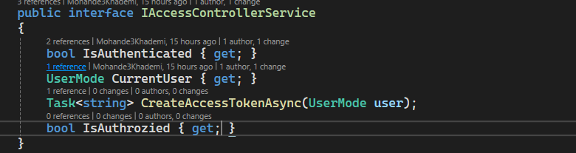
AUTHENTICATION [custom]
9. Create Auth controller
- Register : add new user
- Login : login a user and get token access
10. IAccessControlService
- IsAuthenticated
- GetCurrentUser
- CreateAccessToken(userModel)
- IsAuthorize

Slide 5

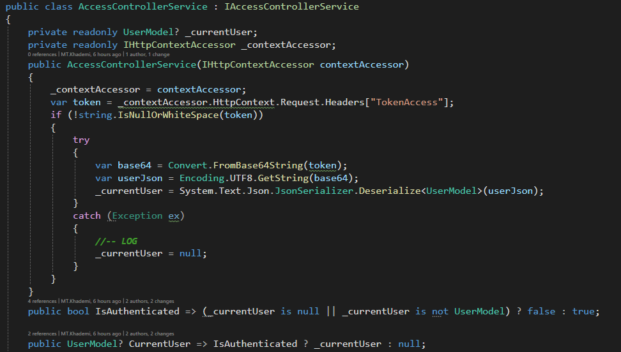
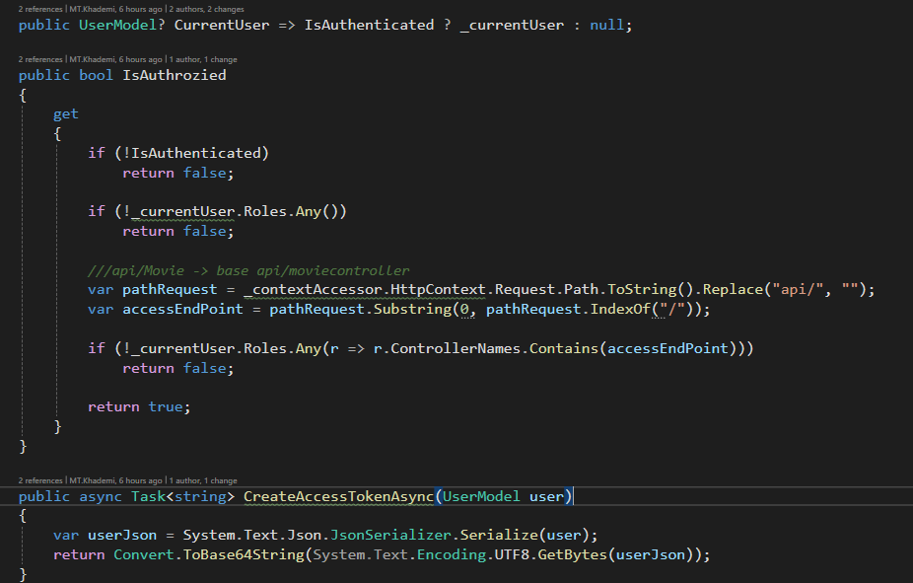
AUTHENTICATION [custom]
11. AccessControlService

Slide 6
AUTHENTICATION [custom]
12. Create Auth controller
- Register : add new user
- Login : login a user and get token access
- GetCurrentUser : Get current user base token access
13. User IAccessControllerService in MovieController
- Get : All user access but you have to login
- Create-Update-Delete : if current user has authenticated and authorize and administrator role then he/she can do it.

Slide 7
AUTHENTICATION [custom]
8. Refactor
. Authentication middleware
- create a middleware for check authenticated and exist token access
. Authorization attribute
- Create an attribute for check authorization
- add this attribute to the movie controller file
. Add expire time in AccessToken
. Anonymous attribute [?]
- for free access

