Slide 1
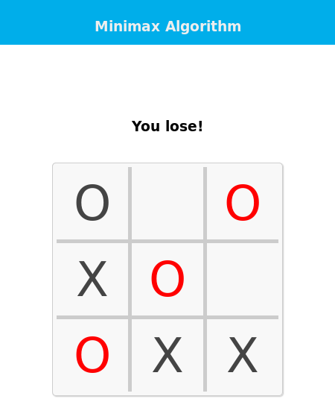
Tic-Tac-Toe Game
Coding + Minimax AI Algorithm = lets you play the classic card game tic-tac-toe vs computer!
Celeste Jackson URL: https://github.com/ksu-is/TICTACTOEGAME

