Slide 1

PROG6212 POE
ST10460792
Goshen Mtambo
Group 3

Slide 2
Introduction & Value Proposition
The Challenge: Manual claim processing is time-consuming, prone to calculation errors, and lacks transparency for lecturers.
The Solution: The CMCS is a centralized web application that digitizes the entire workflow.
Key Benefits:
  Efficiency: Automates calculations and reporting.
  Accuracy: Enforces policy limits (e.g., max hours).
  Security: Role-based access and encrypted document storage.

Slide 3

Evolution from Part 2 to Part 3
Based on feedback and new requirements, the system has been significantly upgraded:
Enterprise Database: Migrated from SQLite to MS SQL Server for scalability.
New HR Super User: Centralized management of user profiles and pay rates.
Automation: Implemented auto-calculations and automated verification flagging.
Security: Added AES-256 encryption for all uploaded documents.

Slide 4
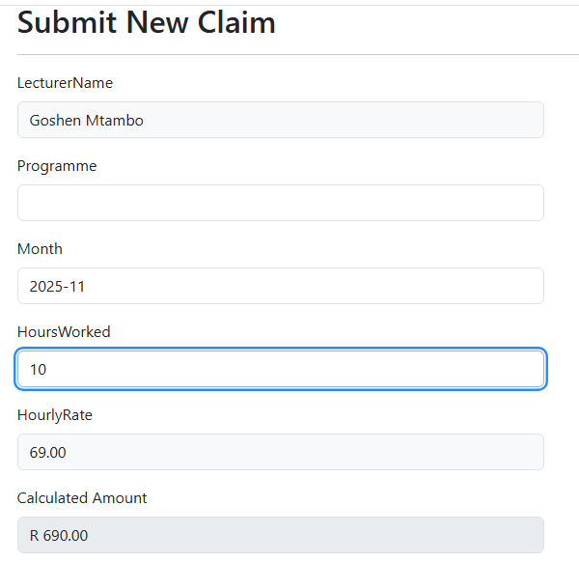
Automated Claim Submission
The submission process is now automated to reduce errors:
Auto-Fill: Lecturer Name and Hourly Rate are pulled directly from the HR profile and cannot be tampered with.
Real-Time Calculation: Total amount calculates instantly via JavaScript as hours are entered.
Policy Validation: The system automatically blocks claims exceeding 180 hours/month.

Slide 5
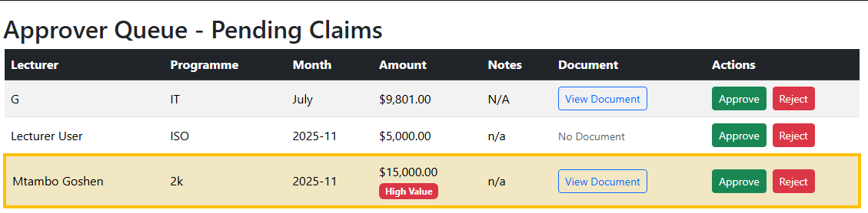
Automated Verification & Approval
The Approver Queue now features smart flagging to streamline review:
Automated Checks: The system instantly analyzes claims against predefined criteria.
Visual Alerts: Claims over R10,000 or 100 hours are highlighted in Amber with specific warning badges (e.g., "High Value").
Efficiency: Managers can prioritize "safe" claims and focus scrutiny on flagged items.

Slide 6
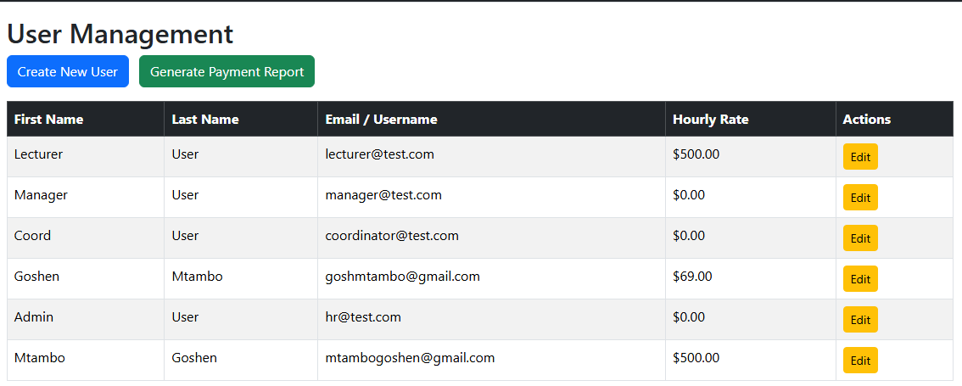
Centralized User & Data Management
A new HR Role allows for centralized control over personnel data:
User Management: HR creates accounts and sets verified Hourly Rates, removing manual entry risks for lecturers.
Data Integrity: Ensures that the rate used for calculations is always the official contract rate.

Slide 7
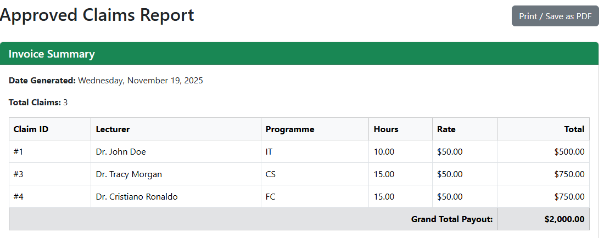
Automated Payment Reporting
The system eliminates manual invoice creation:
One-Click Generation: HR can instantly generate a payment report for all "Approved" claims.
Professional Formatting: Generates a clean, invoice-style summary suitable for finance processing.
Auto-Summing: Automatically calculates the Grand Total Payout.

Slide 8
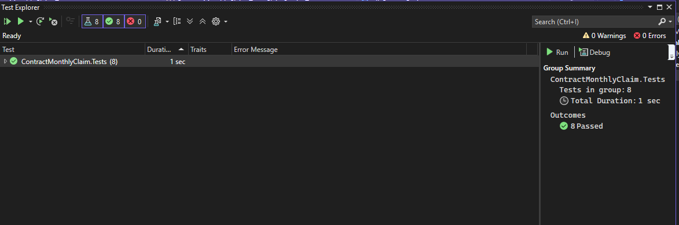
Technical Implementation & Quality
Tech Stack: ASP.NET Core 9.0 MVC, Entity Framework Core, MS SQL Server.
Security: ASP.NET Core Identity for Authentication & Authorization.
Reliability: Core business logic is verified by 8 Unit Tests covering all CRUD and automation features.
Version Control: Developed with Git, featuring a comprehensive history of 10+ commits.

Slide 9

Conclusion
The Contract Monthly Claim System successfully transforms a manual, error-prone process into a secure, automated digital workflow. It meets all requirements for data integrity, role separation, and administrative efficiency.
Youtube Video: https://youtu.be/RUjLIzFlytQ

