Slide 1
Hyperbolic Geometric Priors
for LLM Jailbreak Detection
A Controlled Comparison Study
Methodology critique • HPS vs C4 vs MTP
Cross-model evaluation: Llama-3-8B vs Vicuna-13B
Team meeting — Findings & Open Questions

Slide 2
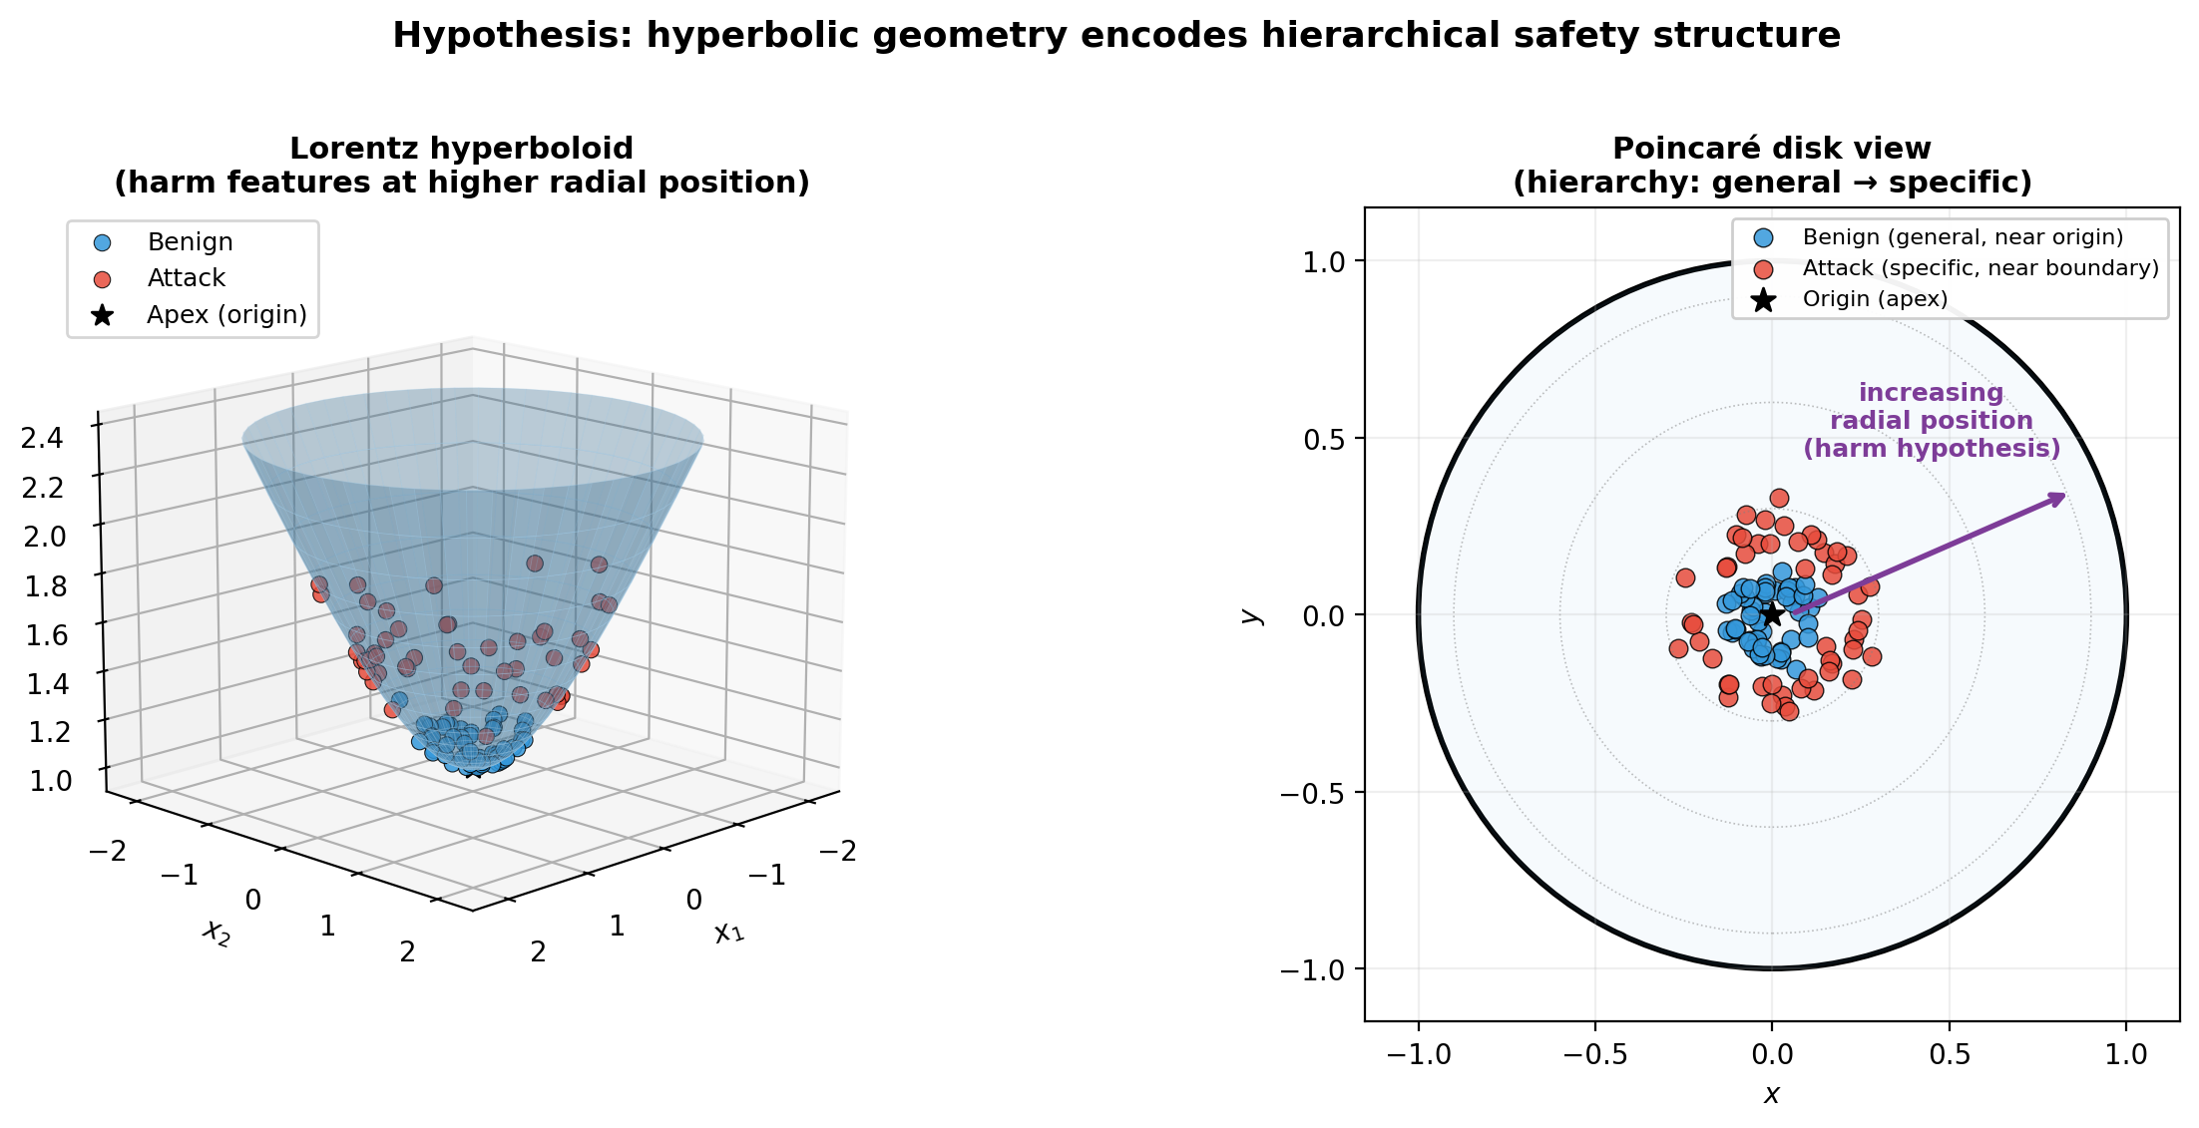
1. Do Hyperbolic Priors Help Jailbreak Detection?
A controlled comparison study
Background
• HypLoRA (NeurIPS 2025): LLM token embeddings show empirical δ-hyperbolicity (tree-like structure)
• HELM (NeurIPS 2025): Power-law radial structure / negative Ricci curvature
• Theoretical prediction: hyperbolic projection should provide useful inductive bias for distinguishing harmful (specific) from benign (general)
"If LLM activations have hierarchical structure, does hyperbolic projection provide a measurable detection advantage over flat (Euclidean) baselines?"
What we built:
• HPS (Hyperbolic Projection Sentinel): Lorentz contrastive framework
• Parameter-matched Euclidean ablation + linear probe baseline
• Two LLMs: Llama-3-8B-Instruct (RLHF) vs Vicuna-13B-v1.5 (SFT-only)
Hypothesis: attacks at higher radial position

Slide 3
2. Methods Under Comparison
Four-method controlled comparison with parameter-matched ablation
Method | Architecture | Parameters | Innovation
HPS (ours) | Lorentz proj + 12 trajectory features + LR | 262K | Hyperbolic geometric prior
HPS-Euclidean (control) | Same arch, FLAT geometry | 262K (matched) | Tests if geometry matters
C4 (baseline) | Mean-pool 6 layers' last-token + LR | 4,097 | Adapted from Anthropic Cheap Monitors
MTP (baseline) | Mean-pool tokens at 1 layer + LR | 4,097 | Faithful Anthropic reproduction
HPS pipeline: Activations [N=6 layers] → W·activations (project to 64-d) → Lorentz hyperboloid (κ=0.1, frozen) → 12 trajectory features (5 radial + 4 curvature + 3 displacement) → LR. Trained with per-layer-temperature contrastive loss, 50 epochs.
Why HPS-Euclidean control is critical: Without parameter-matched Euclidean, any HPS-vs-C4 win could be 'more parameters helped.' HPS-Euclidean has IDENTICAL parameter count and architecture, only flat geometry. This isolates the geometric prior.

Slide 4
3. Methodology Surprise #1 — Length Confound
A trivial classifier using only prompt length detects 96.9% of attacks
Length-only classifier (just len(prompt), no model)
Per-attack length-only AUROC
Metric | Length-only
AUROC | 0.992
TPR @ 5% FPR | 0.969
TPR @ 1% FPR | 0.875
Attack | Mean length | Length-only AUROC
puzzler | 2,193 chars | 1.000
saa | 473 chars | 1.000
drattack | 437 chars | 1.000
base64 | 124 chars | 1.000
ijp | 460 chars | 0.999
autodan | 77 chars | 0.999
pair | 72 chars | 0.997
zulu | 50 chars | 0.976
gcg | 35 chars | 0.971
A classifier that NEVER LOOKS at the prompt CONTENT — only its length — catches 96.9% of attacks at 5% FPR.
Length distribution
• Alpaca harmless: very short (mean ~12-60 chars)
• Attacks: weighted mean 218 chars, extreme by-attack variation
• Per-attack lengths range 35 (gcg) → 2,193 (puzzler)
Our fix: Diverse benign data (WildChat + OR-Bench + MMLU + GSM8K + WikiText long-form). After fix → length-only AUROC: 0.992 → 0.318. Permutation: 0.498 (real signal exists).

Slide 5
4. Methodology Surprise #2 — max_length Confound
Inconsistent token truncation → norm-only AUROC = 1.000
The bug:
Norm-controlled evaluation
Across L2-normalize, standardize, and
L2+std controls:
norm-only AUROC: 0.76 → 0.55
C4 TPR @ 5% FPR: 0.995 → 0.996
→ C4 is robust to all norm controls.
Real semantic signal exists beyond norm.
Original cache: benign max_length = 512 attacks max_length = 512 ✓ consistent → Norm-only AUROC = 0.917 Diverse benign cache (after length confound fix): benign max_length = 2048 attacks REUSED at 512 ✗ MISMATCH → Norm-only AUROC = 1.000 ← perfect detection from norm alone
Layer 31 (deepest) activation norms:
 | Old cache (consistent) | Diverse cache (mismatch)
Benign mean norm | 155.6 | 35.5 ⚠
Attack mean norm | 153.0 | 153.0
Ratio | 1.0× | 4.3×
The fix: Re-extract attacks at max_length=2048 to match diverse benign. Norm-only AUROC: 1.000 → 0.761 ✓ (confound largely resolved) Permutation test AUROC = 0.498 → real signal exists
(see paper appendix for full norm-control table)

Slide 6
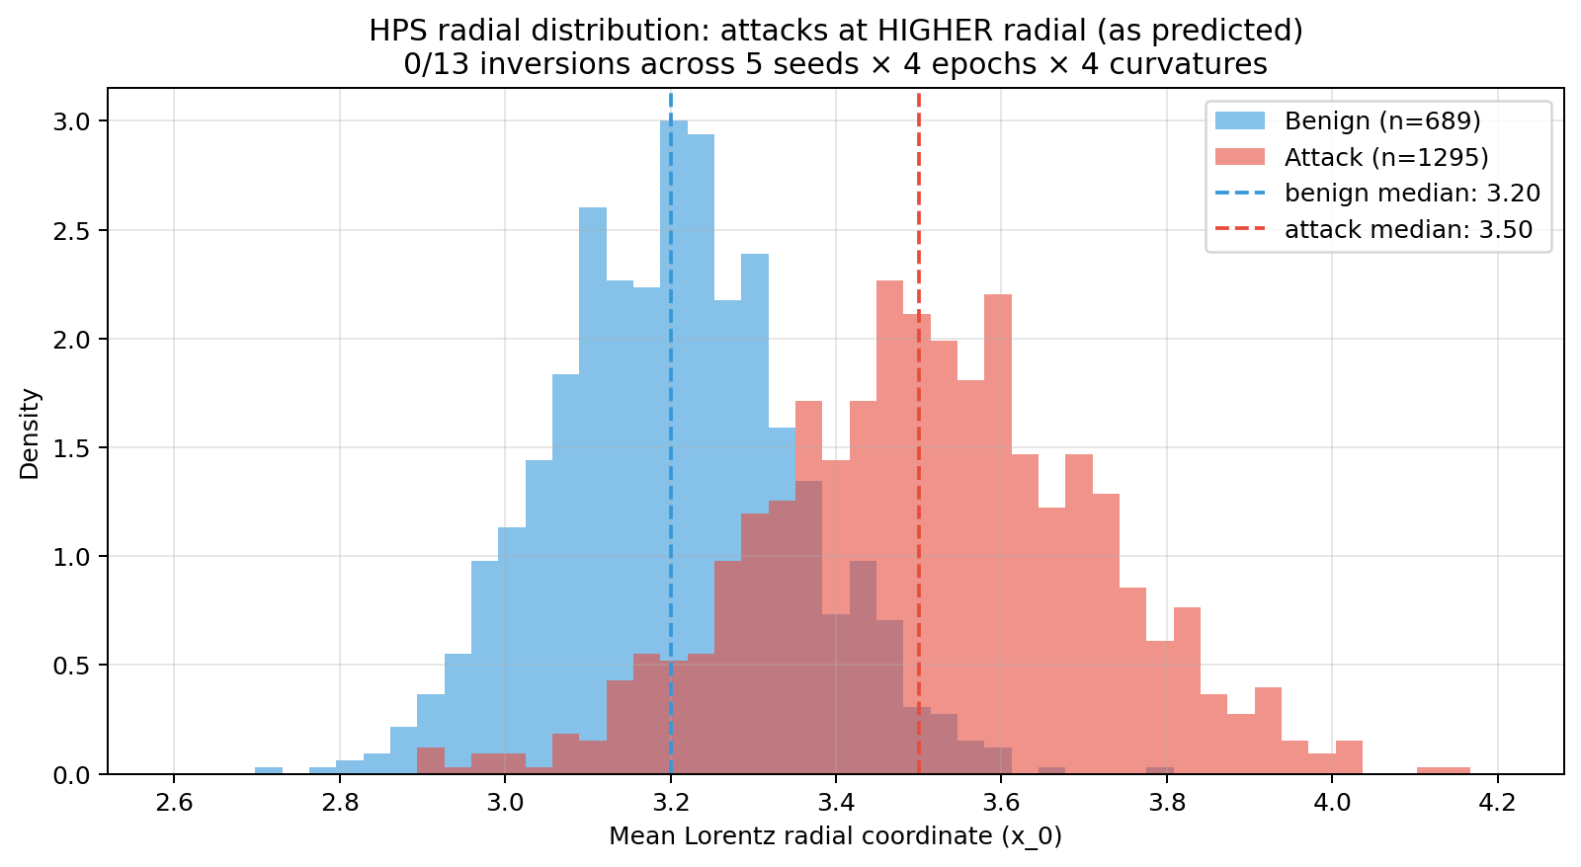
5. Finding 1 — Geometric Hypothesis Confirmed
After methodology fixes: 0/13 inversions across all configurations
13 configurations tested
• 5 random seeds (κ=0.1, 50 epochs)
• 4 epoch checkpoints (5, 10, 25, 50)
• 4 curvature κ values (0.1, 0.5, 1.0, 2.0)
Result: 0/13 inversions. All configurations show benign median < attack median. Hyperbolic prior is VALIDATED.
Mechanism:
Hyperbolic prior predicts: harmful (specific) → high radial.
Before length-confound fix: appeared inverted (length-shortcut).
After fix: attacks ARE at higher radial, as theory predicts.
The geometric prior is theoretically valid. Hyperbolic projection learns the meaningful direction once data is clean.
Radial distribution: benign (median 3.20) vs attacks (median 3.50). 0/13 inversions.

Slide 7
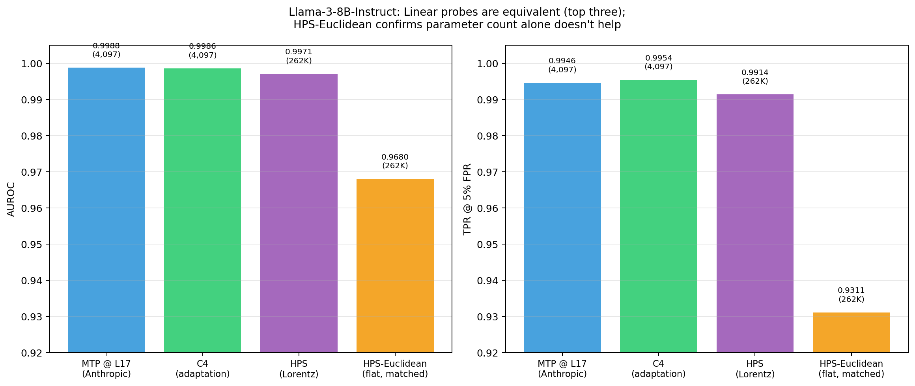
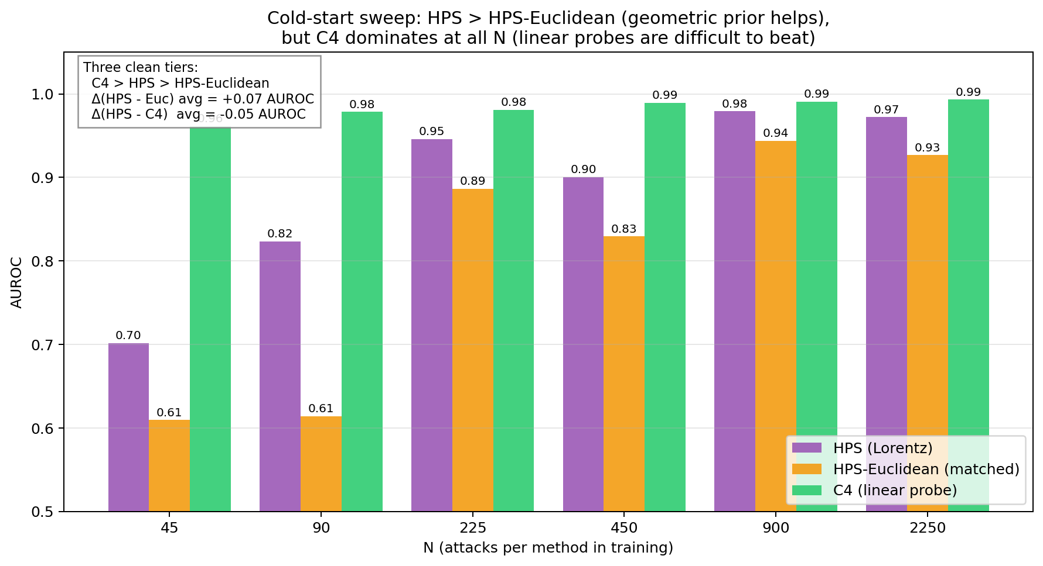
6. Finding 2 — HPS Doesn't Beat Linear Probes
Geometric prior helps over flat (+0.049 TPR), but C4 still wins (+0.015 TPR)
Method | AUROC | TPR@5%FPR | Params
MTP (Anthropic) | 0.999 | 0.995 | 4,097
C4 (linear probe) | 0.999 | 0.995 | 4,097
HPS (Lorentz) | 0.997 | 0.991 | 262K
HPS-Euclidean | 0.968 | 0.931 | 262K
Key deltas:
• HPS − HPS-Euclidean: +0.060 TPR (geometry helps over flat)
• HPS − C4: −0.004 TPR (linear probe still wins)
• MTP − C4: +0.000 (axis swap doesn't matter)
Prediction agreement (calibrated 5% FPR thresholds): • HPS catches that C4 misses: 0 examples • C4 catches that HPS misses: 21 examples • Pearson(HPS, C4) = 0.958 • OR-gate ensemble: no TPR gain, FPR doubles to 0.103 → HPS is essentially a noisy SUBSET of C4.

Slide 8
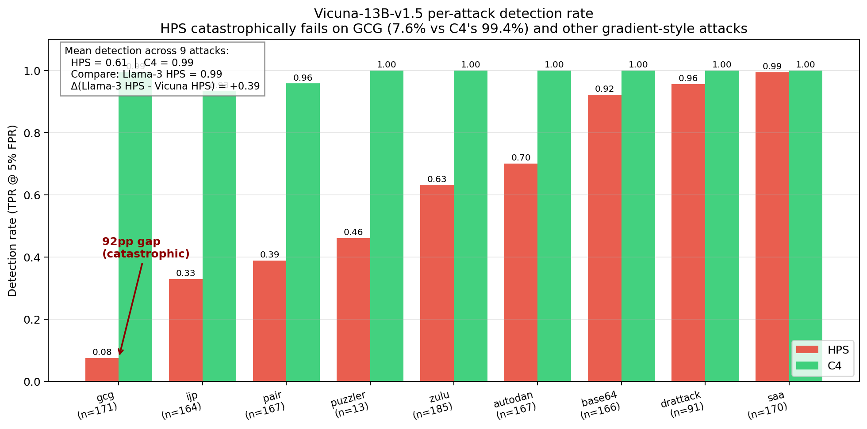
7. Finding 3 — Alignment-Mediated Failure on Vicuna
HPS catches 7.6% of GCG on Vicuna; C4 catches 99% — same code, only LLM differs
HPS GCG detection rate: Llama-3-8B-Instruct (RLHF): 100% (172/172) Vicuna-13B-v1.5 (SFT only): 7.6% (13/171) Cross-model gap: −92 percentage points
Per-attack on Vicuna-13B:
Attack | HPS | C4 | Gap
gcg | 0.076 | 0.994 | +0.92
ijp | 0.329 | 0.933 | +0.60
pair | 0.389 | 0.958 | +0.57
puzzler | 0.462 | 1.000 | +0.54
zulu | 0.632 | 1.000 | +0.37
autodan | 0.701 | 1.000 | +0.30
base64 | 0.922 | 1.000 | +0.08
drattack | 0.956 | 1.000 | +0.04
saa | 0.994 | 1.000 | +0.01
Mechanism: RLHF concentrates harm features into compact regions; SFT-only leaves them diffuse. HPS's 12-feature compression preserves concentrated signals (Llama-3) but filters out diffuse ones (Vicuna).
Mean detection: HPS = 0.61, C4 = 0.99

Slide 9
8. The Threat Surface — Bailey et al. (ICLR 2025)
All latent-space defenses fail under adaptive attacks — field-wide finding
Defense | Standard recall | Under adaptive attack | Section
Logistic regression probe | 100% | 0% | Sec 3.3
MLP probe | 100% | 0% | Sec 3.3
Sparse autoencoder | 91% | 0% | Sec 5
OOD detector (Mahalanobis) | 100% | 0% | Sec 3.3
Adv-trained probe (70 rounds) | perfect on past | 0% on new attacks | Sec 3.5
Circuit Breakers | broken | broken | Sec 3.4
LAT (Latent Adv Training) | broken | broken | Sec 3.4
"Obfuscated activations are not rare exceptions but rather appear to be widespread in the latent space... an attacker can always find new activations that bypass the monitor." — Bailey et al. (ICLR 2025)
Bottom line for our paper: We do not claim adversarial robustness. Bailey et al. shows it doesn't exist for any activation-based probe variant, including ensembles and adversarially trained probes. We compare methods under standard (non-adaptive) conditions; adaptive robustness is a field-wide open problem.

Slide 10
9. What We Found vs. What's Open
Need team input on framing, venue, and next experiments
WHAT WE FOUND
WHAT'S OPEN — DECISIONS FOR THE TEAM
Methodology contributions
Q1: Where to publish?
TMLR (60-65%) | AAAI (35-50%) | USENIX (25-40%)
Recommendation: TMLR
Q2: Run adaptive attacks experiment?
1-2 days compute, predicted: confirms Bailey et al.
Q3: Add Llama-2-7b-chat? CRITICAL.
SFT+RLHF on Vicuna's base model = clean ablation
of RLHF as the variable (vs Vicuna SFT-only)
Q4: What's the lead?
methodology critique | architectural | alignment-mediated
Q5: Multi-turn pivot? 6mo vs 6wk TMLR submission
• Length confound: AUROC=0.992 from length alone
• max_length confound: norm-only AUROC=1.000
• Train/test contamination: 15 prompts (1.15%) overlap
Empirical findings
• Geometric hypothesis CONFIRMED (0/13 inversions)
• HPS > HPS-Euclidean (+0.049 TPR matched-params)
• Vicuna alignment-mediated failure (gcg: 7.6% vs 99%)
• Linear probes (C4 ≈ MTP ≈ HPS) on aligned LLMs
Looking for input on: paper venue, framing priority, whether to add adaptive attacks, and whether to pivot to multi-turn.

Slide 11
Backup: Anticipated Q&A
Q: If geometric priors don't beat linear probes, why publish?
A: Three field-wide methodology issues + controlled comparison + alignment-mediated failure.
Q: Why no adversarial robustness?
A: Bailey et al. (ICLR 2025) shows all latent probes fail. Confirmed limitation.
Q: Are JBShield/HSF/RTV wrong?
A: No — but their benchmarks have inherited methodology issues. Fix is diverse benign.
Q: Why Vicuna-13B?
A: Same family as Llama-2 base, but SFT-only. Isolates alignment as the variable.
Q: What if HPS fails on Llama-2-chat too?
A: Sharpens story to 'specific aligned-model class'. Either way, ablation strengthens paper.
Q: How does this compare to JBShield's 99% detection?
A: Their 99% likely includes substantial length signal. Reproducing on diverse benign would tell us.
Q: TMLR timeline?
A: 4-6 weeks writing → submission August → decision November (3 month review).
Q: Compute budget used?
A: ~10h cache extractions + 5h experiments. ~15 GPU-days project total.

