Slide 1
Dashboard Aesthetics Challenge

Slide 2
Link of Data Used:
https://www.kaggle.com/sanjeetsinghnaik/top-1000-highest-grossing-movies
Title: Highest Hollywood Grossing Movies

Slide 3
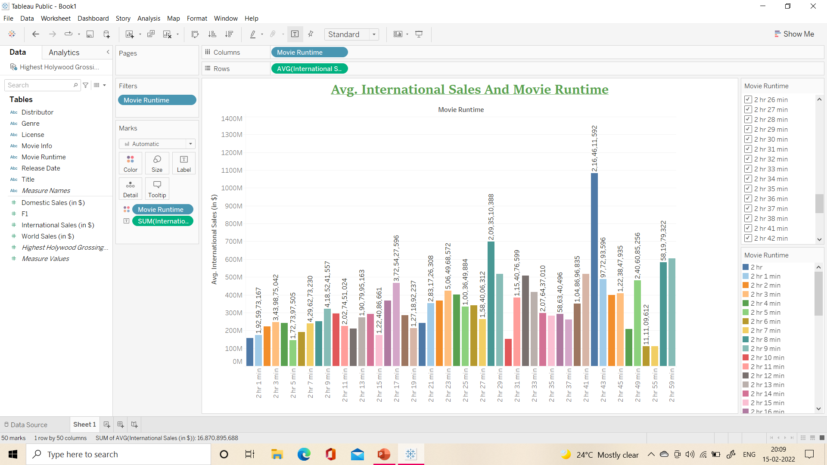

Slide 4
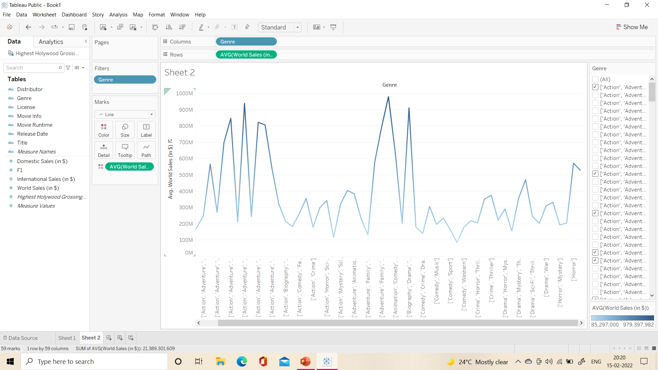

Slide 5
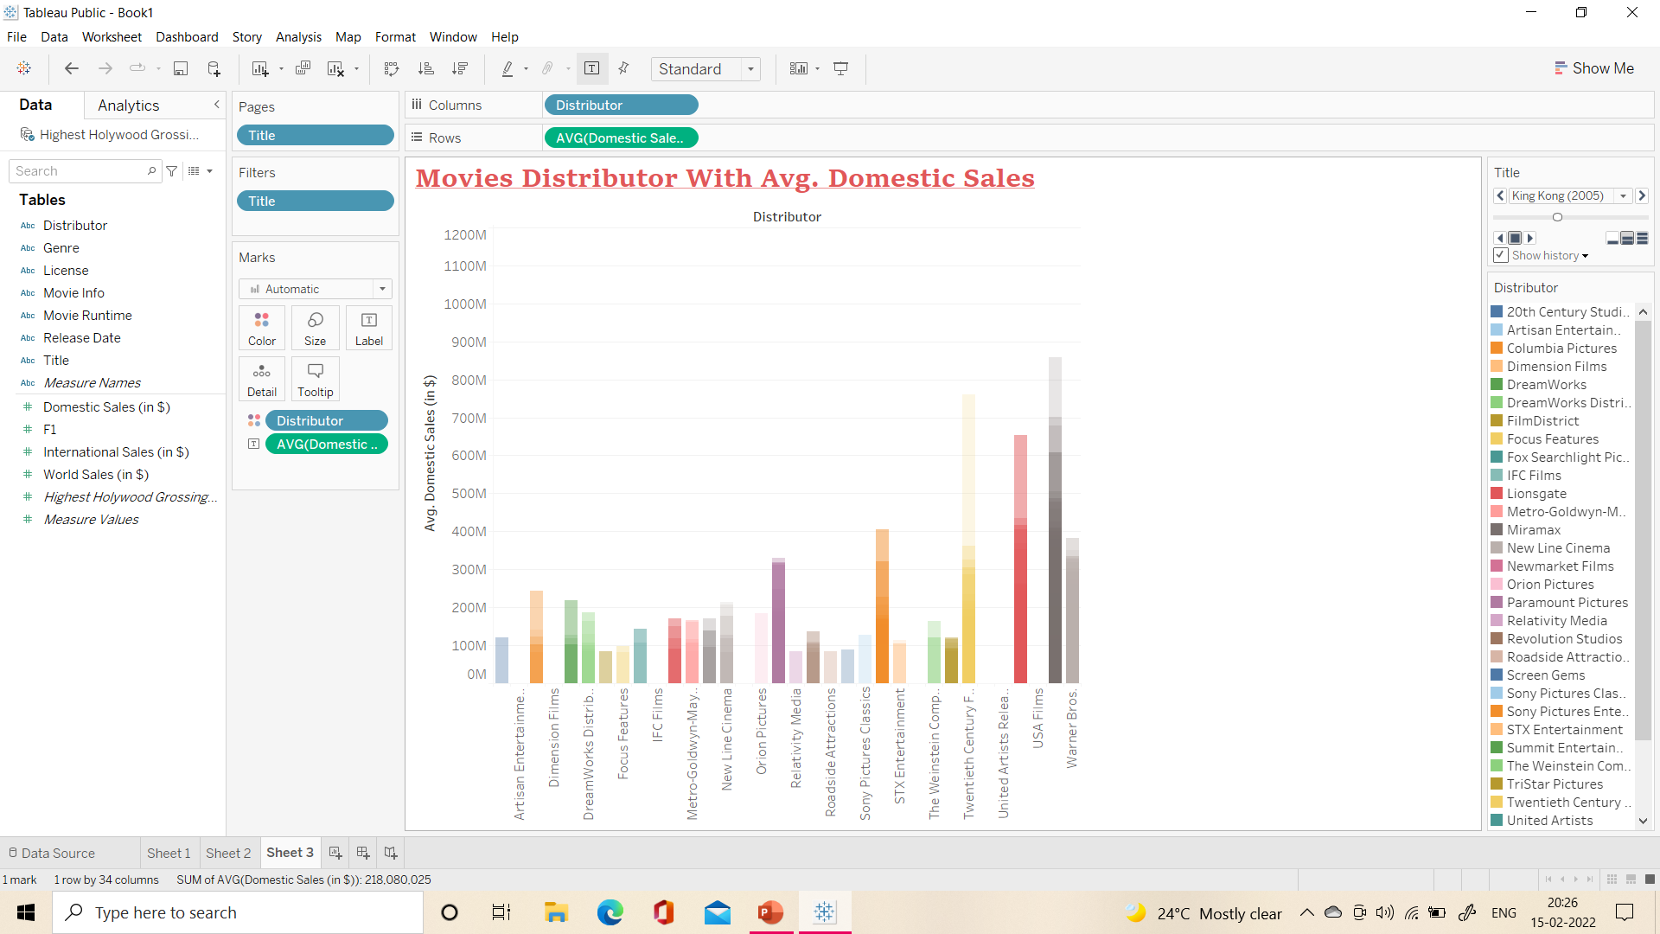

Slide 6
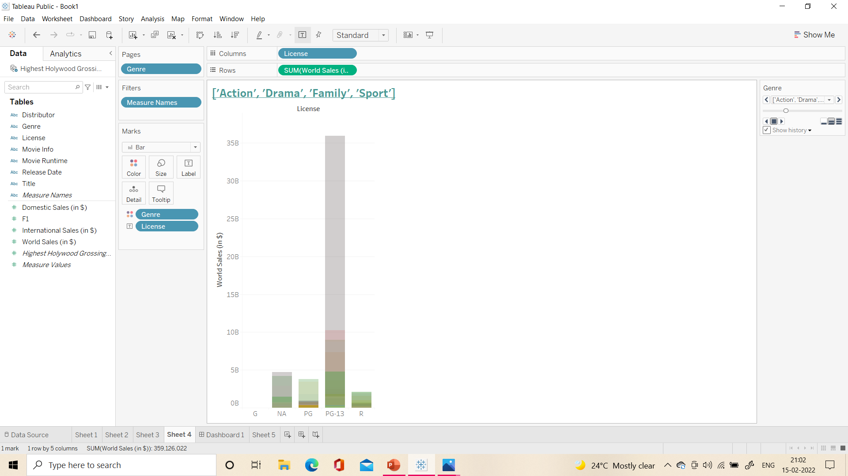

Slide 7
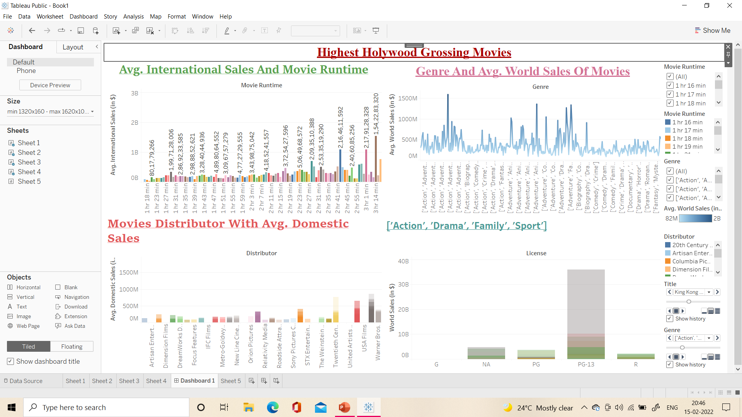
DASHBOARD

