Slide 1
Top 50 Bestselling Books 2009 - 2019
By Ayanda Mteto

Slide 2



OUTLINE
Executive Summary
Data Analysis overview
Introduction
Methodology
Results
Visualization – Charts
Discussion
Findings & Implications
Conclusion

Slide 3


Executive summary
The data analysis explores the top 50 Amazon bestselling books from 2009 to 2019, gaining insights on user ratings, reviews, prices and genre.
Utilizing Python's Pandas for data manipulation and Matplotlib / Seaborn for visualization, key insights are derived to understand trends and patterns within the dataset.

Slide 4
DATA ANALYSIS OVIEW
What is the average rating of the books?
What is the distribution of the number of reviews received by the books?
Which book has the highest price?
What is the correlation between the rating and the price of the books?
What is the distribution of the genres of the books?

Slide 5
INTRODUCTION
Welcome to my data analysis portfolio, where I explore insights derived from a dataset of books, including their ratings, reviews, prices, and genres. This portfolio showcases my ability to clean, analyze, and visualize data using Python, specifically leveraging libraries such as Pandas for data manipulation and Matplotlib/Seaborn for visualizations.
Dataset Description:
Year
Name
Author
User Rating
Reviews
Price
Genre

Slide 6

METHODOLOGY
Data analysis was perform using python pandas, matplotlib and Seaborn. The data did not have missing values or duplicate rows and duplicate column, and this is good as it ensure correct analysis.
Data analysis tickets are as follows:
Ticket 1: Data Cleaning and Preparation
Ticket 2: Descriptive Statistics
Ticket 3: Exploratory Data Analysis: Trend Analysis, Correlation Analysis and Grouped Analysis

Slide 7
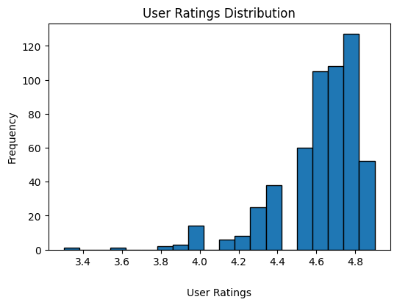
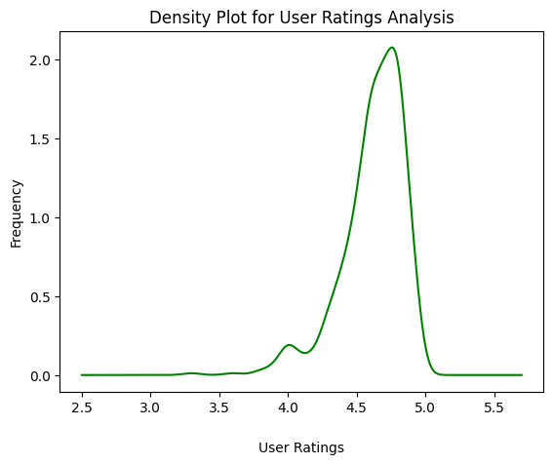
User Rating Analysis
The distribution analysis has highest rating of 4,9 and lowest rating of 3,3.
Most book authors are rated from 4,5 to 4,9 and there is a decline after 4,9. This is where top rated authors can be found.
There are few outliners from 3,3 and 3,6.
The average rating is 4,6 where an upward trend is found until there is downward slop after 4,9 ratings.

Slide 8
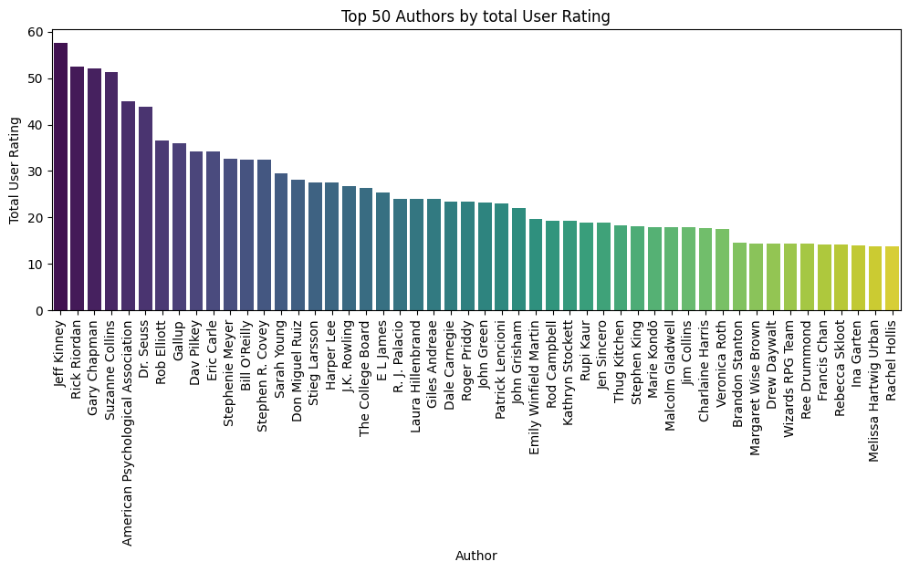
User Rating Analysis
The Top 50 authors are groupby ‘Author’ and aggregated by ‘User Rating’ using the total sum.
The Top 50 authors are extracted from 550 authors in a dataset.
The top-rated author is Jeff Kinney and the lowest in top 50 ratings is Rachel Hollis

Slide 9
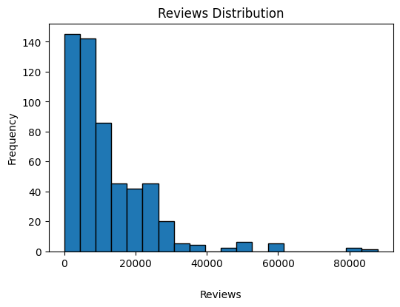
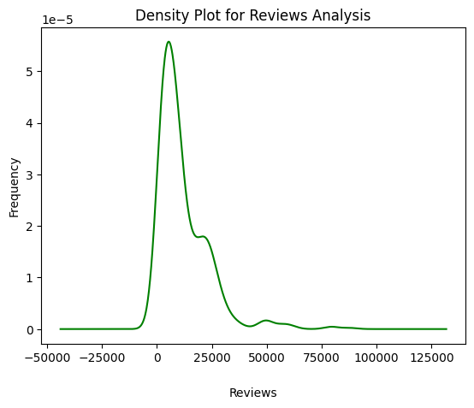
Reviews Analysis
The distribution analysis has the highest reviews of 87841 and lowest reviews of 37.
The common range for review are between 0 – 25000 review.
There are few outliner on 60000 and 80000 reviews.
The average reviews are11953,28 and thereafter there is sharp decline in reviews.

Slide 10
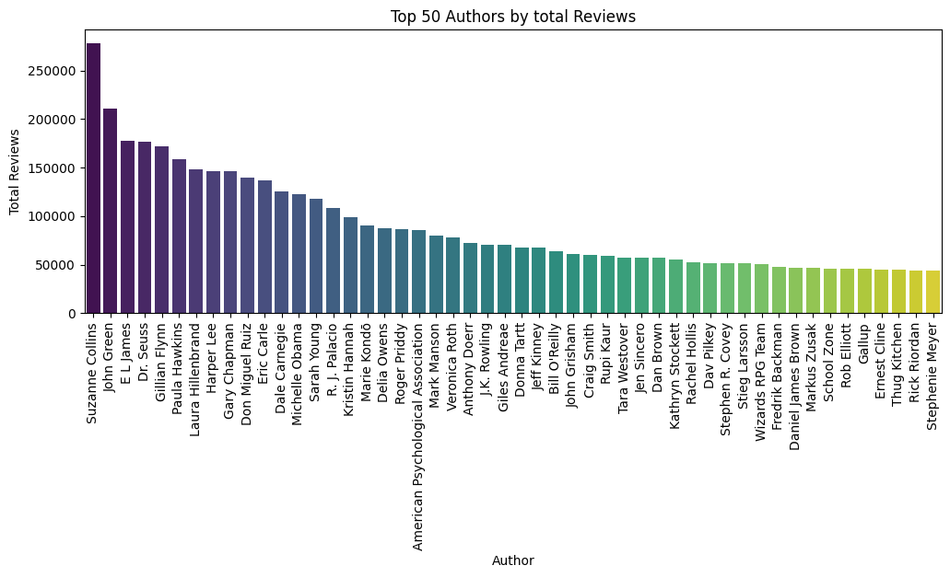
Reviews Analysis
The Top 50 reviews are groupby ‘Author’ and aggregated by ‘Reviews’ using the total sum.
The Top 50 reviews are extracted from 550 authors in a dataset.
The highest reviewed author is Suzanne Collins and lowest in the top 50 review is Stephenie Meyer

Slide 11
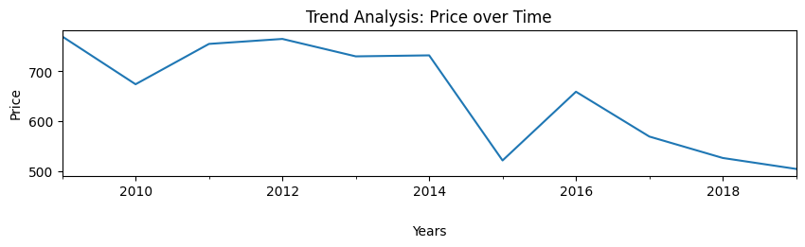
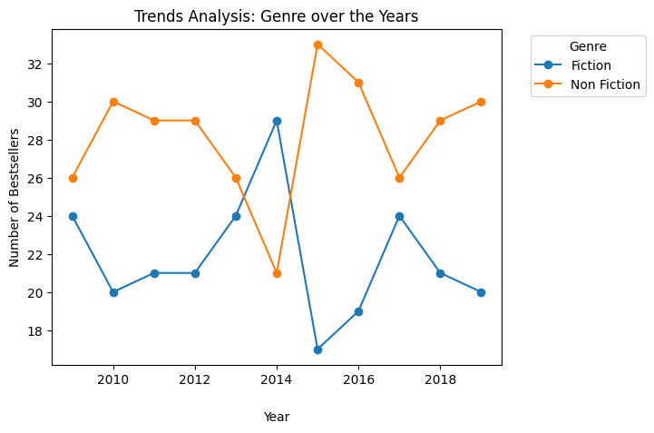
Price Analysis
There is decline in price over the years from 2010 – 2018.
There is a sharp downward fall in price in 2015 from 2014, the prices dropped significantly on fiction genre.
The non-fiction recorded a drop in 2014 that was below the fiction genre, however, it later had a sharp increase in 2015.

Slide 12
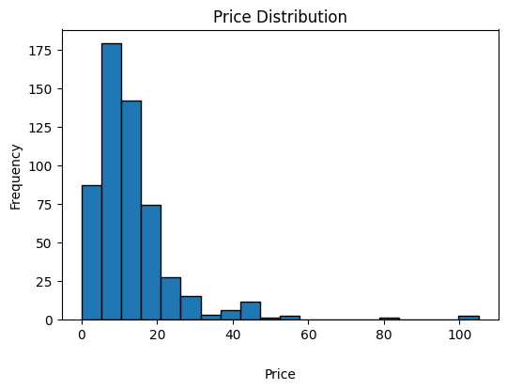
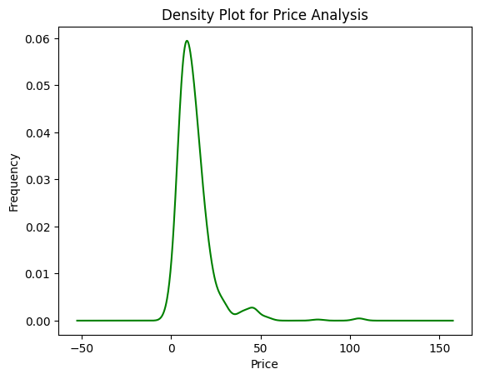
Price Analysis
The distribution analysis has highest price of 105 and lowest price of 0,00.
There are few outliners from 80 and 100 prices.
The average price is 13. The common price range is from 0 – 20, and thereafter the price distribution is low.

Slide 13
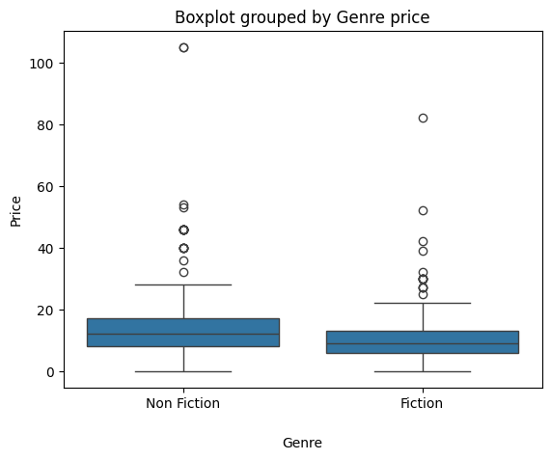
Price Analysis
The min price for both non-fiction and fiction price is 0,00.
The max price for non-fiction is around 25 to 30, and fiction is 20.
The Boxplot further confirm outliner from 80 to 100.
The outliner in both fiction, non-fiction revile prices on unique/ exclusive books are priced higher.

Slide 14
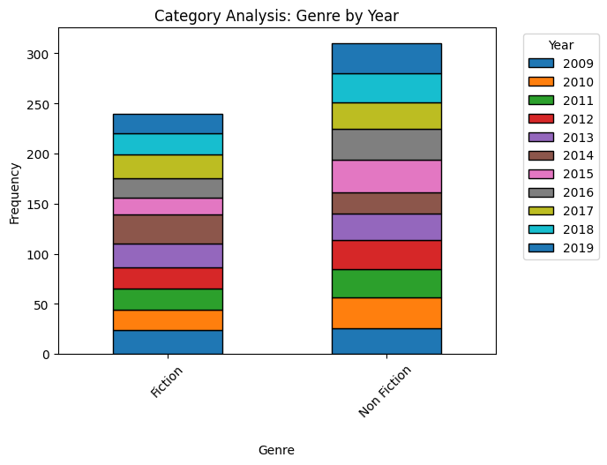
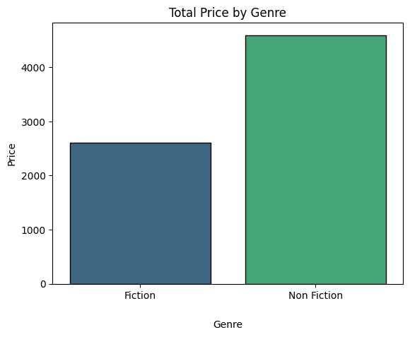
Genre Analysis
The distribution of fiction and non-fiction comparison shows a steady increased on non-fiction.
The total price is higher on non-fiction compared to fiction genre. This could be that non-fiction are price higher or have more variety for customers.
The 2014 year showed fiction exceeding non-fiction, this deemed as outliner, hence over years fiction genre has been stable.

Slide 15
Discussion: Findings & Implications User Rating Analysis
Findings:
Ratings range from 3.3 to 4.9, with an average of 4.6
Most books are rated between 4.5 and 4.9
Top-rated authors cluster in the 4.5-4.9 range
Jeff Kinney is the highest-rated author, Rachel Hollis the lowest among the top 50

Slide 16
Discussion: Findings & Implications User Rating Analysis
Implication:
The high average rating suggests overall customer satisfaction with bestselling books
There's a clear distinction between top-rated authors and others
Ratings above 4.5 seem to be a key factor in becoming a bestseller

Slide 17
Discussion: Findings & Implications REVIEWS ANALYSIS
Findings:
Review counts range from 37 to 87,841
Most books receive between 0-25,000 reviews
Average review count is 11,953
Suzanne Collins has the most reviews, Stephenie Meyer the least among the top 50

Slide 18
Discussion: Findings & Implications REVIEWS ANALYSIS
Implication:
There's a wide disparity in the number of reviews books receive
A small number of books receive an exceptionally high number of reviews
The number of reviews could be an indicator of a book's popularity or impact

Slide 19
Discussion: Findings & Implications PRICE ANALYSIS
Findings:
Prices range from 0 to 105
Average price is 13
Most books are priced between 0- 20
Non-fiction books tend to be priced higher than fiction
There's been a general decline in book prices from 2010 to 2018

Slide 20
Discussion: Findings & Implications PRICE ANALYSIS
Implication:
The wide price range suggests diverse pricing strategies in the book market
Lower-priced books dominate the bestseller list
Non-fiction books command higher prices, possibly due to perceived value or production costs
The declining price trend could indicate increasing competition or changes in the publishing industry

Slide 21
Discussion: Findings & Implications GENRE ANALYSIS
Findings:
Non-fiction has shown steady growth over the years
Non-fiction books generally have higher total prices than fiction
Fiction genre has remained relatively stable, with 2014 being an exception

Slide 22
Discussion: Findings & Implications GENRE ANALYSIS
Implication:
There's growing interest in non-fiction books among readers
Non-fiction books may offer more revenue potential for publishers and authors
Non-fiction books may offer more revenue potential for publishers and authors

Slide 23
Conclusion
In conclusion, these findings highlight the importance of quality content that garners high ratings and encourages customer reviews. They also underscore the need for strategic pricing, especially in the non-fiction category.
The growth in non-fiction suggests opportunities for expansion in this area, while the stability of fiction indicates a reliable market base.
Stakeholders should consider these insights when making decisions about author acquisitions, marketing strategies, pricing, and genre focus in their publishing portfolios. By leveraging these trends, publishers can better position themselves in a competitive and evolving book market.

