Slide 1
BOOTP/DHCP/DNS (Ch 18 & 19)
Dr. Clincy
Lecture

Slide 2
BOOTP
Each station connected to the Internet must know:
It’s IP address
It’s subnet mask
The IP address of a router
The IP address of a name server
Typically, this info is stored in the computer’s config file and retrieved during boot-strap time
What happens if a computer boots-up for the first time or if a computer is diskless ? Will need an ARP/RARP like protocol to get the needed info
BOOTP – stands for Bootstrap Protocol – is a C/S protocol setup to provide the info above
Dr. Clincy
Lecture

Slide 3
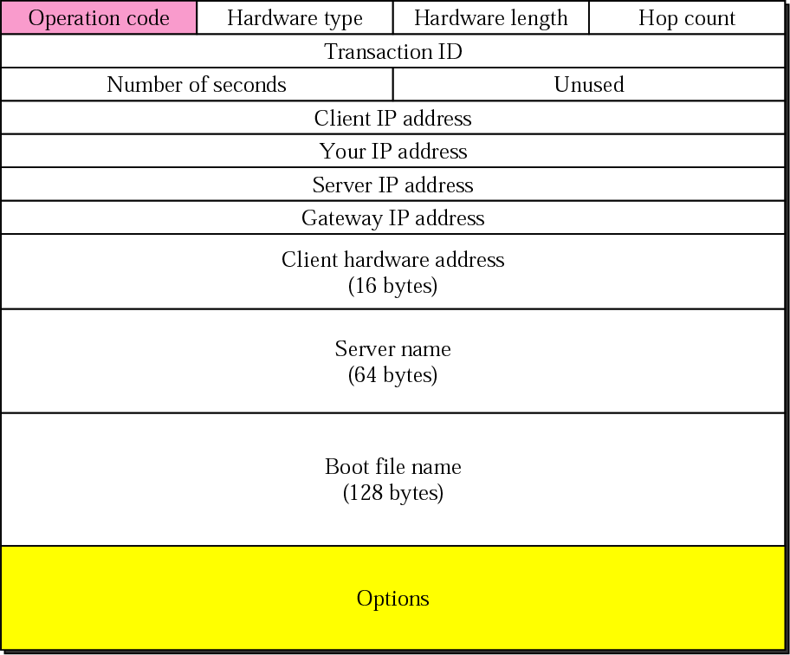
BOOTP packet format
Transaction ID: id used to match reply with request
# of seconds: seconds elasped since start of boot
Client IP address: if the client doesn’t know this, filled with zeros
Your IP address: client address filled in by the server (for a reply message)
Server IP address: filled by the server reply (for a reply message)
Gateway IP address: address of router filled by the server reply
Client hardware address: physical address of client supplied by client
Server name: optional – filled by the server reply (for reply message)
Boot filename: optional – filled by the server reply
Options: can carry either network mask or default router address OR some vendor info
Operation Code: defines the type of BOOTP packet (request or reply)
Hardware Type: type of LAN
Hardware Length: physical address length
Hop Count: max # hops a packet can travel
Dr. Clincy
Lecture

Slide 4
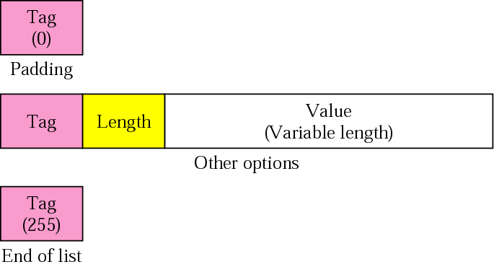
BOOTP Options Field
Only used in the reply (not the request)
When the client finish reading the message, if it encounters 99.130.83.99 (magic cookie), the next 60 bytes are options
Option is composed of: (1) 1-byte tag, (2) a 1-byte length (length of value field) and (3) value
Option format
Do you have any ideas why the length is specified ????
Dr. Clincy
Lecture

Slide 5
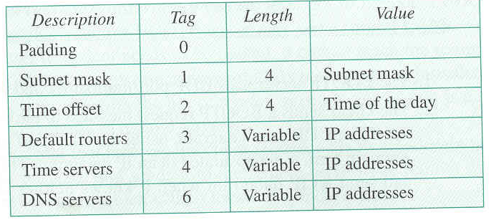
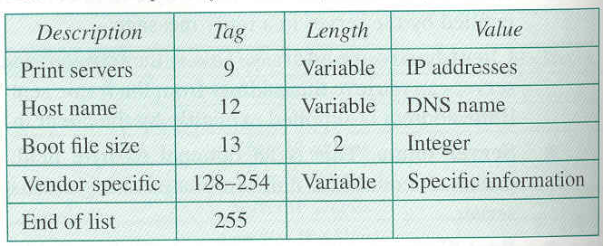
Options for BOOTP
Dr. Clincy
Lecture

Slide 6
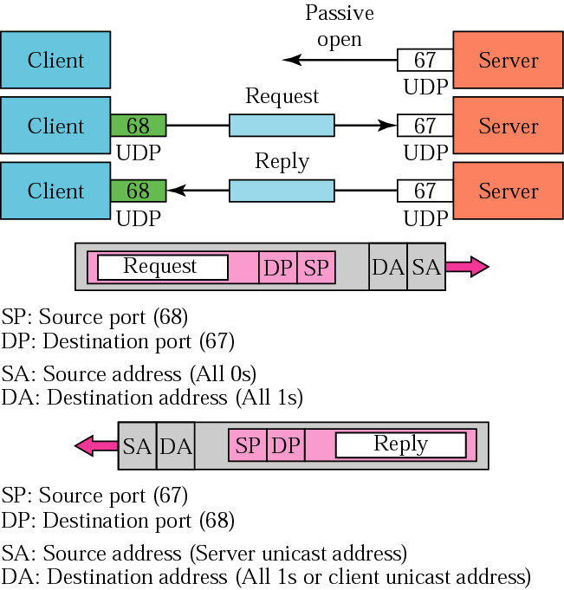
BOOTP operation
Recall that the BOOTP protocol has a C/S implementation
The BOOTP server waits for a request from a client (passive open)
Client sends a request to the server by using “this host on this network” address (recall Ch 4) – host sending to a bootstrap server when it doesn’t know it’s own IP address
Then the server either broadcast or unicast the reply back – if the server unicast, it can’t use the ARP service because the server DOESN’T know the client’s IP address
Other
The server doesn’t send back all of the info needed to boot-up. It sends a pathname to the client and the client can FTP the info over to it
Sometimes a remote server is used via a router (called a relay agent) versus a local server – in this case, the router would work in between the client and remote BOOTP server
Because UDP is used, BOOTP has to implement it’s own error control by (1) using a checksum approach and (2) by retransmitting if necessary (wait times to retransmit are random in minimizing traffic jams)
Dr. Clincy
Lecture

Slide 7
DHCP
Although BOOTP provides more information to the client, the physical-to-logical address mapping is static – this mapping must be pre-determined
The Dynamic Host Configuration Protocol (DHCP) was devised to extend BOOTP
DHCP server has 2 DBs: (1) one DB statically binds the physical and IP addresses (so it can provide the BOOTP type service), (2) a second DB contains a pool of IP addresses (making the assignment of IP addresses dynamic)
Therefore, when a client sends a request, the DHCP server first checks its static DB and a permanent (static) IP address is returned. If the physical-to-logical relationship doesn’t exist, it then sends an un-used IP address from it’s second DB.
The dynamic IP addresses have a time limit
Dr. Clincy
Lecture

Slide 8
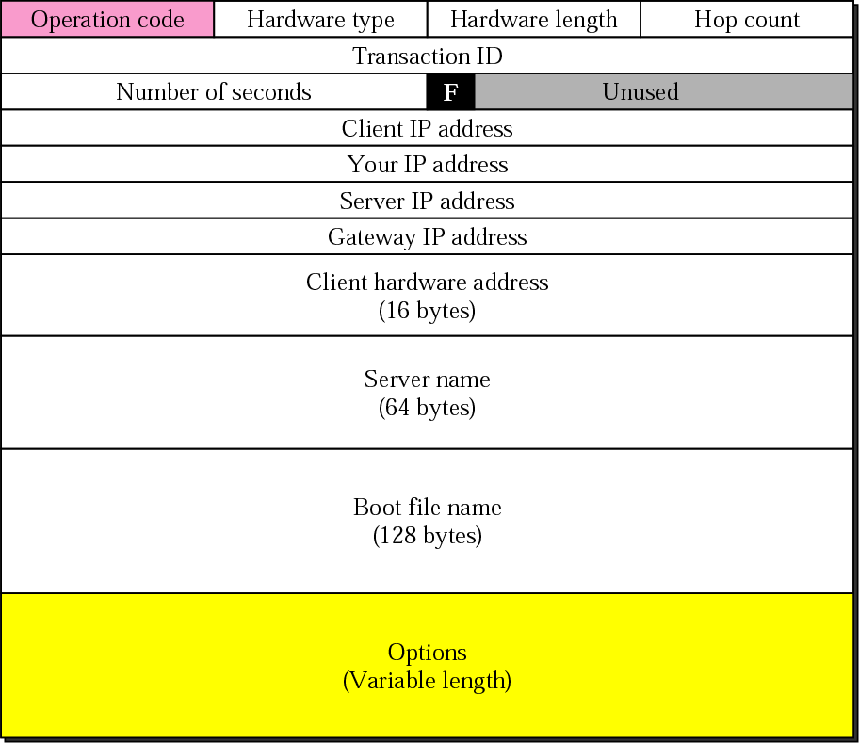
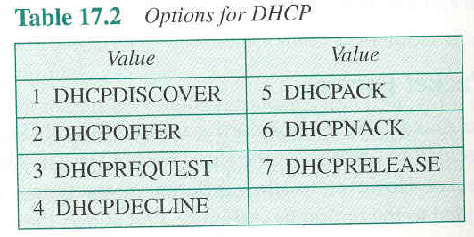
DHCP packet
The DHCP packet is very similar to the BOOTP packet except, a 1-bit flag and more options were added
1-bit flag: 1st bit of the unused field: used to let the client know if the reply is broadcast or unicast – recall the potential problem with a unicast reply – the client itself could possibly NOT know it’s IP address
New options define:
Interactions between the DHCP client and server
Time limits on dynamically issued IP addresses
Etc..
Dr. Clincy
Lecture

Slide 9
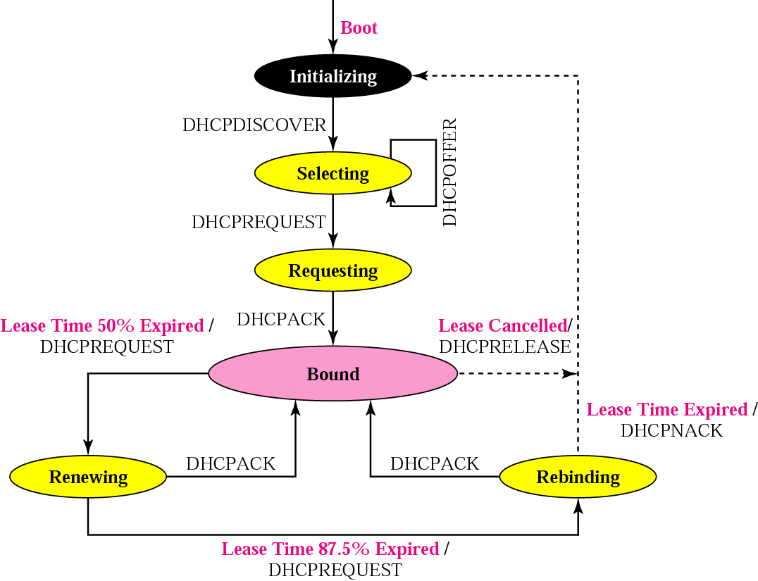
DHCP transition diagram
The DHCP client transitions state to state depending on the messages it receives or sends
The server issues a DHCPOFFER locking in the IP address.
The client then moves to the Selecting state and select one of the DHCPOFFERs and issue a DHCPREQUEST to the selected server and then goes to the Requesting State
If no DHCPOFFER, the client waits and retry
The client remains in the Requesting state until it receives a DHCPACK from the server (creating a bind between the client’s physical and IP addresses)
The client uses the leased IP address during the Bound state – when 50% of the time expire, the client does another DHCPREQUEST for a time renewal. During this state, the client can also cancel
During the Renewing state, if the DHCP server sends a new DHCPACK, the client starts over in the Bound state
If no DHCPACK is received and 87.5% of the time has expired, the client goes into a Rebinding state.
1 of 3 events can happen in the Rebinding state: (1) client receives a DHCPNACK and go back to the init state and try a new IP address , (2) lease expires or (3) receive DHCPACK and go to Bound state
The DHCP starts in an initialization state broadcasting a DHCPDISCOVER request message
Dr. Clincy
Lecture

Slide 10
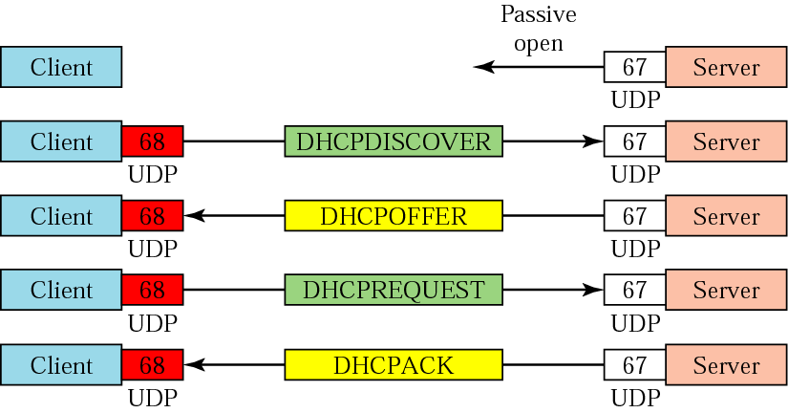
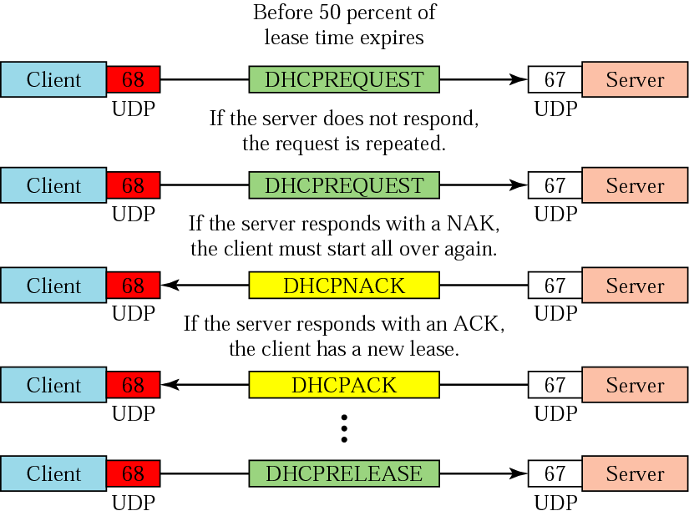
Exchanging messages
The figure below shows the exchange of messages related to the transition diagram
Dr. Clincy
Lecture

Slide 11
DNS (Ch 19)
Dr. Clincy
Lecture

Slide 12
Recall -Domain Name System (DNS)
As we mentioned before, the IP address is used to uniquely identify hosts connected to the Internet (specifically “connections”)
The actual IP address is hard to memorize or identify with
People prefer names instead of addresses
Therefore, we need a way of mapping a name to an address (or vice versa)
In the old days, this mapping was done by each host and the host would update this file from a Master file
Today, the Internet is too global and large for this approach
One approach: have one computer holding these mappings (problem: too many hits – concentrated traffic congestion )
Actual approach: replicate the mappings across distributed computers – the computer needing the info goes to the closest server – approach called DOMAIN NAME SYSTEM (DNS)
Dr. Clincy
Lecture

Slide 13
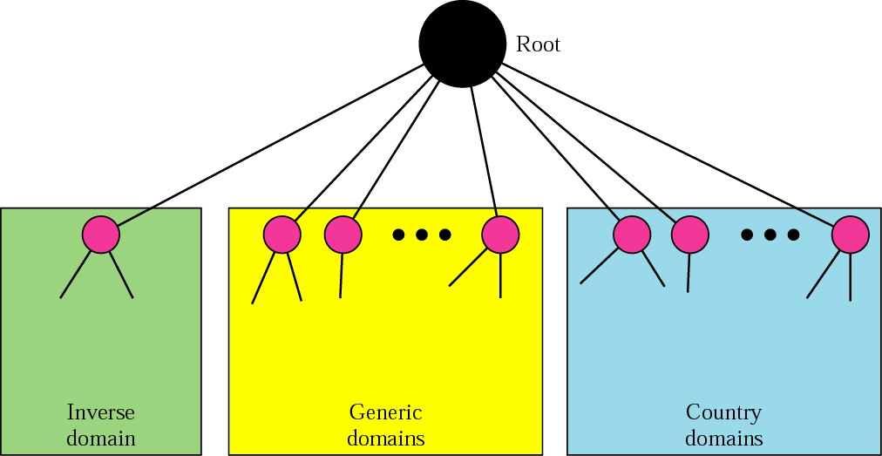
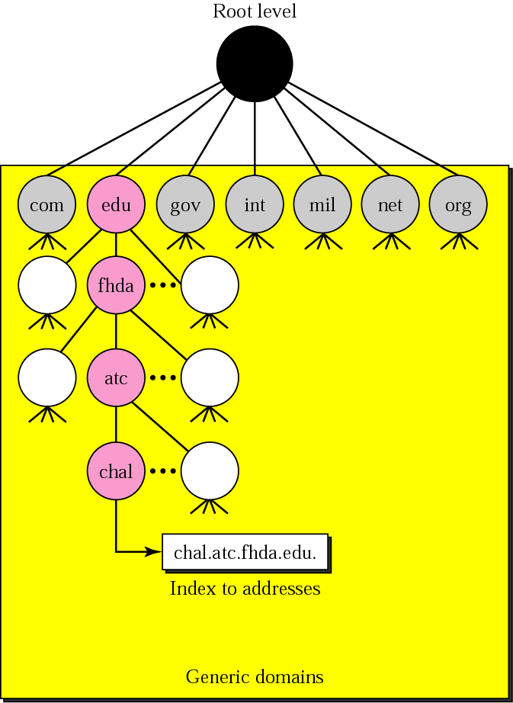
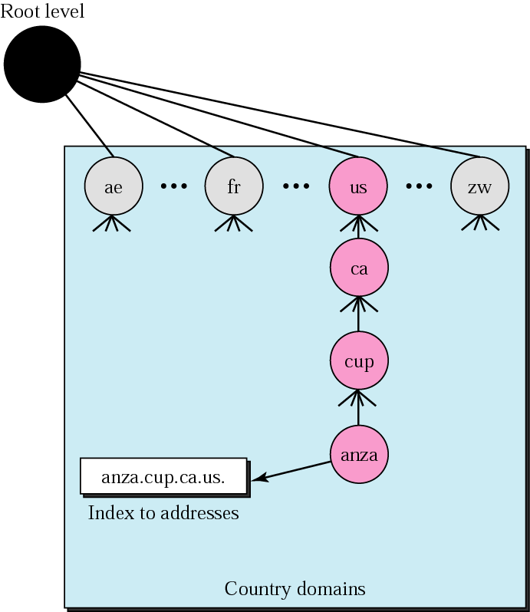
DNS in the Internet
For the Internet, the domain name space is divided into 3 sections: generic domains, country domains and inverse domains.
Generic domains define registered hosts according to their generic behavior.
Country domains follow the same format as generic domains but uses a 2-character country abbreviation
Commercial orgs
Educational orgs
Government orgs
Some new:
Aero (airlines)
Biz (businesses)
Info (info services)
Name (personal name)
Etc..
Dr. Clincy
Lecture

Slide 14
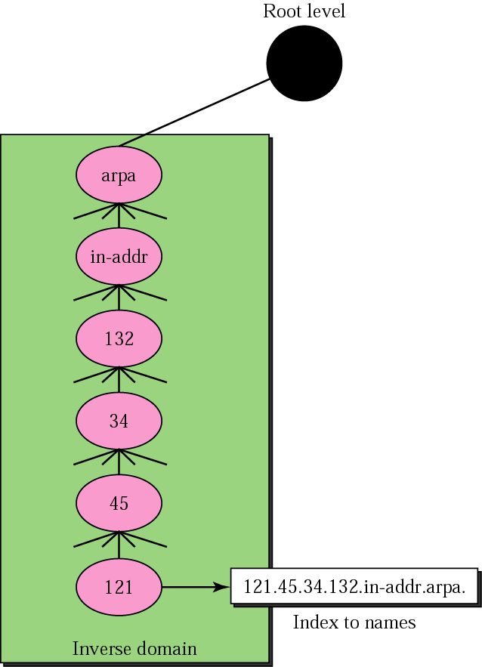
Inverse domain
Inverse domain is used to map an address to a name.
Server can have only the address and need to query the DNS server in mapping the address to name
To follow the convention of reading the domain labels from bottom to top, an IP address in inverted
For example, 132.34.45.121 (class B) is inverted to 121.45.34.132.in-addr.arpa
Where in-addr is the second-level node and arpa is the first-level node
Inverse address
NETWORK (last name)
HOST (first name)
HOST (first name)
NETWORK (last name)
Dr. Clincy
Lecture

Slide 15
RESOLUTION
Mapping a name to an address and vice versa is called name-address resolution
A host needing to map an address to a name (or vice versa) calls a DNS client (called a resolver)
The resolver accesses the closet DNS server with the mapping request
If the server has the info, it provides it
If the server doesn’t have the info, it either gets the info from some other server OR it refers the resolver to some other server
After the resolver receives the mapping, it determines if it’s correct or not – if correct, it sends the results to the requesting process
Dr. Clincy
Lecture

Slide 16
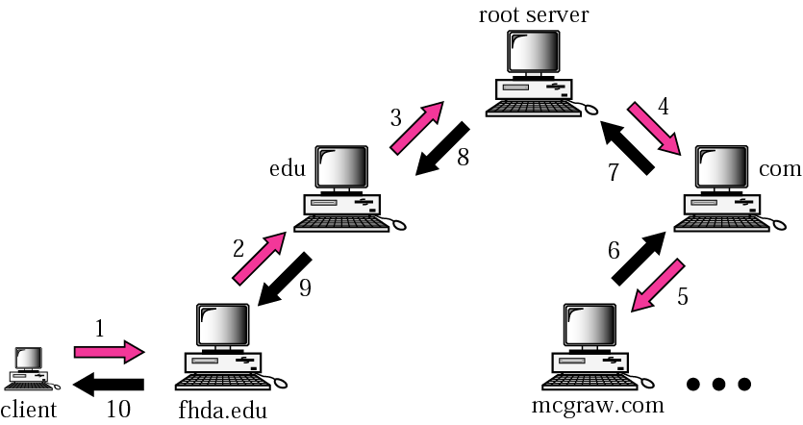
Recursive resolution
Client is seeking an answer (ie. address for a name or name for an address)
In this resolution case, the requesting client (resolver) expects the server to supply the final answer.
If the server can’t resolve the mapping, it forwards the request to it’s parent server.
If the parents server can’t resolve it, it’s sent to the next server – so forth
Once the mapping is resolved, the response travels back to the requesting client
Dr. Clincy
Lecture

Slide 17
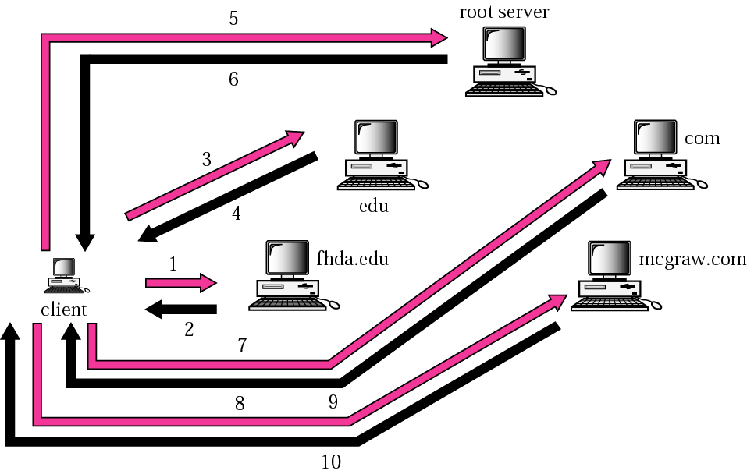
Iterative resolution
In this resolution case, the requesting client sends a request to the server
If the server can’t resolve the mapping, it sends back to the requesting client the IP address of the server it thinks can resolve the mapping
This continues until the mapping is resolved
Dr. Clincy
Lecture

Slide 18
CACHING
Each time a server receives a query for a name not in it’s domain, it has to do a search for the IP address
Reducing these searches increases efficiency
DNS does this by caching (or storing) the mapping responses in memory
If the server sends a client a response from memory (cache) versus the actual server, the response is marked “un-authoritative”.
Caching info too long could cause info to be out of date
To fix this, 2 approaches are used:
(1) the authoritative server attaches a “time-to-live” to the mapping and when that time expires, the server can’t send that info from cache
(2) all of the timing is done with in the server itself – after a certain time limit, all mappings out of date are purged.
Dr. Clincy
Lecture

Slide 19
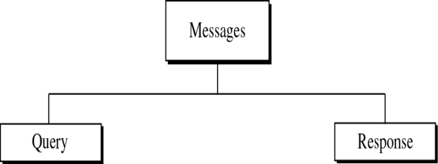
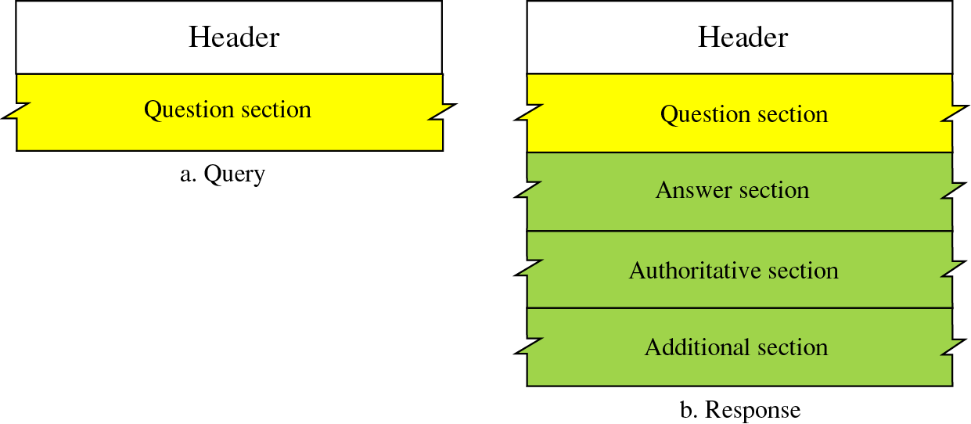
DNS messages
DNS has two types of messages: query and response
Query message consists of a header and question records
Response message consists of a header, question records, answer records, authoritative records and additional records
Dr. Clincy
Lecture

Slide 20
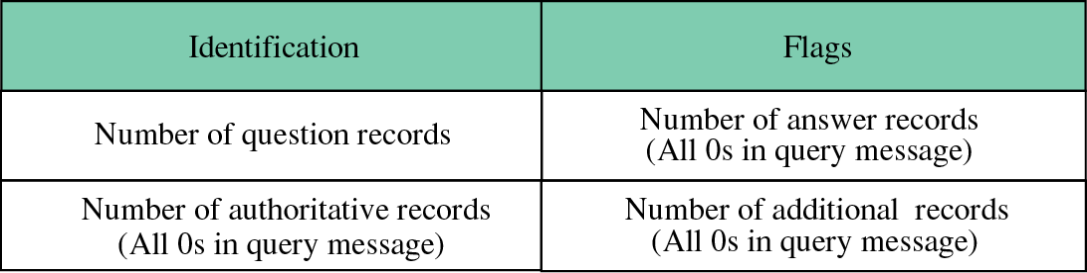
Header format
Header fields are:
Identification: used by the client to match the response with the query
# of question records: # of queries in the question section of the message
# of answer records: # of answer records in the answer section of the response
# of authoritative records: # of authoritative records in the authoritative section of the response
# of additional records: # of additional records in the response message
Flags:
QR: defines the type of message (query or response)
OpCode: defines the type of query or response
AA: Authoritative – if set, it means the name server is an authoritative server
TC: Truncated – if set, means the response was more than 512 bytes and truncated to 512
RD: Recursion Desired – if set, means the client desires a recursive answer
RA: Recursion Available – if set, means a recursive response is available
rCode: Shows the Status of the error in the response
Dr. Clincy
Lecture

Slide 21
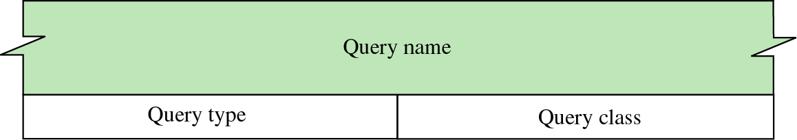
TYPES OF RECORDS
2 types of records: question and resource
For DNS, question records are used in the question section of the query and response messages
For DNS, resource records are used in the answer, authoritative and additional info sections of the response message only.
Question record format
The question records are used by the client in getting info from the server
Query Name: contains the domain name
Query Type: defines the type of query (ie. (1) convert domain name to address, (2) id authoritative servers for zone, etc..
Query Class: defines the protocol using DNS
Dr. Clincy
Lecture

Slide 22
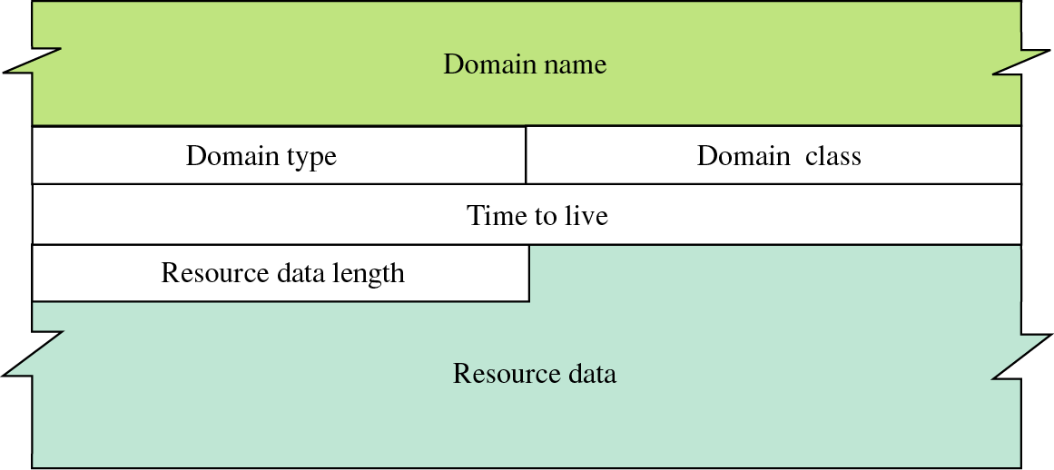
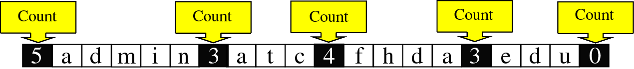
Resource record format
Each domain (node in the tree) is associated with a record called the resource record.
Domain Name (see format below)
Domain type: type of query
Domain class: defines the protocol using DNS
Time to live: # of sec the answer is valid
Resource data length: defines the length of the resource data
Resource data: variable length field – contains (1) answer to the query, (2) domain name of the authoritative server or (3) additional info
admin.atc.fhda.edu.
Dr. Clincy
Lecture

Slide 23
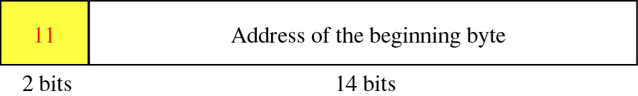
Format of an offset pointer
DNS defines a 2-byte offset pointer that points to a previous occurrence of the domain.
For example, the domain name in the question record is repeated in the resource record however, instead of the name, a pointer is provided
The 2 high-order bits are 11 – to indicate this is a pointer
The other 14 bits represent a number that points to the corresponding byte number in the message
Dr. Clincy
Lecture

Slide 24
Example 1
A resolver sends a query message to a local server to find the IP address for the host “chal.fhda.edu.”. We will illustrate the query and response messages separately.
Dr. Clincy
Lecture

Slide 25
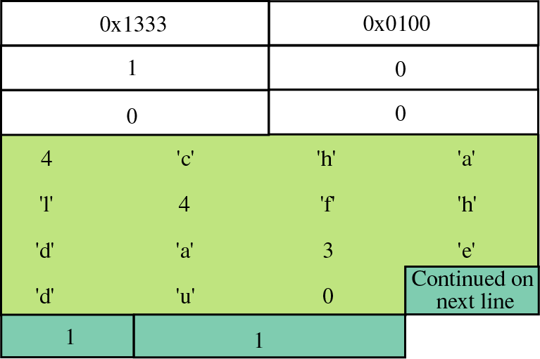
Example of a query message
First 2 bytes show an identifier (1333) which relates a response to a query
The sequence of bits for the flag below is 0000000100000000
The sequence of binary flag bits are translated to hex (0100)
# of question records, # of answer records, # of authoritative records, # of additional records
4chal4fhda3edu0
        Query type(IP address), Class (Internet)
Dr. Clincy
Lecture

Slide 26
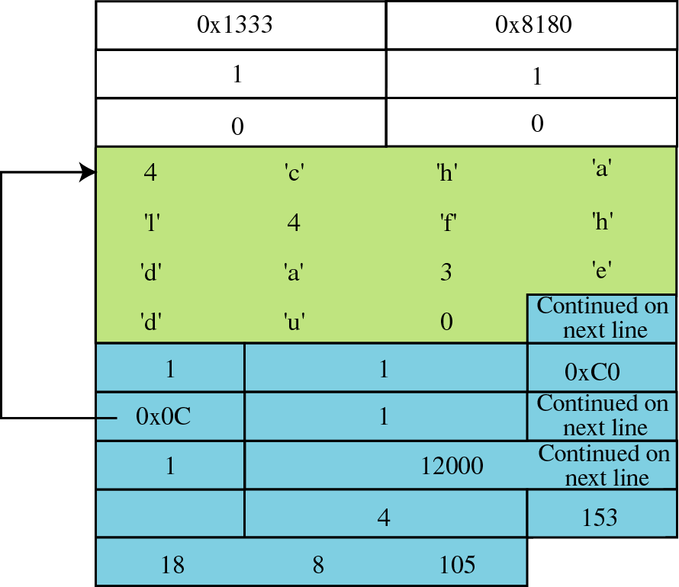
Example of a response message
First 2 bytes show an identifier (1333) which relates a response to a query
The sequence of bits for the flag below is 1 0000 0 0 1 1 000 0000
The sequence of binary flag bits are translated to hex (8180)
# of question records, # of answer records, # of authoritative records, # of additional records
Points to domain versus repeating it
Time to live (12000 seconds)
Size of the IP address
The IP address
Dr. Clincy
Lecture

