Slide 1
Generative Adversarial Networks(GANs):
Guide Name:
Dr. Vijaya Raghavan PhD
HOD Dept Of CSE
Mohammad Thousif
1HM19CS023

Slide 2
Abstract
GANs(Generative Adverasial Networks) are a type of deep learning generative model that has lately gained popularity in recent years. GANs can learn patterns from high-dimensional complex data, making them useful for image, audio and video processing. Nonetheless, there are several signaficant obstacles in the training of GANs, such as instability, mode collapse and non-convergence.

Slide 3
Agenda
Introduction
Literature survey
Existing System
Disadvantages of Existing System
Problem Statement
Proposed System Design
Advantages of Proposed System
Implementation
Testing and Results
Applications
Conclusion and Future work
References

Slide 4
Introduction
Generative Adversarial Networks, or GANs, are a powerful class of deep learning models that have revolutionized the field of data generation.
GANs consist of two neural networks, a generator and a discriminator, that work together to learn the underlying distribution of a given dataset and generate new samples that are similar to the original data.
The generator network takes a random noise vector as input and generates a new sample that is intended to be indistinguishable from the original data. The discriminator network, on the other hand, takes as input either a real sample from the original dataset or a fake sample generated by the generator network, and outputs a probability value indicating whether the input is real or fake.

Slide 5
Literature survey
Project name | Authors | Result
Generative Adversarial Nets | Ian J. Goodfellow, JeanPouget-Abadie∗, Mehdi Mirza, Bing Xu, David Warde-Farley, Sherjil Ozair† , Aaron Courville, Yoshua Bengio | A new framework for estimating generative models via an adversarial process, in which we simultaneously train two models: a generative model G that captures the data distribution, and a discriminative model D that estimates the probability that a sample came from the training data rather than G.
IMAGE GENERATION WITH GANS-BASED TECHNIQUES | Shirin Nasr Esfahani and Shahram Latifi | The overview of state-of-art approaches in five common fields of GANs-based image generation including text-to-image synthesis, image-to-image translation, face aging,3D image generation and DeepMasterPrints.

Slide 6
An Introduction to Image Synthesis with Generative Adversarial Nets | He Huang, Philip S. Yu and Changhu Wang | The basics of Generative GAN and classify image synthesis methods into three main approaches, i.e. direct method, hierarchical method and iterative method, and mention some other gen- eration methods such as iterative sampling.
Generation of Synthetic Continuous Numerical Data Using Generative Adversarial Networks | A H Aziira1, N A Setiawan2 and I Soesanti3 | This paper proven that GAN can also be a suitable method for generating unlabeled continuous numerical data with the similarity between synthetic and real data distribution, and accuracy of synthetic data reaches 63% while the perfect ideal accuracy is 50%.

Slide 7
Existing System
Plenty of existing work on Deep Generative Models
Boltzmann Machine
Deep Belief Nets
Variational Auto Encoders (VAE)

Slide 8
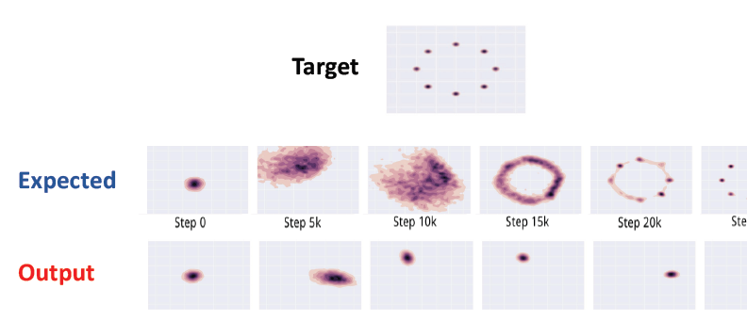
Disadvantages of Existing System
Mode-Collapse
Generator fails to output diverse samples

Slide 9
Problem Statement
“Using Generative Adversarial Networks for Data Generation”

Slide 10
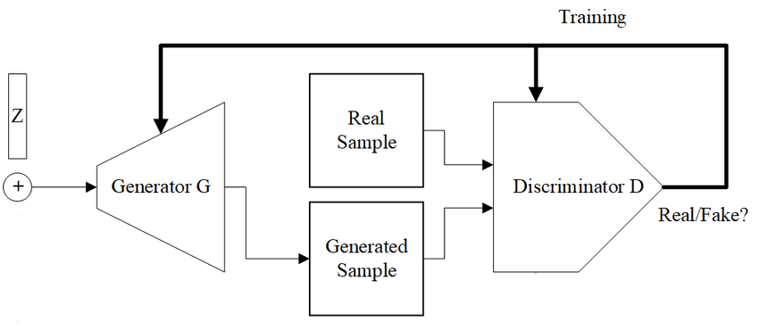
Proposed System Design

Slide 11
Advantages of Proposed System
Why GANs?
• Sampling (or generation) is straightforward.
Training doesn't involve Maximum Likelihood estimation.
Robust to Overfitting since Generator never sees the training data.
Empirically, GANs are good at capturing the modes of the distribution

Slide 12
Implementation
The loss function:
𝑚𝑖𝑛 𝑚𝑎𝑥 V(D,G) = 𝐸𝑥∈𝑋 [log 𝐷(𝑥)] + 𝐸z∈Z [log (1 − 𝐷(𝐺(𝑧)))]
𝐺 𝐷
D(x) is the discriminator’s estimate of the probability that real data instance x is real.
Ex is the expected value over all real data instances.
G(z) is the generator’s output when given noise z.
D(G(z)) is the discriminator’s estimate of the probability that a fake instance is real.
Ez is the expected value over all random inputs to the generator (in effect, the expected value over all generated fake instances G(z))

Slide 13
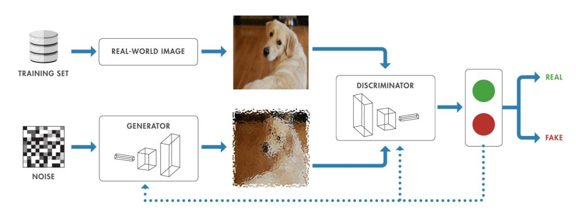
Demonstration of working of GANs

Slide 14
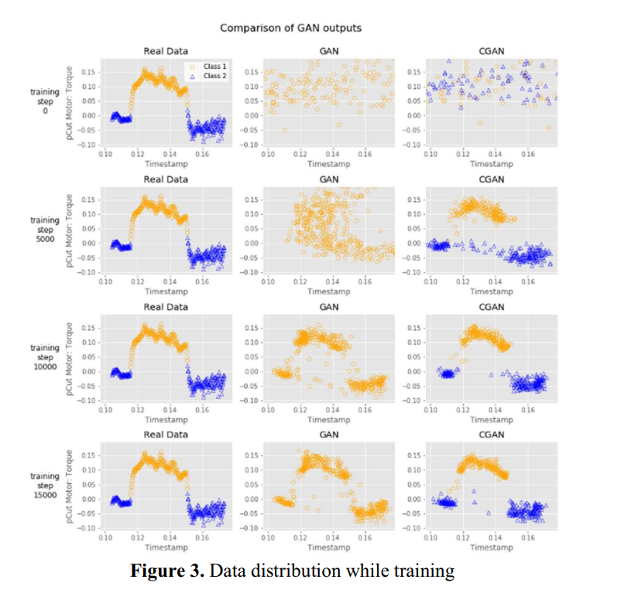
Testing and Results

Slide 15
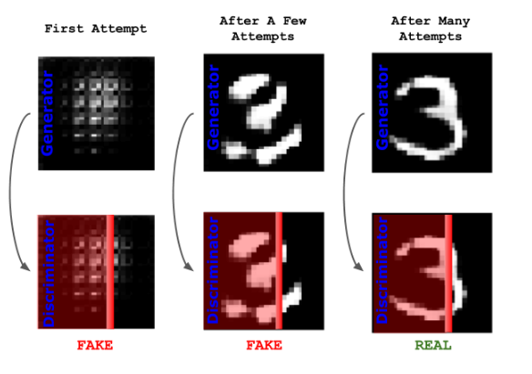

Slide 16
Applications
Data generation:
GANs can be used as a data generation once generator and discriminator are well tuned
One advantage of GANs over other data generation techniques is that they can generate data that is highly variable and unpredictable.
GANs can help organization for generating artificial large dataset from existing amount of data.
2. Deep fake detection:
GANs can be useful in detecting deep fake images generated by AI tools
GANs can also be used to detect deepfakes. By training a GAN to distinguish between real and fake data, the discriminator part of the network can be used as a detector. This is because the discriminator has learned to identify the subtle differences between the real and fake data.
One approach to deepfake detection using GANs is to train a GAN on a dataset of real images and a dataset of deepfake images. The GAN learns to distinguish between the two and the discriminator can be used to identify deepfakes. This approach has shown promising results in detecting deepfakes in images.

Slide 17
Conclusion and Future work
Although digital image synthesis is as old as image processing and machine vision, automatic image generation techniques are still discussed, and new methods are introduced every day
GAN can also be a suitable method for generating unlabeled continuous numerical data with the similarity between synthetic and real data distribution, and accuracy of synthetic data reaches 63% while the perfect ideal accuracy is 50%
Despite their successes, GANs are still an active area of research, and there are many challenges to be addressed, such as mode collapse, stability issues, and the difficulty of evaluating the quality of generated samples.

Slide 18
REFERENCES
https://www.activestate.com/blog/how-to-build-a-generative-adversarial-network-gan/
Goodfellow, I. J., Pouget-Abadie, J., Mirza, M., Xu, B., Warde-Farley, D., Ozair, S., Courville, A., & Bengio, Y. (2014) “Generative adversarial nets”,Advances in Neural Information Processing Systems 27 (NIPS 2014),Montreal, Canada.
Frey, B. J. (1998) “Graphical models for machine learning and digital communication”, MIT Press.
Doersch, C. (2016) “Tutorial on variational autoencoders”, arXiv preprint arXiv:1606.05908 .
M. Mirza & S. Osindero (2014) “Conditional generative adversarial nets”, arXiv:1411.1784v1.
Sh.Nasr Esfahani, &Sh. Latifi (2019) “A Survey of State-of-the-Art GAN-based Approaches to ImageSynthesis”, 9th International Conference on Computer Science, Engineering and Applications (CCSEA 2019), Toronto, Canada, pp. 63-76.

Slide 19
Thank You

