Slide 1
DrThM
Knowledge Discovery Part IV: The Art of Processing Unstructured Data

Slide 2
Recapitulation: Data Science
Data Science combines statistics und knowledge discovery
Statistics:
Make assumption(s) (by modeling from observation)
Collect specific predefined data
Thereby verify assumption ("verify hypothesis")
Knowledge Discovery
Collect all possible data even if only noise
Make as less assumptions as possible in an analysis
Extract knowledge exploratively
Knowledge Discovery: Inspecting a data collection for the purpose of discovering usable knowledge
Usable: Here cost reduction or new business success
Dr. Thrun

Slide 3
A Short List of Definitions
Unstructured data: data that does have a clear, semantically overt, easy-for-a-computer structure
Document: whatever units we decide to build a retrieval system over, e.g. memos, chapters of a book web pages
Corpus: collection of documents relevant for a question
Tokenization: Task of chopping a character sequence into tokens
Term: Indexed units, derived from normalized tokens, usually words (but every word becomes a term, it depends on preprocessing)
Stop words: extremely common words without a meaning to the task at hand, e.g. “the”
Stemming: refers to a cruide heuristic process that chops off the end of words in the hope of finding the common overlapping word, e.g. cats -> cat
Lemmatization: using vocabulary a morphological analysis of the word is done returning it to the base form+
Levenshtein distance: edit-distance: minimum number of oprations necessary to transform one word into another
Term-Document Matrix (TD): binary matrix indicating which term is in which document. In IR normally inverse with an index (and many algorithms based on this form)
Manning, Christopher D., Prabhakar Raghavan, and Hinrich Schütze, Introduction to information retrieval, 2008.
Notes:
Christopher Manning, Stanford NLP in Machine Learning, Professor of Linguistics and of Computer Science

Slide 4
Overview Over the Processing of Text
Information retrieval (IR)
Finding documents of an unstructured data that satisfies an information need within large collections
Defines words in text as terms and gathers documents into collections
Used in web search, in libraries
Simple preprocessing of text available, like punctuation, stop words, tokenization, basic stemming
Transfers Term document (full) matrix into sparse matrix (inverted index, indexation)
Considers a variety of algorithms based on inverted indexes
Text Mining (TM):
Deals with the text itself seen as characters
Basic IR is prerequesite (1.)
Text to values transformation in order to discover relevant data
No text structure such as grammar considered
Natural language processing (NLP):
Linguistic analysis which helps machine to read text, e.g.
Summarization, disambiguation, Lemmatization, Synonyms
Deals with underlying latent metadata like sentiment, category of content
For NLP please see Manning, Christopher and Hinrich Schütze, Foundations of Statistical Natural Language Processing, 1999.
Notes:
NLP is Good for gramar
Lemmatization: process of grouping the together the inflected forms of a word

Slide 5
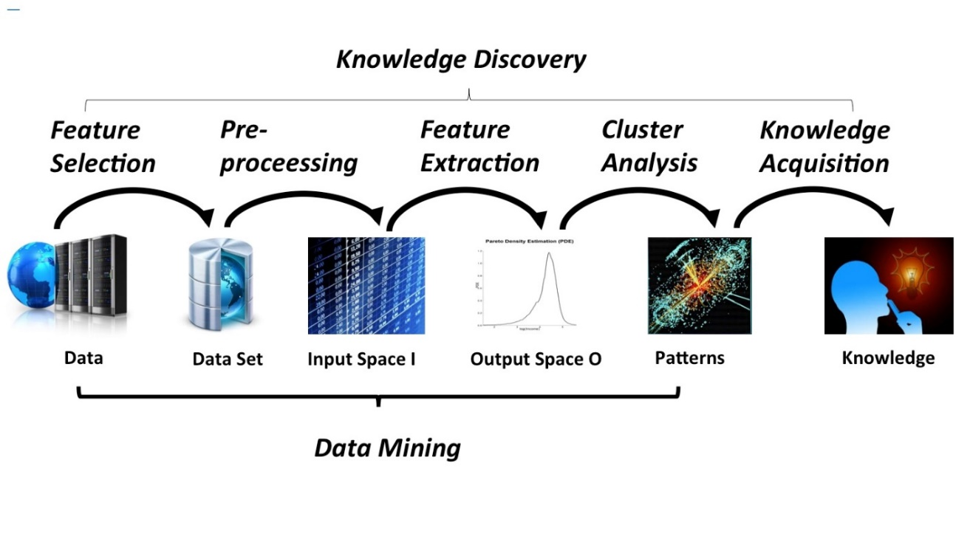
Having a TD from IR or distance from TM we are able to apply common data science knowledge to use cases
Basic IR
Text Mining (TM)
Natural language processing
Thrun, M;.C.: A System for Projection Based Clustering through Self-Organization and Swarm Intelligence, Springer, Heidelberg, 2017

Slide 6
Text Processing in R - Basic IR
Goal: Extract for each document with a lot of characters understandable terms (Words)
Basic algorithms can be found in
require('tm’) and require('SnowballC’)
# Generate Corpus
Chars= chars=VectorSource(unstructuredData) #list of documents
doc=Corpus(chars,readerControl = list(language = "ger",removePunctuation=TRUE,stemming=FALSE)) #unsuported for german ut of documents
#easy preprocessing using IR
doc=tm_map(doc,tolower);doc = tm_map(doc, stripWhitespace)
#special manual preprocessing for German
doc=tm_map(doc, cleanThis) # verhindern, dass wir Müll verarbeiten
doc=tm_map(doc, CombineThis) # verhindern, dass wir Müll verarbeiten
#achtung streicht keine
doc=tm_map(doc,removeWords,stopwords('german’))
cleanThis <- function(x) {
x = gsub(pattern = 'ü','ue',x)
x = gsub(pattern = 'ä','ae',x)
x = gsub(pattern = 'ö','oe',x)
x = gsub(pattern = 'ü','ue',x)
x = gsub(pattern = 'ß','ss',x)
Encoding(x) <- "UTF-8"
x <- iconv(x, "UTF-8", "UTF-8",sub='')
return(x)
}
CombineThis=function(x){
x = gsub(pattern = ' nicht','nicht',x)
x = gsub(pattern = 'wegen ','wegen',x)
#gsub(pattern = 'nicht ','nicht',x)
x = gsub(pattern = 'wegen ','wegen',x)
x = gsub(pattern = 'mehr ','mehr',x)
x = gsub(pattern = 'keine ','kein',x)
x = gsub(pattern = 'kein ','kein',x)
x = gsub(pattern = 'keinen ','kein',x)
x = gsub(pattern = 'keiner ','kein',x)
x = gsub(pattern = 'keinem ','kein',x)
x = gsub(pattern = ' nr','nr',x)
return(x)
}
DrThM

Slide 7
Text Mining
Goal: Get from unstructured data (text documents) to structured data
Similarity like in genetics; e.g.
edit distance, and only such words recognized, e.g.
basic stemming (fragen: fragte <-> fragt)
No lemmatization (e.g. good and better ), no synonyms (car and automobile )
b) Term-Document Matrix
Apply statistical inference, e.g.
Probability of words per document (i.e. normalized word counts)
Similarity definition between terms or documents possible
Then apply some kind of algorithm depending on the problem
Question: What are the main two topics in a corpus?
#Further Manual processing, like
doc2=doc
doc2=tm_map(doc2,removeWords,c('ueber','fuer','wurde','wurden','beim'))
doc2$content=sapply(1:length(doc2$content),FUN=function(i,j) gsub(pattern = 'fragt','frage',j[[i]]),doc$content)
(…)
tf=DocumentTermMatrix(doc2)
DrThM
Notes:
Statistical inference: process of generating conclusions about a population from a noisy sample

Slide 8
Answer: Text Mining by Latent dirichlet allocation (LDS)
Generative Probabilistic model of LDA finds groups of word belonging to one topic
Hierarchical Bayesian model
Number of topics has to be set
Verification unknown
Output is value (beta)
Beta: Probability of a term generated from a topic according to the multinomial model
Most frequent term in a topic can be shown
Most different terms regarding beta being in one topic are chosen
require ('topicmodels’)
#apply clustering by generating two topics
ap_lda=LDA(tf,k=2,control=list(seed=5678)) #k=number of topics, see [Blei, 2003]
require ('tidytext’); require('dplyr’)
ap_topics=tidy(ap_lda,matrix='beta') #Probability of a term generated from a topic according to the multinominal model
ap_top_terms<-ap_topics %>%group_by(topic)%>%top_n(20,beta)%>%ungroup()%>%arrange(topic,-beta)
#Show most used words per topic (cluster)
ap_top_terms %>% mutate(term=reorder(term,beta)) %>% ggplot(aes(term,beta,fill=factor(topic)))+geom_col(show.legend=TRUE)+facet_wrap(~topic,scales="free")+coord_flip()
#Show most different words per topic
beta_spread<-ap_topics %>% mutate(topic=paste0('topic',topic)) %>% tidyr::spread(topic,beta) %>% filter(topic1>0.001|topic2>0.001) %>% mutate(log_ratio=relDiff4AB(topic2,topic1))
beta_spread
Blei, D. M., Ng, A. Y., & Jordan, M. I. Latent dirichlet allocation. Journal of machine Learning research, 3(Jan), 993-1022, 2003.
http://www.tidytestmining.com/dtm.html
Notes:
Generative probabilistic: generates input (e.g. densities from raw data) and output (here probabilities) through hidden parameters

Slide 9
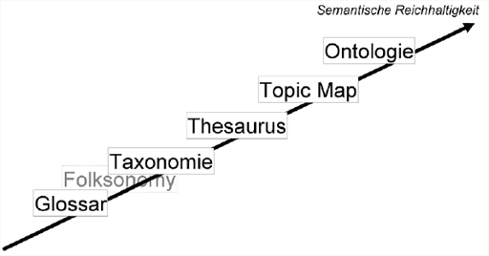
Natural language processing (NLP)
Uses Information Extraction
Coreference: Two or more expressions refer to the same thing/person
Relationship extraction, e.g. Person works for company, located in location
Terminology extraction: Finding relevant Terms in Corpus
NLP requires knowledge base (thesaurus,…, ontology)
Glossar: an easy list of terms
Taxonomie: Hierarchy of terms, “part of”
Partof(hand,humand)
Thesaurus: Relations between Terms, “is a”
isa(human,mammal)
Topic Map: Topics with various associations between terms
Ontology: Knowledge associated with terms
http://www.wissensexploration.de/textmining-hintergrundwissen.php

Slide 10
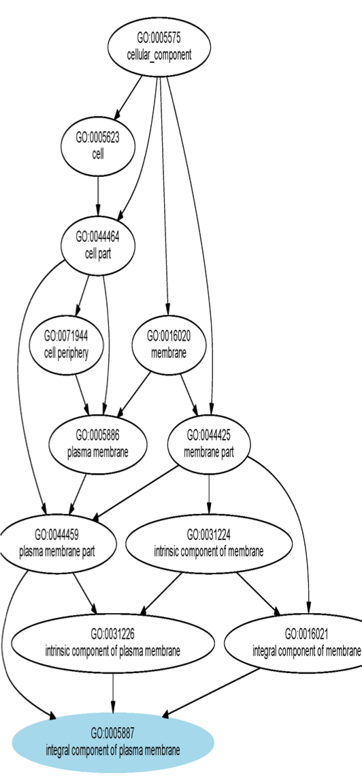
Example for an Ontology, in GeneOntology GO-Terms are the Documents Genes are the Terms
http://www.geneontology.org/
Biology knowledge about cells, molecules and genetic processes in an data base
Relations
Partof and isa relations
Regulates, positively_regulates, negatively_regulates
Directed Acyclic Graph (see on the right)
GO-Terms (documents) have a..
Name and ID
Relations to other Terms
Parent Terms and children Terms (hierarchy)
Biological Definition
Set of Annotated Genes (“words/terms”)
Statistical Analysis possible, e.g.
Overrepresentations Analysis, i.e.
Given a set of Genes What function do they have?
A. Ultsch, Lectures of bioinfomatics, Gene Ontology, 2015

Slide 11
Challenges in unstructured data of Viessmann
For IR
Language is German
-> Stemming algorithms not working well, character preprocessing is trying
Special terms like GFA, TD, …
Use the Term-Document Matrix approach
Higher algorithms not relevant for our use cases
Text Mining
Lot of very short text documents
Distance based on Term-Document Matrix or Genetics
Higher Algorithms take a long time to process
NLP
No knowledge base available for special Terms
We do not have the resources (in the team) to build our own knowledge base
We cannot buy a knowledge basis due to the specific terms
DrThM

Slide 12
Conclusion
We are able to use text mining, but…
Common machine learning methods are build on Euclidean distance
In text mining we cannot use this distance
Building another distance takes effort (working hours) and computation time, because..
We would have to implement our own versions of these methods
We would have to use cloud computing
Alternatively:
“Simple” transformation of “text into numbers”
Apply basic inference statistical methods
In the future we should build a knowledge base regarding errors and devices
DrThM
Notes:
Statistical inference: process of generating conclusions about a population from a noisy sample

Slide 13
Vielen Dank fürs Zuhören.
Noch Fragen?
Dr. Thrun

