Slide 1
NLP and ML Methods to Predict Stock Price Change from Earnings Call Transcripts
Qi Li, Kelly Phalen, Marco Tortolani, Emily Wang, Xinyu Wu
Notes:
Marco

Slide 2
Presentation Overview
Goals + Significance
Methodology + Demo
Text cleaner
Stock price puller
Transcript database
Vectorizer
Supervised model
Results
Next steps
Notes:
Marco

Slide 3
Goals & Significance
Participants form market sentiment and make decisions leading to buying and selling stocks
Psychology of market participants has really only been studied in the last two decades
Now it is easier to access news and data like earnings reports
Looking at how much market sentiment of investors affects stock prices
Model predicts when stocks will rise or fall based on companies’ earnings call transcripts
How people reacted
Will help investors determine if an investment will be profitable
Will allow companies to predict future gains or losses
Notes:
Kelly

Slide 4
Methodology
Clean Text
Pull Stock Price
Store Transcripts
Vectorize Text
Train Models
Pipeline to process raw pdf earnings call transcript data and output a prediction of whether the stock price will increase or decrease
Object-oriented design approach and pickled models allow this pipeline to be easily scalable for future use
Notes:
Xin

Slide 5
Text Cleaner
PDFCleaner Class
Modules
Pdfplumber: extracts text from pdf files
Genism: removes stopwords
Re: remove numbers
Remove all punctuation and numbers
Return length of original and cleaned texts
Print original and cleaned texts
1
2
3
Notes:
Qi

Slide 6
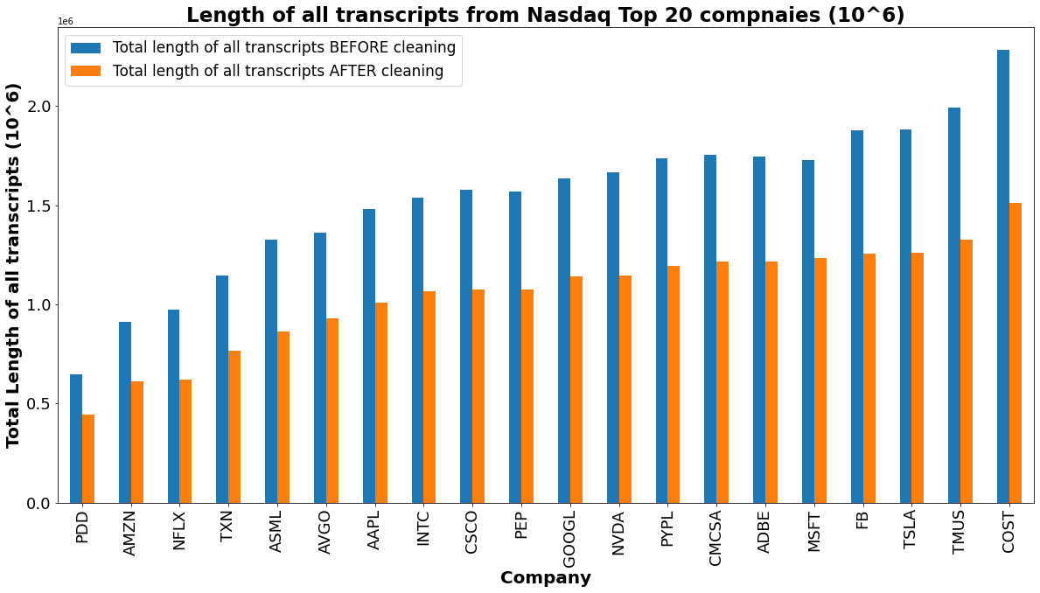
Visualizing Text Cleaning Methods
Notes:
Qi

Slide 7
Organizing Stock Data
yfinance library to access yahoo finance stock price history
Filters out invalid requests for stock data during closed market hours
Market open schedule: 9:30 am - 4:30 am, Monday - Friday
Model is trained to look ahead by one day
StockPuller class can look at performance across multiple days or intraday
Stockpuller returns a (1) if stock price rises and a (0) if a stock price drops
StockPuller can output percent price changes for future use in making numerical predictions of stock price change
The PerformanceTester class is organized to quickly run through clean transcripts and return their classification
Transcripts loaded into Performance Tester in form [‘AAPL’, %Y%m%d, cll
Notes:
Marco

Slide 8
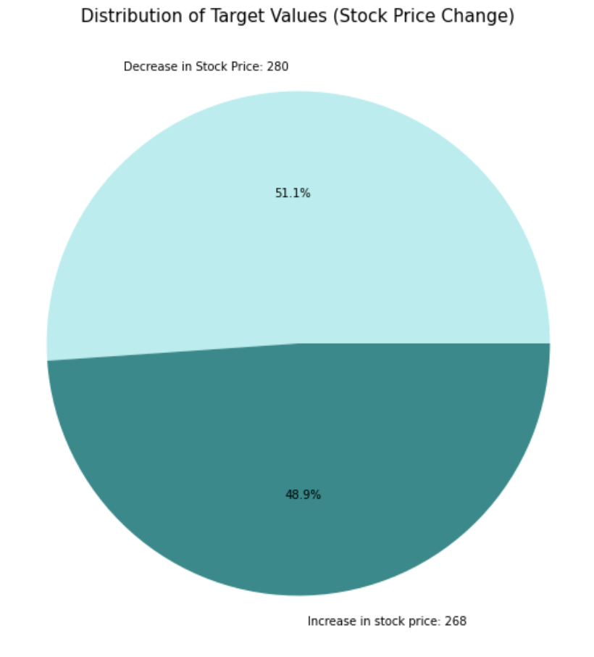
Stock Price Change
Target Data Distribution
Even distribution between rise and drop in stock prices falling earnings calls
Less likely to create bias when training our models
Notes:
Emily:
Brief overview of the data we inputted into our model
Approx equal distribution of target values for each target
Want balanced distribution of our target variable

Slide 9




















Transcript & Price Data Storage
MongoDB Database
Format
'price_change' : 1
'name' : 'AAPL'
'date' : '20181101'
'transcript' : ‘...’
Transcript Data
Bloomberg
5 years of quarterly earnings calls
548 total transcripts
Companies Used
Notes:
Xin

Slide 10
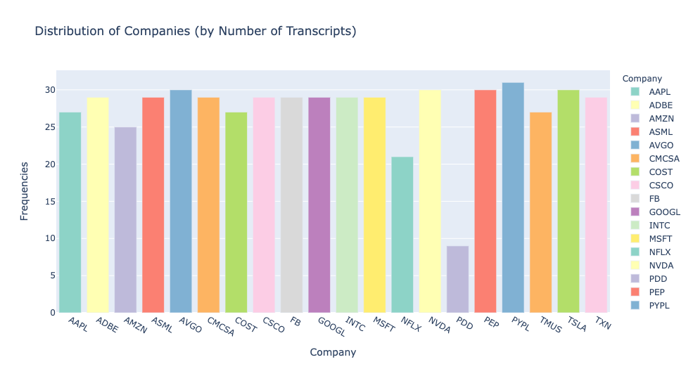
Visualizing Transcript Data
Notes:
Xin

Slide 11
Vectorizing Features
TFIDF Vectorizer: measures importance of word
Principal Component Analysis (PCA): reduces high-dimensional data to fewer dimensions
Allows us to specify the number of components
Text Vectorizer
Dimensionality Reduction
Text Data
Supervised ML Model
Cleaned text queried from transcripts database
Importance of words normalized to be between 0 and 1
Reduce vectorized text to a smaller # of dimensions
The PCA results are stored in a pandas dataframe to train the models
Notes:
Emily
Need to convert text data to numerical data in order to input in ML models
Tfidf vectorizer assigns each word a value corresponding to its importance when compared with all the other documents (which in our case, is all the other earning transcript calls of the specific company and other companies)
Measures importance based on uniqueness where common words have less importance/smaller tfidf values
Currently, each word is considered a separate feature (hundreds of thousands) so we used
Principal Component Analysis: reduces the total number of features so we can feed the reduced data into our supervised machine learning models
Number of columns/features significantly reduced
Further optimize our models by tuning certain parameters
Tfidf vectorizer: min_df (specifies minimum number of times a word must show up to be included as a feature), ngrams (groups words together)

Slide 12
Supervised ML Model
Clean and Vectorize Data
TextCleaner Methods
TFIDF Vectorizer
Principal Component Analysis
Hyperparameter Tuning
Cross-validated Gridsearch
Find best parameters
Base Models
Logistic Regression
Support Vector Machine (Classifier)
Gaussian Naive Bayes
Decision Tree
K-Fold Cross Validation
Split into 20 folds
Highest accuracy: SVM 63.58%
Notes:
Kelly

Slide 13
Model Results: Top 3 Models
 | Support Vector Machine w/ hyperparameter tuning | Gaussian Naive Bayes w/ hyperparameter tuning | Support Vector Machine w/o hyperparameter tuning
Accuracy | 67.88% | 66.42% | 66.09%
Precision | 68.26% | 68.23% | 68.28%
Recall | 67.88% | 66.42% | 65.69%
Notes:
Emily

Slide 14
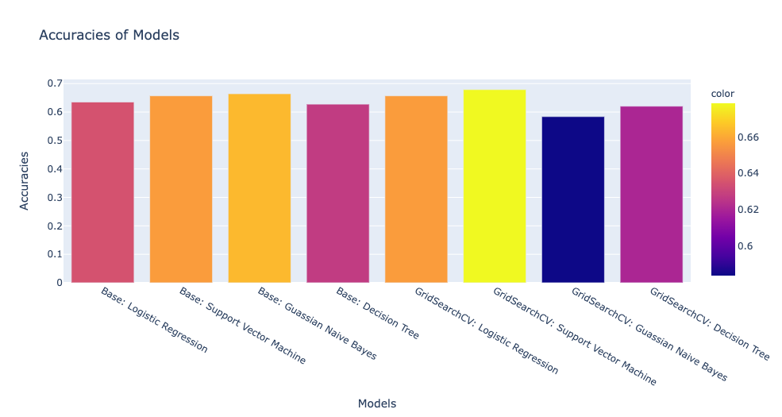
Visualizing Model Accuracies
Notes:
Kelly

Slide 15
Next Steps
By Wednesday
Pickle model for future use by developers
Scale to use a larger database of companies
Develop a demo to predict stock price change using a single transcript
For Future Developers
Profile code and compare training time
If transcript is from a market close date, get next open date stock price date
Make numeric predictions of stock price change
Design program to execute trades based off of the model’s predictions
Find method to download transcripts automatically
Improve running time for transcript database storage
Try other types of textual data (i.e. 10k, news articles)
Notes:
Qi

Slide 16
Thank you!
Questions?
Notes:
Marco

