Slide 1
Best Practices for sharing code
(+Git hands-on)
By Ali Boushehri

Slide 2
What? Why? How? So What?
What?
I want to share my code (or work in general) with my colleagues
Why? Because I want to...
be transparent
collaborate better
contribute
get feedback
How? → Best practices!!!
Use version control (Git)
Work with virtual environments (HPC, conda)
Modularize code (smaller and re-usable functions)
Document my code
So what?
F.A.I.R. is not only for data but for workflows as well!
Workshop Agenda

Slide 3
Workshop Agenda
Use version control (Git)
What is Git?!
Create my first git repo (command-line, gitkraken)
Connect my git repo to a remote server (GitHub)
How to use git when I work alone
How to use git when I work with others
Work with virtual environments (HPC, conda)
Why should I and when to use a virtual environment
Use virtual environments in HPC (ml, conda)
Modularize code (smaller and re-usable functions)
Functions purpose
Functions structure
Documentation
Git commit messages and in-code comments
HANDS-ON
HANDS-ON
HANDS-ON

Slide 4
Version Control (Git)

Slide 5
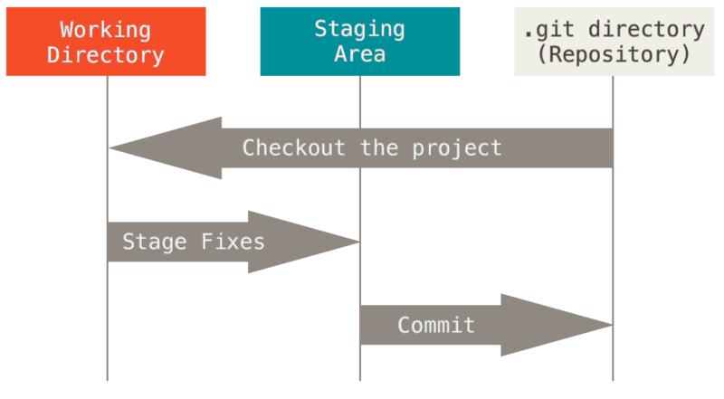
What is Git?!
Version control (Git) - Virtual environments - Modularize code - Documentation
“Git is a free and open source distributed version control system designed to handle everything from small to very large projects with speed and efficiency.”
Snapshots, Not Differences
Nearly Every Operation Is Local
Git Has Integrity
Git Generally Only Adds Data
The Three States
Please. Stop Using Git. (5min video)
Source: https://git-scm.com/book/en/v2/Getting-Started-What-is-Git%3F

Slide 6
Create my first git repo (command-line, TortoiseGit)
Version control (Git) - Virtual environments - Modularize code - Documentation
HANDS-ON
Choose command-line or Tortoise GIT client for Windows (install here)
Login to HPC (git should be pre-installed) or stay in your laptop’s system (you need to install git for your OS here)
Choose the path where you want to create your Git repository
Create a folder
Initiate git inside the folder
Create a file inside the folder
Stage the file
Commit the changes
Simple getting started guides:
git - the simple guide
learn git branching
Troubleshoot problems
Oh shit, Git?!
How to undo (almost) anything with Git
Resolve merge conflicts

Slide 7
Connect my Git repository to a remote server (BitBucket, GitHub)
Version control (Git) - Virtual environments - Modularize code - Documentation
HANDS-ON
Go to: GitHub or GitLab
Create a repository
Clone or Push
Push when you have already created the repository in your system (as we did in previous step):
Add your remote repository in your local repository
Push your local repo to the remote server
Clone when the repo already exists in the remote server but not in your local system (e.g. you clone someone else’s repo)

Slide 8
How to use git when I work alone
Version control (Git) - Virtual environments - Modularize code - Documentation
Split all my work in seperate folders according to the functionality of my code
Initiate git in every folder and push it in BitBucket
No need to have many branches, just the master and develop
Add version tags
Commit early and often
Push early and often
Write short and informative commit messages (more in Documentation…)
Commit ONLY one thing (function/logic/change/…) at a time
Be proud of your work and share it, it doesn’t have to be perfect to be useful!

Slide 9
How to use git when I work with others (suggestions)
Version control (Git) - Virtual environments - Modularize code - Documentation
Every team is different! Start by discussing about coding conventions.
Create Master and Develop branch
Master will be the Fully Functioning code which is tested
Develop will be the branch the newest development will happen
Assign one or more team admins, They will be responsible in merging all changes to the master/developp branch.
Clone the team repository to your local repo and create your own branch from Develop.
On your own branch (if no one else is working there as well, work as if you work alone. (same previous tips apply here too)

Slide 10
GitFlow (Simplified Version)
Version control (Git) - Virtual environments - Modularize code - Documentation
Master
Develop
Feature
V0.1
V0.2
V1.0
More info: https://datasift.github.io/gitflow/IntroducingGitFlow.html

Slide 11
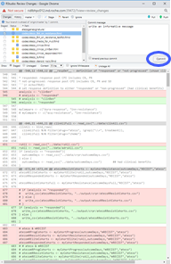
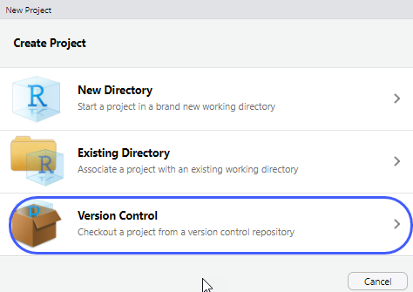
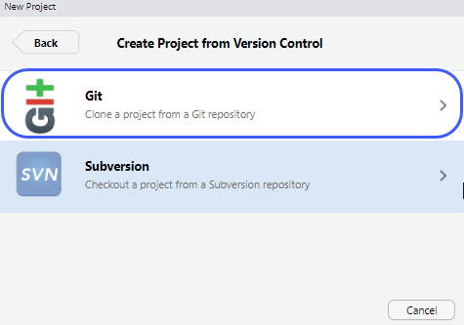
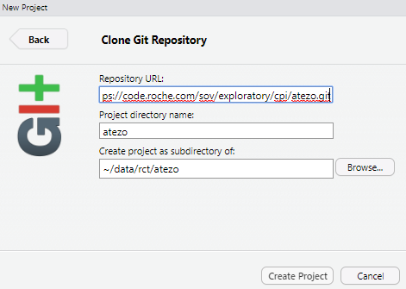

Git repo functions in R Studio
Create a Group (for organization) and a project (repo) in https://code.roche.com
In RStudio, create an R project with a git repo:
If you have an existing R project, follow the instruction in code.roche.com after you’ve created a repo to “Push an existing folder” or “Push an existing Git repository” depending on if the project already has a git repo set up
To Commit your code, “Commit” and check the differences > check “Staged” box > write an informative message and click Commit > click “push”
Some useful git functions in RStudio: * Check box to “Amend previous commit”
* “History” of commits and their visualization
* “Revert” to the previous commit

Slide 12
Virtual Environments

Slide 13
Why should I and when to use a virtual environment
Version control (Git) - Virtual environments - Modularize code - Documentation
Why:
Someone else can reproduce your work
You can change between projects with custom package requirements
The more your projects grows the more you will need them
When:
Mainly for packages
Necessary for multiple projects
Vital for sharing code
What:
Virtualenv
Conda
...
Just the tip of the iceberg (...see Docker)
Workshop Focus

Slide 14
Use virtual environments in Conda
Version control (Git) - Virtual environments - Modularize code - Documentation
HANDS-ON
Create a conda environment
Create the conda environment with a specific python version
$ conda create --name virtual_env python=3.6.5
Activate the conda environment
$ source activate virtual_env
Install any package you want with pip or conda
$ pip install …
$ conda install ...
Export a conda environment
Export all installed packages to a requirement file for easier installation by another user
$ conda env export > environment.yml
If you have installed pip with anaconda (“conda install pip” or “conda update pip”) and used it to install the packages then conda-env exports those pip installed packages automatically.
Then you can create the same conda environment with
$ conda env create -f environment.yml

Slide 15
Modularize Code

Slide 16
Functions purpose
Version control (Git) - Virtual environments - Modularize code - Documentation
Modularization
saves space
supports maintenance
makes debugging easier
It is always good practice to avoid duplicate code
Wrap code you are about to copy and reuse in a function, which you can then call from anywhere as desired.
If you are going to reuse the code in other projects, consider turning it into a module, package, or library.

Slide 17
Functions structure
Version control (Git) - Virtual environments - Modularize code - Documentation
Keys To A Good Function
Is sensibly named
Has a single responsibility
Includes a docstring (see documentation)
Returns a value
Is short in length
Is idempotent and, if possible, pure
Source: https://jeffknupp.com/blog/2018/10/11/write-better-python-functions/

Slide 18
Documentation

Slide 19
Git commit messages and in-code comments
Version control (Git) - Virtual environments - Modularize code - Documentation
HANDS-ON
The most important rule for a Git commit message:
Use the imperative mood in the subject line
More rules here
Optional: customize a pretty git log in one line
Design your code to be read, run, and explored
Include docstrings in your functions
PEP 257 -- Docstring Conventions
“Get in the habit of always writing docstrings, and try to write them before you write the code for the function. If you can't write a clear docstring describing what the function will do, it's a good indication you need to think more about why you're writing the function in the first place.”[source]
Use proper grammar and punctuation; write in complete sentences

Slide 20
Markdown
Version control (Git) - Virtual environments - Modularize code - Documentation
HANDS-ON
Add markdown to your codes
In the markdown, explain how the code should be run
Always provide a simple example for running the code
Explain the environments that are used and which library versions are used
Explain the folder structure of the code
Explain how to contribute to your code
Add Todos at the end markdown

Slide 21
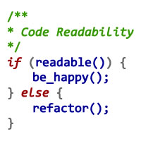
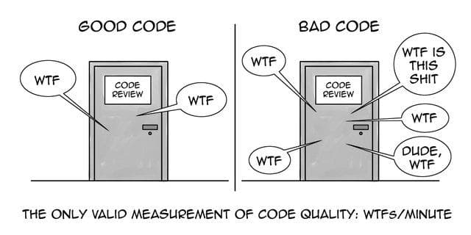
Thank you and happy coding! :)

