Slide 1
Best Practices Machine Learning

Slide 2
Agenda
Machine Learning in Production
Machine Learning Project Management

Slide 3
Agenda
Machine Learning in Production
Machine Learning Project Management

Slide 4
Machine Learning in Production
Code
Unit & E2E tests
Production
Model
Statistical Tests
Users
Data
Correctly labeled?

Slide 5
Code
Always, always and always use git for your codes!
Add version tags
Commit early and often
Push early and often
Write short and informative commit messages (more in Documentation…)
Commit ONLY one thing (function/logic/change/…) at a time
Add markdown to your codes
In the markdown, explain how the code should be run
Always provide a simple example for running the code
Explain the environments that are used and which library versions are used
Explain the folder structure of the code
Explain how to contribute to your code
Add Todos at the end markdown

Slide 6

Machine Learning in Production
Code
Unit & E2E tests
Production
Model
Statistical Tests
Users
Data
Correctly labeled?

Slide 7
Testing
Unit tests:
Focused, low-level; test individual methods or pieces of methods.
Easier to ensure that each piece of code is tested
Easier to write and run
May not catch problems coming from interactions between different pieces of code
System tests (or integration tests):
test the entire system working together.
Good for making sure that all of the pieces work together
Can generate more complex interactions between pieces
Harder to write and run.
Why write tests?
Find bugs in the initial version of the code
Bugs found earlier in the development cycle are much cheaper to fix than those found later (e.g., in the field)
Makes it easier to refactor code later
Engineers should write their own unit tests (not separate QA organization).
https://web.stanford.edu/~ouster/cgi-bin/cs190-spring15/lecture.php?topic=testing

Slide 8
White-box tests
Design tests by looking at the implementation; make sure every aspect is tested.
Isomorphism: test structure matches code structure
One test file per code file
One group of tests per method, in the same order
Makes it easy to find relevant tests after code modifications
Include the name of the method and the thing being tested in the test name: test_loadTweetFile_cantOpenFile
May not need any other documentation in tests
Each test case should be short and focused:
Several small tests better than one long one
https://web.stanford.edu/~ouster/cgi-bin/cs190-spring15/lecture.php?topic=testing

Slide 9
White-box tests
Test robustness:
Ideally, a system change should only break tests related to change
Test should not depend on parts of the system other than the specific features they are testing.
Examples:
Log messages including line numbers
Order of enumeration for hashes (sort results)
Avoid timing-sensitive tests
Miscellaneous ideas:
Write a test before fixing a bug
Use tests to "document" tricky corner cases that can occur
For complex data structures (e.g. trees), write a method to check internal consistency
Use during testing
Can also use during production to hunt down non-reproducible problems
https://web.stanford.edu/~ouster/cgi-bin/cs190-spring15/lecture.php?topic=testing

Slide 10
Test Cases
How to construct test cases?
A test case should answer a single question about the code,
A test case should
Run by itself, no human input required
Determine on its own whether the test has passed or failed
Be separate from other tests
What to test:
Known values
Sanity check (for conversion functions for example)
Bad input
Input is too large?
Negative input?
String input when expected an integer? etc: very
dependent on problem
https://web.stanford.edu/~schmit/cme193/lec/lec8.pdf

Slide 11
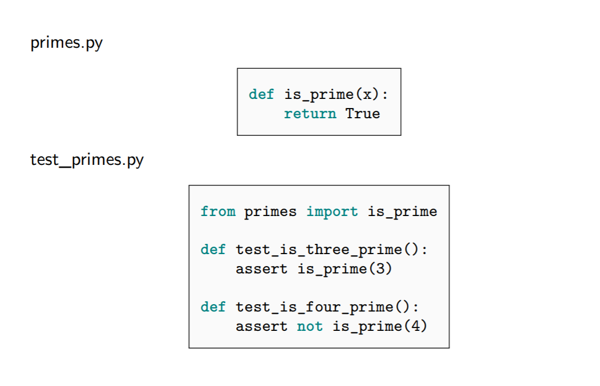
Pytest
https://web.stanford.edu/~schmit/cme193/lec/lec8.pdf

Slide 12
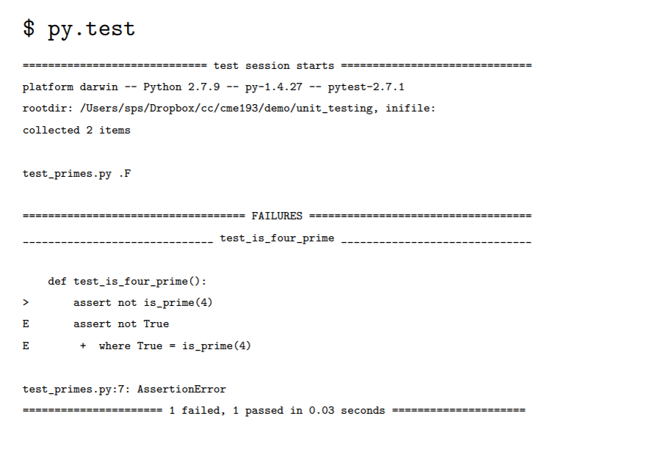
Pytest output
https://web.stanford.edu/~schmit/cme193/lec/lec8.pdf

Slide 13
TODO:
From

Slide 14
Some stuff to read
http://www.personal.psu.edu/jhm/ME540/lectures/VandV/MMS_summary.pdf
https://semaphoreci.com/community/tutorials/testing-python-applications-with-pytest
https://tech.comtravo.com/testing/Testing_Machine_Learning_Models_with_Unittest/
https://medium.com/@keeper6928/how-to-unit-test-machine-learning-code-57cf6fd81765

Slide 15


Machine Learning in Production
Code
Unit & E2E tests
Production
Model
Statistical Tests
Users
Data
Correctly labeled?

Slide 16
Model Versioning
Git is a distributed version control system, meaning the entire history of the repository is transferred to the client during the cloning process.
For projects containing large files, particularly large files that are modified regularly, this initial clone can take a huge amount of time, as every version of every file has to be downloaded by the client
Git LFS (Large File Storage) is a Git extension developed by Atlassian, GitHub, and a few other open source contributors, that reduces the impact of large files in your repository by downloading the relevant versions of them lazily. Specifically, large files are downloaded during the checkout process rather than during cloning or fetching.
Git LFS does this by replacing large files in your repository with tiny pointer files. During normal usage, you'll never see these pointer files as they are handled automatically by Git LFS:
https://www.atlassian.com/git/tutorials/git-lfs

Slide 17


Model Versioning
1. When you add a file to your repository, Git LFS replaces its contents with a pointer, and stores the file contents in a local Git LFS cache.
Git repo
Working Copy
Git LFS
Git LFS Cache
$ git add
https://www.atlassian.com/git/tutorials/git-lfs

Slide 18


Model Versioning
2. When you push new commits to the server, any Git LFS files referenced by the newly pushed commits are transferred from your local Git LFS cache to the remote Git LFS store tied to your Git repository.
Git repo
Git host
Git LFS Cache
Git LFS store
$ git push
https://www.atlassian.com/git/tutorials/git-lfs

Slide 19
Model Versioning
3. When you checkout a commit that contains Git LFS pointers, they are replaced with files from your local Git LFS cache, or downloaded from the remote Git LFS store.
Git LFS
Working Copy
Git repo
Git LFS store
Git LFS Cache
$ git checkout
https://www.atlassian.com/git/tutorials/git-lfs

Slide 20
Model Versioning
Always use versioning on your model
Always calculate different metrics for your model such as accuracy, recall, precision etc.
Keep the metrics in a csv file and keep track of that . For example:
Keep different test sets for your model and try to evaluate your model on different datasets
Keep the exact list of files/data which are used for training, validation and test.
Version | Accuracy | FPR | FNR | Precision | …
V01 | 90 | 3 | 5 | 93 | …
V02 | 92 | 6 | 4 | 90 | …
V03 | 94 | 2 | 2 | 91 | …
… | … | … | … | … | …

Slide 21

Machine Learning in Production
Code
Unit & E2E tests
Production
Model
Statistical Tests
Users
Data
Correctly labeled?

Slide 22
Model Update
Whenever you updated the model (for example once a months), the model needs to be checked against the previous versions.
All the main information used in the training, such as list of the training/validation/test samples, hyper parameters, seeds and other log files must be stored on git.
If the updated model works better, then system should automatically accept the new model and allows to commit the model
As soon as the model accepted, the model gets a new version and with all the metrics needs to be added to the model version table

Slide 23
Machine Learning in Production
Code
Unit & E2E tests
Production
Model
Statistical Tests
Users
Data
Correctly labeled?

Slide 24
Data Versioning
For each training, keep a text file, containing ALL the samples which are used for training/validation/test. This file should the same from the previous step
Whenever the database is updated, a new training can be triggered. Therefore, the file containing the data information should be updated

Slide 25

Machine Learning in Production
Code
Unit & E2E tests
Production
Model
Statistical Tests
Users
Data
Correctly labeled?

Slide 26
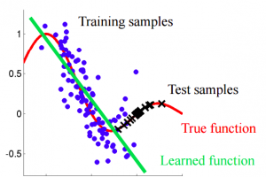
Data feedback
In general we need to be sure that our predictions in production are correct
Different scenarios can happen that the prediction is not correct
No matter what, it is likely to have covariate shift as soon as we go to production

Slide 27
Data feedback
Feedback Sources: Experts & Users
Users should be able to provide feedback regarding the quality of the prediction
Experts should take a look at the feedbacks and choose
In addition, we can calculate parameters such as uncertainty to check our prediction reliability
How to overcome covariate shift
Training zero-shot learning algorithms
Dropping drifting features
Reweight importance of datapoints
Active-learning

Slide 28

Machine Learning in Production
Code
Unit & E2E tests
Production
Model
Statistical Tests
Users
Data
Correctly labeled?

Slide 29
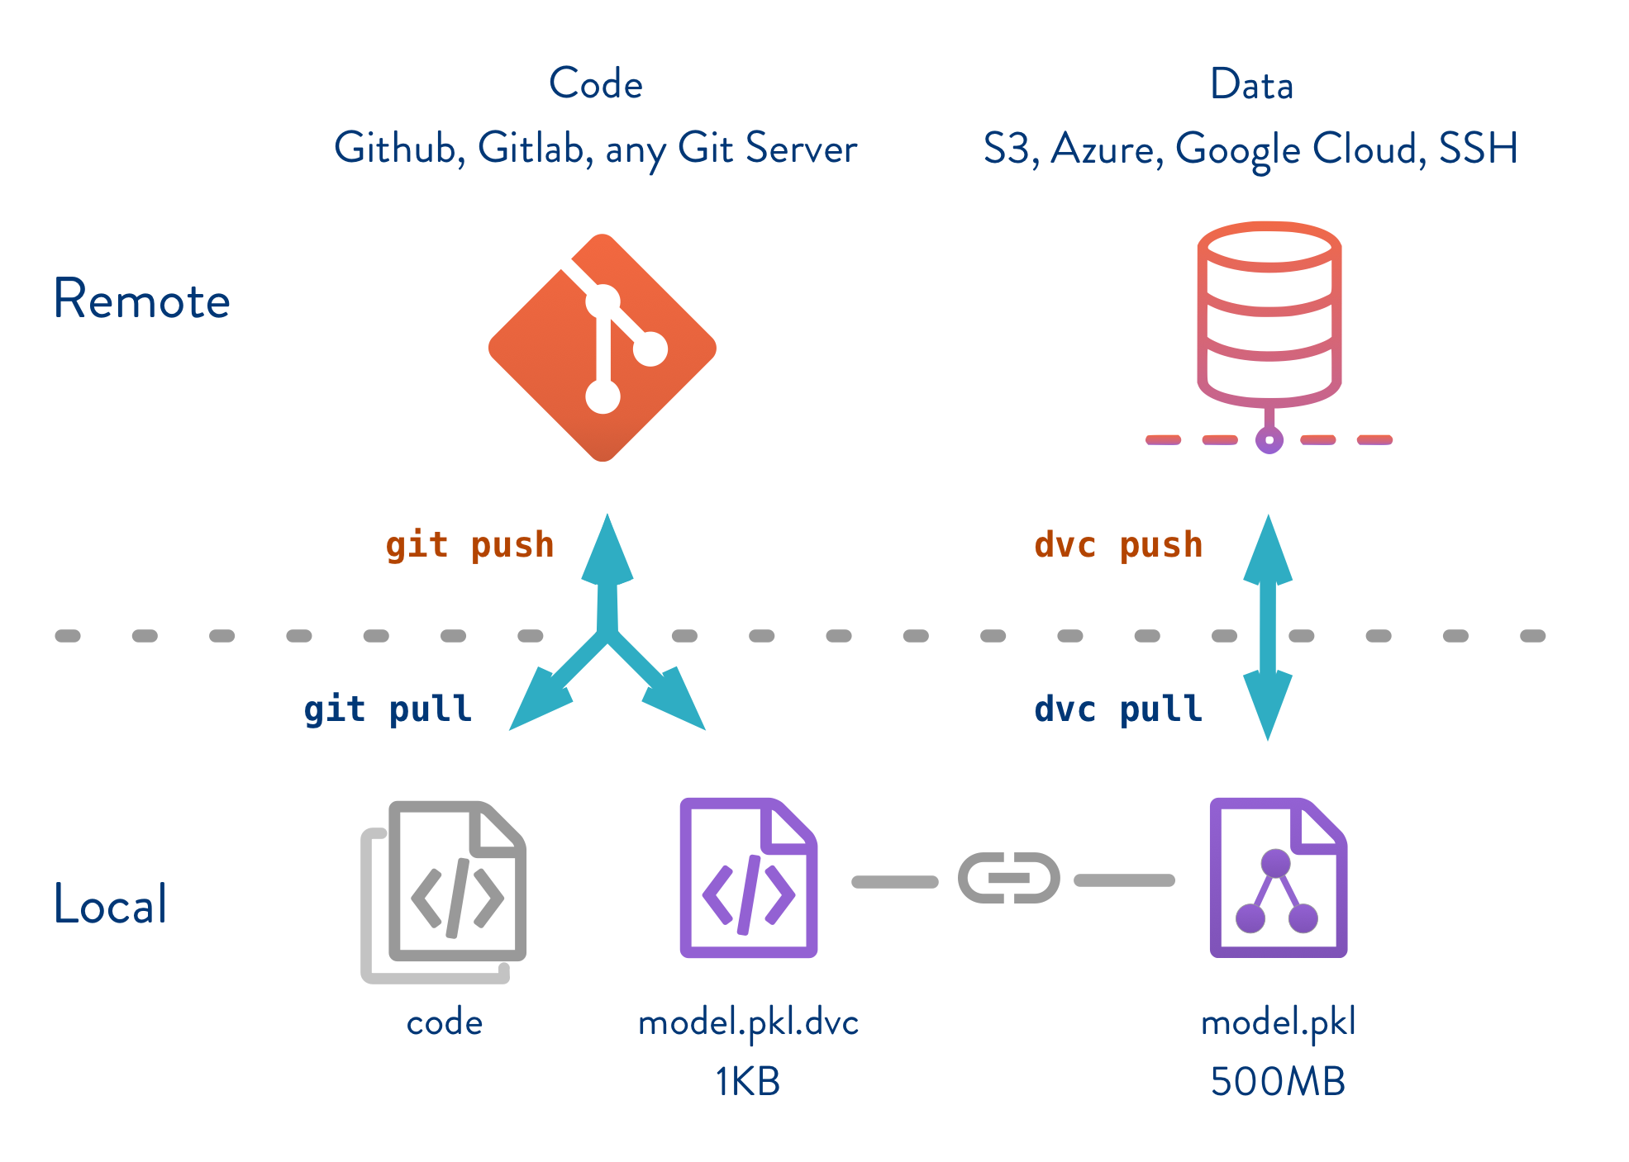

Data Versioning Control

Slide 30
DVC
Code
Unit & E2E tests
Production
Model
Statistical Tests
Users
Data
Correctly labeled?

Slide 31
Agenda
Machine Learning in Production
Machine Learning Project Management

Slide 32
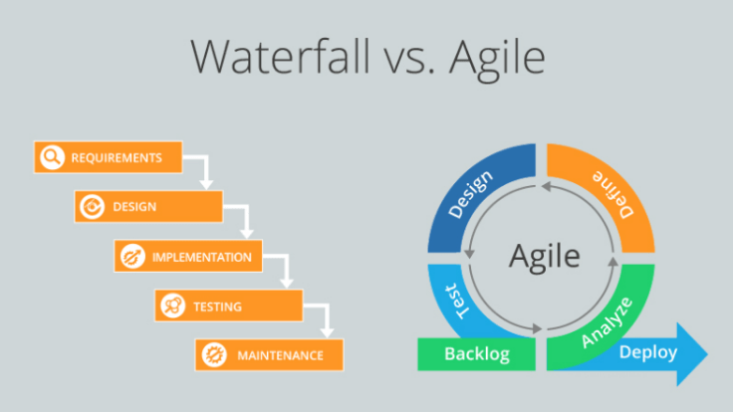
Project Management
https://commons.wikimedia.org/wiki/File:Waterfall_Vs_Agile_m,method.png

Slide 33
Project Management
Waterfall is a Liner Sequential Life Cycle Model whereas Agile is a continuous iteration of development and testing in the software development process.
Agile methodology is known for its flexibility whereas Waterfall is a structured software development methodology.
Agile follows an incremental approach whereas the Waterfall methodology is a sequential design process.
Agile performs testing concurrently with software development whereas in Waterfall methodology testing comes after the “Build” phase.
Agile allows changes in project development requirement whereas Waterfall has no scope of changing the requirements once the project development starts.

Slide 34
RAPIDE
R
A
P
I
D
E
Readiness Assessment
Advanced Data Screening
Pinpointing Driving Factors
Identification of Algorithms
Development of Powerful Models
Embedding and Evolving Solution
Objectives are clarified and initial data is sufficient.
Predictive or diagnostic potential in the data is demonstrated.
Key features driving the behaviour of interest are isolated.
Most promising techniques to meet objectives are identified.
The best hybrid data-driven and principles-based model is developed.
The solution is refined using evidence gained from in-service use.
https://www.tessella.com/
https://cdn2.hubspot.net/hubfs/5116386/Downloads/RAPIDE-a-professional-governance-framework-for-data-science.pdf

Slide 35
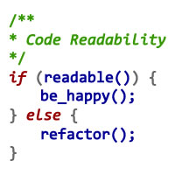
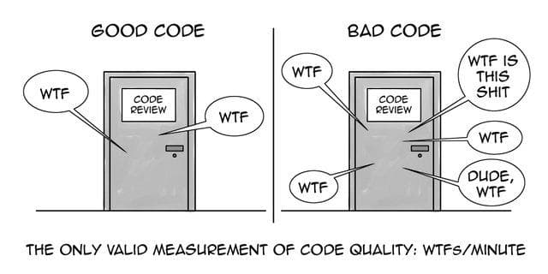
Thank you and happy coding! :)

