Slide 1
Facebook API
Document
Computational Thinking and Problem Solving Fall 2020

Slide 2
CONTENT
Part 01
Part 02
Web Crawler
Data Structure
Selenium Beautifulsoup
Json file
Part 03
Part 04
Database
API Function
Google Cloud
Python

Slide 3
Part 01
Web Crawler
Facebook club

Slide 4
Web Crawler
Request
Data
Request
Selenium
動態網頁Request
Beautifulsoup
靜態HTML原始碼分析

Slide 5
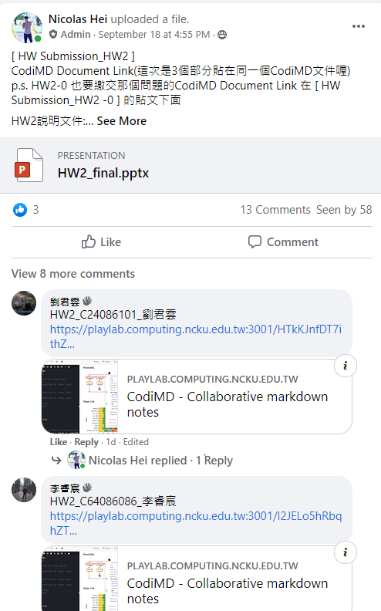
Web Crawler
Post
Comment
Comment of the post
comment of the comment
Emoji
7 kinds of reaction
Link
Content contain gif link image

Slide 6
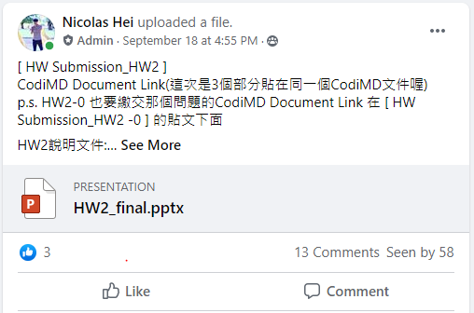
Web Crawler
Post
Comment
Comment of the post
comment of the comment
Emoji
7 kinds of reaction
Link
Content contain gif link image

Slide 7
Part 02
Data Structure
Json file

Slide 8
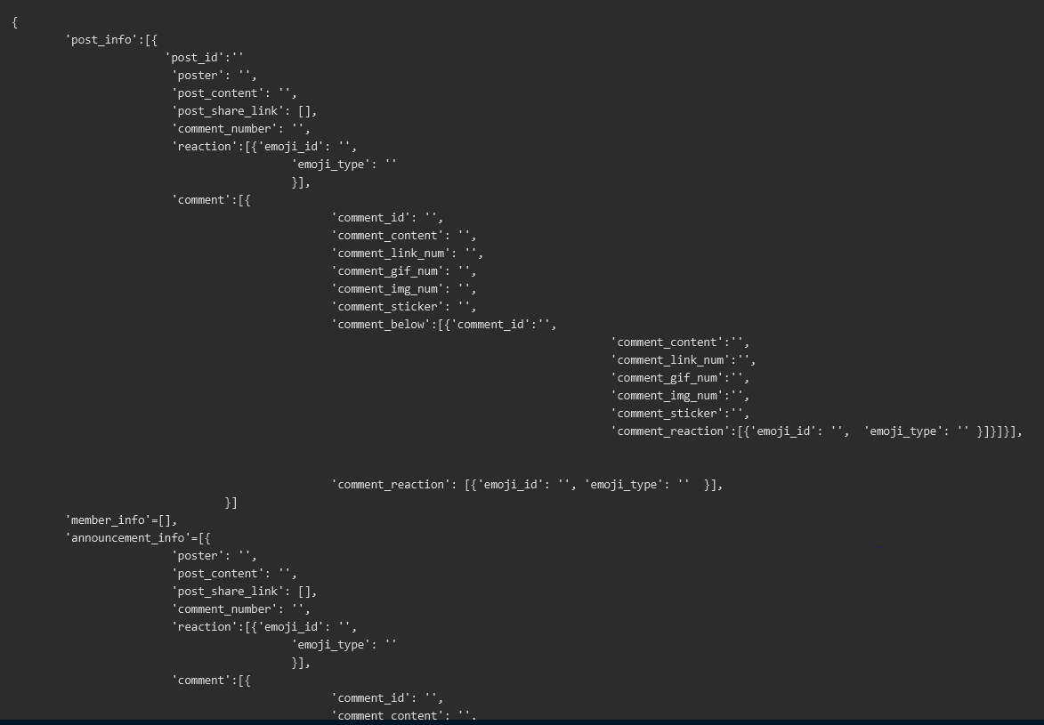
Data Structure

Slide 9
Part 03
Database
Google Cloud

Slide 10

Data Flow
Produce json file
Google cloud
User download data
Web Crawler
Python google api
Gdown package

Slide 11
Part 04
API Function

Slide 12

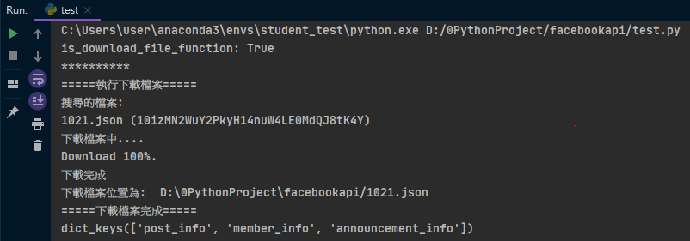
API Function
dataset = fbapi.get_json_from_cloud(date='1021')
What Function do

Slide 13
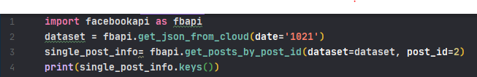
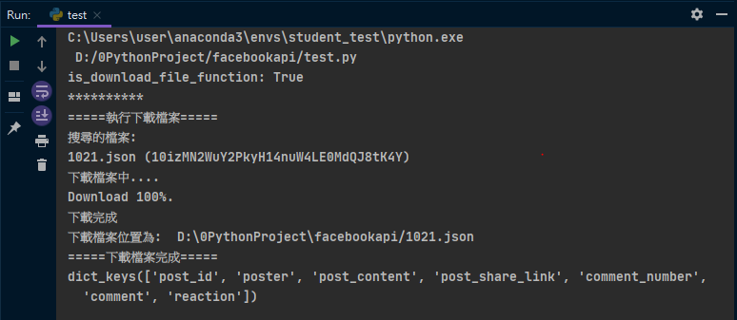
API Function
single_post_info= fbapi.get_posts_by_post_id(dataset=dataset, post_id=2)
What Function do

Slide 14

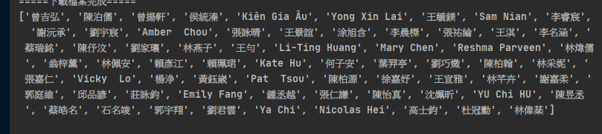
API Function
userid_list = fbapi.get_all_user_ids(dataset)
What Function do

Slide 15
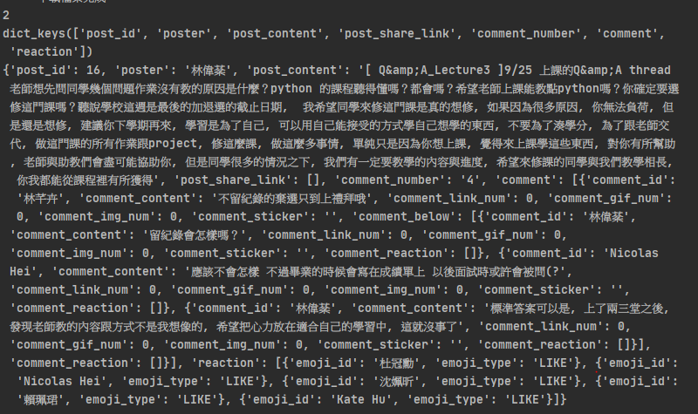
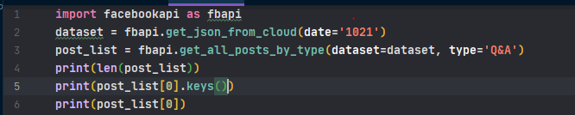
API Function
post_list = fbapi.get_all_posts_by_type(dataset=dataset, type='Q&A')
What Function do

Slide 16
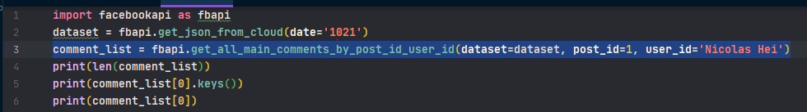
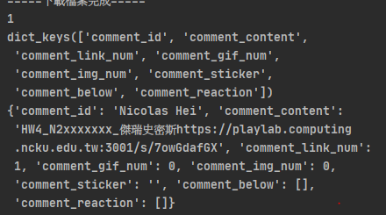
API Function
comment_list = fbapi.get_all_main_comments_by_post_id_user_id(dataset=dataset, post_id=1, user_id='Nicolas Hei')
What Function do

Slide 17
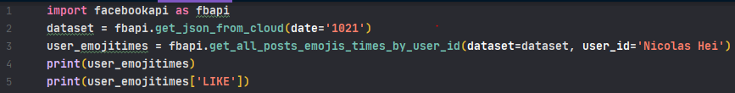

API Function
user_emojitimes = fbapi.get_all_posts_emojis_times_by_user_id(dataset=dataset, user_id='Nicolas Hei')
What Function do

Slide 18
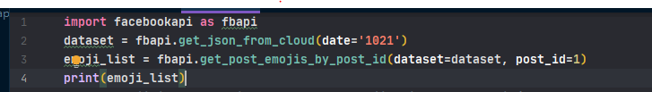
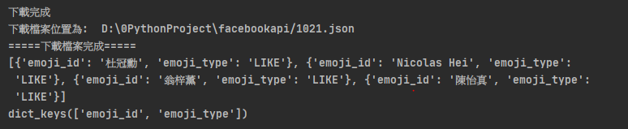
API Function
emoji_list = fbapi.get_post_emojis_by_post_id(dataset=dataset, post_id=1)
What Function do

Slide 19
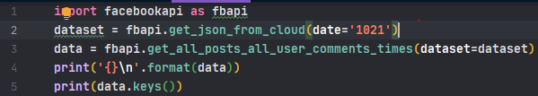
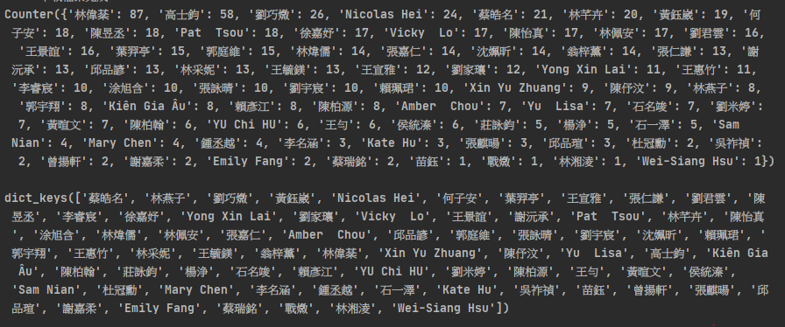
API Function
data = fbapi.get_all_post_all_user_comments_times(dataset=dataset)
What Function do

Slide 20
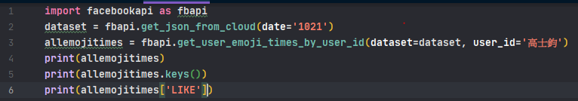
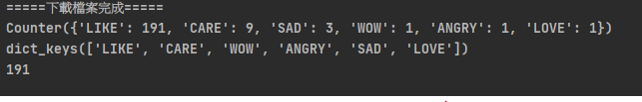
API Function
allemojitimes = fbapi.get_user_emoji_times_by_user_id(dataset=dataset, user_id='高士鈞')
What Function do

Slide 21
Thanks for watching
Computational Thinking and Problem Solving Fall 2020

