Slide 1


NYC Job market
CS 523 Final Project
Team Members:
Mohamed Ahmed Abdelmonem Youssef
Ganbayar Tsogbadrakh
Rahel Fesshaye Yehdego

Slide 2

01 - Introduction
02 - Project architecture
03 - Code
04 - Conclusions

Slide 3


01 - Introduction
Our team has successfully developed a robust data pipeline designed to generate comprehensive job market analyses for New York City.
This sophisticated system enables us to identify emerging job trends by geographical area and ascertain salary offerings by employers across various professions, providing valuable insights into the dynamic employment landscape of the city.

Slide 4





02 - Data flow diagram
Spark streaming
Kafka producer
Kafka consumer
NYC_job.csv
result

Slide 5
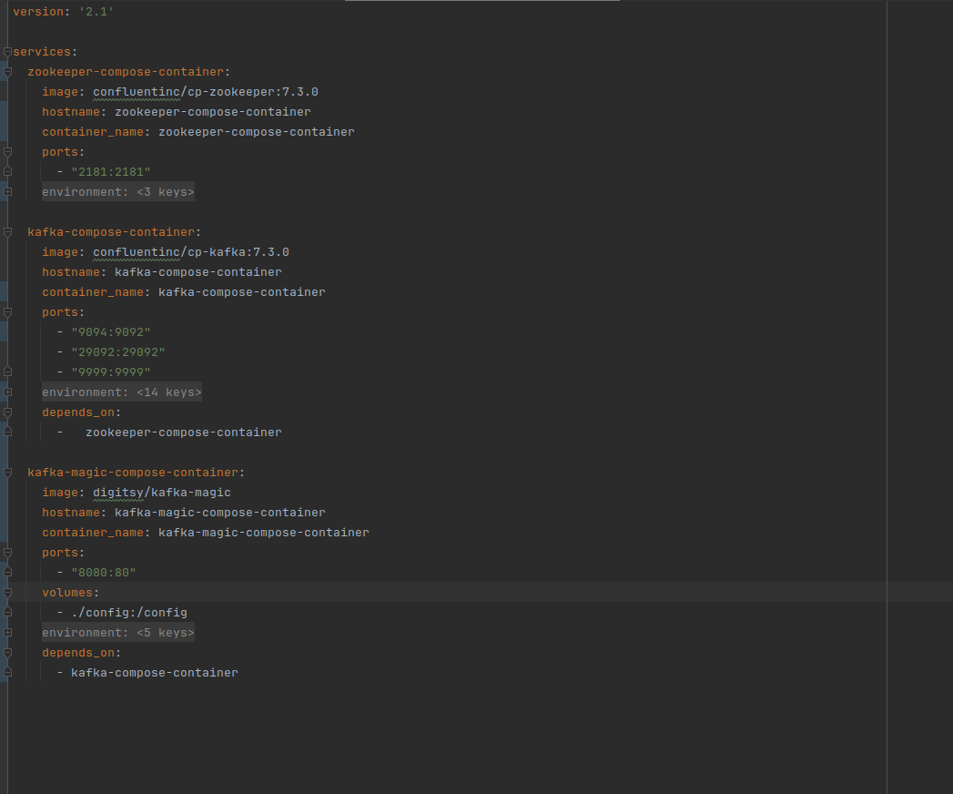
03 - Code
03 - Code
Docker Compose for supporting services

Slide 6
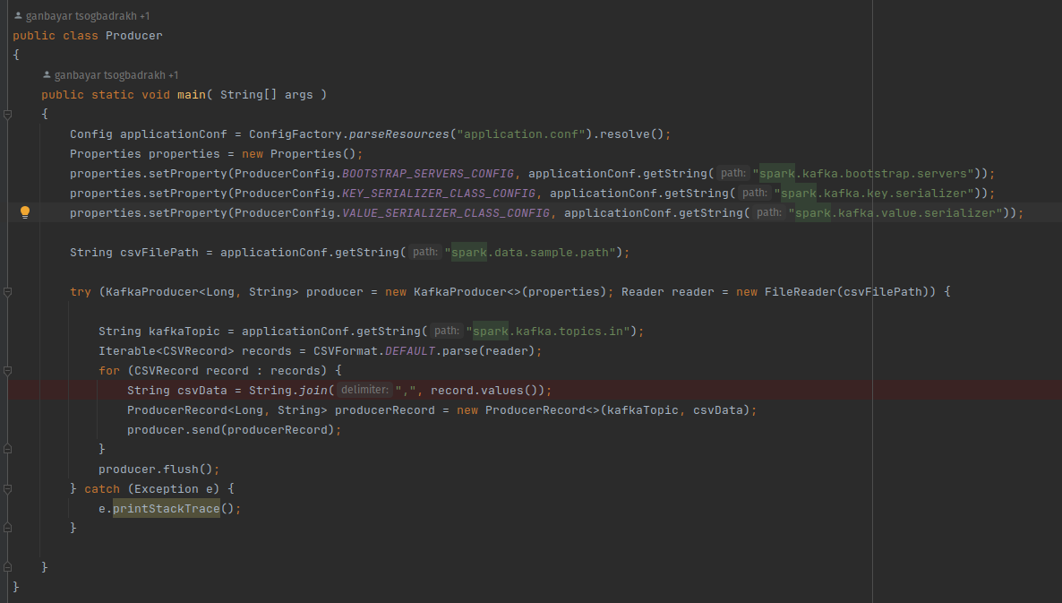
Data Producer

Slide 7
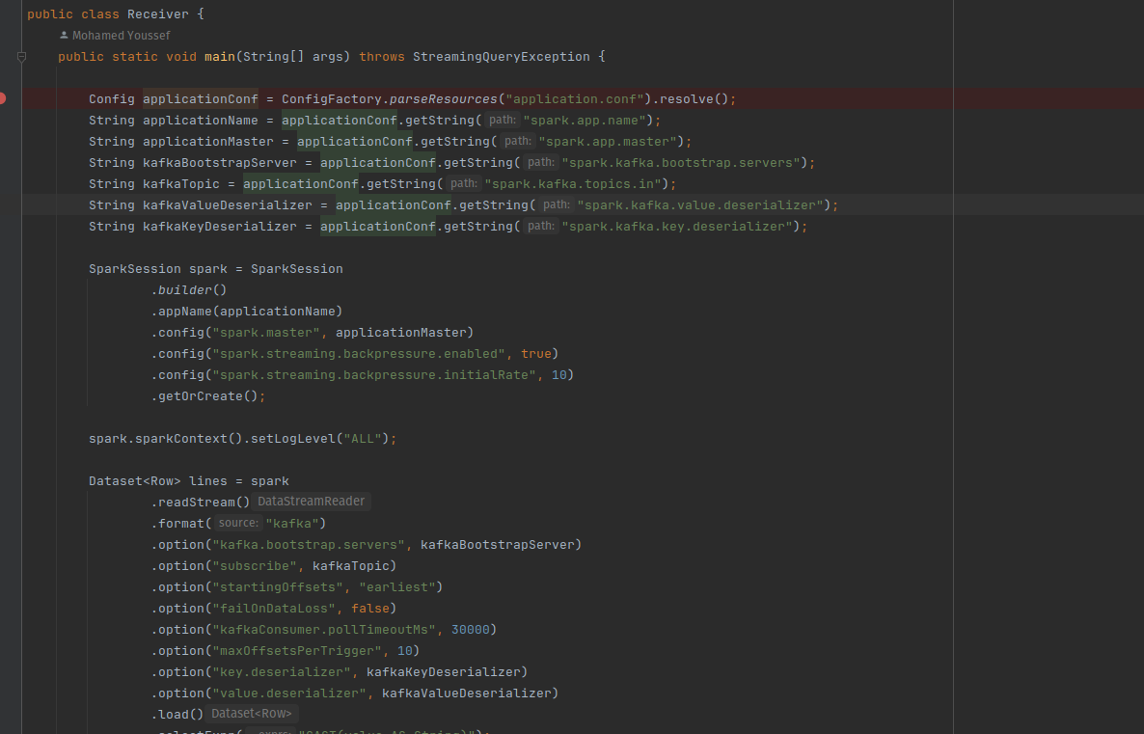
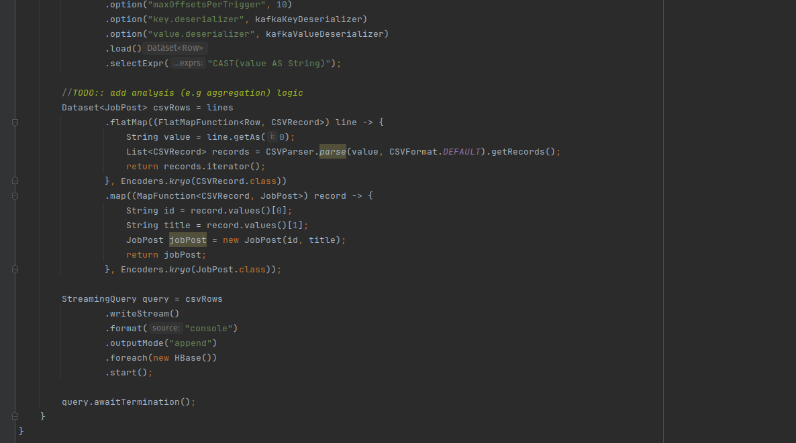
Data Consumer

Slide 8
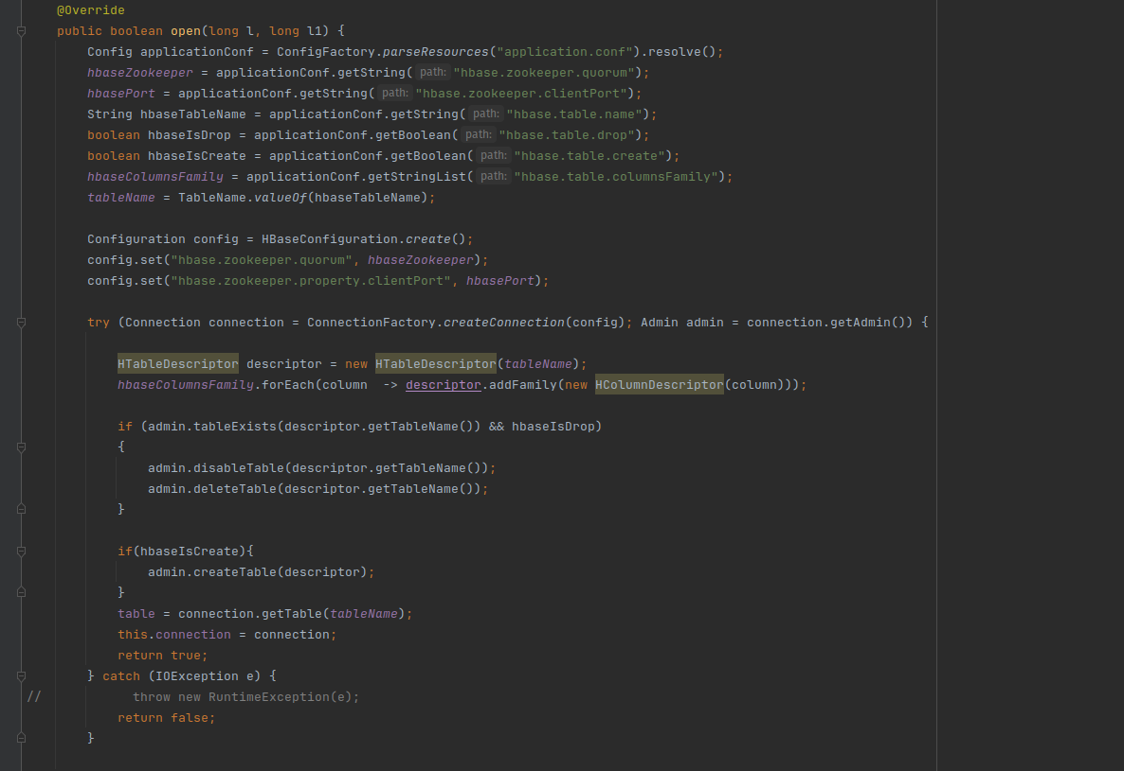
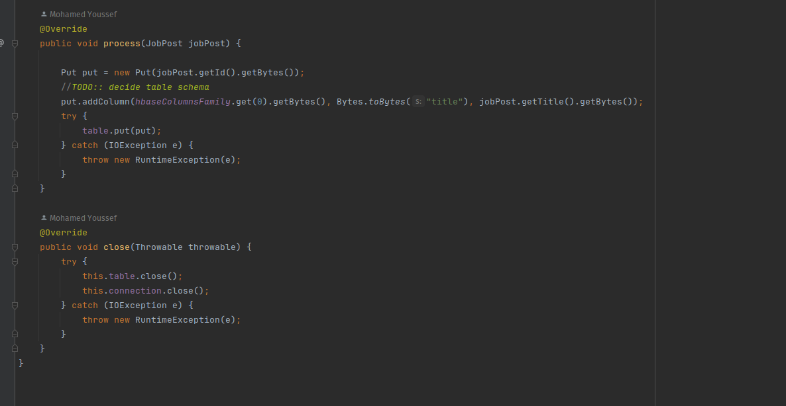
HBase

Slide 9
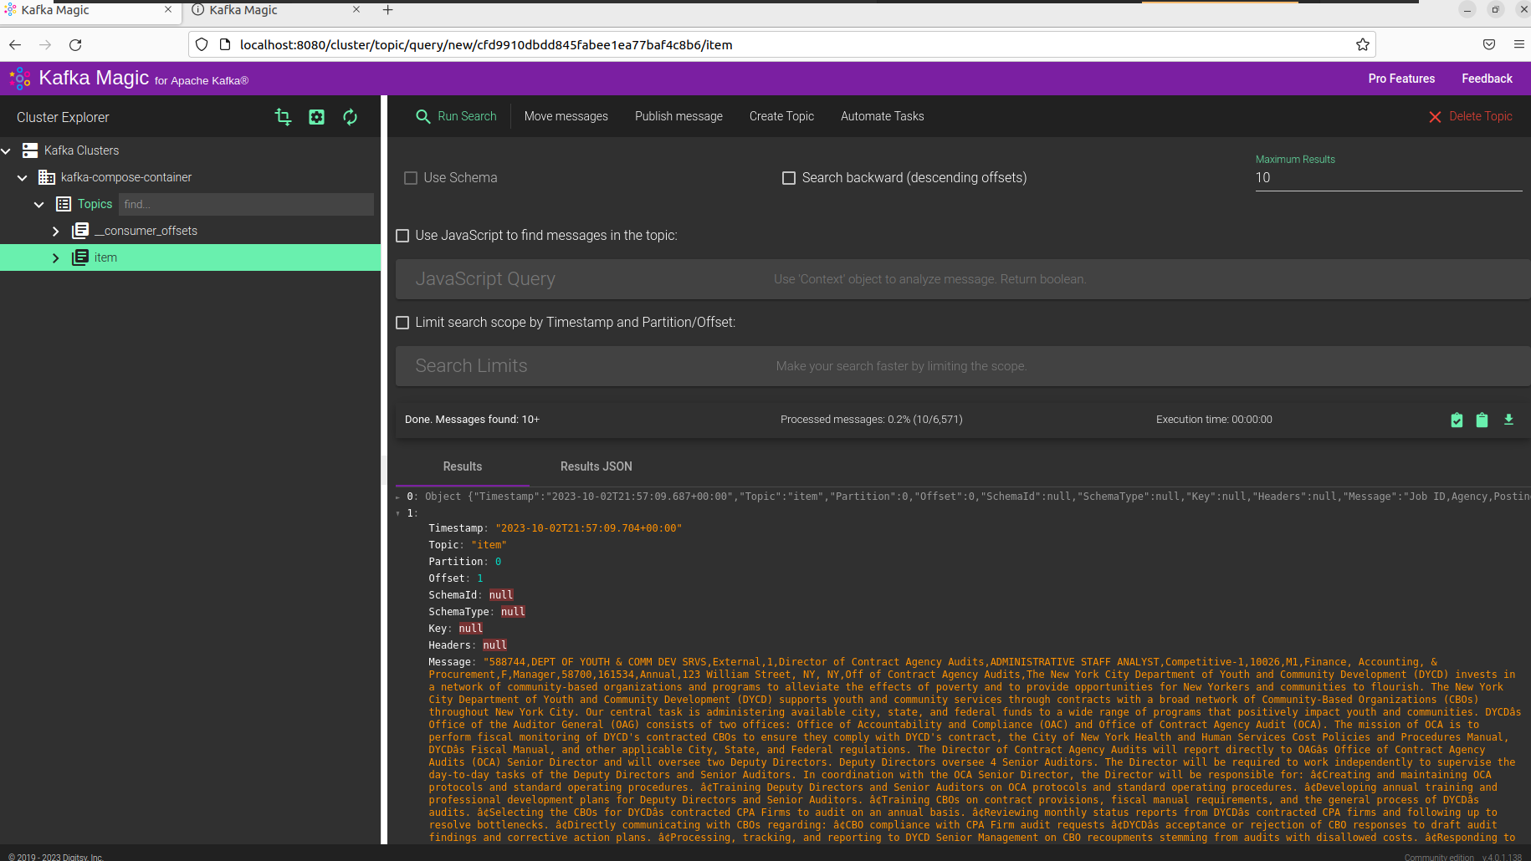
Kafka Magic

Slide 10
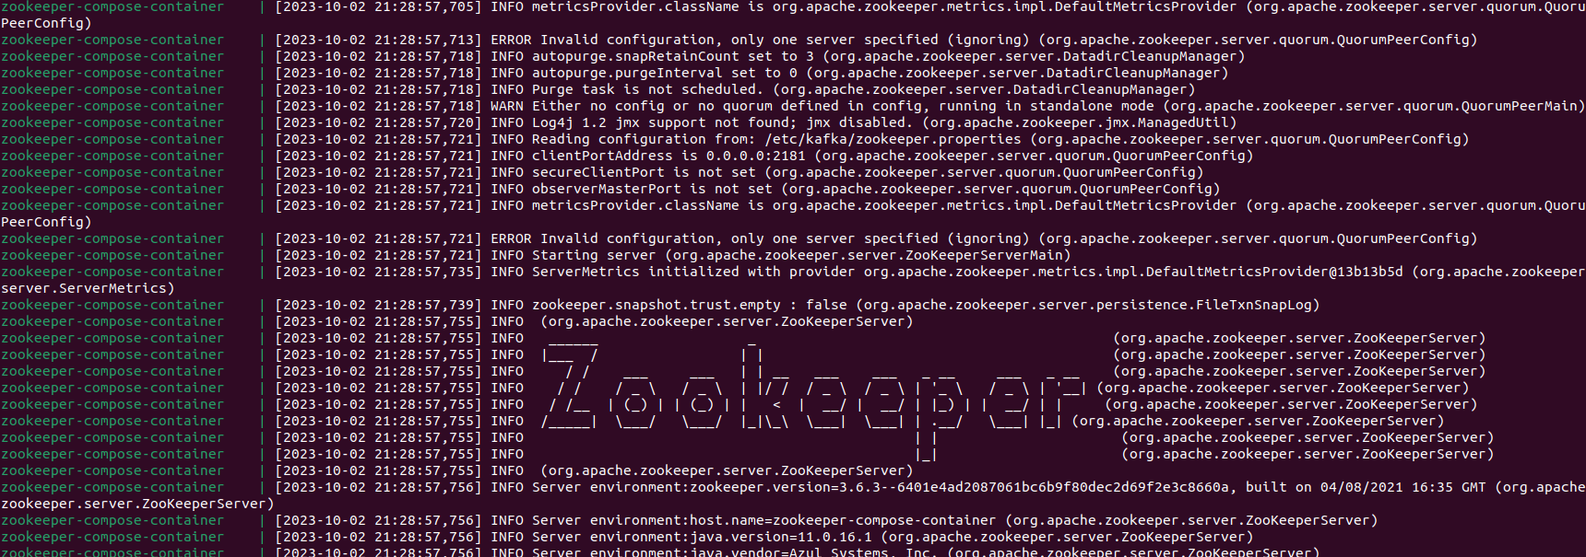
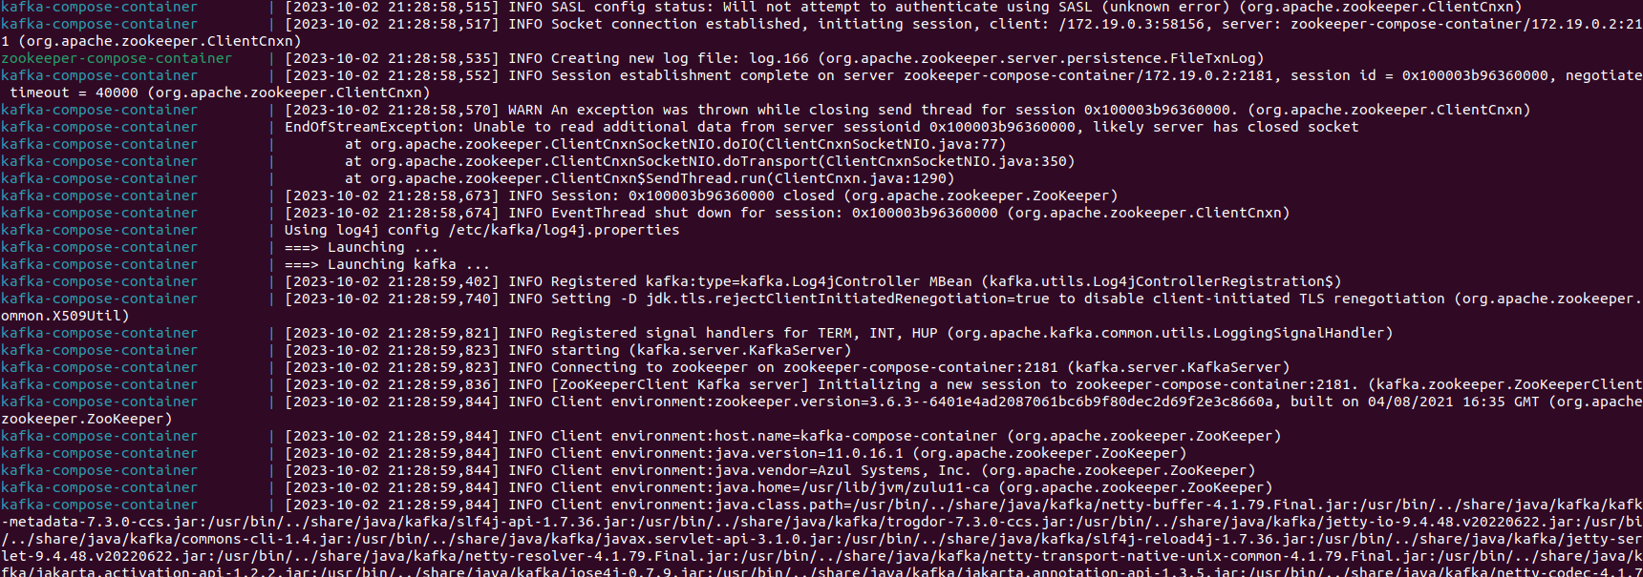
Kafka and Zookeeper Containers Log

Slide 11

As graduates of MIU, we have personally encountered the challenges associated with navigating the competitive job market and securing reliable employment swiftly. In our quest to empower our fellow graduates in their pursuit of their dream careers, we have undertaken the development of a powerful tool. Leveraging comprehensive analysis of authentic job market data sourced from data.gov, our solution is not only tailored to the unique demands of New York City but can also be seamlessly adapted for application in other major metropolitan areas.
The collaborative spirit that has defined our teamwork has not only made the project a rewarding endeavor but has also significantly enhanced its productivity and efficacy. Through self-directed study and dedicated efforts, we have honed our proficiency in Kafka, a cutting-edge technology that addresses contemporary challenges in the tech industry. This hands-on project experience has further fortified our knowledge, enriched by the insights acquired during the course.
In closing, we extend our heartfelt gratitude to our esteemed professor, Mrudula Mukadam, whose guidance and mentorship have been instrumental in shaping the success of this project and our educational journey as a whole.
04 - Conclusions

Slide 12

Thanks

