Slide 1
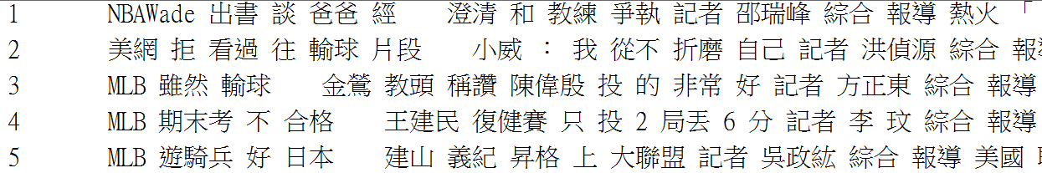
Programming Assignment 2
Write a program to retrieve 10 documents that are most similar to DocId 56 using vector space model.
Text collection: TMBD_news_files_assignment2.txt
Please zip and submit (1) the source code, (2) the result, and (3) a report to MY2.
4 weeks to complete, that is 2017/04/20 13:00.
Result format
ID
Similarity
131
223
998
1033
0.896
0.795
0.565
0.511

Slide 2
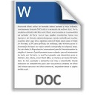
Programming Assignment 2 (cont.)
DocId 56
N=10000
Dictionary
TF
DF
IDF
Weighting
17.61
w₁
17.61
w₁
0
w₁
5
3
3.52
30
2.82
84.71
w₂
84.71
w₂
84.71
w₂
15
2.44
w₃
0
w₃
0
w₃
89
36
217.49
…
…
…
…
…
…
…
26
w_{n-1}
83.77
w_{n-1}
83.77
w_{n-1}
6
3.22
83.77
w_{n}
294.99
w_{n}
0
w_{n}
131
56
2.25
294.99

