Slide 1
DATABASE MANAGEMENT SYSTEM
Entity Relationship (ER) Modeling (Chapter 04)

Slide 2
Entity Relationship Model
2
The Entity Relationship Model (ERM) forms the basis of an Entity Relationship Diagram (ERD).
ERD represents the conceptual database as viewed by the end user.
ERDs depict the database’s main components: entities, attributes, and relationships.
Because an entity represents a real-world object, the words entity and
object are often used interchangeably.

Slide 3
Example
3
In the example of Tiny College database, the entities (objects) include students, classes, teachers, and classrooms.
Which notation to use?
The Chen notation favors conceptual modeling.
The Crow’s Foot notation favors a more implementation- oriented approach.

Slide 4
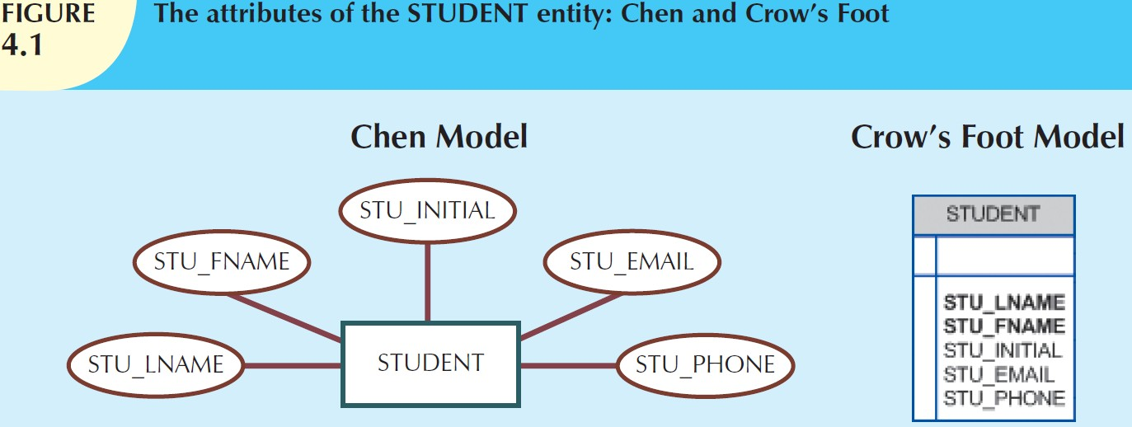
4

Slide 5
Entities
5
An entity is an object of interest to the end user.
At the ER modeling level, an entity actually refers to the entity set and not to a single entity occurrence.
table = entity,
row = entity instance or entity occurrence)
In both the Chen and Crow’s Foot notations, an entity is represented by a rectangle containing the entity’s name (a noun), usually written in all capital letters.

Slide 6
Attributes
6
Attributes are characteristics of entities. For example, STUDENT entity includes the attributes STU_LNAME, STU_FNAME and STU_INITIAL.
In the original Chen notation, attributes are represented by ovals and are connected to the entity rectangle with a line. Each oval contains the name of the attribute it represents.
In the Crow’s Foot notation, the attributes are written in the attribute box below the entity rectangle. (See Figure 4.1.)

Slide 7
7
Because the Chen representation is rather space-consuming, vendors have adopted the Crow’s Foot attribute display.
software

Slide 8
Required and Optional Attributes
8
A required attribute is an attribute that must have a value; in other words, it cannot be left empty. For example, in Figure 4.1, two boldfaced attributes in Crow’s Foot notation indicate that a data entry will be required since the assumption is that all students have a last name and a first name.
An optional attribute is an attribute that does not require a value; therefore, it can be left empty.

Slide 9
Domains
9
Attributes have a domain.
A domain is the set of possible values for a given attribute.
For example,
the domain for the grade point average (GPA) attribute is written (0,4).
The domain for the gender attribute consists of only two
possibilities: M or F
The domain for a company’s date of hire attribute consists of all dates that fit in a range (for example, company startup date to current date).
Attributes may share a domain. For example, a STUDENT ADDRESS and a PROFESSOR ADDRESS share the same domain of all possible addresses.

Slide 10
Identifiers (Primary Keys)
10
The ERM uses identifiers, that is, one or more attributes that uniquely identify each entity instance.
In the relational model, such identifiers are mapped to primary keys (PKs) in tables.
Identifiers are underlined in the ERD.
PK attributes are also underlined in a frequently used table structure shorthand notation.
For example, a CAR entity may be represented by: CAR (CAR_VIN, MOD_CODE, CAR_YEAR, CAR_COLOR)

Slide 11
Composite Identifiers
11
A composite identifier is a primary key composed of more than one attribute.
For example, for CLASS entity, a composite primary key composed of the combination of CRS_CODE and CLASS_SECTION can be used, instead of using CLASS_CODE:
CLASS (CRS_CODE, CLASS_SECTION, CLASS_TIME, ROOM_CODE, PROF_NUM)
◻

Slide 12
Composite and Simple Attributes
12
Attributes are classified as simple or composite.
A composite attribute (not to be confused with a composite identifier) is an attribute that can be further subdivided to yield additional attributes. For example, the attribute ADDRESS can be subdivided into street, city, state, and zip code. Similarly, the attribute PHONE_NUMBER can be subdivided into area code and exchange number.

Slide 13
13
A simple attribute is an attribute that cannot be subdivided.
For example, age, gender and marital status would be classified as simple attributes.
To facilitate detailed queries, it is wise to change composite attributes into a series of simple attributes.

Slide 14
Single-Valued Attributes
14
A single-valued attribute is an attribute that can have only a single value.
For example, a person can have only one Social Security number, and a manufactured part can have only one serial number.
Keep in mind that a single-valued attribute is not necessarily a
simple attribute.
For example, a part’s serial number, such as SE-08-02- 189935, is single-valued, but it is a composite attribute because it can be subdivided into the region in which the part was produced (SE), the plant within that region (08), the shift within the plant (02), and the part number (189935).

Slide 15
Multivalued Attributes
15
Multivalued attributes are attributes that can have many values.
For example, a person may have several college degrees, and a household may have several different phones, each with its own number.
Similarly, a car’s color may be subdivided into many colors
(that is, colors for the roof, body, and trim).
In the Chen ERM, the multivalued attributes are shown by a double line connecting the attribute to the entity.
The Crow’s Foot notation does not identify multivalued
attributes.

Slide 16
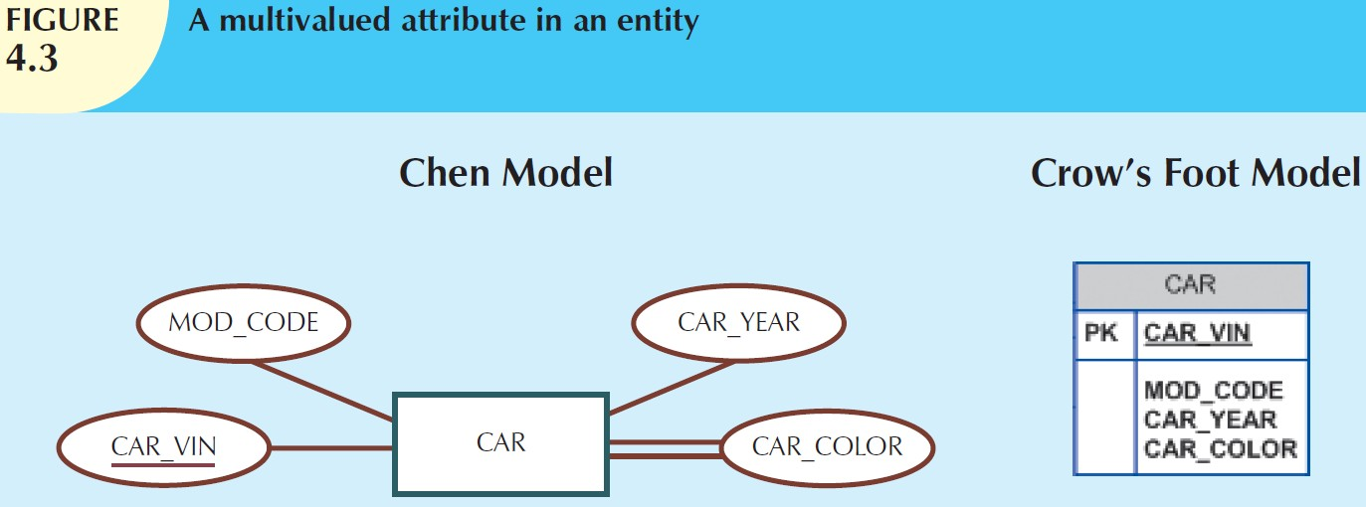
16
The ERD in Figure 4.3 contains all of the components introduced thus far.
Note that CAR_VIN is the primary key, and CAR_COLOR is a multivalued attribute of the CAR entity.

Slide 17
Implementing Multi-valued
Attributes
17
Although the conceptual model can handle M:N relationships and multi-valued attributes, you should not implement them in the RDBMS.
Since each column/row intersection represents a single data value, if multi-valued attributes exist, the designer must decide on one of two possible courses of action:
Within the original entity, create several new attributes, one for each of the original multivalued attribute’s components. For example, CAR_COLOR can be split into CAR_TOPCOLOR, CAR_BODYCOLOR, and CAR_TRIMCOLOR. (See Figure 4.4.)

Slide 18
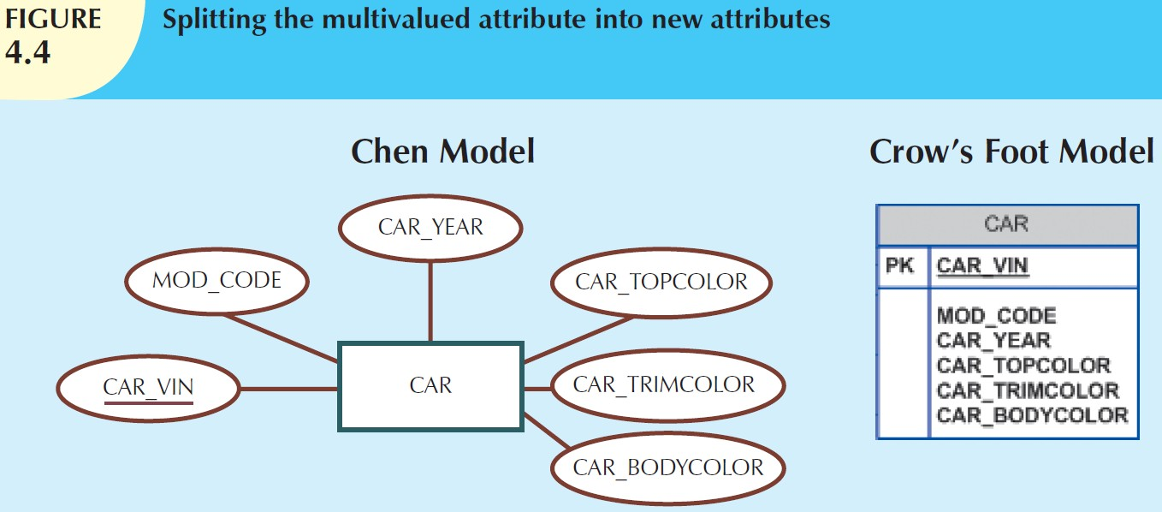
18

Slide 19
19
◉ Although this solution seems to work, its adoption can lead to major structural problems in the table. For example, if additional color components—such as a logo color—are added for some cars, the table structure must be modified to accommodate the new color section. In that case, cars that do not have such color sections generate nulls for the non- existing components.

Slide 20
20
Create a new entity composed of the original multi- valued attribute’s components. This new entity allows the designer to define color for different sections of the car. (See Table 4.1.) Then, this new CAR_COLOR entity is related to the original CAR entity in a 1:M relationship.

Slide 21
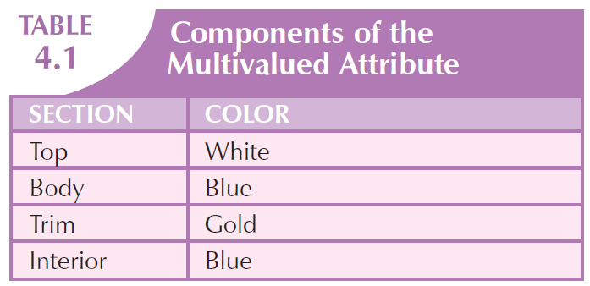
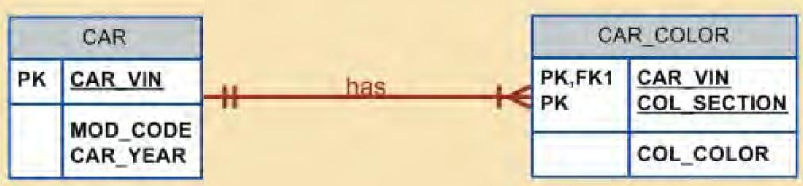
21

Slide 22
22
Using this approach you are now able to assign as many colors as necessary without having to change the table structure. (see Figure 4.5) This is the preferred way to deal with multi-valued attributes. It is a more flexible, expandable solution, and it is compatible with the relational model!

Slide 23
Derived Attributes (Computed
Attributes)
23
A derived attribute is an attribute whose value is calculated (derived) from other attributes.
The derived attribute need not be physically stored within the database; instead, it can be derived by using an algorithm.

Slide 24
Example
24
An employee’s age, EMP_AGE, may be found by computing the integer value of the difference between the current date and the EMP_DOB. If you use Microsoft Access, you would use the formula INT((DATE() – EMP_DOB)/365).
Similarly, the total cost of an order can be derived by multiplying the quantity ordered by the unit price. Or the estimated average speed can be derived by dividing trip distance by the time spent on route.

Slide 25
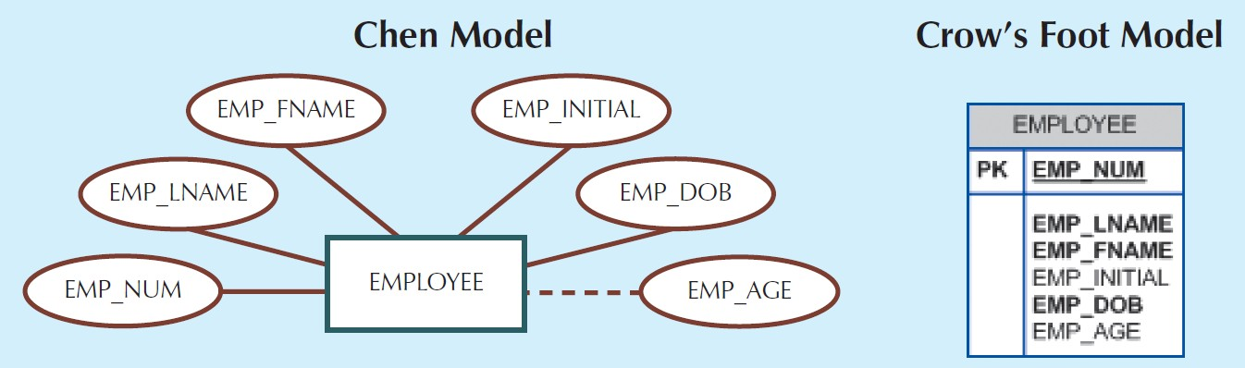
25
A derived attribute is indicated in the Chen notation by a dashed line connecting the attribute and the entity. (See Figure 4.6.)
The Crow’s Foot notation does not have a method for distinguishing the
derived attribute from other attributes.
A derived attribute computation can be as simple as adding two attribute values located on the same row, or it can be the result of aggregating the sum of values located on many table rows (from the same table or from a different table).

Slide 26
26
The decision to store derived attributes in database tables depends on the processing requirements and the constraints placed on a particular application. The designer should be able to balance the design in accordance with such constraints.
We normally use views for the derived attributes
Table 4.2 shows the advantages and disadvantages of storing (or not storing) derived attributes in the database.

Slide 27
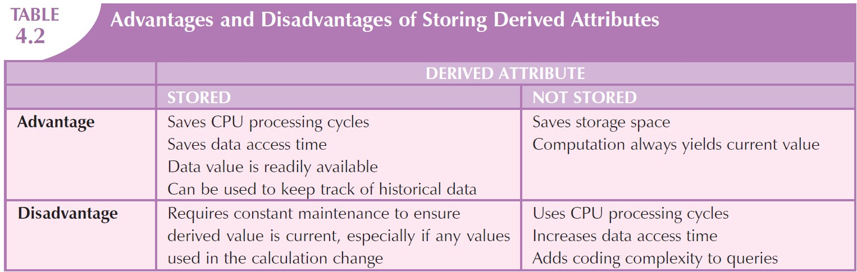
27

Slide 28
Relationships
28
A relationship is an association between entities.
The entities that participate in a relationship are also known as participants.
The relationship name is an active or passive verb; for example, a STUDENT takes a CLASS, a PROFESSOR teaches a CLASS, a DEPARTMENT employs a PROFESSOR, a DIVISION is managed by an EMPLOYEE, and an AIRCRAFT is flown by a CREW.
Relationships between entities always operate in both directions.

Slide 29
29
For example: for relationship between CUSTOMER and INVOICE, you would specify that:
A CUSTOMER may generate many INVOICEs.
Each INVOICE is generated by one CUSTOMER. Because you know both directions of the relationship it is easy to be classified as 1:M.
If you know only one side of the relationship, the classification is difficult to establish.

Slide 30
Example
30
◉ A DIVISION is managed by one EMPLOYEE. You don’t know if the relationship is 1:1 or 1:M.
Therefore, you should ask the question ―Can an employee manage more than one division?‖ If the answer is yes, the relationship is 1:M, and the second part of the relationship is then written as: An EMPLOYEE may manage many DIVISIONs.
If an employee cannot manage more than one division, the relationship is 1:1, and the second part of the relationship is then written as:
An EMPLOYEE may manage only one DIVISION.
◻

Slide 31
Connectivity and Cardinality
31
Entity relationships may be classified as one-to-one, one-to-many, or many-to-many.
The term connectivity is used to describe the relationship classification (1:1, 1:M or M:N).
Cardinality expresses the minimum and maximum number of entity occurrences associated with one occurrence of the related entity.
In the ERD, cardinality is indicated using the format (x,y).
(the minimum number of associated entities, the maximum number of associated entities)

Slide 32
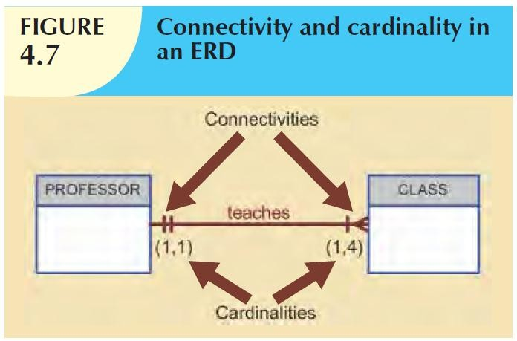
32
The specific limits described by the cardinalities cannot be implemented directly through the database design. (see Figure 4.7)

Slide 33
33
Cardinality (1,4) written next to the CLASS entity in the ―PROFESSOR teaches CLASS‖ relationship indicates that each professor teaches up to four classes, which means that the PROFESSOR table’s primary key value occurs at least once and no more than four times as foreign key values in the CLASS table.
If the cardinality had been written as (1,N), there would be no upper limit
to the number of classes a professor might teach.
Similarly, the cardinality (1,1) written next to the PROFESSOR entity indicates that each class is taught by one and only one professor. That is, each CLASS entity occurrence is associated with one and only one entity occurrence in PROFESSOR.

Slide 34
34
The numeric cardinality range is very useful at the application software level.
For example, Tiny College might want to ensure that a class is not taught unless it has at least 10 students enrolled. Similarly, if the classroom can hold only 30 students, the application software should use that cardinality to limit enrollment in the class.

Slide 35
35
DBMS cannot handle the implementation of the cardinalities at the table level—that capability is provided by the application software or by triggers.
Connectivities and cardinalities are established by very concise statements known as business rules.
The Chen notation places the cardinalities on the side of the related entity. The Crow’s Foot and UML diagrams place the cardinalities next to the entity to which the cardinalities apply

Slide 36
Existence Dependence
36
An entity is said to be existence-dependent if it can exist in the database only when it is associated with another related entity occurrence.
In implementation terms, an entity is existence- dependent if it has a mandatory foreign key—that is, a foreign key attribute that cannot be null.

Slide 37
37
For example: in ―EMPLOYEE claims DEPENDENT‖ it is impossible for the dependent to exist apart from the EMPLOYEE in the database.
If an entity can exist apart from all of its related entities, it is existence-independent, and the entity is referred to as a strong entity or regular entity. For example, suppose that the XYZ Corporation uses parts to produce its products and some of those parts are produced in-house and other parts are bought from vendors.

Slide 38
38
In that scenario, it is quite possible for a PART to exist independently from a VENDOR in the relationship ―PART is supplied by VENDOR,‖.
The relationship strength concept is not part of the original ERM. Instead, this concept applies directly to Crow’s Foot diagrams. Because Crow’s Foot diagrams are used extensively to design relational databases, it is important to understand relationship strength as it affects database implementation.

Slide 39
39
The Chen ERD notation is oriented toward conceptual modeling and therefore does not distinguish between weak and strong relationships.

Slide 40
Relationship Strength
40
The concept of relationship strength is based on how the primary key of a related entity is defined.
Weak (Non-identifying) Relationships
A weak relationship, also known as a non- identifying relationship, exists if the PK of the related entity does not contain a PK component of the parent entity.

Slide 41
Example
41
COURSE(CRS_CODE, DEPT_CODE, CRS_DESCRIPTION, CRS_CREDIT)
CLASS(CLASS_CODE, CRS_CODE, CLASS_SECTION, CLASS_TIME, ROOM_CODE, PROF_NUM)
In this case, a weak relationship exists between COURSE and CLASS because the CLASS_CODE is the CLASS entity’s PK, while the CRS_CODE in CLASS is only a FK. In this example, the CLASS PK did not inherit the PK component from the COURSE entity.
(see Figure 4.8)

Slide 42
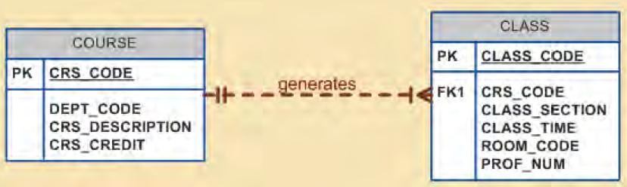
42
Crow’s Foot notation depicts a weak relationship by placing a dashed relationship line between the entities.
(Remember that the ERD is used for communication between the designer(s) and end users.)

Slide 43
Strong (Identifying) Relationship
43
A strong relationship, also known as an identifying relationship, exists when the PK of the related entity contains a PK component of the parent entity.

Slide 44
Example
44
COURSE(CRS_CODE, DEPT_CODE, CRS_DESCRIPTION, CRS_CREDIT) CLASS(CRS_CODE, CLASS_SECTION , CLASS_TIME, ROOM_CODE, PROF_NUM)
In this case a strong relationship exists between COURSE and CLASS, because the CLASS entity’s composite PK is composed of CRS_CODE + CLASS_SECTION. (Note that the CRS_CODE in CLASS is also the FK to the COURSE entity.)

Slide 45
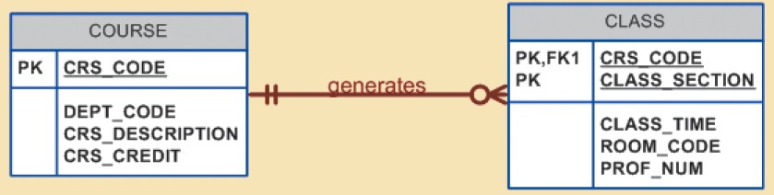
45
Crow’s Foot notation depicts the strong (identifying) relationship with a solid line between the entities, shown in Figure 4.9.

Slide 46
Weak Entities
46
A weak entity is one that meets two conditions:
The entity is existence-dependent; that is, it cannot exist without the entity with which it has a relationship.
The entity has a primary key that is partially or totally derived from the parent entity in the relationship.

Slide 47
Example
47
For example, DEPENDENT is a weak entity in the relationship ―EMPLOYEE has DEPENDENT.‖
An EMPLOYEE might or might not have a DEPENDENT, but the DEPENDENT must be associated with an EMPLOYEE.
Moreover, the DEPENDENT cannot exist without the EMPLOYEE; that is, a person cannot get benefit coverage as a dependent unless he or she happens to be a dependent of an employee. (see Figure 4.10)

Slide 48
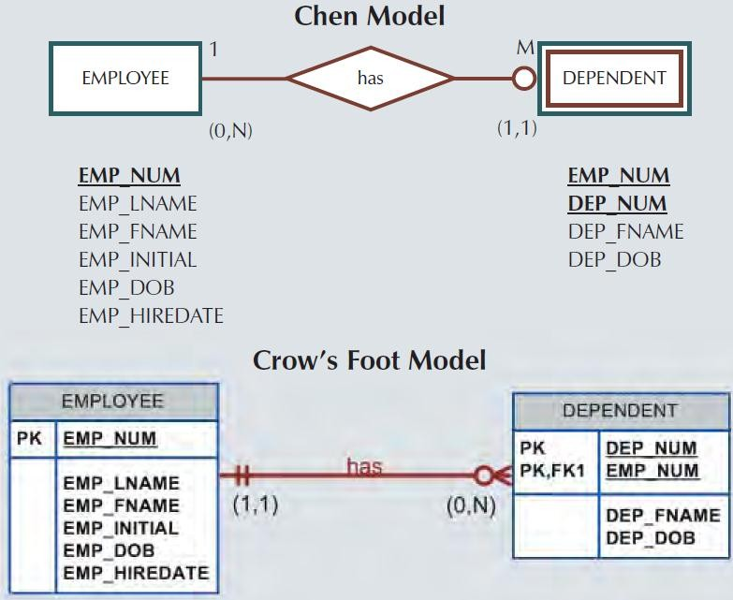
48
Fig. 4.10

Slide 49
49
Chen notation identifies the weak entity by using a double-walled entity rectangle.
The Crow’s Foot notation generated by Visio Professional uses the relationship line and the PK/FK designation to indicate whether the related entity is weak.
A strong (identifying) relationship indicates that the related entity is weak.

Slide 50
50
Remember that the weak entity inherits part of its primary key from its strong counterpart. For example, at least part of the DEPENDENT entity’s key shown in Figure 4.10 was inherited from the EMPLOYEE entity:
EMPLOYEE (EMP_NUM, EMP_LNAME, EMP_FNAME, EMP_INITIAL, EMP_DOB, EMP_HIREDATE)
DEPENDENT (EMP_NUM, DEP_NUM, DEP_FNAME, DEP_DOB)

Slide 51
51
Figure 4.11 illustrates the implementation of the relationship between the weak entity (DEPENDENT) and its parent or strong counterpart (EMPLOYEE).

Slide 52
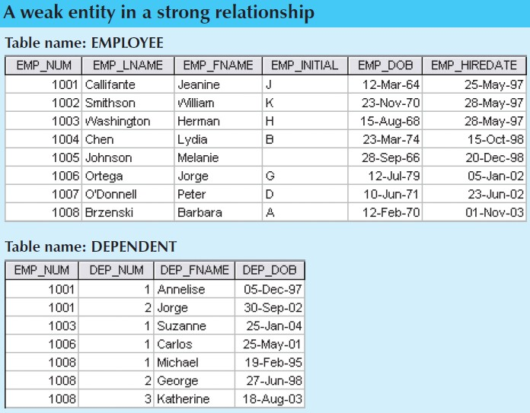
52
Fig 4.11

Slide 53
Relationship Participation
53
Participation in an entity relationship is either
Optional or Mandatory.
Optional participation means that one entity occurrence does not require a corresponding entity occurrence in a particular relationship.

Slide 54
54
For example, in the ―COURSE generates CLASS‖ relationship, an entity occurrence (row) in the COURSE table does not necessarily require the existence of a corresponding entity occurrence in the CLASS table. Therefore, the CLASS entity is considered to be optional to the COURSE entity.
In Crow’s Foot notation, an optional relationship between entities is shown by drawing a small circle
(O) on the side of the optional entity, as illustrated in Figure 4.9.

Slide 55
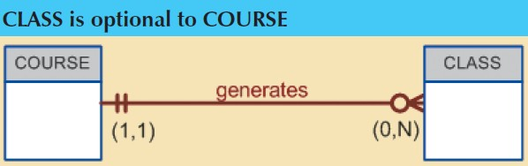
55

Slide 56
56
The existence of an optional entity indicates that the minimum cardinality is 0 for the optional entity. (The term optionality is used to label any condition in which one or more optional relationships exist.)

Slide 57
57
Mandatory participation means that one entity occurrence requires a corresponding entity occurrence in a particular relationship.
If no optionality symbol is depicted with the entity, the entity is assumed to exist in a mandatory relationship with the related entity.
The existence of a mandatory relationship indicates that the minimum cardinality is at least 1 for the mandatory entity.

Slide 58
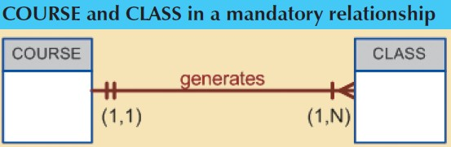
58

Slide 59
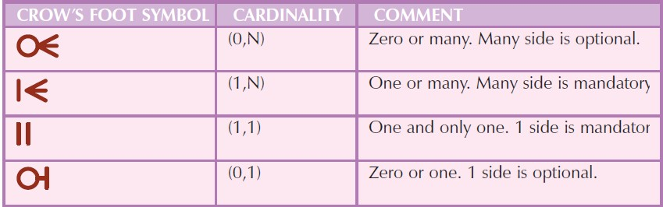
59

Slide 60
Relationship Degree
60
A relationship degree indicates the number of entities or participants associated with a relationship.

Slide 61
61
A unary relationship exists when an association is maintained within a single entity.
A binary relationship exists when two entities are associated.
A ternary relationship exists when three entities are associated.
Although higher degrees exist, they are rare and are not specifically named.
(For example, an association of four entities is described simply as a four-degree relationship.)

Slide 62
Unary Relationships
62
In the case of the unary relationship shown in Figure 4.15, an employee within the EMPLOYEE entity is the manager for one or more employees within that entity. In this case, EMPLOYEE has a relationship with itself. Such a relationship is known as a recursive relationship.

Slide 63
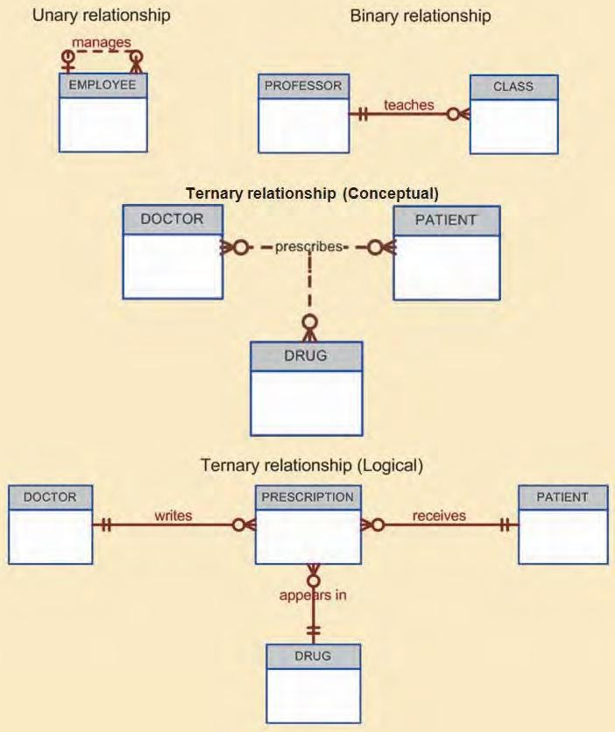
63

Slide 64
Binary Relationships
64
A binary relationship exists when two entities are associated in a relationship.
Binary relationships are most common. In fact, to simplify the conceptual design, whenever possible, most higher-order (ternary and higher) relationships are decomposed into appropriate equivalent binary relationships.
In Figure 4.15, the relationship ―a PROFESSOR teaches one or more CLASSes‖ represents a binary relationship.

Slide 65
65

Slide 66
Ternary and Higher-Degree Relationships
66
A ternary relationship implies an association among three different entities.
For example, in Figure 4.16, following business rules are represented:
A DOCTOR writes one or more PRESCRIPTIONs.
A PATIENT may receive one or more PRESCRIPTIONs.
A DRUG may appear in one or more PRESCRIPTIONs.

Slide 67
Recursive Relationships
67
A recursive relationship is one in which a relationship can exist between occurrences of the same entity set. (Naturally, such a condition is found within a unary relationship.)

Slide 68
Example
68
A 1:M unary relationship can be expressed by ―an EMPLOYEE may manage many EMPLOYEEs, and each EMPLOYEE is managed by one EMPLOYEE.‖
A 1:1 unary relationship may be expressed by ―an EMPLOYEE may be married to one and only one other EMPLOYEE.‖
A M:N unary relationship may be expressed by ―a COURSE may be a prerequisite to many other COURSEs, and each COURSE may have many other COURSEs as prerequisites.‖ Those relationships are shown in Figure 4.17.

Slide 69
Associative (Composite) Relationships
69
The associative entity is used to implement a M:N relationship between two or more entities.
This associative entity (also known as a composite or bridge entity) is composed of the primary keys of each of the entities to be connected.

Slide 70
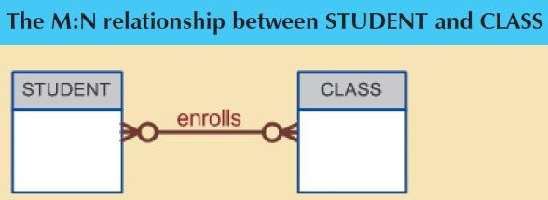
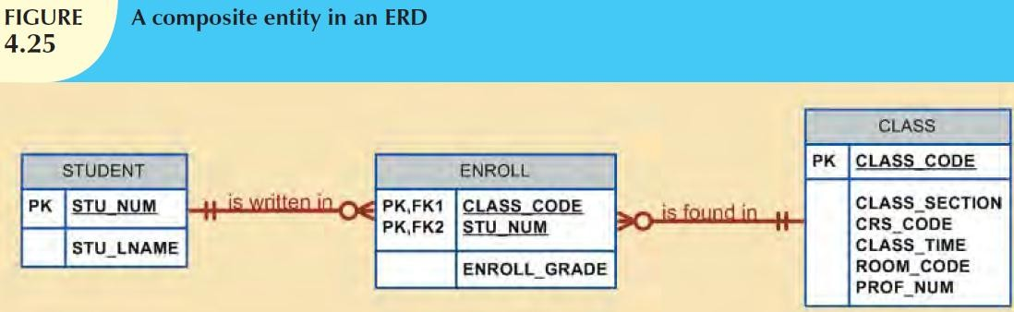
70

