Slide 1
DATABASE MANAGEMENT SYSTEM
Normalization

Slide 2
Normalization of Database
2
Database Normalization is a technique of organizing the data in the database.
Normalization is a systematic approach of decomposing tables to eliminate data redundancy and undesirable characteristics like Insertion, Update and Deletion Anomalies.

Slide 3
3
It is a multi-step process that puts data into tabular form by removing duplicated data from the relation tables.
Ensuring data dependencies make sense i.e data is logically stored.

Slide 4
Uses of Normalization
4
Normalization is used for mainly three purposes,
Eliminating Database Anomalies.
Eliminating redundant data.
Ensuring data dependencies make sense i.e data is logically stored.

Slide 5
Problems without Normalization
5
Without Normalization, it becomes difficult to handle and update the database, without facing data loss.
Insertion, Updation and Deletion Anomalies are very frequent if database is not Normalized.
To understand these anomalies let us take an example of Student table.

Slide 6
Example (Student)
6
S_Name | S_Address | Subject_opted (NOT NULL)
Waseem | Karachi | Bio
Ahmed | Lahore | Maths
Sajid | Islamabad | Maths
Khalid | Karachi | Physics
Waseem | Karachi | Physics

Slide 7
7
Updation Anomaly : To update address of a student who occurs twice or more than twice in a table, we will have to update S_Address column in all the rows, else data will become inconsistent.
Insertion Anomaly : Suppose for a new admission, we have a Student name , address and subject opted for .But if student has not opted for any subject yet then we have to insert NULL there, leading to Insertion Anomaly.

Slide 8
8
Deletion Anomaly : If (S_Name) Ahmed has only one subject and temporarily he drops it, when we delete that row, entire student record will be deleted along with it.

Slide 9
9
There is a sequence to normal forms:
1NF is considered the weakest,
2NF is stronger than 1NF,
3NF is stronger than 2NF, and
BCNF (Boyce Codd Normal Form) is considered the strongest
Also,
any relation that is in BCNF, is in 3NF;
any relation in 3NF is in 2NF; and
any relation in 2NF is in 1NF.

Slide 10
First Normal Form (1NF)
10
As per First Normal Form:
No two Rows of data must contain repeating group of information i.e each set of column must have a unique value, such that multiple columns cannot be used to fetch the same row.
Each table should be organized into rows, and each row should have a Primary Key that distinguishes it as unique.

Slide 11
11
The Primary key is usually a single column, but sometimes more than one column can be combined to create a single primary key.
For example consider a table which is not in First normal form

Slide 12
First Normal Form (1NF)
12
Student | Age | Subject
Waseem | 15 | Biology, Maths
Ahmed | 14 | Maths
Sajid | 17 | Maths
In First Normal Form, any row must not have a column in which more than one value is saved, like separated with commas. Rather than that, we must separate such data into multiple rows.

Slide 13
13
Student | Age | Subject
Waseem | 15 | Biology
Waseem | 15 | Maths
Ahmed | 14 | Maths
Sajid | 17 | Maths
Student Table following 1NF will be :
Using the First Normal Form, data redundancy increases, as there will be many columns with same data in multiple rows but each row as a whole will be unique.
In this case (Student , Subject) is a Primary Key.

Slide 14
Functional Dependencies
14
We say an attribute, B, has a functional dependency on another attribute, A, if for any two records, which have the same value for A, then the values for B in these two records must be the same. We illustrate this as:
A → B
Example: Suppose we keep track of employee email addresses, and we only track one email address for each employee. Suppose each employee is identified by their unique employee number. We say there is a functional dependency of email address on employee number:
employee number → email address

Slide 15
Functional Dependencies
15
EmpNum | EmpEmail | EmpFname | EmpLname
123 | jdoe@abc.com | John | Doe
456 | psmith@abc.c | m Peter | Smith
555 | alee1@abc.co | m Alan | Lee
633 | pdoe@abc.co | m Peter | Doe
787 | alee2@abc.co | m Alan | Lee
o
If EmpNum is the PK then the FDs: EmpNum → EmpEmail EmpNum → EmpFname EmpNum → EmpLname
must exist

Slide 16
Functional Dependencies
16
EmpNum → EmpEmail EmpNum → EmpFname EmpNum → EmpLname
3 different ways you might see FDs depicted
EmpEmail
EmpFname
EmpNum
EmpLname
EmpNum | EmpEmail | EmpFname | EmpLname

Slide 17
Determinant
17
Functional Dependency
EmpNum → EmpEmail
Attribute on the L.H.S is known as the Determinant
EmpNum is a determinant of EmpEmail
91.2914

Slide 18
Transitive dependency
18
Consider attributes A, B, and C, and where A → B and B → C.
Functional dependencies are Transitive, which means that we also have the functional dependency
A → C
We say that C is transitively dependent on A through B.

Slide 19
Transitive dependency
19
EmpNum → DeptNum
EmpNum | EmpEmail | DeptNum | DeptNname
DeptNum → DeptName
EmpNum | EmpEmail | DeptNum | DeptNname
DeptName is Transitively Dependent on EmpNum via DeptNum
EmpNum → DeptName

Slide 20
Partial dependency
20
A Partial Dependency exists when an attribute B is functionally dependent on an attribute A, and A is a component of a multipart candidate key.
InvNum | LineNum | Qty | InvDate
Candidate keys: {InvNum, LineNum} InvDate is partially dependent on {InvNum, LineNum} as InvNum is a determinant of InvDate and InvNum is part of a candidate key

Slide 21
Second Normal Form (2NF)
21
As per the Second Normal Form:
◉ There must not be any Partial Dependency of any column of primary key.
It means that for a table that has concatenated primary key (composite key), each column in the table that is not part of the primary key must depend upon the entire concatenated key for its existence.
If any column depends only on one part of the concatenated key (composite key), then the table fails Second Normal Form.

Slide 22
Table in 1NF
22
Student | Age | Subject
Waseem | 15 | Biology
Waseem | 15 | Maths
Ahmed | 14 | Maths
Sajid | 17 | Maths

Slide 23
23
In example of First Normal Form, there are two rows for Waseem, to include multiple subjects that he has opted for.
While this is searchable, and follows First normal form, but it is an inefficient use of space.
Also in the above Table in First Normal Form, while the candidate key is {Student, Subject}, Age of Student only depends on Student column, which is incorrect as per Second Normal Form.

Slide 24
24
To achieve Second Normal Form, it would be helpful to split out the subjects into an independent table, and match them up using the student names as foreign keys.

Slide 25
New STUDENT table following 2NF will be
25
Student (PK) | Age
Waseem | 15
Ahmed | 14
Sajid | 17
In Student Table, the Primary key will be Student column, because all other column i.e Age is dependent on it.

Slide 26
26
New SUBJECT Table, introduced for 2NF will be :
Student (FK) | Subject
Waseem | Biology
Waseem | Maths
Ahmed | Maths
Sajid | Maths

Slide 27
27
Now, both the above tables qualifies for Second Normal Form and will never suffer from Update Anomalies.
Although there are a few complex cases in which table in Second Normal Form suffers Update Anomalies, and to handle those scenarios Third Normal Form is there.

Slide 28
Third Normal Form (3NF)
28
Third Normal Form applies that:
◉ Every non-prime attribute of table must be dependent on primary key, or we can say that, there should not be the case that a non-prime attribute is determined by another non-prime attribute.
So this Transitive Functional Dependency should be removed from the table and also the table must be in Second Normal form.

Slide 29
EMP Table
29
In EMP table, EMPNO is Primary key, but DNAME
and LOC depends upon DEPTNO.
The dependency between DEPTNO and other fields is called Transitive Dependency.
Hence to apply 3NF, we need to move the DNAME and LOC to a new table, with DEPTNO as primary key.

Slide 30
30
The advantage of removing transitive dependency is,
Amount of data duplication is reduced.
Data integrity achieved.

Slide 31
BCNF
31
Boyce Codd Normal Form is a higher version of the Third Normal form.
This form deals with certain type of anomaly that is not handled by 3NF.
A 3NF table which does not have multiple overlapping candidate keys is said to be in BCNF. :

Slide 32
32
For a table to be in BCNF, following conditions must be satisfied:
R(relation) must be in 3rd Normal Form
For each Functional Dependency ( X → Y ), X should be a super Key.
Consider the following relationship R(A,B,C,D) and following relationships:
A → BCD BC → AD
D → B
Above relationship is already in 3NF. Keys are A & BC

Slide 33
33
Hence, in the functional dependency, A → BCD, A is the superkey.
In the second relation, BC → AD, BC is also a key.
But in D → B, D is not a key.
Hence, we can break our relationship R, into R1 and R2.
R(A,B,C,D)
R1(A,D,C) R2(D,B)

Slide 34
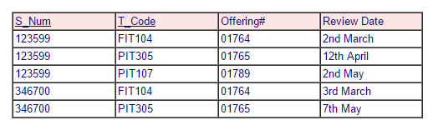

Slide 35
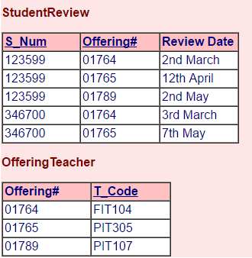

Slide 36
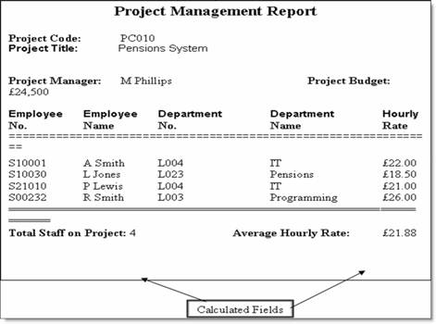

Slide 37
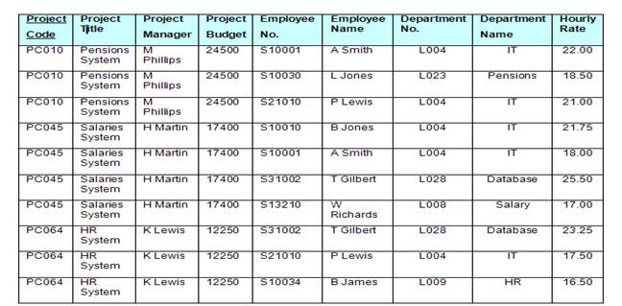
UNF

Slide 38
1NF
Project Code | Project Title | Project Manager | Project Budget
PC010 | Pensions System | M Phillips | 24500
PC045 | Salaries System | H Martin | 17400
PC064 | HR System | K Lewis | 12250
Project Code | Employee No. | Employee Name | Department No. | Department Name | Hourly Rate
PC010 | S10001 | A Smith | L004 | IT | 22.00
PC010 | S10030 | L Jones | L023 | Pensions | 18.50
PC010 | S21010 | P Lewis | L004 | IT | 21.00
PC045 | S10010 | B Jones | L004 | IT | 21.75
PC045 | S10001 | A Smith | L004 | IT | 18.00
PC045 | S31002 | T Gilbert | L028 | Database | 25.50
PC045 | S13210 | W Richards | L008 | Salary | 17.00
PC064 | S31002 | T Gilbert | L028 | Database | 23.25
PC064 | S21010 | P Lewis | L004 | IT | 17.50
PC064 | S10034 | B James | L009 | HR | 16.50

Slide 39
2NF
Project Code | Project Title | Project Manager | Project Budget
PC010 | Pensions System | M Phillips | 24500
PC045 | Salaries System | H Martin | 17400
PC064 | HR System | K Lewis | 12250
Project Code | Employee No. | Hourly Rate |  | Employee No. | Employee Name | Department No. | Department Name
PC010 | S10001 | 22.00 |  | S10001 | A Smith | L004 | IT
PC010 | S10030 | 18.50 |  | S10030 | L Jones | L023 | Pensions
PC010 | S21010 | 21.00 |  | S21010 | P Lewis | L004 | IT
PC045 | S10010 | 21.75 |  | S10010 | B Jones | L004 | IT
PC045 | S10001 | 18.00 |  | S31002 | T Gilbert | L028 | Database
PC045 | S31002 | 25.50 |  | S13210 | W Richards | L008 | Salary
PC045 | S13210 | 17.00 |  | S10034 | B James | L009 | HR
PC064 | S31002 | 23.25
PC064 | S21010 | 17.50
PC064 | S10034 | 16.50

Slide 40
3NF
Project Code | Project Title | Project Manager | Project Budget
PC010 | Pensions System | M Phillips | 24500
PC045 | Salaries System | H Martin | 17400
PC064 | HR System | K Lewis | 12250
Project Code | Employee No. | Hourly Rate
PC010 | S10001 | 22.00
PC010 | S10030 | 18.50
PC010 | S21010 | 21.00
PC045 | S10010 | 21.75
PC045 | S10001 | 18.00
PC045 | S31002 | 25.50
PC045 | S13210 | 17.00
064 | S31002 | 23.25
PC064 | S21010 | 17.50
PC064 | S10034 | 16.50

Slide 41
Employee No. | Employee Name | Department No. *
S10001 | A Smith | L004
S10030 | L Jones | L023
S21010 | P Lewis | L004
S10010 | B Jones | L004
S31002 | T Gilbert | L023
S13210 | W Richards | L008
S10034 | B James | L0009

Slide 42
Department No. | Department Name
L004 | IT
L023 | Pensions
L028 | Database
L008 | Salary
L009 | HR

Slide 43
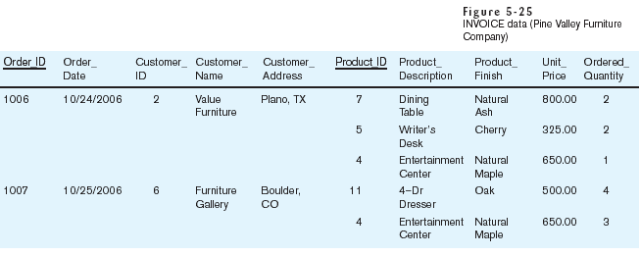
Table with multivalued attributes, not in 1st normal form
Note: this is NOT a relation

Slide 44
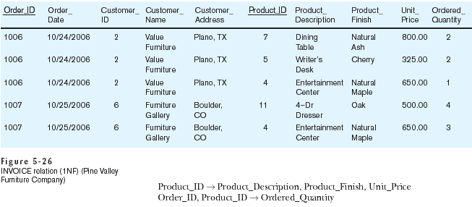
Table with no multivalued attributes and unique rows, in 1st normal form
Note: this is relation, but not a well-structured one

Slide 45
Anomalies in this Table
Insertion–if new product is ordered for order 1007 of existing customer, customer data must be re-entered, causing duplication
Deletion–if we delete the Dining Table from Order 1006, we lose information concerning this item's finish and price
Update–changing the price of product ID 4 requires update in several records
Why do these anomalies exist?
Because there are multiple themes (entity types) in one relation. This results in duplication and an unnecessary dependency between the entities

Slide 46
Second Normal Form
1NF PLUS every non-key attribute is fully functionally dependent on the ENTIRE primary key
Every non-key attribute must be defined by the entire key, not by only part of the key
No partial functional dependencies

Slide 47
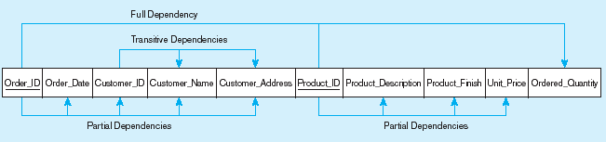
Figure 5-27 Functional dependency diagram for INVOICE
Order_ID ➔ Order_Date, Customer_ID, Customer_Name, Customer_Address
Customer_ID ➔ Customer_Name, Customer_Address
Product_ID ➔ Product_Description, Product_Finish, Unit_Price
Order_ID, Product_ID ➔ Order_Quantity
Therefore, NOT in 2nd Normal Form

Slide 48
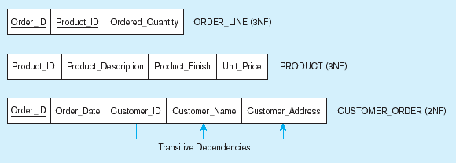
Figure 5-28 Removing partial dependencies
Getting it into Second Normal Form
Partial dependencies are removed, but there are still transitive dependencies

Slide 49
Third Normal Form
2NF PLUS no transitive dependencies (functional dependencies on non-primary-key attributes)
Note: This is called transitive, because the primary key is a determinant for another attribute, which in turn is a determinant for a third
Solution: Non-key determinant with transitive dependencies go into a new table; non-key determinant becomes primary key in the new table and stays as foreign key in the old table

Slide 50
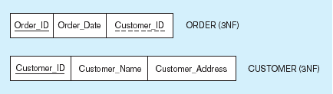
Figure 5-28 Removing partial dependencies
Getting it into Third Normal Form
Transitive dependencies are removed

