Slide 1
Street View House Number Recognition

Slide 2
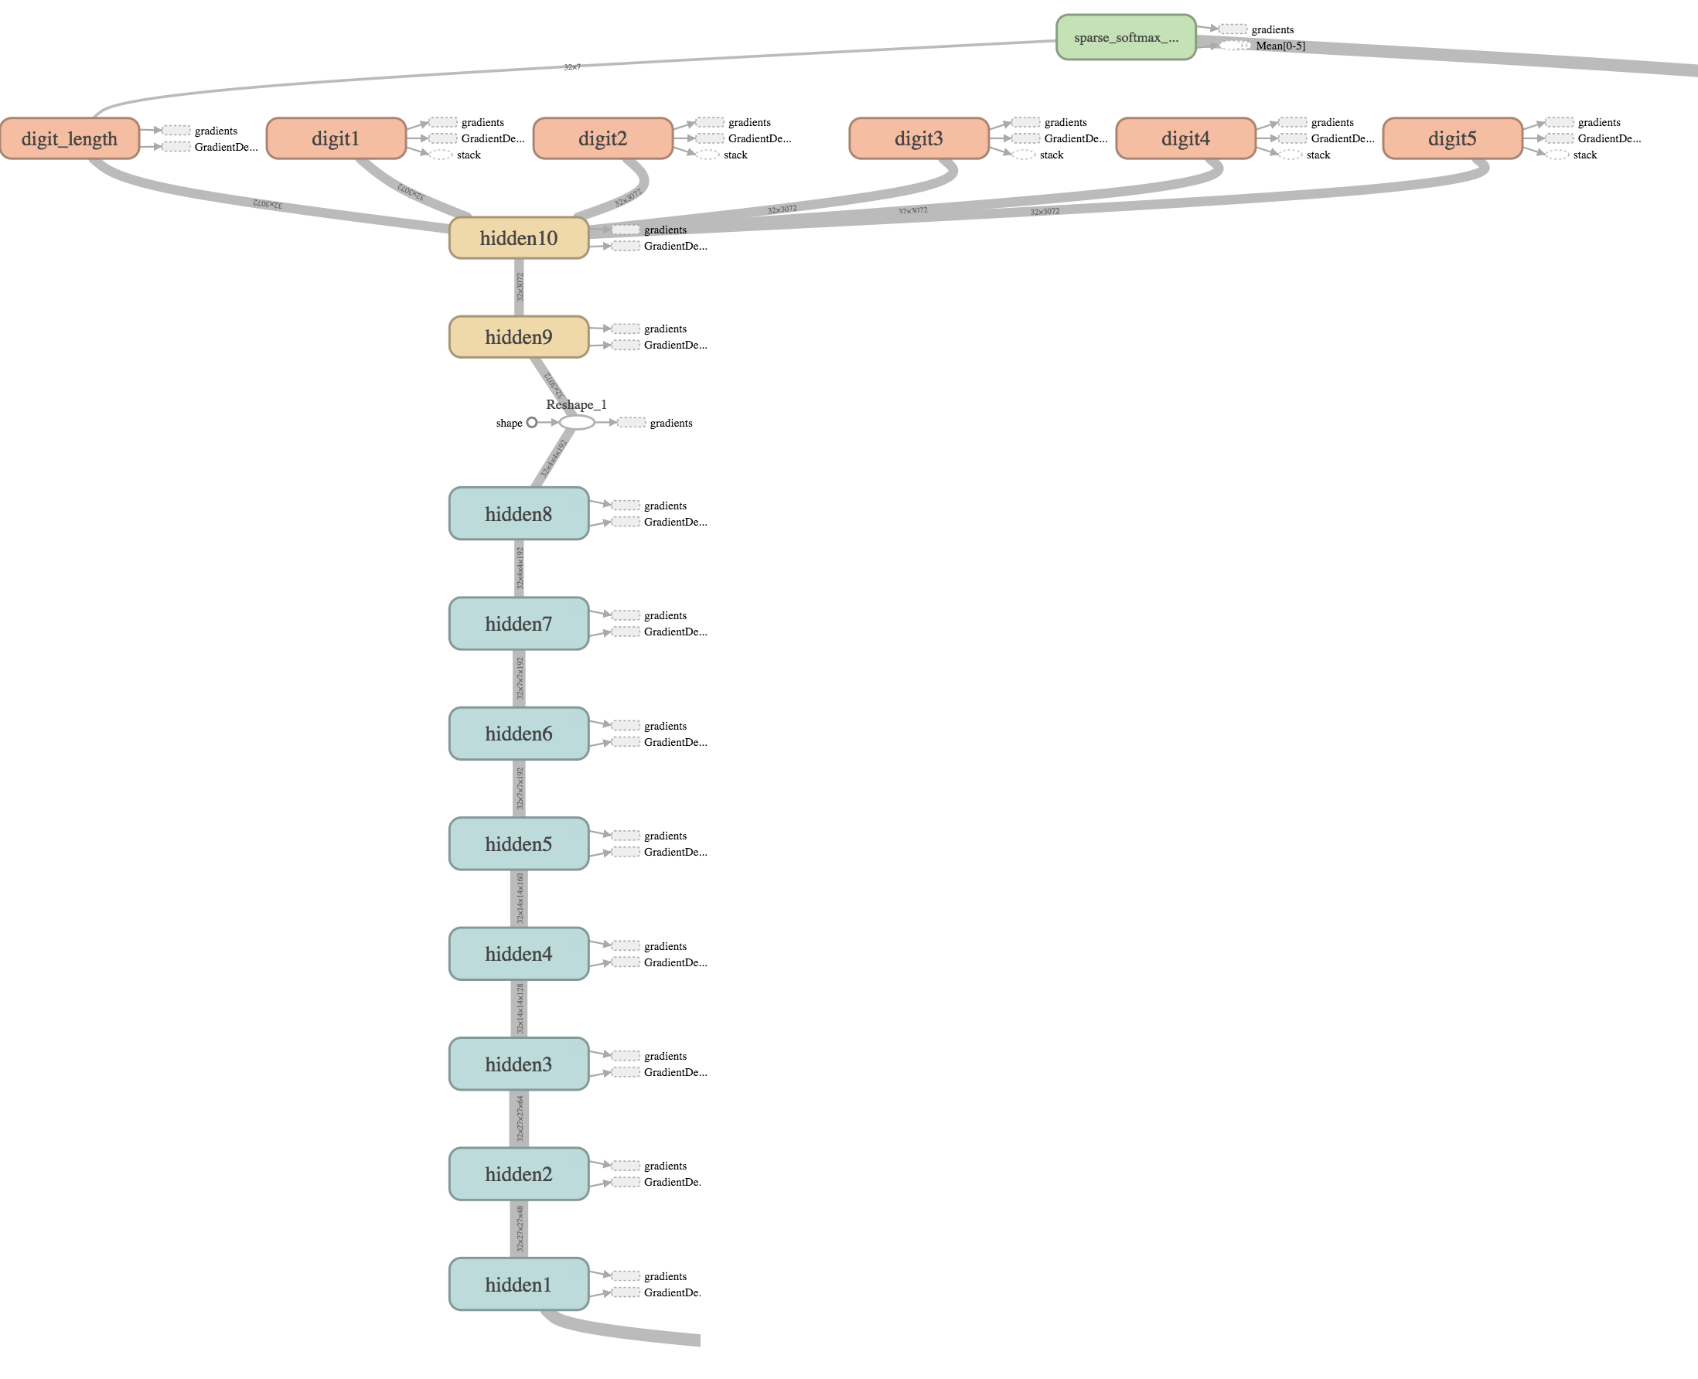
Model
This is a Pytorch implementation of a baseline work:
Multi-digit Number Recognition from Street View Imagery using Deep Convolutional Neural Networks
Its network structure is on the right.

Slide 3
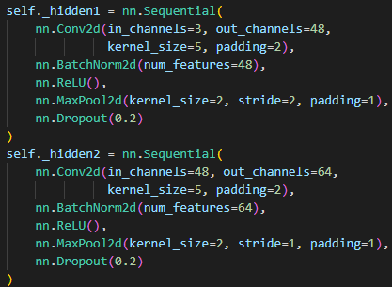
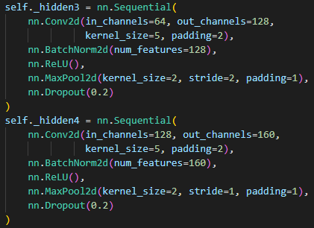
Params
Steps | GPU | Batch Size | Learning rate | Patience | Decay Step | Decay Rate
122000 | GTX 1080Ti | 512 | 0.01 | 100 | 625 | 0.9

Slide 4
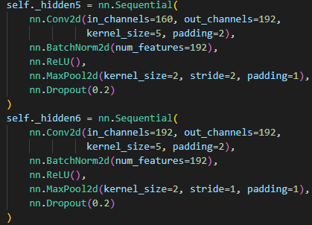
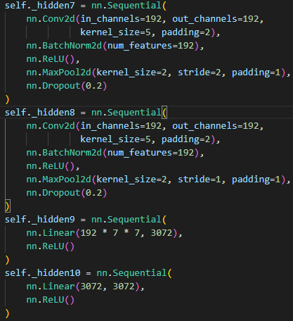
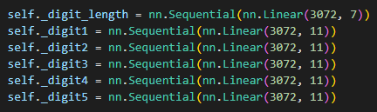
Params

Slide 5
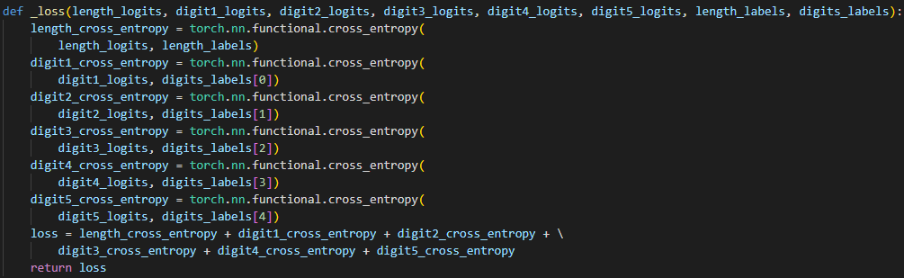
Training method
Loss function
Use Backpropagation algorithm on the sum of all digit cross entropies.
That is using loss.backward() where loss is defined as follow:

Slide 6

Optimization
Use SGD method and StepLR to optimize the training
SGD
StepLR

Slide 7
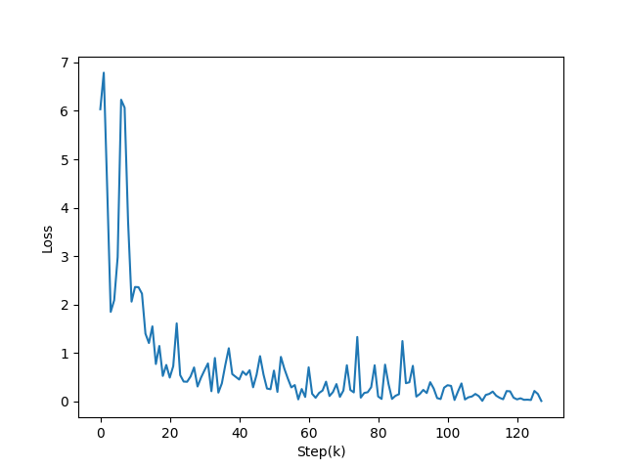
Training curve

Slide 8
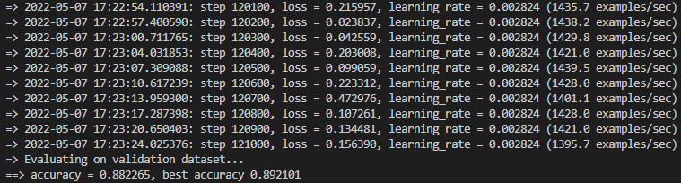
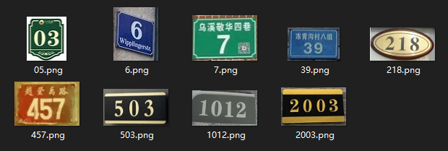
Accuracy
All these house numbers on the right can be well sorted by running the infer.py

Slide 9
THANKS

