Slide 1
Lesson 10 Final Project
Lea Misigaro

Slide 2
Objective
Create a boxplot of the average number of packs per capita by state. Which states have the highest number of packs? Which have the lowest?
Find the median over all the states of the number of packs per capita for each year. Plot this median value for the years from 1985 to 1995. What can you say about cigarette usage in these years?
Create a scatter plot of price per pack vs number of packs per capita for all states and years.
Are the price and the per capita packs positively correlated, negatively correlated, or uncorrelated? Explain why your answer would be expected.
Change your scatter plot to show the points for each year in a different color. Does the relationship between the two variable change over time?
Do a linear regression for these two variables. How much variability does the line explain?
The plot above does not adjust for inflation. You can adjust the price of a pack of cigarettes for inflation by dividing the avgprs variable by the cpi variable. Create an adjusted price for each row, then re-do your scatter plot and linear regression using this adjusted price.
Create a data frame with just the rows from 1985. Create a second data frame with just the rows from 1995. Then, from each of these data frames, get a vector of the number of packs per capita. Use a paired t-test to see if the number of packs per capita in 1995 was significantly different than the number of packs per capita in 1985.
In the process of doing this project, have any questions come to mind that this data set could answer? If so, pick one and do the analysis to find the answer to your question.

Slide 3
1st we must get the functions and code to insure we will be able to use the necessary tools to go further
state year cpi pop packpc 1 AL 1985 1.076 3973000 116.4863 2 AR 1985 1.076 2327000 128.5346 3 AZ 1985 1.076 3184000 104.5226 4 CA 1985 1.076 26444000 100.3630 5 CO 1985 1.076 3209000 112.9635 6 CT 1985 1.076 3201000 109.2784 income tax avgprs taxs 1 46014968 32.5 102.18167 33.34834 2 26210736 37.0 101.47500 37.00000 3 43956936 31.0 108.57875 36.17042 4 447102816 26.0 107.83734 32.10400 5 49466672 31.0 94.26666 31.00000 6 60063368 42.0 128.02499 51.48333 inflation 1 94.96438 2 94.30762 3 100.90962 4 100.22058 5 87.60842 6 118.98234
library("ggplot2")
library(dplyr)
library(Ecdat)
head(Cigarette)
View(Cigarette)
colnames(Cigarette)
unique(Cigarette$year)

Slide 4
Colnames(Cigarette)
state'
'year'
'cpi'
'pop'
'packpc'
'income'
'tax'
'avgprs'
'taxs'

Slide 5
Now the plots and data

Slide 6
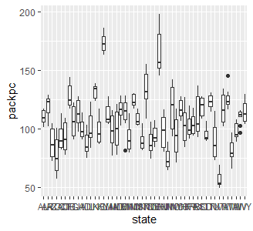
#2a-Boxplot Average of number of packs/Cap/state
ggplot(Cigarette, aes(x=state, y=packpc)) + geom_boxplot()

Slide 7
#2b Highest pack/cap
Cigarette %>% group_by(state) %>% summarise(Mean=mean(packpc)) %>% arrange(desc(Mean))
# A tibble: 48 × 2 state Mean <fct> <dbl> 1 KY 174. 2 NH 166. 3 NC 135. 4 IN 132. 5 DE 128. 6 VT 126. 7 MO 124. 8 TN 124. 9 AR 119. 10 SC 119. # … with 38 more rows

Slide 8
#2c Lowest pack/cap
Cigarette %>% group_by(state) %>% summarise(Mean=mean(packpc)) %>% arrange(Mean)
# A tibble: 48 × 2 state Mean <fct> <dbl> 1 UT 56.8 2 NM 74.4 3 CA 76.7 4 WA 81.0 5 ID 87.5 6 AZ 87.8 7 ND 88.4 8 MT 89.2 9 TX 89.8 10 MN 92.2 # … with 38 more rows

Slide 9
#3a Median over all states for packs/cap
# A tibble: 11 × 2 year Median <int> <dbl> 1 1985 119. 2 1986 116. 3 1987 113. 4 1988 111. 5 1989 108. 6 1990 100. 7 1991 97.9 8 1992 95.1 9 1993 93.2 10 1994 92.8 11 1995 92.8
Cigarette %>% group_by(year) %>% summarise(Median=median(packpc))

Slide 10
#3b Plot Median from 1985-1995...
MedianDF<- Cigarette %>% group_by(year) %>% summarise(Median=median(packpc))

Slide 11
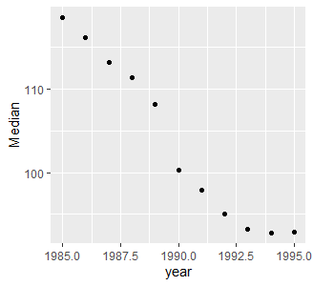
#3b Plot Median from 1985-1995... Contin,
ggplot(MedianDF, aes(x=year, y=Median)) + geom_point()

Slide 12
#3c What can you say about cigarette usage in these years?
#This graph tell us that usage has been in a fairly large decline from 1985 to 1995

Slide 13
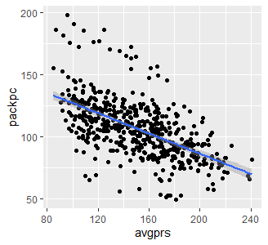
#4 Scatterplot of $/pack v # of Pack/cap for all states and years
ggplot(Cigarette, aes(x=avgprs, y=packpc)) + geom_point() + geom_smooth(method=lm)

Slide 14
#5a Correlation
cor.test(Cigarette$avgprs, Cigarette$packpc, method="pearson", use="complete.obs")
Pearson's product-moment correlation data: Cigarette$avgprs and Cigarette$packpc t = -16.562, df = 526, p-value < 2.2e-16 alternative hypothesis: true correlation is not equal to 0 95 percent confidence interval: -0.6388606 -0.5264104 sample estimates: cor -0.5854443

Slide 15
#5
#5b The price and the per capita packs are negatively correlated.
#5c The answer would be expected because wit the line offered we see that there is a decline and then it was confirmed with
#the correlation coefficiant = < 0 and th p-Value is < 0.05

Slide 16
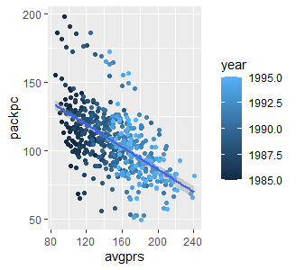
#6a Scatter plot each year in a different color
ggplot(Cigarette, aes(x=avgprs, y=packpc, color=year)) + geom_point() + geom_smooth(method=lm)

Slide 17
#6b Does the relationship between the two variable change over time?
The relationship does change from 1985 to 1995 the avgprs gets higher as the Packs/cap lowers

Slide 18
#7a Linear regression
Call: lm(formula = packpc ~ avgprs, data = Cigarette) Residuals: Min 1Q Median 3Q Max -56.977 -9.710 -0.716 8.550 69.451 Coefficients: Estimate Std. Error t value (Intercept) 167.87737 3.79749 44.21 avgprs -0.40879 0.02468 -16.56 Pr(>|t|) (Intercept) <2e-16 *** avgprs <2e-16 *** --- Signif. codes: 0 ‘***’ 0.001 ‘**’ 0.01 ‘*’ 0.05 ‘.’ 0.1 ‘ ’ 1 Residual standard error: 18.76 on 526 degrees of freedom Multiple R-squared: 0.3427, Adjusted R-squared: 0.3415 F-statistic: 274.3 on 1 and 526 DF, p-value: < 2.2e-16
lin_Reg<- lm(packpc~avgprs, Cigarette)
Print(lin_Reg)
summary(lin_Reg)

Slide 19
#7b How much variability does the line explain?
We know that we have to pay attention to the Adjusted R^2, P-value and the line for the 'avgprs'
The 'avgprs' shows that the 'packpc' will decrease 0.41 units bases every 1 unit of 'avgprs' in cents
We also know that the p-Value < 0.05
The Variability is 34.2% variability when we look at the Adjusted R^2

Slide 20
#8a Adjust for inflation.
We can adjust the price per pack cig for inflation by dividing the avgprs variable by the cpi variable
Cigarette$inflation <- Cigarette$avgprs / Cigarette$cpi

Slide 21
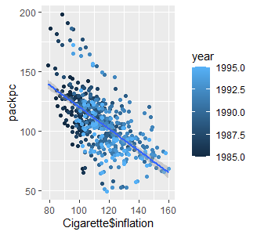
#8b Re-do your scatter plot using adjusted price with Color
ggplot(Cigarette, aes(x=Cigarette$inflation, y=packpc, color=year)) + geom_point() + geom_smooth(method=lm)

Slide 22
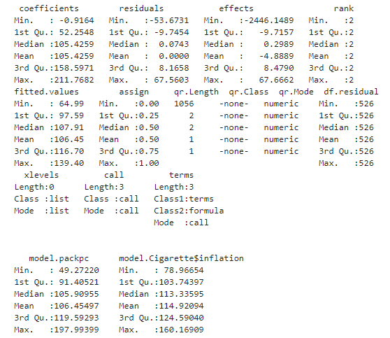
#8c linear regression using adjusted price
lin_Regadj<- lm(packpc~Cigarette$inflation, Cigarette)
summary.data.frame(lin_Regadj)

Slide 23
9 Create a data frame
#9a Create a data frame with just the rows from 1985
#9b Create a data frame with just the rows from 1995
Num_ppc85 <-Cigarette %>% filter(year==1985)
Num_ppc85subset <- Num_ppc85[1:48,]
Num_ppc95 <-Cigarette %>% filter(year==1995)
Num_ppc95subset <- Num_ppc95[1:48,]
#both have 48 obs, and 10 variables

Slide 24
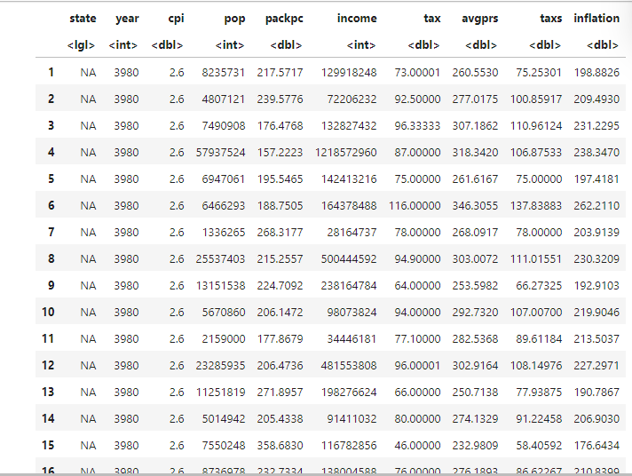
#9c Get a vector of the number of packs per capita
Num_ppc85 + Num_ppc95

Slide 25
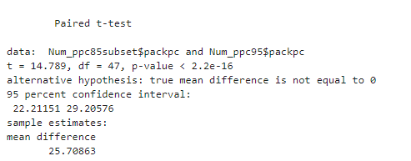
#9d paired t-test to see if the number of packs per capita(ppc) in 1995 was significantly different than the number of packs per capita in 1985 We see that the P-value is less than 0.05, which means that the ppc in 1995 are significantly diffrent from that of 1985
t.test(Num_ppc85subset$packpc, Num_ppc95$packpc, paired = TRUE)

Slide 26

Thank you!

