Slide 1
Overall Workflow

Slide 2


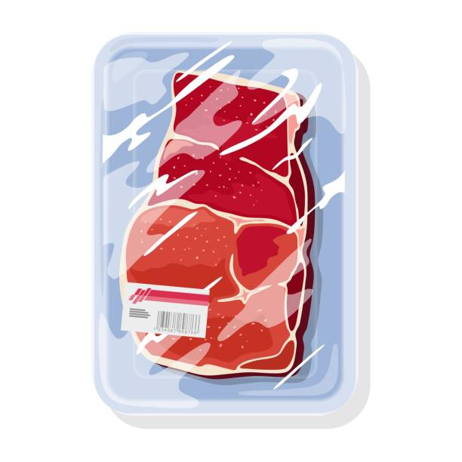







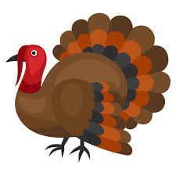













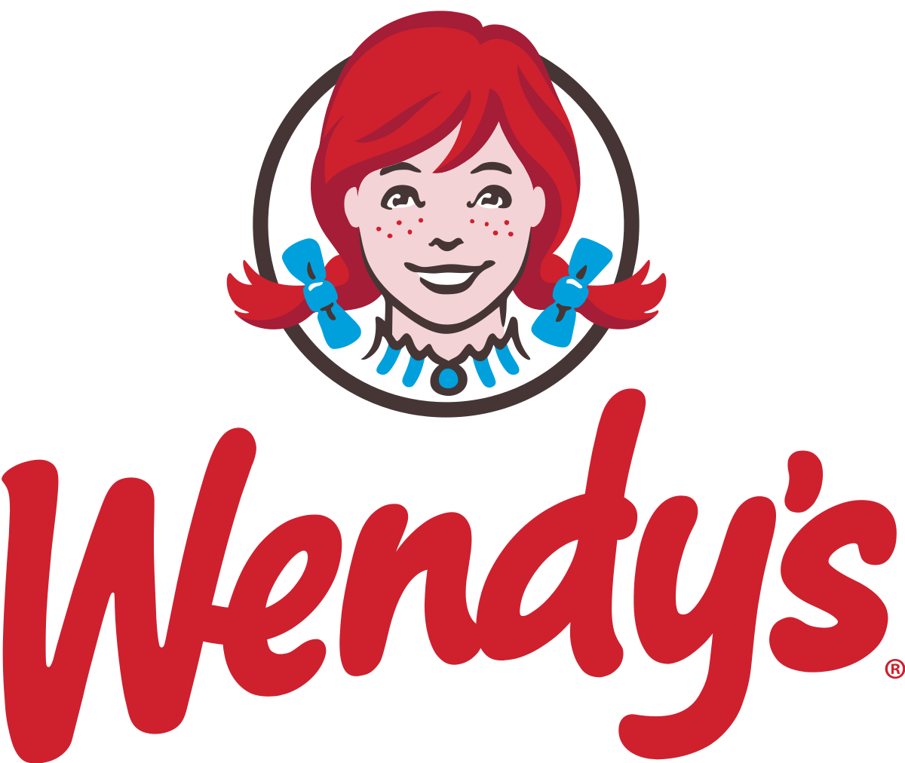



Meat Industry
Social Influence
hogs, cattle
Fruit
Cold Storage Supply
Veg
Unhealthy Eating
Slaughter Factory
Food Retail & Restaurant
2
poultry
age
Meat Production
edu
1.1
1.2
people
Obesity
inc
Financial Market
age
edu
……
……
……
……
Manufacturing
Technology
Trade & Services
Indexes
Unemployment
inc
---: impact direction, ——: meat production pipeline

Slide 3
Meat Industry
Social Influence
Cold Storage Supply
age level
hogs, cattle
Slaughter Factory
Food Retail & Restaurant
2
Unhealthy Eating
education level
poultry
Meat Production
income level
1.1
1.2
Obesity
Financial Market
people
Manufacturing
Manufacturing
Manufacturing
Manufacturing
Unemployment
---: impact direction, ——: meat production pipeline

