Slide 1
Marks Distribution
Quizzes | 15
Assignments | 10
Midterm | 25s
Final | 50
Total | 100

Slide 2








Intelligence
Are the things shown below, Intelligent?

Slide 3
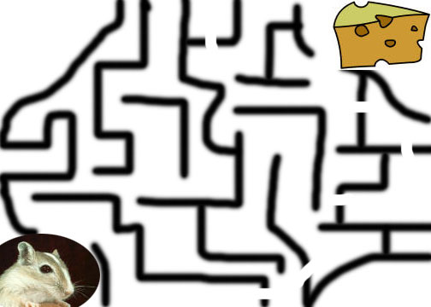
Ex-1: Searching a path …
Different mice might follow different paths based to their intelligence
In other words: The problem can be solved in many ways
Ability to solve problems demonstrates Intelligence

Slide 4
Ex-2: Next number in the sequence …
Consider the following sequence …
1,3,7,13,21,__
  What is the next number ?
Key: Adding the next EVEN number …
1+2 = 3; 3+4 = 7; 7+6 = 13; 13+8 =21; 21+10 = 31
1,3,7,13,21,31
Ability to solve problems demonstrates Intelligence

Slide 5
So, Let’s Summarize…
Ability to solve problems
Ability to plan and schedule
Ability to memorize and process information
Ability to answer fuzzy questions
Ability to learn
Ability to recognize
Ability to understand
Ability to perceive
And many more …
Food for thought: Can only humans beings and animals possess these qualities?

Slide 6
What if?
A machine searches through a mesh and finds a path?
A machine solves problems like the next number in the sequence?
A machine develops plans?
A machine diagnoses and prescribes?
A machine answers ambiguous questions?
A machine recognizes fingerprints?
A machine understands?
A machine perceives?
A machine does MANY MORE SUCH THINGS …
A machine behaves as HUMANS do? HUMANOID!!!

