Slide 1
Best First Search

Slide 2
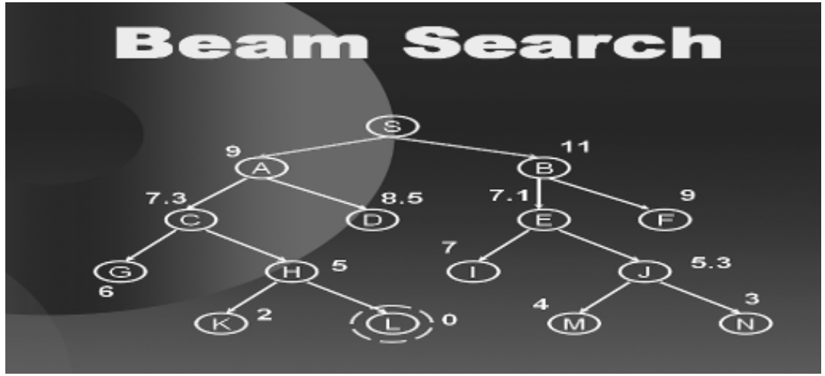

Slide 3
Branch and Bound
Basic Observation
S
The length of complete path
from S to G, S-D-E-F-G is 9
Similarly the length of the
partial path S-D-A-B also is
9 and any additional
movement along a branch
will make it longer than 9
D
A
E
B
F
9
G
9
Notes:
Accordingly there is no need to pursue path SDAB any further because any complete path starting with SDAB has to be longer than a complete path already known. Only the other path emerging from S and from SDE has to be considered as they may provide a shortest path.

Slide 4
Branch and Bound
A
3
3
2
B
C
4
4
G
S
2
S
3
D
E
F
1
3
2
A
D
3
5
B
D
6
7
A
E
4
7
10
8
7
8
C
E
9
E
B
B
F
10
12
11
10
11
11
9
D
F
B
F
C
E
A
C
G
G
C
G
F
G

Slide 5
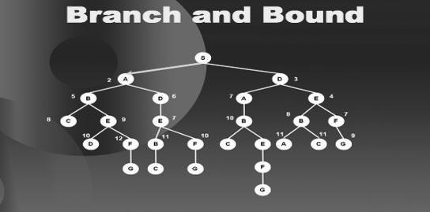
From S the options to travel are B and D, the children of A and D the child of S.
Among these, D the child of S is the best option. So we explore D.

Slide 6
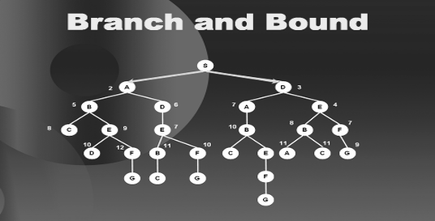
From here the best option is E so we go there,

Slide 7
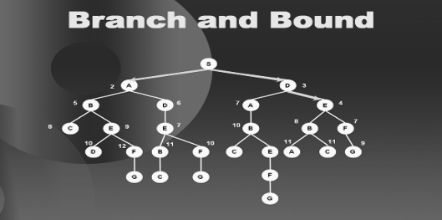
then B,

Slide 8
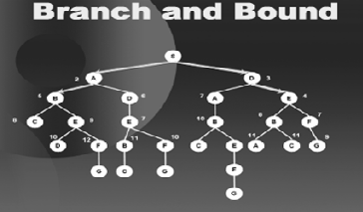
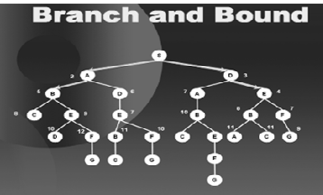
then D

Slide 9
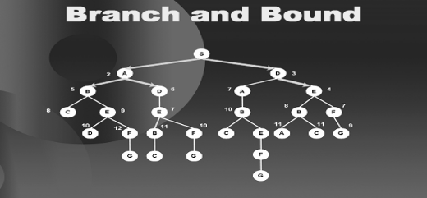
Here we have E, F and A as equally good options so we select arbitrarily and
move to say A,

Slide 10
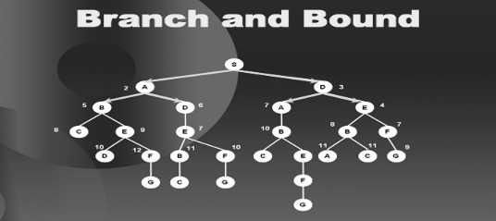
then E.

Slide 11
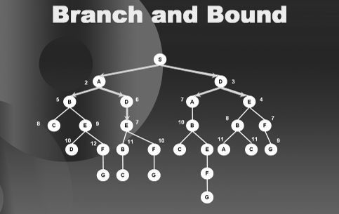
we explore E we find out that if we follow this path further, our path length
will increase beyond 9 which is the distance of S to G. we block all the
further sub-trees along this paths.

Slide 12
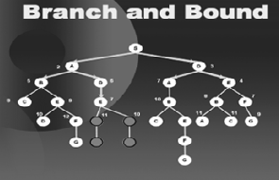
Then move to F as that is the best option at this point with a value 7.

Slide 13
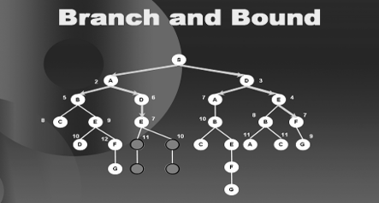
then C,

Slide 14
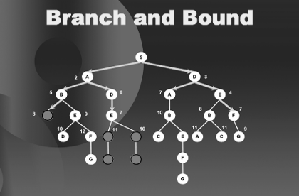
C is a leaf node so we bind C too as in diagram we move to B on the right hand side of the tree and bind the sub trees ahead of B as they also exceed the path length 9.

Slide 15
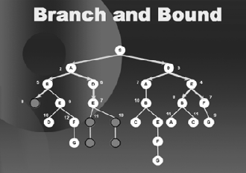

Slide 16
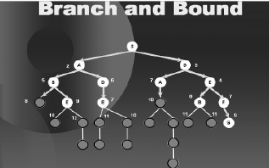
We go on proceeding in this fashion, binding the paths that exceed 9 and hence
we are saved from traversing a considerable portion of the tree. The subsequent
diagrams complete the search until it has found all the optimal solution, that is
along the right hand branch of the tree

Slide 17
Branch and Bound
The basic idea was to reduce the search space by binding the paths that exceed the path length from S to G.
We will discuss the two most famous ways to improve it.
1. Estimates
2. Dynamic Programming

Slide 18
A* Procedure
2
A
3
3
2
B
C
5
3
8
4
4
S
G
0
0+8 = 8
1
S
3
D
E
F
2
1
3
6
5
2+2 = 4
A
D
3+6 = 9
7+2 = 9
5+3 = 8
B
D
6+6 = 12
A
E
4+5 = 9
7+1=8
8+5 = 13
C
E
9+5 = 14
E
10+3 = 13
B
8+3 = 11
B
F
D
F
B
F
C
E
A
C
G
9+0 = 9
G
C
G
F
G

Slide 19
Search and Game Playing
We will focus on Board Games
We will represent the game as a tree
The node is a game tree represent board configuration, and the branches indicate how moves can connect them.
Original Board
A
Situation
New Board Situation
B
C
New Board Situation
F
G
D
E

Slide 20
The Minimax Procedure
3
Maximizing Level
A
3
2
B
C
Minimizing Level
Maximizing Level
D
E
F
G
3
6
2
7

Slide 21
Alpha Beta Pruning
=3
>=3
A
Maximizing Level
=3
B
=<2
C
Minimizing Level
Maximizing Level
3
6
2

Slide 22
Alpha Beta Pruning
50
50
Maximizing Level
50
30
20
Minimizing Level
70
30
20
50
Maximizing Level
50
40
70
10
60
30
80
90
20
90
70
60
Notes:
Winston Page 107 to 109

