Slide 1
Lecture 17

Slide 2
Recap
Reasoning
Types of reasoning:
  Deductive
  Inductive
  Adbuctive
  Analogical
  common-sense
  non-monotonic reasoning
Logic: syntax, semantics, Proof systems
Rules of inference: Modus ponens, Modus tolens, And-introduction, And-elimination
Inference example

Slide 3
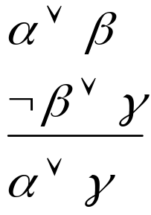
Resolution
The deduction mechanism we discussed may be used in practical systems, but is not feasible. It uses a lot of inference rules, which introduces a large branch factor in the search for a proof.
An alternative is Resolution, a strategy used to assert the determine the truth of an assertion.
Only one Resolution rule:
Notes:
We have talked a little bit about proof, with the idea that you write down some axioms -- statements that you're given -- and then you try to derive something from them. And we've all had practice doing that in high school geometry and we've talked a little bit about natural deduction. So what we're going to talk about now is resolution. Which is the way that pretty much every modern automated theoremprover is implemented. It seems to be the best way for computers to think about proving things. So here's the Resolution Inference Rule, in the propositional case. It says that if you know "alpha or beta", and you know "not beta or gamma", then you're allowed toconclude "alpha or gamma". OK.
Remember from when we looked at inference rules before that these Greek letters are meta-variables. They can stand for big chunks of propositional logic, as long as the parts match up in the right way. So if you know something of the form "alpha or beta", and you also know that "not beta or gamma", then you can conclude "alpha or gamma".
First, you convert all of your sentences to conjunctive normal form. You already know how to do this! Then, you write each clause down as a premise or given in you proof.
Then, you negate the desired conclusion -- so you have to say what you're trying to prove, but what we're going to do is essentially a proof by contradiction. You've all seen the strategy of proof by contradiction (or, if we're being fancy and Latin, reductio ad absurdum). You assert that the thing that you're trying to prove is false, and then you try to derive a contradiction. That's what we're going to do. So you negate the desired conclusion and convert that to CNF. And you add each of these clauses as a premise of your proof, as well.
And then we apply the Resolution Rule until either we derive "false" -- which means that the conclusion did, in fact, follow from the things that we had assumed. If you assert that the negation of the thing that you're interested in is true, and then you prove for a while and you manage to prove false, then you've succeeded in a proof by
contradiction of the thing that you were trying to prove in the first place. So you run the resolution rule until you derive false or until you can't apply it anymore.
What if you can't apply the Resolution Rule anymore? Is there anything in particular that you can conclude? In fact, you can conclude that the thing that you were trying to prove can't be proved. So resolution refutation for propositional logic is a complete proof procedure. If the thing that you're trying to prove is, in fact, entailed by the
things that you've assumed, then you can prove it using resolution refutation. It's guaranteed that you'll always either prove false, or run out of possible steps. It's complete, because it always generates an answer. Furthermore, the process is sound: the answer is always correct.

Slide 4







Resolution Rule
F | F | F | T | F | T | F
F | F | T | T | F | T | T
F | T | F | F | T | F | F
F | T | T | F | T | T | T
T | F | F | T | T | T | T
T | F | T | T | T | T | T
T | T | F | F | T | F | T
T | T | T | F | T | T | T

Slide 5
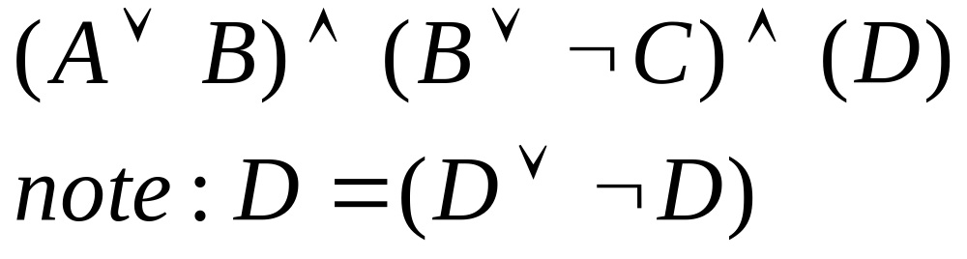
Conjunctive Normal Form
ANDs of ORs
Resolution requires all sentences to be converted into a special form called Conjunctive Normal Form (CNF)
A sentence written in CNF looks like
Outermost structure is made up of conjunctions. Inner units called clauses are made up of disjunctions
Notes:
A clause is the disjunction of many things. The units that make up a clause are called literals. And a literal is either a variable or the negation of a variable. So you get an expression where the negations are pushed in as tightly as possible, then you have ors, then you have ands. This is like saying that every assignment has to meet each of a set of requirements. You can think of each clause as a requirement. So somehow, the first clause has to be satisfied, and it has different ways that it can be satisfied, and the second one has to be satisfied, and the third one has to be satisfied, and so on.

Slide 6

Conjunctive Normal Form
Clause
  A clause is the disjunction of many things.
Literals
  The units that make up a clause are called literals. And a literal is either a variable or the negation of a variable. So you get an expression where the negations are pushed in as tightly as possible, then you have ors, then you have ands.
You can think of each clause as a requirement. Each clause has to be satisfied to satisfy the entire statement
Notes:
A clause is the disjunction of many things. The units that make up a clause are called literals. And a literal is either a variable or the negation of a variable. So you get an expression where the negations are pushed in as tightly as possible, then you have ors, then you have ands. This is like saying that every assignment has to meet each of a set of requirements. You can think of each clause as a requirement. So somehow, the first clause has to be satisfied, and it has different ways that it can be satisfied, and the second one has to be satisfied, and the third one has to be satisfied, and so on.

Slide 7
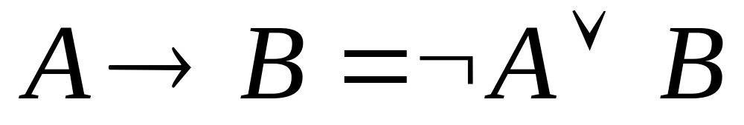
Convert to CNF
Eliminate arrows (implications)

Slide 8
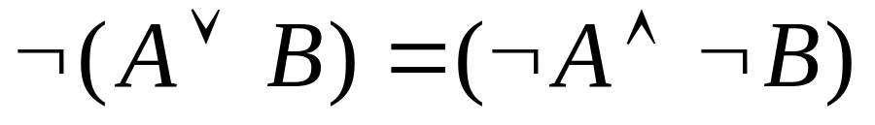
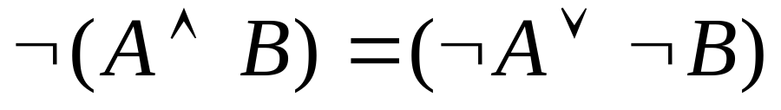
Convert to CNF
Drive in negations using De Morgan’s Laws

Slide 9
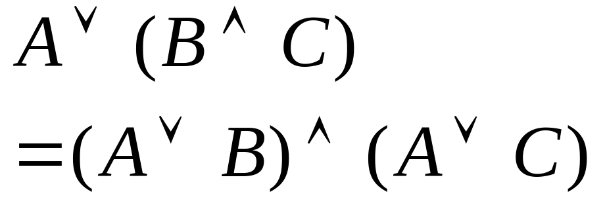
Convert to CNF
Distribute OR over AND

Slide 10
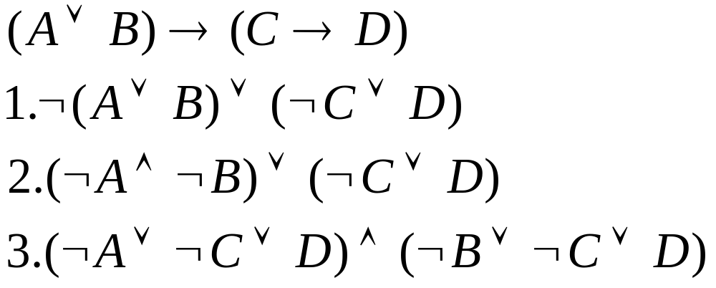
Convert to CNF Example

Slide 11
Resolution by Refutation
Proof strategy called Resolution Refutation
  Write all sentences in CNF
  Negate the desired conclusion
  Apply the resolution rule until you derive a contradiction or cannot apply the rule anymore.
If we derive a contradiction, then the conclusion follows from the given axioms
If we cannot apply anymore, then the conclusion cannot be proved from the given axioms
Notes:
We have talked a little bit about proof, with the idea that you write down some axioms -- statements that you're given -- and then you try to derive something from them. And we've all had practice doing that in high school geometry and we've talked a little bit about natural deduction. So what we're going to talk about now is resolution. Which is the way that pretty much every modern automated theoremprover is implemented. It seems to be the best way for computers to think about proving things. So here's the Resolution Inference Rule, in the propositional case. It says that if you know "alpha or beta", and you know "not beta or gamma", then you're allowed toconclude "alpha or gamma". OK.
Remember from when we looked at inference rules before that these Greek letters are meta-variables. They can stand for big chunks of propositional logic, as long as the parts match up in the right way. So if you know something of the form "alpha or beta", and you also know that "not beta or gamma", then you can conclude "alpha or gamma".
First, you convert all of your sentences to conjunctive normal form. You already know how to do this! Then, you write each clause down as a premise or given in you proof.
Then, you negate the desired conclusion -- so you have to say what you're trying to prove, but what we're going to do is essentially a proof by contradiction. You've all seen the strategy of proof by contradiction (or, if we're being fancy and Latin, reductio ad absurdum). You assert that the thing that you're trying to prove is false, and then you try to derive a contradiction. That's what we're going to do. So you negate the desired conclusion and convert that to CNF. And you add each of these clauses as a premise of your proof, as well.
And then we apply the Resolution Rule until either we derive "false" -- which means that the conclusion did, in fact, follow from the things that we had assumed. If you assert that the negation of the thing that you're interested in is true, and then you prove for a while and you manage to prove false, then you've succeeded in a proof by
contradiction of the thing that you were trying to prove in the first place. So you run the resolution rule until you derive false or until you can't apply it anymore.
What if you can't apply the Resolution Rule anymore? Is there anything in particular that you can conclude? In fact, you can conclude that the thing that you were trying to prove can't be proved. So resolution refutation for propositional logic is a complete proof procedure. If the thing that you're trying to prove is, in fact, entailed by the
things that you've assumed, then you can prove it using resolution refutation. It's guaranteed that you'll always either prove false, or run out of possible steps. It's complete, because it always generates an answer. Furthermore, the process is sound: the answer is always correct.

Slide 12
Resolution by Refutation
Step | Formula | Derivation
1 | P ∨ Q | Given
2 | ¬P ∨ R | Given
3 | ¬Q ∨ R | Given
Prove R
1 | P ∨ Q
2 | P→R
3 | Q →R

Slide 13
Resolution Example
Step | Formula | Derivation
1 | P ∨ Q | Given
2 | ¬P ∨ R | Given
3 | ¬Q ∨ R | Given
4 | ¬R | Negated Conclusion
Prove R
1 | P ∨ Q
2 | P→R
3 | Q →R

Slide 14
Resolution Example
Step | Formula | Derivation
1 | P ∨ Q | Given
2 | ¬P ∨ R | Given
3 | ¬Q ∨ R | Given
4 | ¬R | Negated Conclusion
5 | Q ∨ R | 1,2 Resolution Rule
Prove R
1 | P ∨ Q
2 | P→R
3 | Q →R

Slide 15
Resolution Example
Step | Formula | Derivation
1 | P ∨ Q | Given
2 | ¬P ∨ R | Given
3 | ¬Q ∨ R | Given
4 | ¬R | Negated Conclusion
5 | Q ∨ R | 1,2
6 | ¬P | 2,4
Prove R
1 | P ∨ Q
2 | P→R
3 | Q →R

Slide 16
Resolution Example
Step | Formula | Derivation
1 | P ∨ Q | Given
2 | ¬P ∨ R | Given
3 | ¬Q ∨ R | Given
4 | ¬R | Negated Conclusion
5 | Q ∨ R | 1,2
6 | ¬P | 2,4
7 | ¬Q | 3,4
Prove R
1 | P ∨ Q
2 | P→R
3 | Q →R

Slide 17
Resolution Example
Step | Formula | Derivation
1 | P ∨ Q | Given
2 | ¬P ∨ R | Given
3 | ¬Q ∨ R | Given
4 | ¬R | Negated Conclusion
5 | Q ∨ R | 1,2
6 | ¬P | 2,4
7 | ¬Q | 3,4
8 | R | 5,7 Contradiction!
Prove R
1 | P ∨ Q
2 | P→R
3 | Q →R
Notes:
Note that you could have come up with multiple ways to reaching this same conclusion

Slide 18
Resolution Example
Note that you could have come up with multiple ways of proving R
Step | Formula
1 | P ∨ Q | Given
2 | ¬P ∨ R | Given
3 | ¬Q ∨ R | Given
4 | ¬R
5 | ¬Q | 3,4
6 | P | 1,5
7 | R | 2,6
Step | Formula
1 | P ∨ Q | Given
2 | ¬P ∨ R | Given
3 | ¬Q ∨ R | Given
4 | ¬R
5 | Q ∨ R | 1,2
6 | ¬P | 2,4
7 | ¬Q | 3,4
8 | R | 5,7

Slide 19
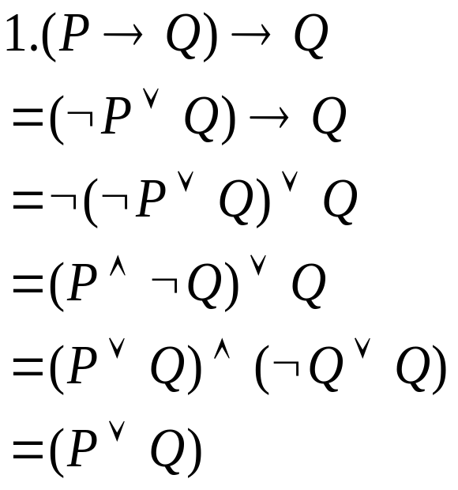


Resolution Example 2
1. (P→Q) →Q
2. P→R
3. ¬R → ¬Q
Convert to CNF:

Slide 20
Resolution Example 2
Step | Formula | Derivation
1 | Q ∨ P | Given
2 | ¬ P ∨ R | Given
3 | R ∨ ¬Q | Given
4 | ¬R
5 | P | 2,4
6 | R | 2,5
Step | Formula | Derivation
1 | Q ∨ P | Given
2 | ¬ P ∨ R | Given
3 | R ∨ ¬Q | Given
4 | ¬R
5 | ¬Q | 3,4
6 | P | 1,5
7 | R | 2,6

Slide 21
Proof Strategies
We may apply rules in an arbitrary order, but there are some rules of thumb
  Unit preference: prefer using a clause with one literal. Produces shorter clauses
  Set of support: try to involve the thing you are trying to prove. Chose a resolution involving the negated goal. These are relevant clauses. We move ‘towards solution’

Slide 22
Lecture Summary
Reasoning
Types of reasoning: Deductive, Inductive, Adbuctive, Analogical, common-sense, non-monotonic reasoning
Logic: syntax, semantics, Proof systems
Rules of inference: Modus ponens, Modus tolens, And-introduction, And-elimination
Inference example
Resolution Refutation
  Convert to CNF
    Remove arrows
    Drive in Negations (De Morgans)
    Distribute Or over And
  Add negation of Goal
  Repeatedly apply resolution rule

