Slide 1
Environment

Slide 2
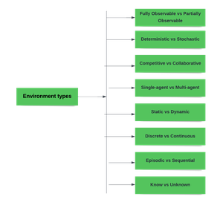
Environment

Slide 3
Fully Observable vs Partially Observable
When an agent sensor is capable to sense or access the complete state of an agent at each point in time, it is said to be a fully observable environment else it is partially observable.
Maintaining a fully observable environment is easy as there is no need to keep track of the history of the surrounding.
An environment is called unobservable when the agent has no sensors in all environments.
Examples:
Chess – the board is fully observable, and so are the opponent’s moves.
Driving – the environment is partially observable because what’s around the corner is not known.

Slide 4
Deterministic vs Stochastic
When a uniqueness in the agent’s current state completely determines the next state of the agent, the environment is said to be deterministic.
The stochastic environment is random in nature which is not unique and cannot be completely determined by the agent.
Examples:
Chess – there would be only a few possible moves for a coin at the current state and these moves can be determined.
Self-Driving Cars- the actions of a self-driving car are not unique, it varies time to time.

Slide 5
Competitive vs Collaborative
An agent is said to be in a competitive environment when it competes against another agent to optimize the output.
The game of chess is competitive as the agents compete with each other to win the game which is the output.
An agent is said to be in a collaborative environment when multiple agents cooperate to produce the desired output.
When multiple self-driving cars are found on the roads, they cooperate with each other to avoid collisions and reach their destination which is the output desired.

Slide 6
Single-agent vs Multi-agent
An environment consisting of only one agent is said to be a single-agent environment.
A person left alone in a maze is an example of the single-agent system.
An environment involving more than one agent is a multi-agent environment.
The game of football is multi-agent as it involves 11 players in each team.

Slide 7
Dynamic vs Static
An environment that keeps constantly changing itself when the agent is up with some action is said to be dynamic.
A roller coaster ride is dynamic as it is set in motion and the environment keeps changing every instant.
An idle environment with no change in its state is called a static environment.
An empty house is static as there’s no change in the surroundings when an agent enters.

Slide 8
Discrete vs Continuous
If an environment consists of a finite number of actions that can be deliberated in the environment to obtain the output, it is said to be a discrete environment.
The game of chess is discrete as it has only a finite number of moves. The number of moves might vary with every game, but still, it’s finite.
The environment in which the actions are performed cannot be numbered i.e. is not discrete, is said to be continuous.
Self-driving cars are an example of continuous environments as their actions are driving, parking, etc. which cannot be numbered.

Slide 9
Episodic vs Sequential
In an Episodic task environment, each of the agent’s actions is divided into atomic incidents or episodes. There is no dependency between current and previous incidents. In each incident, an agent receives input from the environment and then performs the corresponding action.
Example: Consider an example of Pick and Place robot, which is used to detect defective parts from the conveyor belts. Here, every time robot(agent) will make the decision on the current part i.e. there is no dependency between current and previous decisions.
In a Sequential environment, the previous decisions can affect all future decisions. The next action of the agent depends on what action he has taken previously and what action he is supposed to take in the future.
Example:
Checkers- Where the previous move can affect all the following moves.

Slide 10
Known vs Unknown
In a known environment, the output for all probable actions is given. Obviously, in case of unknown environment, for an agent to make a decision, it has to gain knowledge about how the environment works.

Slide 11
Agents
Agents can be grouped into five classes based on their degree of perceived intelligence and capability. All these agents can improve their performance and generate better action over the time. These are given below:

Slide 12
Agents
Simple Reflex Agent
Model-based reflex agent
Goal-based agents
Utility-based agent
Learning agent

Slide 13
Simple Reflex agent:
The Simple reflex agents are the simplest agents. These agents take decisions on the basis of the current percepts and ignore the rest of the percept history.
These agents only succeed in the fully observable environment.
The Simple reflex agent does not consider any part of percepts history during their decision and action process.
The Simple reflex agent works on Condition-action rule, which means it maps the current state to action. Such as a Room Cleaner agent, it works only if there is dirt in the room.
Problems for the simple reflex agent design approach:
They have very limited intelligence
They do not have knowledge of non-perceptual parts of the current state
Mostly too big to generate and to store.
Not adaptive to changes in the environment.

Slide 14
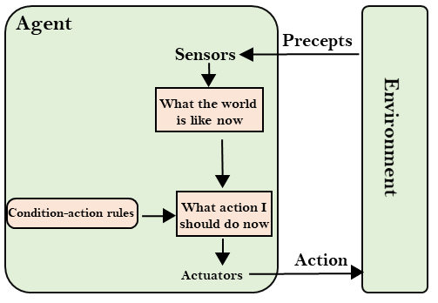
Simple Reflex Agent

Slide 15
Model-based reflex agent
The Model-based agent can work in a partially observable environment, and track the situation.
A model-based agent has two important factors:
Model: It is knowledge about "how things happen in the world," so it is called a Model-based agent.
Internal State: It is a representation of the current state based on percept history.
These agents have the model, "which is knowledge of the world" and based on the model they perform actions.
Updating the agent state requires information about:
How the world evolves
How the agent's action affects the world.

Slide 16
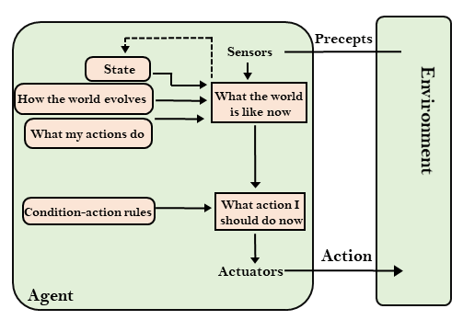

Slide 17
Goal-based agents
The knowledge of the current state environment is not always sufficient to decide for an agent to what to do.
The agent needs to know its goal which describes desirable situations.
Goal-based agents expand the capabilities of the model-based agent by having the "goal" information.
They choose an action, so that they can achieve the goal.
These agents may have to consider a long sequence of possible actions before deciding whether the goal is achieved or not. Such considerations of different scenario are called searching and planning, which makes an agent proactive.

Slide 18
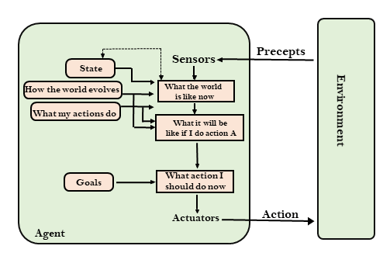
Goal Based Agent

Slide 19
Utility-based agents
These agents are similar to the goal-based agent but provide an extra component of utility measurement which makes them different by providing a measure of success at a given state.
Utility-based agent act based not only goals but also the best way to achieve the goal.
The Utility-based agent is useful when there are multiple possible alternatives, and an agent has to choose in order to perform the best action.
The utility function maps each state to a real number to check how efficiently each action achieves the goals.

Slide 20
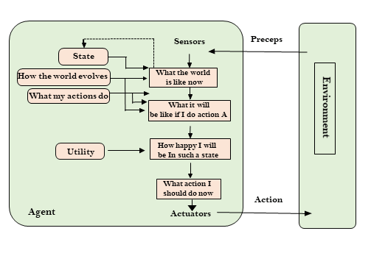
Utility Based Agent

Slide 21
Learning Agents
A learning agent in AI is the type of agent which can learn from its past experiences, or it has learning capabilities.
It starts to act with basic knowledge and then able to act and adapt automatically through learning.
A learning agent has mainly four conceptual components, which are:
Learning element: It is responsible for making improvements by learning from environment
Critic: Learning element takes feedback from critic which describes that how well the agent is doing with respect to a fixed performance standard.
Performance element: It is responsible for selecting external action
Problem generator: This component is responsible for suggesting actions that will lead to new and informative experiences.
Hence, learning agents are able to learn, analyze performance, and look for new ways to improve the performance.

Slide 22
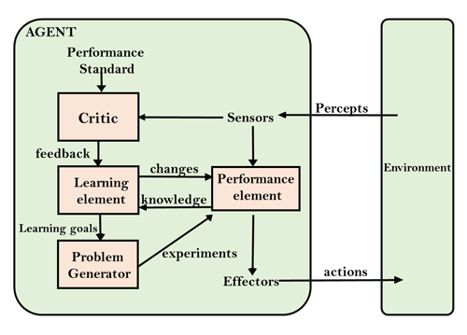
Learning Agent

