Slide 1
Monte Carlo Tree Search

Slide 2
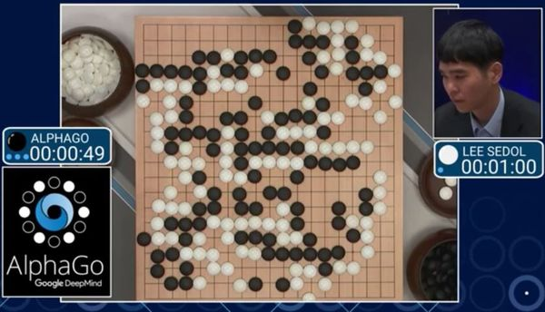
Monte Carlo Tree Search

Slide 3
Start
One of the most popular board game AI milestones was reached in 2016 in the game of Go. Lee Sedol, a 9-dan professional Go player, lost a five-game match against Google DeepMind’s AlphaGo software which featured a deep reinforcement learning approach
Notable recent milestones in video game AI include algorithms developed by Google DeepMind to play several games from the classic Atari 2600 video game console at a super-human skill level

Slide 4
Components of the AlphaGo
The core parts of the Alpha Go comprise of:
Monte Carlo Tree Search: AI chooses its next move using MCTS
Residual CNNs (Convolutional Neural Networks): AI assesses new positions using these networks
Reinforcement learning: Trains the AI by using the current best agent to play against itself

Slide 5
The Game Tree Concept
Game Trees are the most well known data structures that can represent a game. This concept is actually pretty straightforward.
Each node of a game tree represents a particular state in a game. On performing a move, one makes a transition from a node to its children. The nomenclature is very similar to decision trees wherein the terminal nodes are called leaf nodes.

Slide 6
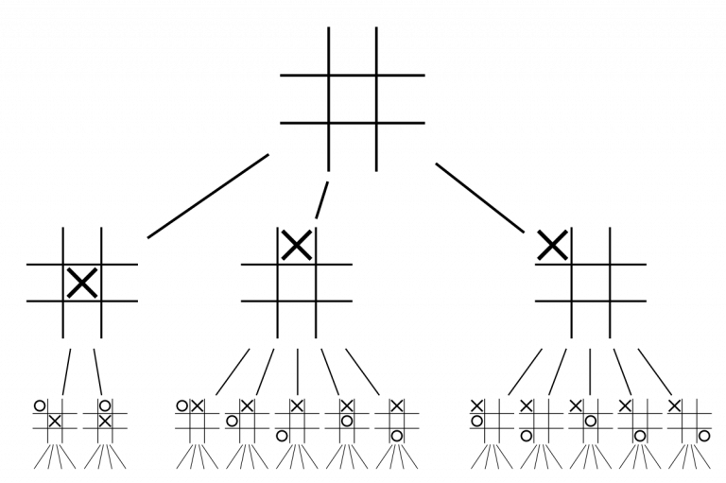
Game Tree Concept

Slide 7
Monte Carlo Tree Search
The basic MCTS algorithm is simple:
A search tree is built.
Node-by-node,
According to the outcomes of simulated playouts.
The process can be broken down into the following steps:

Slide 8
Steps
Selection Selecting good child nodes, starting from the root node R, that represent states leading to better overall outcome (win).
Expansion If L is a not a terminal node (i.e. it does not end the game), then create one or more child nodes and select one (C).
Simulation (rollout) Run a simulated playout from C until a result is achieved.
Backpropagation Update the current move sequence with the simulation result.

Slide 9
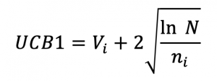
Tree Traversal & Node Expansion
Before we delve deeper and understand tree traversal and node expansion, let’s get familiar with a few terms.
UCB Value
UCB1, or upper confidence bound for a node, is given by the following formula:

Slide 10
UCB
Where
Vi is the average reward/value of all nodes beneath this node
N is the number of times the parent node has been visited, and
ni is the number of times the child node i has been visited

Slide 11
Roll Out
Until we reach the leaf node, we randomly choose an action at each step and simulate this action to receive an average reward when the game is over.

Slide 12
Monte Carlo Tree Search
Monte Carlo Tree Search (MCTS) is a powerful algorithm used for making decisions in scenarios with uncertainty, like games. It's especially popular in games like Go, Chess, and other strategic games. Here's a simplified step-by-step explanation of how MCTS works:
Initialization**:
- Begin with a root node representing the current state of the game. This node has information about the current game state, like the board configuration.

Slide 13
Selection**:
- Start from the root node and navigate down the tree to select a child node. You do this by choosing nodes with a good balance between exploration and exploitation. Essentially, you're trying to balance between trying out new options and sticking with known good options.
Expansion**:
- If the selected node has unexplored moves (i.e., it's not a terminal state), expand it by creating one or more child nodes. These represent the possible moves from the current state.

Slide 14
Simulation**:
- Once you've reached a node that either has no children (terminal state) or you've expanded it, perform a simulation from that state. This is where the "Monte Carlo" part comes in. You play out the game from that state using random moves (or sometimes with some heuristic) until the end of the game.

Slide 15
Backpropagation**:
After the simulation, you evaluate the outcome of the game. If you win, you update the values of the nodes you visited in the selection step to indicate that these moves were good. If you lose, you do the same, but in the opposite direction. This step is crucial for learning which moves are better.

Slide 16
The Upper Confidence Bound (UCB) is a key element of the Monte Carlo Tree Search (MCTS) algorithm. It helps in balancing the exploration and exploitation of nodes during the search process. Let's break down UCB with an actual example.

Slide 17
Imagine we're using MCTS to play a simple game with three possible moves. We have a tree with a root node and three child nodes representing these moves.
Node A: Visited 10 times, with an average reward of 0.7
Node B: Visited 5 times, with an average reward of 0.8
Node C: Visited 8 times, with an average reward of 0.6

Slide 18
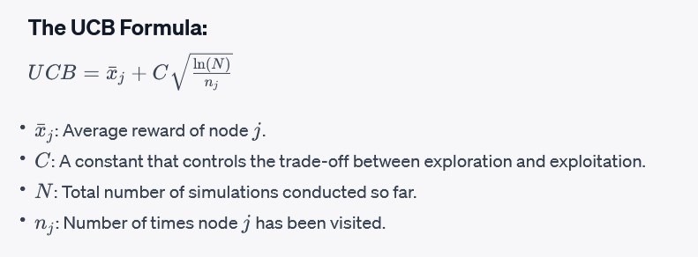
The UCB Formula:

Slide 19
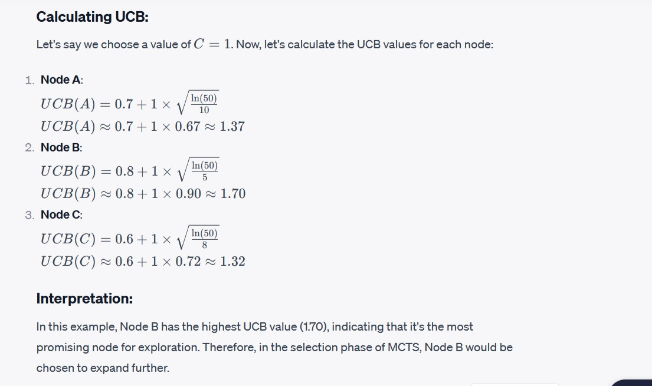

Slide 20
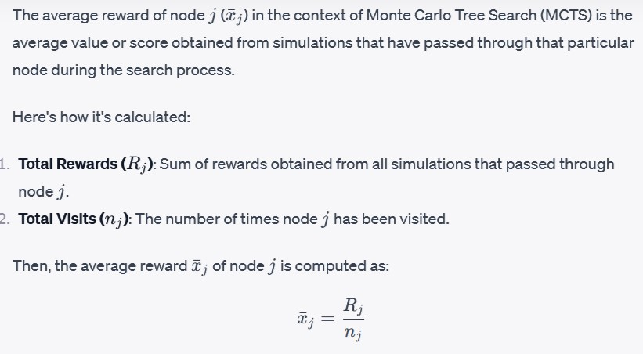

Slide 21
In the context of Monte Carlo Tree Search (MCTS), C refers to a constant that is used in the Upper Confidence Bound (UCB) formula.
The UCB formula is a key component of MCTS and is employed to balance exploration and exploitation during the selection phase of the algorithm.

Slide 22
A higher value of C encourages more exploration, meaning the algorithm will favor nodes that have been visited fewer times. Conversely, a lower value of CC places more emphasis on exploiting nodes with higher average rewards.
Choosing an appropriate value for C is crucial for the performance of the MCTS algorithm. It can have a significant impact on the behavior and effectiveness of the search process, and it may require tuning based on the specific problem and domain being addressed.

Slide 23
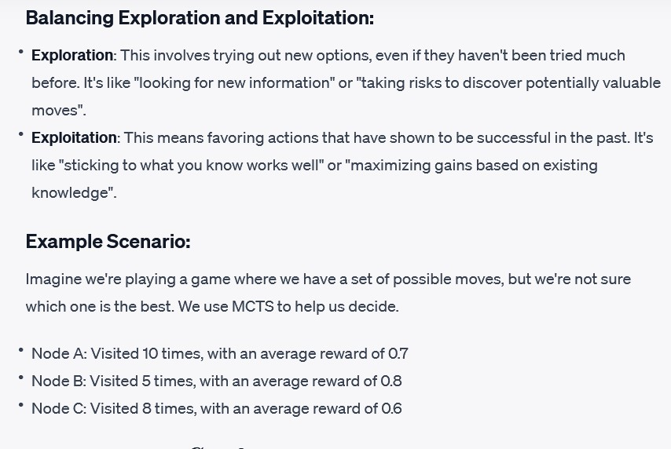

Slide 24
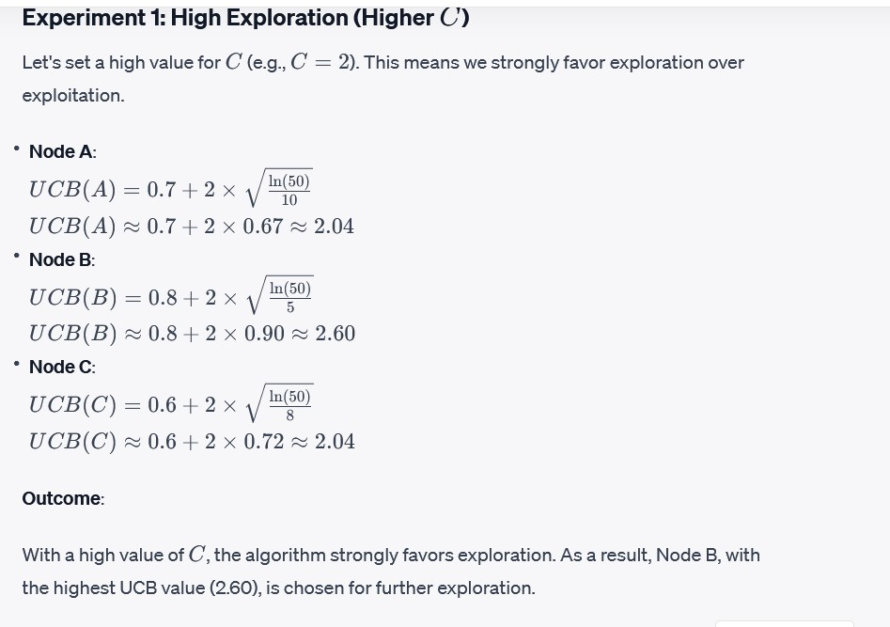

Slide 25
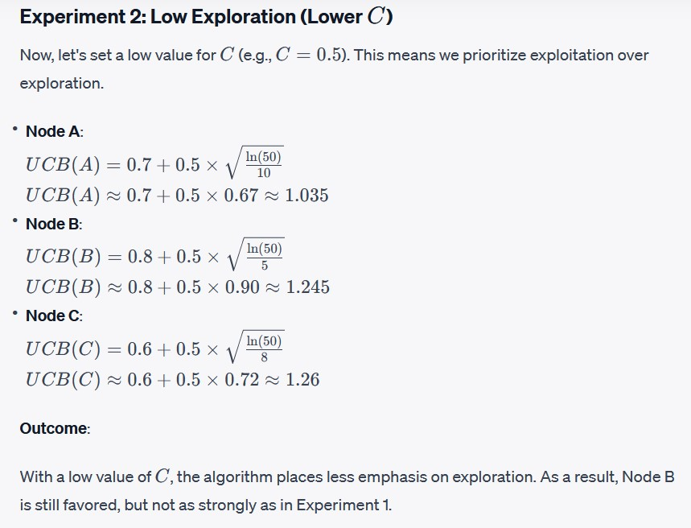

Slide 26
The choice of C significantly influences the behavior of MCTS. A higher C encourages more exploration, which can be useful for initially discovering promising nodes. A lower C places more emphasis on exploiting nodes with higher average rewards.
The optimal value of C depends on the specific problem and domain. It may require tuning based on factors such as the complexity of the game, the level of uncertainty, and the desired balance between exploration and exploitation.

Slide 27
Simulation (Rollout):
Let's consider a simple game where you roll a fair six-sided die. The goal is to reach a target number, say 20, by adding up the rolls. If you go over 20, you lose.
Now, we update the statistics of the nodes we visited in this iteration. We increment the visit count for each node and update the win/loss score. In this case, we increment the visit count for all nodes and mark them as losses.

Slide 28
As we repeat this process, the algorithm accumulates statistics about the various sequences of rolls and their outcomes. Over time, the algorithm will learn which sequences tend to lead to successful outcomes.

Slide 29
Let's consider a simple example of a two-player game where each player takes turns drawing a card from a deck. The goal is to draw the highest card. The deck contains four cards: 2, 4, 6, and 8.

Slide 30
Game Description: In Rock-Paper-Scissors, two players simultaneously choose one of three options: rock, paper, or scissors. The winner is determined based on a simple set of rules (rock beats scissors, scissors beats paper, paper beats rock).
Use a selection policy (e.g., UCB1) to choose a child node to explore. Let's assume we have a choice between three unexplored child nodes, each corresponding to one of the three possible moves: rock, paper, and scissors.

Slide 31
Expansion
Select one of the unexplored child nodes. Suppose we choose to explore the "rock" action.

Slide 32
Simulation (Rollout):
In this simple example, the simulation consists of randomly selecting actions for both players. Let's say we randomly choose "scissors" for the player's move, and for the opponent's move, we randomly select "paper." This results in a win for the player because "rock beats scissors."

Slide 33
Game State:
We start with a certain game state. In this case, it's the state where we've selected "rock" as our move.

Slide 34
Random Actions:
In the simulation step, we simulate the rest of the game by making random choices. In Rock-Paper-Scissors, this means randomly selecting a move for both players.
Suppose we randomly choose "scissors" for our opponent and "paper" for ourselves.

Slide 35
Outcome:
Based on these random choices, we determine the outcome of the simulated game. In this case, "rock" beats "scissors," so the simulated game results in a win for us.
This outcome is then used to evaluate the quality of the node.

Slide 36
Backpropagation:
After the simulation is complete, the result (in this case, a win) is backpropagated up the tree.
The statistics of all nodes visited in this iteration are updated based on the outcome. Specifically, the visit count and accumulated value (in this case, a win) of each node are updated.
In this example, the "rock" node would have its visit count incremented, and its win count also incremented because the simulation resulted in a win.

