Slide 1
Artificial Intelligence (CSC 462)
Blind Searches
Informed Searches
Local Searches
Adversarial Search

Slide 2
Blind Searches

Slide 3
Blind Searches
Depth First Search (DFS)
Goes in the depth (top to bottom, left to right)
Breadth First Search (BFS)
Searches Level by Level
Iterative Deepening
Fix the level, then apply DFS, if goal found terminate, otherwise increase level
Uniform Cost (Dijkstra Algo)
Find all the paths to the goal, and find the shortest

Slide 4
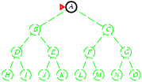
Depth-first search
Expand deepest unexpanded node

Slide 5
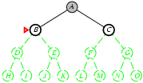
Depth-first search

Slide 6
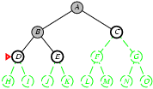
Depth-first search

Slide 7
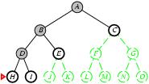
Depth-first search

Slide 8
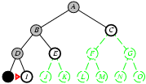
Depth-first search

Slide 9
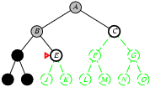
Depth-first search

Slide 10
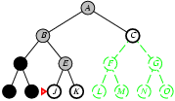
Depth-first search

Slide 11
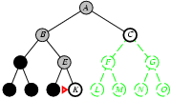
Depth-first search

Slide 12
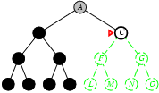
Depth-first search

Slide 13
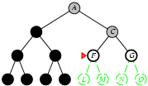
Depth-first search

Slide 14
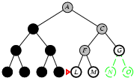
Depth-first search

Slide 15
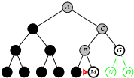
Depth-first search

Slide 16
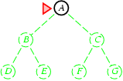
Breadth-first search

Slide 17
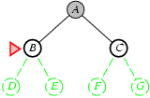
Breadth-first search

Slide 18
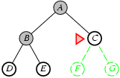
Breadth-first search

Slide 19
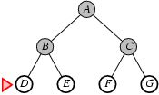
Breadth-first search

Slide 20
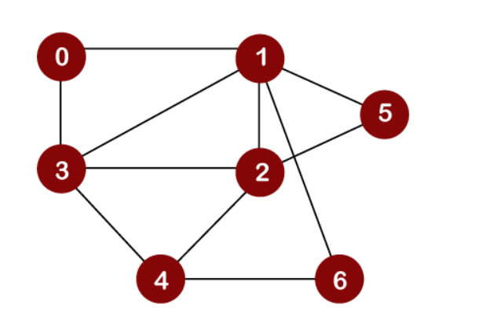
DFS
In DFS traversal, the stack data structure is used, which works on the LIFO (Last In First Out) principle.

Slide 21
DFS
Stack:
0
Result / Output / Visited:

Slide 22
DFS
Stack:
1
0
Result / Output / Visited:

Slide 23
DFS
Stack:
3
1
0
Result / Output / Visited:

Slide 24
DFS
Stack:
2
3
1
0
Result / Output / Visited:

Slide 25
DFS
Stack:
4
2
3
1
0
Result / Output / Visited:

Slide 26
DFS
Stack:
6
4
2
3
1
0
Result / Output / Visited:

Slide 27
DFS
Stack:
4
2
3
1
0
Result / Output / Visited:
6

Slide 28
DFS
Stack:
2
3
1
0
Result / Output / Visited:
6 4

Slide 29
DFS
Stack:
5
2
3
1
0
Result / Output / Visited:
6 4

Slide 30
BFS
It is also known as level order traversal. The Queue data structure is used for the Breadth First Search traversal.

Slide 31
BFS
Queue:
0
Result / Output / Visited:

Slide 32
BFS
Queue:
1
Result / Output / Visited:
0

Slide 33
BFS
Queue:
3 2 5 6
Result / Output / Visited:
0 1

Slide 34
BFS
Queue:
2 5 6
Result / Output / Visited:
0 1 3

Slide 35
BFS
Queue:
2 5 6 4
Result / Output / Visited:
0 1 3

Slide 36
BFS
Queue:
5 6 4
Result / Output / Visited:
0 1 3 2

Slide 37
BFS
Queue:
6 4
Result / Output / Visited:
0 1 3 2 5

Slide 38
BFS
Queue:
4
Result / Output / Visited:
0 1 3 2 5 6

Slide 39
BFS
Queue:
Result / Output / Visited:
0 1 3 2 5 6 4

Slide 40
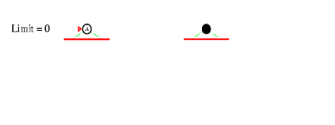
Iterative Deepening

Slide 41
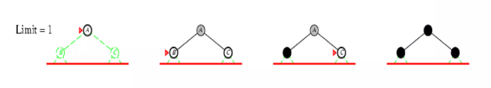
Iterative Deepening

Slide 42
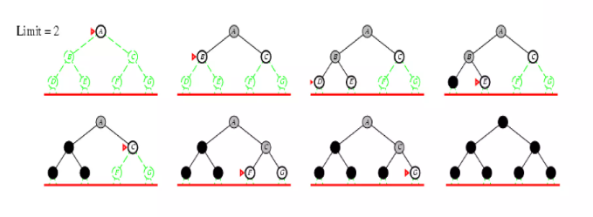
Iterative Deepening

Slide 43
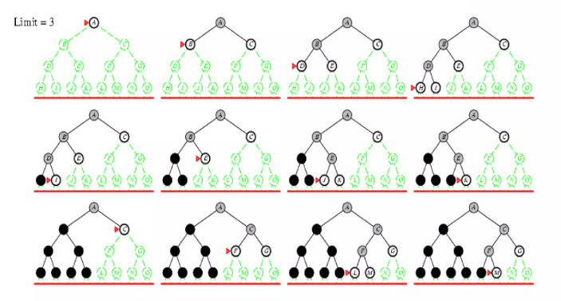
Iterative Deepening

Slide 44
Uniform Cost Search
S
3
8
1
A
B
C
3
15
7
20
5
D
E
G

Slide 45
Uniform Cost search
Expanded node Nodes list
{ S⁰ }
S⁰ { B¹ A³ C⁸ }
B¹ { A³ C⁸ G²¹ }
A³ { D⁶ C⁸ E¹⁰ G¹⁸ G²¹ }
D⁶ { C⁸ E¹⁰ G¹⁸ G¹ }
C⁸ { E¹⁰ G¹³ G¹⁸ G²¹ }
E¹⁰ { G¹³ G¹⁸ G²¹ }
G¹³ { G¹⁸ G²¹ }
Solution path found is S C G, cost 13
Number of nodes expanded (including goal node) = 7

Slide 46
Informed Methods

Slide 47
Heuristically Informed Methods
Greedy Best First Search (GBFS)
Open the next MOST promising candidate
F(n) = H(n)
A* Search
Estimate the Remaining cost to goal, from current state, as well
F(n) = H(n) + G(n)
Weighted A*
Assign weight (w) to the heuristic function
G(n) + W*H(n)
Beam Search
Expand w best children at next level, instead of all

Slide 48
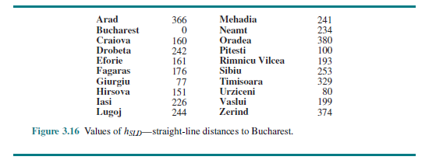
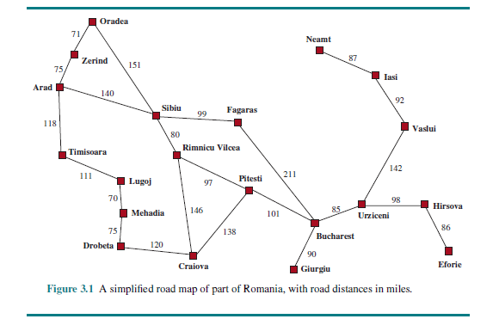

Slide 49
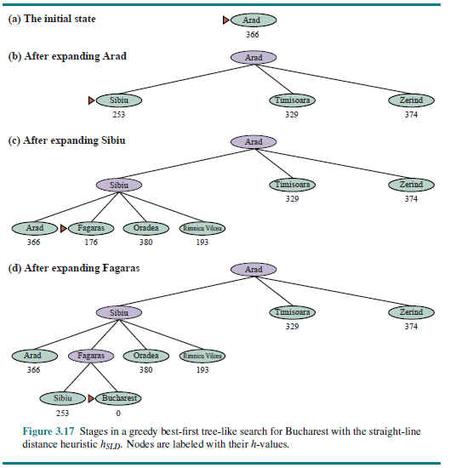
GBFS

Slide 50
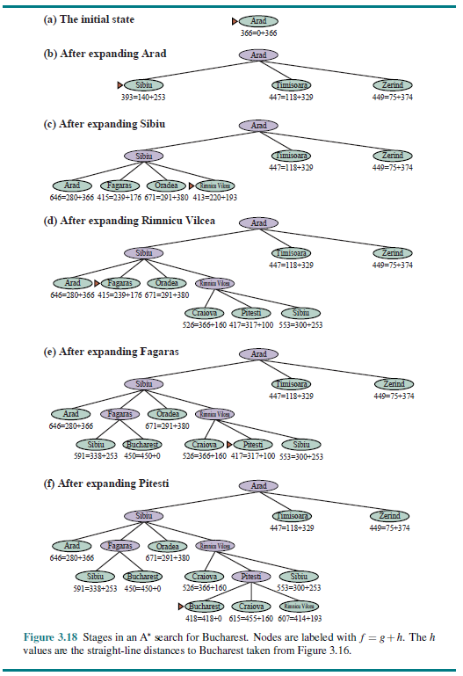
A*

Slide 51

A* search example

Slide 52
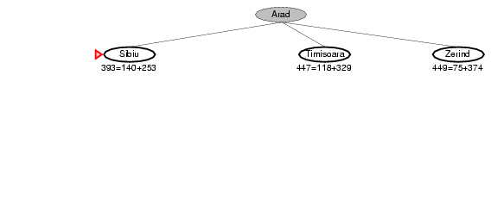
A* search example

Slide 53
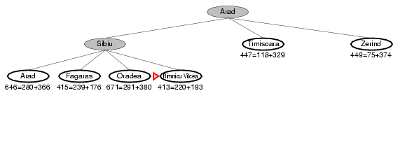
A* search example

Slide 54
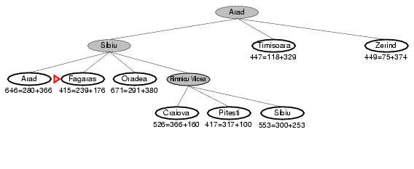
A* search example

Slide 55
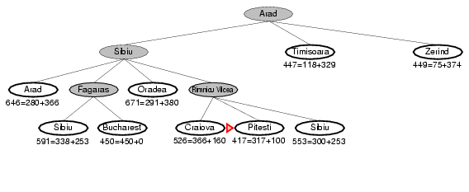
A* search example

Slide 56
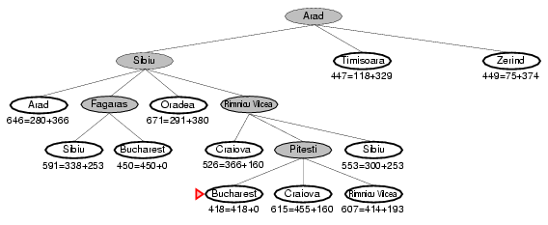
A* search example

Slide 57
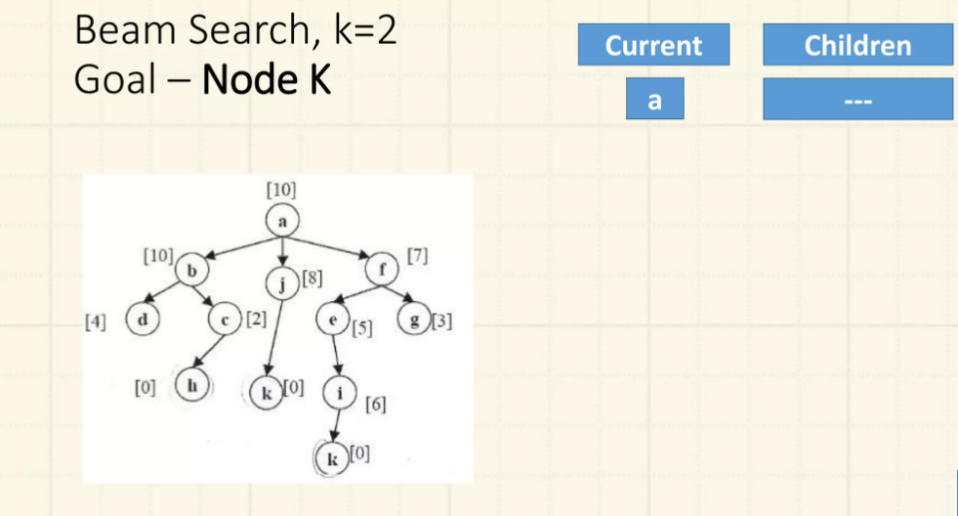
Beam Search

Slide 58
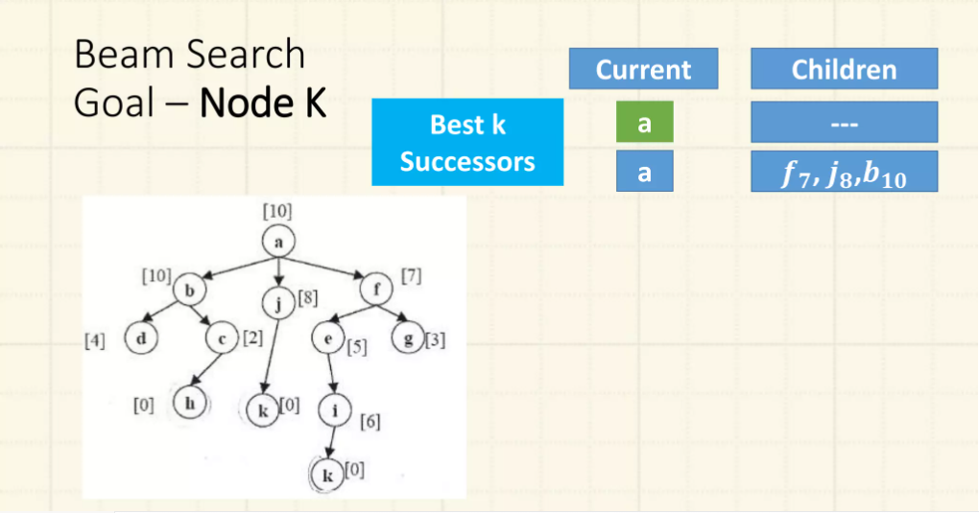
Beam Search

Slide 59
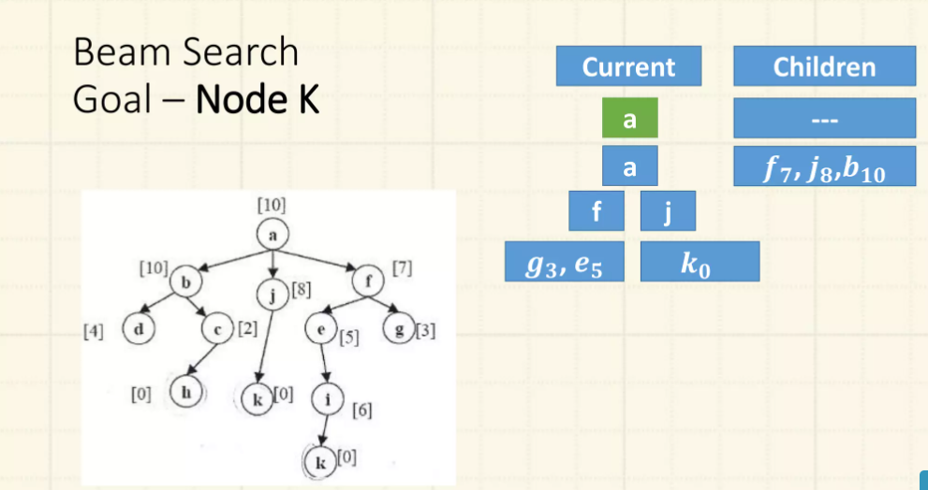
Beam Search

Slide 60
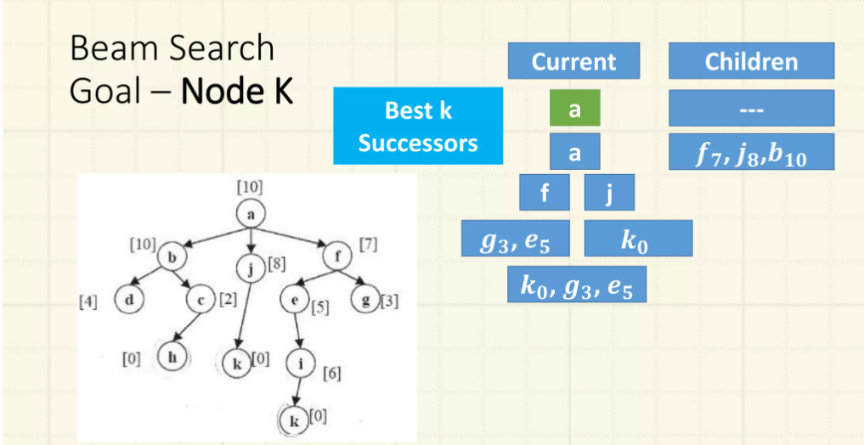
Beam Search

Slide 61
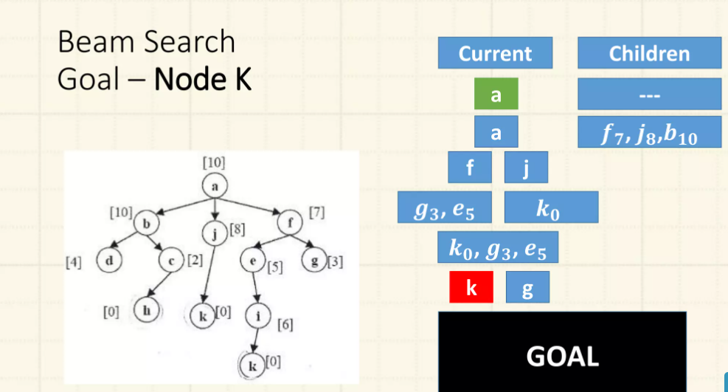
Beam Search

Slide 62
Local Searches

Slide 63
Local Searches
Hill Climbing
Local Beam Search
Genetic Algorithms
Simulated Annealing
8 Queen Problem

Slide 64
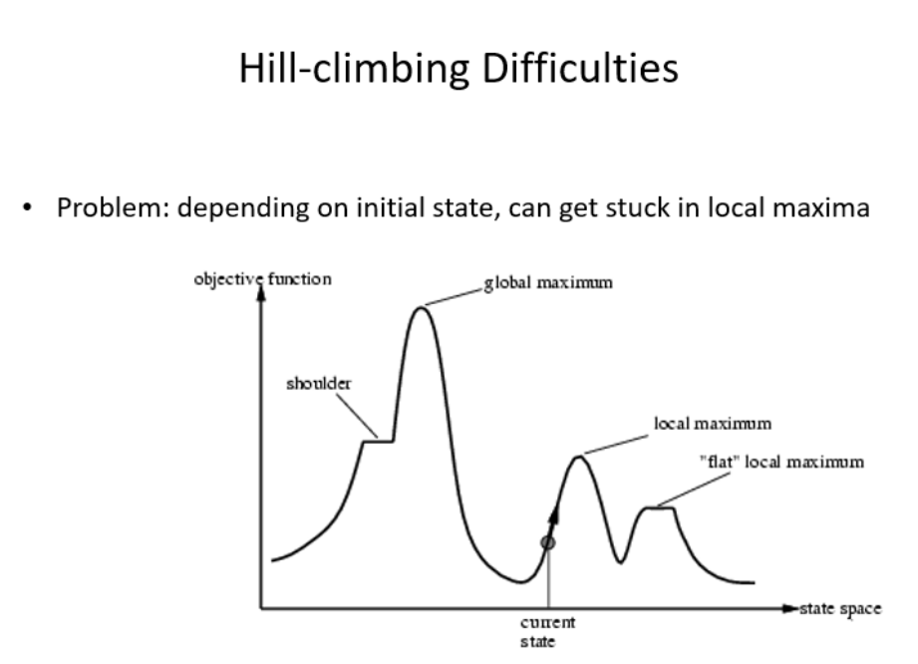
Hill Climbing

Slide 65
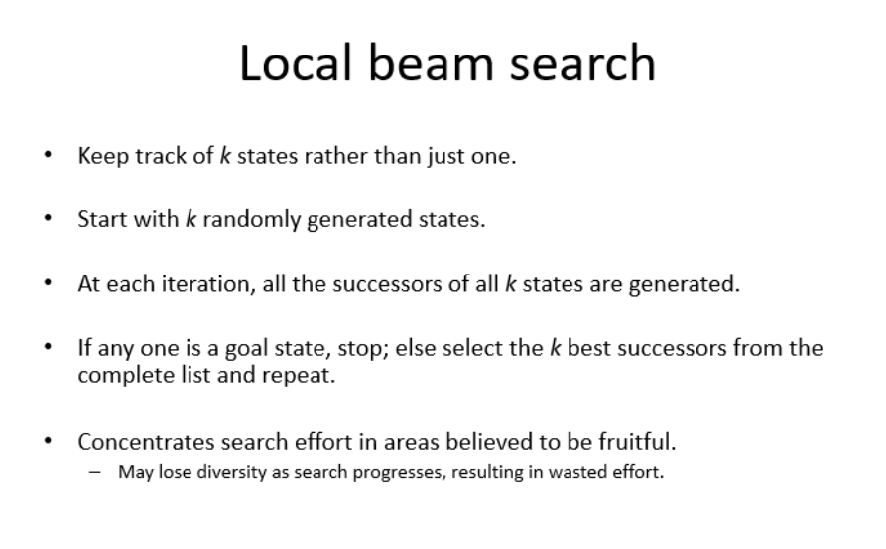
Local Beam Search

Slide 66
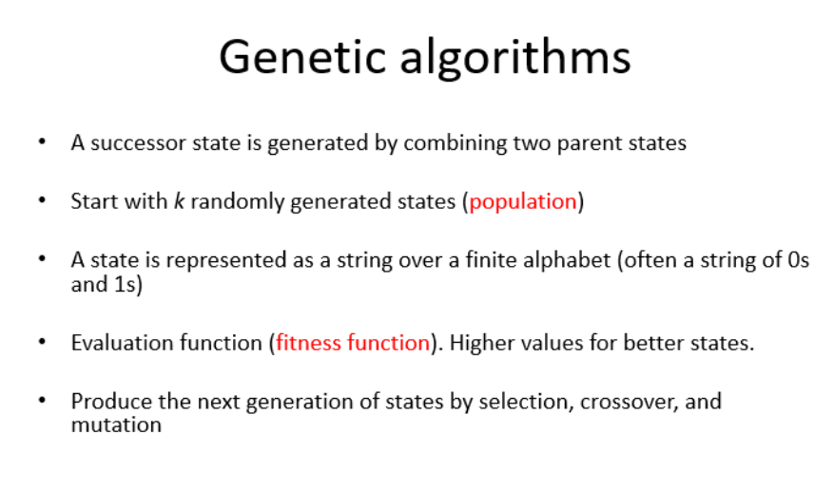
Genetic Algorithm (GA)

Slide 67
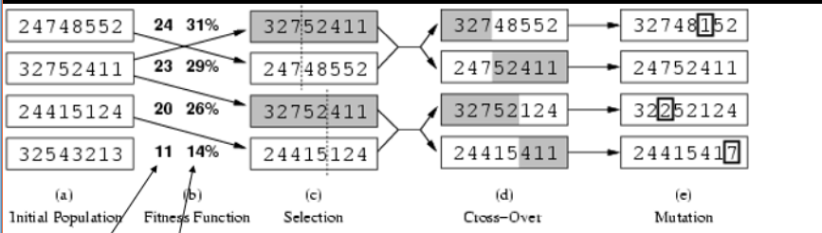
GA: Example 1

Slide 68
GA: Example 2
Find a number: 001010
You have guessed this binary number. If you write a program to randomly guess it, then there are 2⁶ = 64 possibilities
If you find it with the help of Genetic Algorithm, then the program gives a number and you tell its fitness
The fitness score is the number of correctly guessed bits

Slide 69
GA: Example 2
Find a number: 001010
Step 1. Variants (individuals) produced.
A) 010101 - 1
B) 111101 - 1
C) 011011 - 4 *
D) 101100 - 3 *
Best ones C & D

Slide 70
GA: Example 2
Find a number: 001010
Mating New Variants Evaluation
C) 01:1011 01:1100 (E) 3
D) 10:1100 10:1011 (F) 4 *
C) 0110:11 0110:00 (G) 4 *
D) 1011:00 1011:11 (H) 3
Selection of F & G

Slide 71
GA: Example 2
Mating New Variants Evaluation
F) 1:01011 1:11000 (H) 3
G) 0:11000 0:01011 (I) 5 *
F) 101:011 101:000 (J) 4 *
G) 011:000 011:011 (K) 4
Selection of I and J

Slide 72
GA: Example 2
Mating New Variants Evaluation
I) 0010:11 0010:00 (L) 5
J) 1010:00 1010:11 (M) 4
I) 00101:1 00101:0 (N) 6 (success) *
J) 10100:0 10100:1 (O) 3
In this game success was achieved after 16 questions, which is 4 times faster then checking all possible 2⁶ = 64 combination

Slide 73
GA: Basic Attributes
Genetic representation of candidate solutions
Population size
Evaluation function
Genetic Operators
Selection algorithm
Generation gap
Amount of elitism used
Number of duplicates allowed

Slide 74
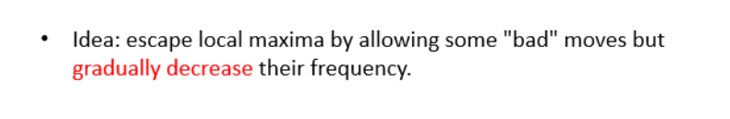
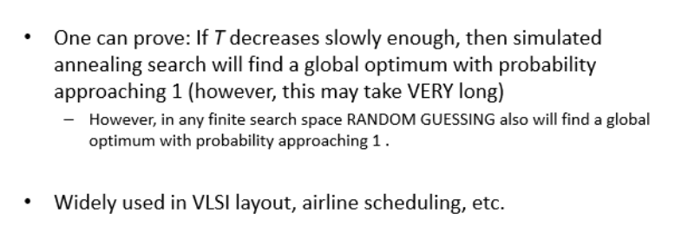
Simulated Annealing

Slide 75
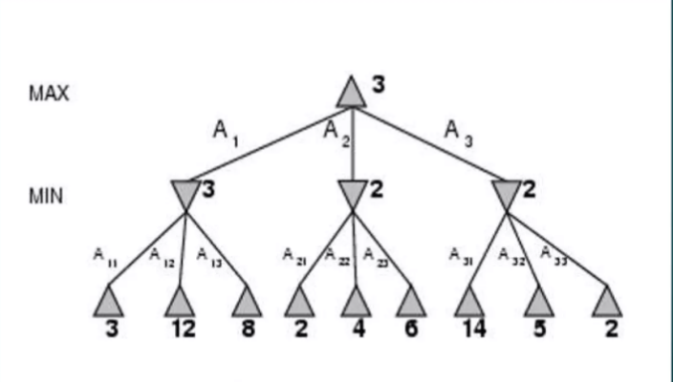
Adversarial Search: Example 1 – MinMax

Slide 76
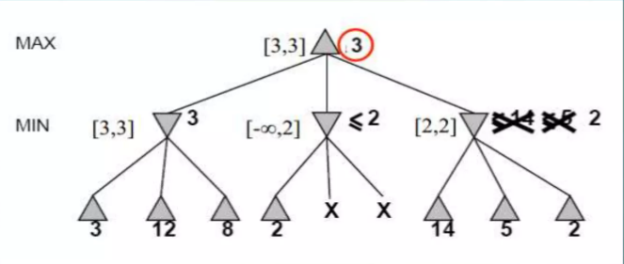
Adversarial Search: Example 2 - αβ

Slide 77
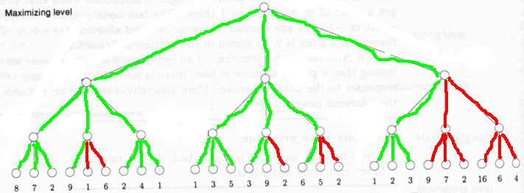
Adversarial Search: Example 3

Slide 78
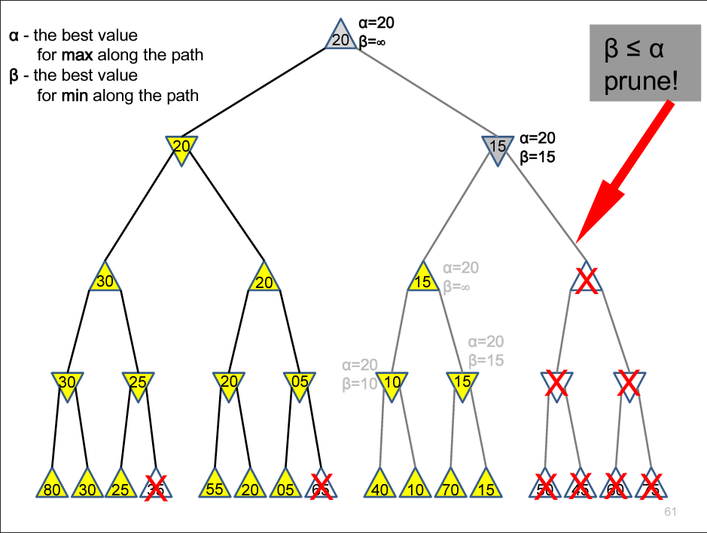
Adversarial Search: Example 4

Slide 79
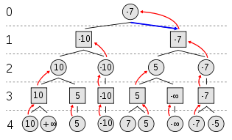
Adversarial Search: Example 5
MAX to move

Slide 80
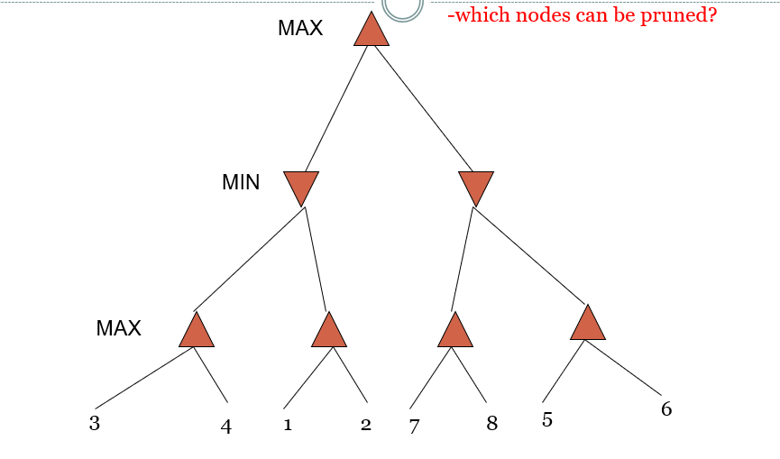
Adversarial Search: Example 6

