Slide 1
Chapter 1&2: Introduction-Fundamentals of Testing
Software Testing
Lecture 1
Fundamentals of Software Testing

Slide 2
Observations about Testing
“Testing is the process of executing a program with the intention of finding errors.” – Myers
Process used to identify the correctness, completeness and quality of developed computer software.
Includes a set of activities conducted with the intent of finding errors in the software
An activity to check that the software system is defect free.
Process of executing a program / application under positive and negative conditions by manual or automated means. It checks for the :-
- Specification
- Functionality
- Performance

Slide 3
Software Testing Purposes
Testing software has different purposes:
Executing a program to find failures
Executing a program to measure quality
Executing a program to provide confidence
Analyzing a program or its documentation to prevent failures

Slide 4
Basic Question’s about Testing

Slide 5
Why Testing?
To find and correct defects.
To check whether the Client/User needs are satisfied
To avoid user detecting problems
Also to provide Quality Product.
It also helps to identify errors, gaps or missing requirements in contrary to the actual requirements. So it can be either done manually or using automated tools.

Slide 6
What to test?
Any working product which forms part of the software application has to be tested. Both data and programs must be tested.
How often to test?
When a program (source code) is modified or newly developed, it has to be tested.

Slide 7
Who does testing ?
Software Tester
Software Developer
Project Lead/Manager
End User/Customer/Third Party

Slide 8
When starts testing
Testing is done in different forms at every phase of SDLC:
During the requirements gathering phase, the analysis and verification of requirements are also considered as testing.
Reviewing the design in the design phase with the intent to improve the design is also considered as testing.
Testing performed by a developer on completion of the code is also categorized as testing.

Slide 9
When to Stop Testing?
The following aspects are to be considered for stopping the testing process:
Testing Deadlines
Completion of test case execution
Completion of functional and code coverage to a certain point
Bug rate falls below a certain level and no high-priority bugs are identified
Management decision

Slide 10
Why does S/W have bugs?
Miscommunication or No Communication (That we are not clear about what an application should do or shouldn’t do)
Time Pressure (Time scheduling)
Changing Requirements
Software Complexity (Without experience its bit tough to do the tough application)
Programming Mistakes

Slide 11
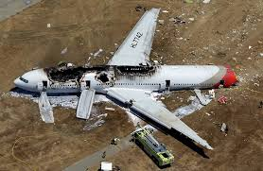
Costly Software Failures Examples
China airplane crash on April 26th 1994, due to software bug in controls and caught fire during landing, killing 264 people.

Slide 12
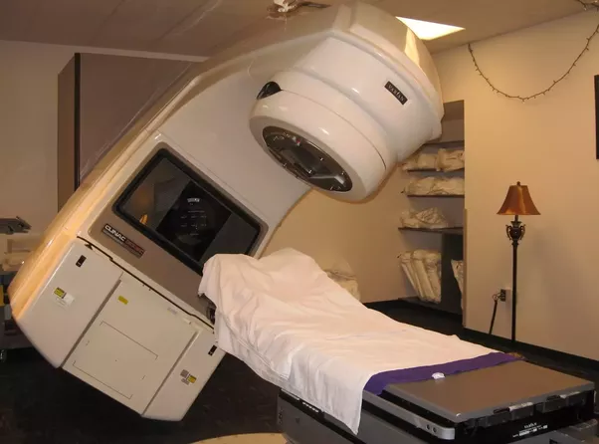
Other Examples……
In 1985, Therac-25 Radiation Theraphy Machine kill 3 people and 3 injured due to massive overdoses of radiations.

Slide 13
Other Examples…..
In April of 1999, a software bug caused the failure of a $1.2 billion military satellite launch, the expensive accident in history
In 2015 fighter plane F-35 fell victim to a software bug, making it unable to detect targets correctly.
Some of the Amazon’s third party retailers saw their product price is reduced to 1p due to a software glitch. They were left with heavy losses.
In may of 1996, a software bug caused the bank accounts of 823 customers of a major U.S. bank to be credited with 920 million US dollars.

Slide 14
Testing Activities
Identify
Test conditions (“What”): an item or event to be verified.
How the “what” can be tested: realization
Design
Build test cases
Build
Run the system
Execute
Test case outcome with
expected outcome
Compare
Test result

Slide 15
Error, Fault & Failure
Error :
An error is a mistake, misconception, or misunderstanding on the part of a software developer that cause fault or we can say defective programming by the developer.
Fault/Bug/Defect :
A fault is introduced into the software as the result of an error. OR Discrepancy in code that causes failure.
An incorrect step, process or data definition in a computer program which causes the program to perform in an unintended or unanticipated manner.
It is a condition that causes the software to fail to perform its required function
Example: statements in the program
Failure :
Deviation of the software from its expected result. OR failure means that a given requirement is not fulfilled; it is a discrepancy between the actual result or behavior and the expected result or behavior
Software Failure: External, incorrect behavior with respect to the requirements or another description of the expected behavior.
Example:
There is a product that is too difficult to use.
Or an output is wrong or the program crashes.

Slide 16
Error, Fault and Failure

Slide 17
Basic Terms
Error:
Errors are a part of our daily life.
Humans make errors in their thoughts, actions, and in the products that might result from their actions.
Errors occur wherever humans are involved in taking actions and making decisions.
Software Error: An incorrect internal state that is the manifestation of some fault.
Examples:
Hearing:
Spoken: He has a garage for repairing foreign cars.
Heard : He has a garage for repairing falling cars.
Medicine:
Incorrect Antibiotic prescribed.
Sports:
Incorrect call by a referee in a tennis match.

Slide 18
S/W Error, Fault & Failure
Software Fault: A static defect in the software.
Software Error: An incorrect internal state that is the manifestation of some
fault.
Software Failure: External, incorrect behavior with respect to the requirements or another description of the expected behavior.

Slide 19
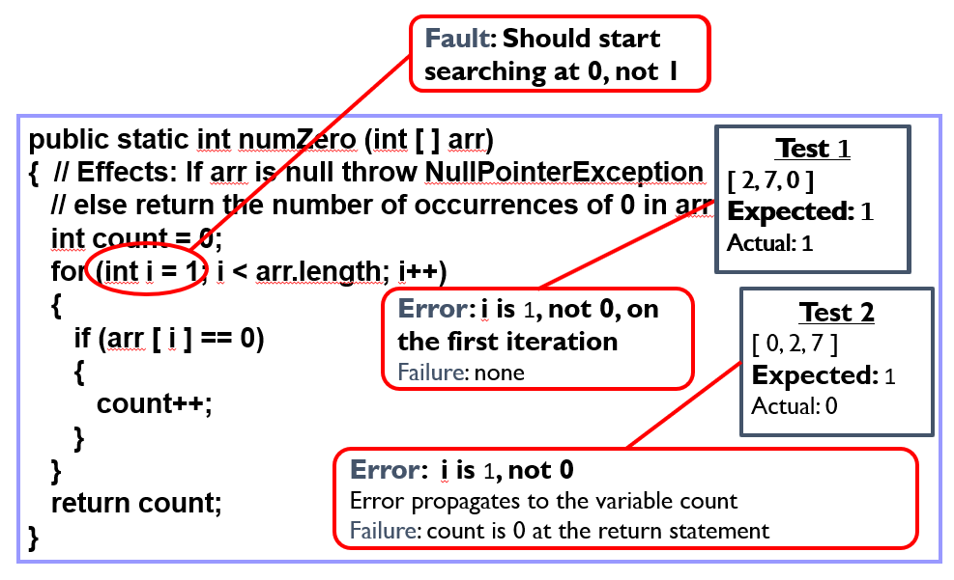
Error, Fault & Failure

Slide 20
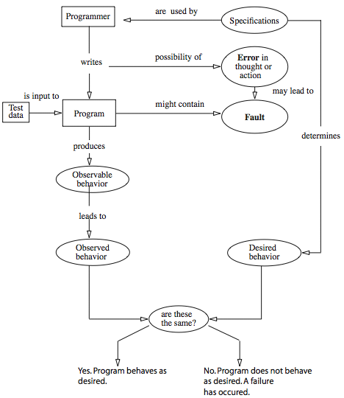
Error, Fault and Failure

Slide 21
Software Quality attributes
Availability: Is it available when and where I need to use it?
Efficiency: How few system resources does it consume?
Flexibility: How easy is it to add new features?
Install ability: How easy is it to correctly install the product.
Interoperability: How easily does it interconnect with other systems?
Maintainability: How easy it is to correct defects or make changes?
Portability: Can it be made to work on other platforms?

Slide 22
Software Quality Attributes
Reliability: How long does it run before causing a failure?
Reusability: How easily can we use components in other systems?
Testability: Can I verify that it was implemented correctly?
Usability: How easy is it for people to learn or to use?
Performance: the response time, utilization, and throughput behavior of the system.
Security: system’s ability to resist unauthorized attempts at usage or behavior modification, while still providing service to authorized users.

Slide 23
Software Quality
Static Quality Attributes:
Structured, maintainable, testable code as well as the availability of correct and complete documentation.
Dynamic Quality Attributes:
Software reliability, correctness, completeness, consistency, usability, and performance.

Slide 24
Software Quality (contd.)
Completeness:
It refers to the availability of all features listed in the requirements, or in the user manual.
An incomplete software is one that does not fully implement all features required.
Consistency:
It refers to adherence to a common set of conventions and assumptions. For example, all buttons in the user interface might follow a common color coding convention.
An example of inconsistency would be when a database application displays the date of birth of a person in the database.

Slide 25
Software Quality (contd.)
Usability:
Refers to the ease with which an application can be used.
This is an area in itself and there exist techniques for usability testing. Psychology plays an important role in the design of techniques for usability testing.
Performance:
Refers to the time the application takes to perform a requested task. It is considered as a non-functional requirement.
It is specified in terms such as ``This task must be performed at the rate of X units of activity in one second on a machine running at speed Y, having Z gigabytes of memory."

Slide 26
Audit and Inspection
Audit:
An independent examination of a work product or set of work products to assess compliance with specifications, standards, contractual agreements, or other criteria.
As per IEEE, it is a review of documented processes that organizations implement and follow. Types of audit include Legal Compliance Audit, Internal Audit, and System Audit.
At high level audits are a “Check”.

Slide 27
Inspection
Inspection :
Process of evaluating or examining things
A formal evaluation technique in which software requirements, design, or code are examined in detail by person or group other than the author to detect faults, violations of development standards, and other problems.
It improves product quality and documentation
At high level inspections are a “do”.

Slide 28
Testing and Debugging
Testing is the process of determining if a program has any errors. When testing reveals an error, the process used to determine the cause of this error and to remove it, is known as debugging.
Localization and correction of defects are tasks for a software developer and are often called debugging.
Debugging is often equated with testing, but they are entirely different activities. Debugging is the task of localizing and correcting faults.
The goal of testing is the (more or less systematic) detection of failures (that indicate the presence of defects).

Slide 29
Testing &Debugging Difference
Testing: It involves the identification of bug/error/defect in the software without correcting it. Normally professionals with a Quality Assurance background are involved in the identification of bugs. Testing is performed in the testing phase.
Debugging: It involves identifying, isolating and fixing the problems/bug. Developers who code the software conduct debugging upon encountering an error in the code. Debugging is the part of White box or Unit Testing. Debugging can be performed in the development phase while conducting Unit Testing or in phases while fixing the reported bugs.

Slide 30
Defect Masking
Masked defect
Existing error that has not yet caused a failure just because another error has prevented that piece of the code from being performed.
Masked defect hides other defects in the system.
E.g. There is a link to add employee in the system. On clicking this link you can also add a task for the employee. Let’s assume, both the functionalities have bugs. However, the first bug (Add an employee) goes unnoticed. Because of this the bug in the add task is masked.
Latent defect
Existing error that has not yet caused a failure because the accurate set of conditions was never met.
E.g. February has 28 days. The system could have not considered the leap year which results in a latent defect
These defects do not cause damage to the system immediately but wait for a particular event sometime to cause damage and show their presence.

Slide 31
Test Effort
Test effort is often shown as the proportion between the number of testers and the number of developers.
The proportion varies from 1 tester per 10 developers to up to 3 testers per developer.
The conclusion is that test efforts or the budget spent for testing vary enormously.

Slide 32
Test Effort
Testing cannot prove the absence of faults.
In order to do this, a test would need to execute a program in every possible situation with every possible input value and with all possible conditions.
But in practice complete testing is not feasible.
Test effort is difficult as it depends very much on the character of the project.

Slide 33
Test Effort
Define test intensity and test extent depending on risk (For every software program it must be decided how intensively and thoroughly it shall be tested. This decision must be made based upon the expected risk of failure of the program)
Select adequate test techniques(Every technique especially focuses on and checks particular aspects of the test object)
Test of extra functionality (The product should provide only the required functionality)
Test case explosion(The testing effort can grow very large)
Limited resources

Slide 34
Thank you

