Slide 1
Chapter 1&2: Introduction-Fundamentals of Testing
Software Testing
Lecture 2
Fundamental Test Process

Slide 2
Fundamental Test Process
The fundamental test process divides into the following basic steps:
1) Planning and Control
2) Analysis and Design
3) Implementation and Execution
4) Evaluating exit criteria and Reporting
5) Test Closure activities

Slide 3
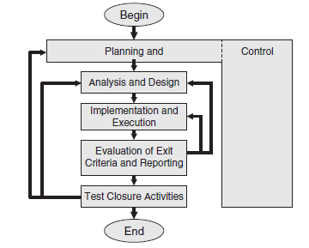
Generic ISTQB Test Process

Slide 4
1. Planning and Control
PLANNING:
i. To determine the scope and risks and identify the objectives of testing.
ii. To determine the test approach(A test approach is the test strategy implementation of a project, defines how testing would be carried out.).
iii. To implement the test policy and/or the test strategy.
iv. To determine the required test resources like people, test environments, PCs, etc.
v. To schedule test analysis and design tasks, test implementation, execution and evaluation.
vi. To determine the Exit criteria(The conditions that must be met before testing should be concluded.) for this we need to set criteria such as Coverage criteria(amount of testing performed by a set of test cases is Test Coverage).

Slide 5
Entry Criteria, Exit Criteria, Test Coverage
Entry Criteria: The prerequisites that must be achieved before commencing the testing process OR Specific conditions or on-going activities that must be present before a process can begin.
Exit Criteria: The conditions that must be met before testing should be concluded OR The specific conditions or on-going activities that should be fulfilled prior to completing the software testing life cycle.
Test Coverage: It is a technique to ensure that your tests are actually testing your code or how much of your code you exercised by running the test.
->It helps in finding area of a requirement not implemented by a set of test cases. And also to create additional test cases to increase coverage.

Slide 6
1.Planning and Control
TEST CONTROL:
i. To measure and analyze the results of reviews and testing.
ii. To monitor and document progress, test coverage and exit criteria.
iii. To provide information on testing.
iv. To initiate corrective actions.
v. To make decisions.

Slide 7
2. Analysis and Design
i. To review the test basis(source of information or the document that is needed to write test cases and also for test analysis).
ii. To identify test conditions.
iii. To design the tests cases: determine ‘how’ the identified test conditions are going to be exercised.
- Traceability important
iv. To check testability of the requirements and system.
v. Consider the risk
vi. To design the test environment set-up and identify the required infrastructure and tools
Notes:
Testability(This process includes checking the ease with which interfaces can be addressed (interface openness) and the ease with which the test object can be separated into smaller, more easily testable units. These issues need to be addressed during development and the test object should be designed and programmed accordingly. The results of this analysis are also used to state and prioritize the test conditions based on the general objectives of the test. The test conditions state exactly what shall be tested.)

Slide 8
3. Implementation and Execution
Test Implementation:
i. To develop and prioritize our test cases by using techniques and create test data for those tests.
ii. To create test suites(It is a container that has a set of tests which helps testers in executing and reporting the test execution status. It can take any of the three states namely Active, In-progress and completed) from the test cases for efficient test execution.
Test Scenario/Test Suites Vs Test Case
Test scenarios are rather unclear and cover a wide range of possibilities. Testing is all about being very specific.
For a Test Scenario: Check Login Functionality there many possible test cases are:
Test Case 1: Check results on entering valid User Id & Password
Test Case 2: Check results on entering Invalid User ID & Password
Test Case 3: Check response when a User ID is Empty & Login Button is pressed, and many more )
iii. To implement and verify the environment.

Slide 9
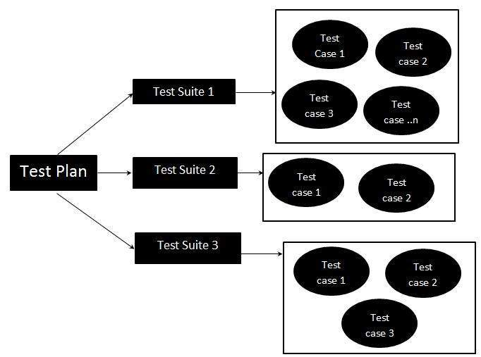
Test Suites
EXAMPLE: If each test case represents a piece of a scenario, such as the elements that simulate completing a transaction, use a test suite. For instance, a test suite might contain four test cases, each with a separate test script:
Test case 1: Login
Test case 2: Add New Products
Test case 3: Checkout
Test case 4: Logout

Slide 10
3. Implementation and Execution
Test Execution:
i. To execute test suites and individual test cases following the test procedures.
ii. To re-execute the tests that previously failed in order to confirm a fix. This is known as confirmation testing or re-testing.
iii. To log the outcome of the test execution and record the identities and versions of the software under tests.
iv. To Compare actual results with expected results.
v. Where there are differences between actual and expected results, it report discrepancies as Incidents.

Slide 11
4. Evaluating Exit criteria and Reporting
Exit criteria come into picture, when:
Maximum test cases are executed with certain pass percentage.
Bug rate falls below certain level.
When achieved the deadlines.
Evaluating exit criteria has the following major tasks:
i. To check the test logs(The test log is the file containing the test execution result information tester name, date-time of execution, actual result, Test result (pass/fail). The test log is used to log the relevant details about the execution of each release version test. Its purpose is to share information among testers, users, developers, and others.) against the exit criteria specified in test planning.
ii. To assess if more test are needed or if the exit criteria specified should be changed.
iii. To write a test summary report for stakeholders.

Slide 12
5. Test Closure activities
i. To check which planned deliverables are actually delivered and to ensure that all incident reports have been resolved.
ii. To finalize and archive testware (Testware includes documentation, scripts, inputs, expected results, set-up and clear-up procedures, files, databases, environment, and any additional software or utilities used in testing) for later reuse.
iii. To handover the testware to the maintenance organization. They will give support to the software.
iv To evaluate how the testing went and learn lessons for future releases and projects.

Slide 13
Logical and concrete test cases
Example: Using the sales software, the car dealer is able to define discount rules for his salespeople: With a price of less than $15.000, no discount shall be given. For price of $20.000, 5% is OK.
If the price is below $25.000, a 7% discount is possible. For higher prices, 8.5% can be granted.
Price < 15.000 discount = 0%
15.000 <= price >= 20.000 discount = 5%
20.000 < price < 25.000 discount = 7%
price <=25.000 discount = 8.5%

Slide 14
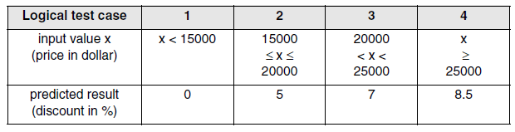
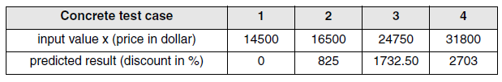
Logical and Concrete Tables
Logical Test Table
Concrete Test table

Slide 15
The Psychology of Testing
Psychology of testing is a type of testing which fully depends on the mindset of developers and tester.
When we are building the software, we working positively towards the software never think about negative things.
The mindset should be different while testing and reviewing developing software. With the correct mindset, the programmer can test their own code. At a certain point independence tester often makes the tester more effective of finding the defects.

Slide 16
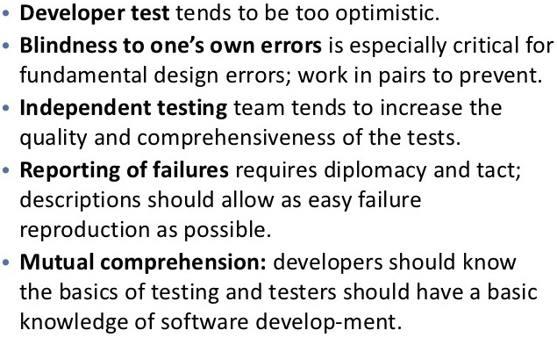
The Psychology of Testing

Slide 17
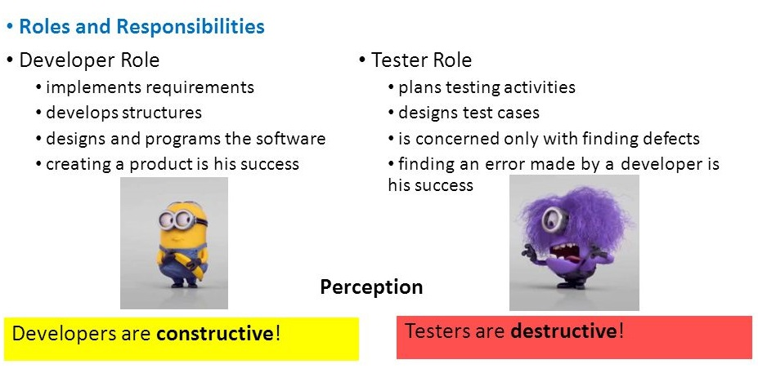
The Psychology of Testing

Slide 18
Key Players and Their Roles
Business sponsor(s) and partners | Provides funding Specifies requirements and deliverables Approves changes and some test results
Project manager | Plans and manages the project
Software developer(s | Designs, codes, and builds the application Participates in code reviews and testing
Testing Coordinator(s) | Creates test plans and test specifications based on the requirements and functional, and technical documents
Tester(s) | Executes the tests and documents results

Slide 19
Thank you

